Slide 1
Glibc 6 Function Optimization
1H06 Report

Slide 2
Goals
Optimizations for 6 functions from glibc
Optimization targeted for Geode LX800
At least 20% improvement for 3 of the 6 functions.
Measured relative to the Gentoo Validation Image (486 target)
Develop deep understanding of optimization for the Geode LX
Document the lessons learned

Slide 3
The six functions
The functions
  Memcmp – compare memory
  Memcpy – copy memory
  Memset – set memory
  Strcmp – compare strings
  Strcpy – copy strings
  Strlen – find the length of a string
Reasons chosen
  Broadly, commonly used.
  Canonical operations (copy, set, compare, examine)

Slide 4
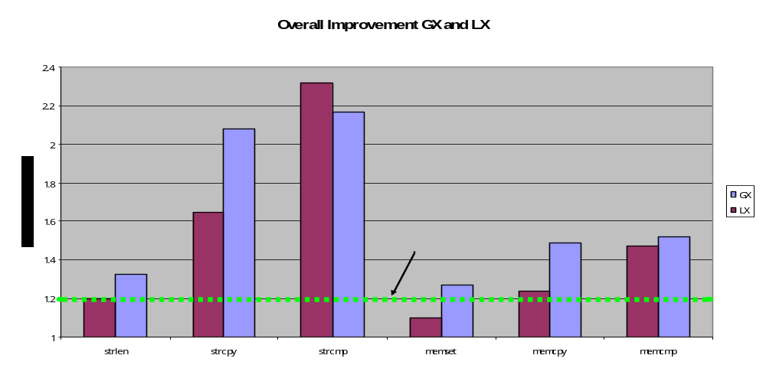
Summary of Results

Slide 5
Methodology
Common Framework
  Common Basis for performance and unit tests
  "test_" Test framework for performance testing
  "loop_" Standard loops for testing and reporting
  "stats_" Simple Approximate Statistics Package
  "opts_" Callback based command line options handler
  "deck_" Deck of cards API

Slide 6
Methdology Details
Buffer Management
  Cache management
  Size and alignment randomization
Statistics Gathering
  Broad dynamic range
  Adaptive, constant precision
Timing
  RDTSC
  Empty Loop
  Serialization Compensation

Slide 7
Design Targets
Optimization needs “target domain”
Optimization frequently decreased the performance “off design”
  Glibc examples trade large buffer performance vs. small buffer
Selected three targets
  Trivial – 0-3 bytes
  Small – average 64 bytes (0-128 inclusive)
  Large – average 1024 bytes (0-2049 inclusive)

Slide 8
Results Reporting
Performance Ratio cycles_{ref}/cycles_{opt} c.f. (Hennessy and Patterson)
Test Cases Reported
  Trivial – (<4 bytes) to show impact
  Small Aligned – small range with Dword aligned buffers
  Small Unaligned – small range with random buffer alignment
  Large Aligned – large range with Dword aligned buffers
  Large Unaligned – large range with random buffer alignment
Overall Result
  Average of small and large, aligned and unaligned
  Effectively double weight to small region.

Slide 9
Optimization Approach
Implement performance unit test application using framework
Identify extant implementations
Test the initial candidate and identify potential strategies to optimize.
Target the 0-128 and 0-2049 size ranges
Testing both aligned and randomly unaligned data.
Develop a “from scratch” or hybrid approach based on lessons learned
Test and improve, peer reviews
Final polishing on “short” and “trivial” buffer length cases.

Slide 10
Common Function Elements
Setup phase
  compute alignment, select small vs. large path(s)
Inner loop
  the core algorithm
  Assumes size and/or alignment constraints
Clean-up/Remainder – complete the operation
  Buffer size remainder
  Other byte accurate operation

Slide 11
Common optimizations
Avoid mis-predicted conditional jump instructions
Use PREFETCH to avoid MOV stalls
Unroll loops to support PREFETCH, and minimize loop and increment overhead
Convert from byte sized to double-word size operations as possible
Align to source or destination addresses
Simplify function preamble and return clauses – avoiding registers protected by the i386 ABI Function call standard
Hide CLD EX stall with MOV AC stall
Avoid multiple short REP
Use src + (dst-src) single pointer addressing tricks
  Uses base,offset addressing modes to minimize pointer arithmetic.
Balance “setup” complexity w/ performance gains in “inner loop” stage

Slide 12
Memcmp Overview
int memcmp(const void *s1, const void *s2, size_t n);
  Compares the first n bytes of the memory areas s1 and s2.
Approach
  uses dword operations instead of byte operations
  Byte operations on dword mismatch or remainder
  Conditional moves to avoid jump for return value
Derivation
  Derived from “i386_memcmp.S” -- licensed under the LPGL
  Original work
    dword-then-byte-logic
    return values computation
Future Work (potential)
  unroll loop into 32 or 64 byte REP’s and PREFETCH
  MMX comparison operations
  byte-wise only search for < 7 bytes -- improve “Trivial” case

Slide 13
Memcmp Results
Trivial case performance slower
Overall 1.47x better
Length | Aligned | Unaligned
Trivial | 0.92^{[1]} | 0.91
Small | 1.36 | 1.27
Large | 1.66 | 1.59
Overall | 1.47
^{[1]} Note that values < 1 indicate a performance reduction. These are common in the Trivial case, both for these optimizations and those extant in the glibc codebase.

Slide 14
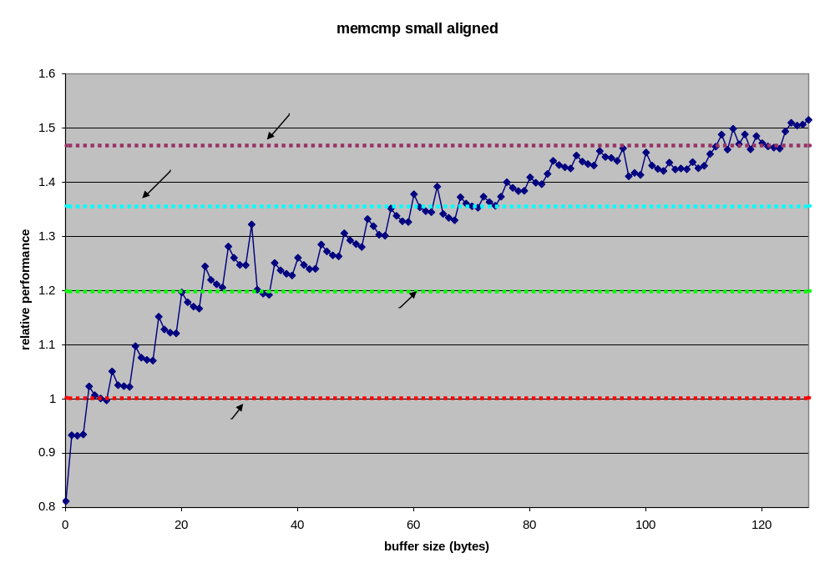
Memcmp Small Aligned Performance

Slide 15
Memcpy Overview
void *memcpy(void *dest, const void *src, size_t n);
  Copies n bytes from memory area src to memory area dest. Non-overlapping.
Approach
  an unrolled, prefetch loop
  Optimum unroll size 64 bytes (2 cache lines).
  MMX MOVQ instructions to do quad-word movement
  “Trivial” case performance < 16 bytes abort.
  Function preamble and setup phase optimized by exhaustive searc
    Over 600 possibilities tested
    2-4 cycles gain vs. original version.
Derivation
  Entire implementation is original
Future Work
  Improvement of 16-32 byte case

Slide 16
Memcpy Results
Trivial Case (<4 bytes) here performs as well as the reference implementation,
Performance issue in the 16 – 32 byte range.
Overall 1.23 improvement
Length | Aligned | Unaligned
Trivial | 0.99 | 1.02
Small | 1.16 | 1.30
Large | 1.25 | 1.25
Overall | 1.23

Slide 17
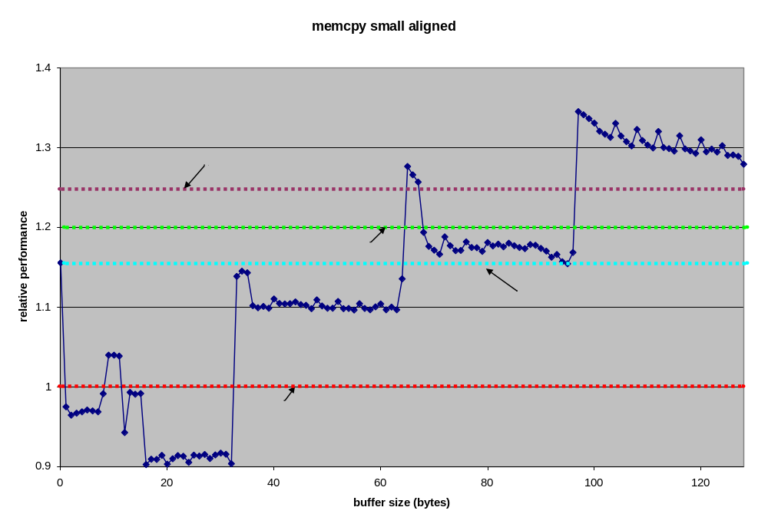
Memcpy Small Aligned Performance

Slide 18
Memset Overview
void *memset(void *s, int c, size_t n);
  Fills the first n bytes of the memory area pointed to by s with the constant byte c.
Approach
  Optimized alignment selection logic
    Uses CMOV to eliminate conditional jump
  Two domains
    > 512 bytes: MMX MOVQ 64 byte loops
    < 512 bytes: REP; STOS
Derivation
  LPGL: Framework (preamble, REP; STOS code)
  Original: All Optimizations (alignment, multi-domain, movq)
Future Work
  Domain hand-off optimization
  Optimized versions for specific domains (page clear, etc)

Slide 19
Memset Results
Best overall candidate not fastest for any of the 4 test cases
10% overall win balanced across all segments
Up to 10% loss for “Trivial” case
Length | Aligned | Unaligned
Trivial | 0.97 | 0.89
Small | 1.14 | 1.01
Large | 1.14 | 1.11
Overall | 1.10

Slide 20
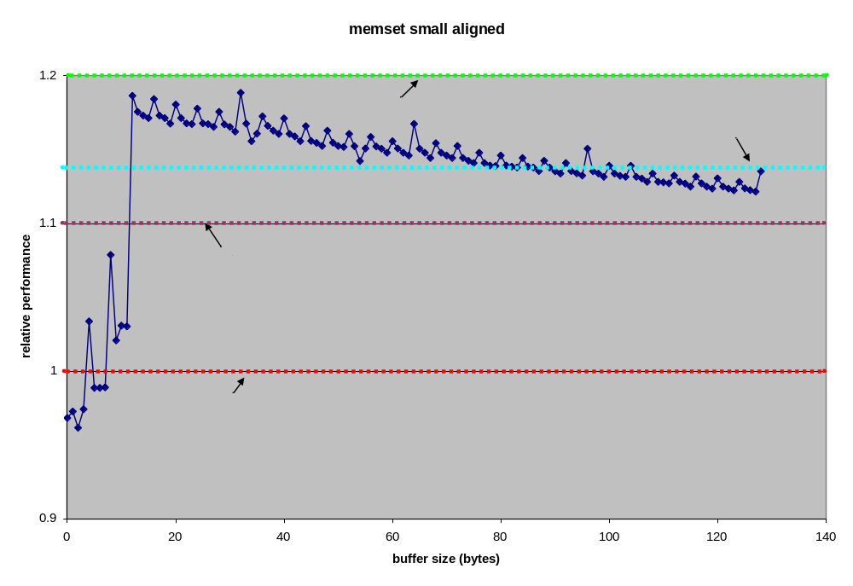
Memset Small Aligned Performance

Slide 21
Strcmp Overview
int strcmp(const char *s1, const char *s2);
  Compares the two strings s1 and s2.
Approach
  Based on i686 Glibc implementation
  Single pointer trick
  16 byte Unroll
  PREFETCH of both s1 and s2
  Pointer math reduction
Derivation
  LPGL: Functional framework (preamble, return computation)
  Original: All inner loop
Future Work
  Probably none – best optimization in project

Slide 22
Strcmp Results
From 1.2x to 2.3x improvement vs. baseline
Best result in project
  1.3x to 1.5x better than initial i686 code upon which it is based
Length | Aligned | Unaligned
Trivial | 1.21 | 1.21
Small | 2.14 | 2.15
Large | 2.49 | 2.49
Overall | 2.31

Slide 23
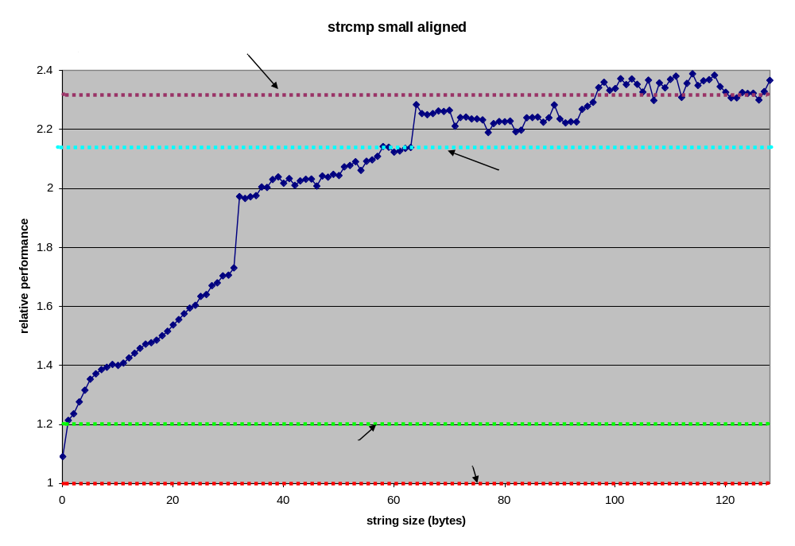
Strcmp Small Aligned Performance

Slide 24
Strcpy Overview
char *strcpy(char *dest, const char *src);
  Copies the string src (including '\0') to dest. Non-overlapping
Approach
  Simplified preamble
  Reduced pointer math
  Improved “zero finding” algorithm
  PREFETCH of src
  Unroll of copy loop
Derivation
  LGPL: function framework (preamble, return, etc)
  Original: All optimizations listed in approach
Future Work
  Single pointer trick
  Revisit aligment logic in light of strlen results

Slide 25
Strcpy Results
Up to 10% negative impact for zero-length strings
Exceeds goal for all strings > 15 characters
Approx. 1.5x faster for “Small” domain
Length | Aligned | Unaligned
Trivial | 0.95 | 0.90
Small | 1.58 | 1.47
Large | 1.81 | 1.74
Overall | 1.65

Slide 26
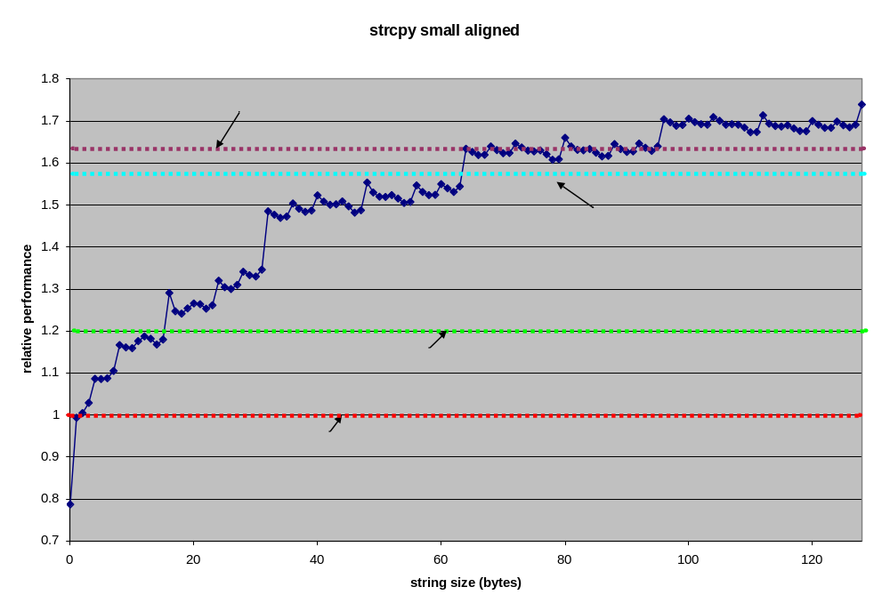
Strcpy Small Aligned Performance

Slide 27
Strlen Overview
size_t strlen(const char *s);
  Calculates the length of the string s, not including the terminating '\0'.
Approach
  Cleaner “zero find” implementation
  PREFETCH of s
Derivation
  LPGL: all code except inner loop
  Original: Zero find, and modified inner loop
Future Work
  Understand why condition jump preamble from i486/strlen.S is faster than computed jump approach
  Explore elimination of conditional jump in byte accurate zero find
    use CMOV to clear incremement amount

Slide 28
Strlen Results
Just meets project goal
Largest effect is addition of prefetch (20-25%)
Zero find optimization accounts for 3% (large)
Length | Aligned | Unaligned
Trivial | 0.95 | 1.01
Small | 1.10 | 1.13
Large | 1.28 | 1.28
Overall | 1.20

Slide 29
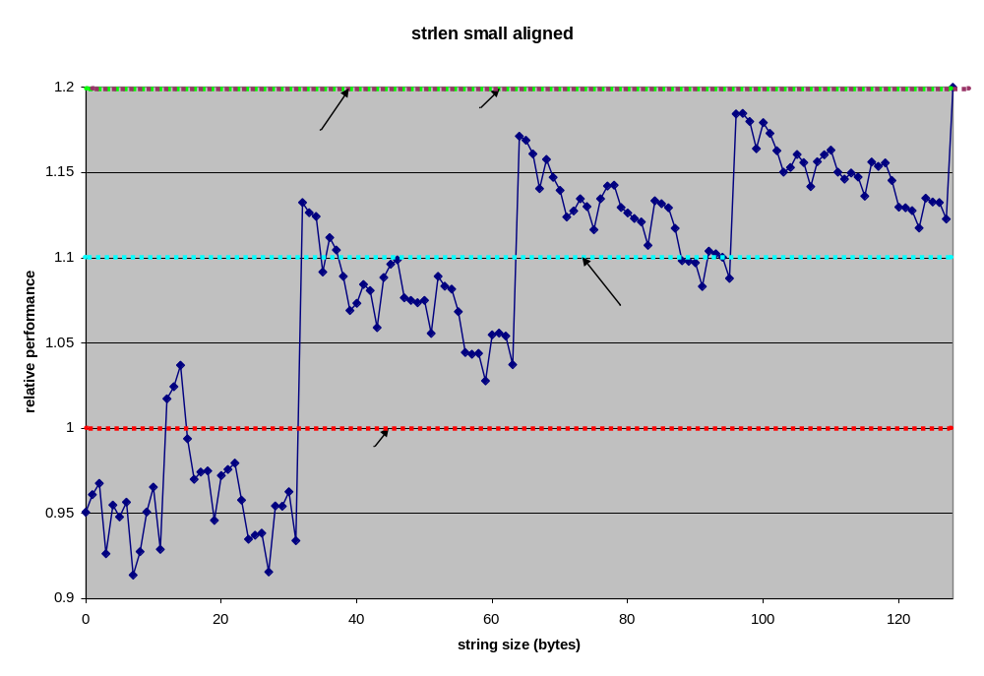
Strlen Small Aligned Performance

Slide 30
Future Work
Application of Current Work
  Potential Glibc target
    First step – evaluation by AMD Gnu Tools Team
    If advised – mainstreaming efforts, many community expectations
  Productization
    Apss/FAE/Technical Marketing has expressed interest
    Productization steps
      Cleanup of current LPGL’d versions
      License clean versions for non Gnu enviroments
Future Future
  More functions
  Prereq is profiling
  Tools development to support
  Target Application/Use Case Needed

Slide 31
Conclusion
Exceeded Project Goals
  5 of 6 functions meet or exceed target
  Deep knowledge developed
Common Optimization Concepts Identified
Results not encouraging w.r.t. gcc optimizations
  Most improvements were algorithmic not “ordering”
  Ordering/instruction mix were 2nd order effects
Future work must be based on profiled targeted application/benchmark

