Slide 1
COMP 6600 Final Project Presentation
Breast Cancer Detection Using AI Models
Ken Chen
Donglai Liu
Junyao Yang

Slide 2
COMP 6630 Final Project Presentation
Models
Dataset: Breast Cancer Dataset -Wisconsin Breast Cancer database
Machine Learning Algorithm
Baseline - KNN
Naive Bayes
Neural Network
Convolutional Neural Network

Slide 3
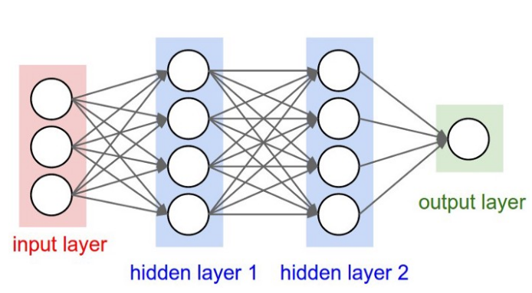
neural networks learning rate
COMP 6630 Final Project Presentation
Neural Network(NN)
2 hidden layer Neural Network
learned function would be: f(x) = f_3(f_2(f_1(x)))
f_1(x): Function learned on first hidden layer
f_2(x): Function learned on second hidden layer
f_3(x): Function learned on output layer
Rectified Linear Unit (ReLU): g(z) = max{0, z}
Figure 1: Neural Network with two hidden layers

Slide 4
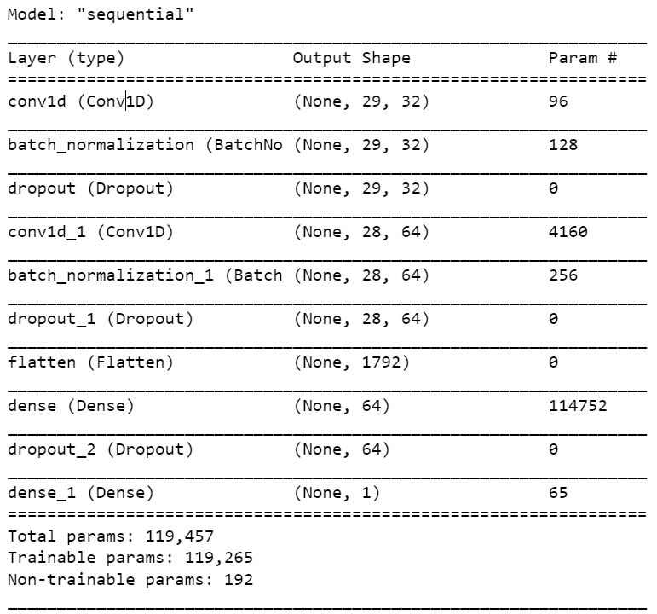
COMP 6630 Final Project Presentation
Convolution Neural Network(CNN)
Feature Learning
Flatten Layer
Convolution + Relu
Classification
Flatten Layer
Fully Connected Network
Dense Layer(Sigmod)

Slide 5
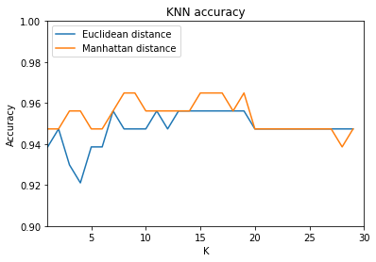
COMP 6630 Final Project Presentation
Experiments (Baseline)
Distance | Default | Range | Accuracy
Euclidean | 5 | [5, 30] | 0.94
Manhattan | 5 | [5, 30] | 0.95
Distance | Best | Worst | Average
Euclidean | 0.95 | 0.92 | 0.94
Manhattan | 0.96 | 0.94 | 0.95
 | Best | Worst | Average
NBC | 0.95 | 0.93 | 0.94
Figure 2:Learning Curve for KNN

Slide 6
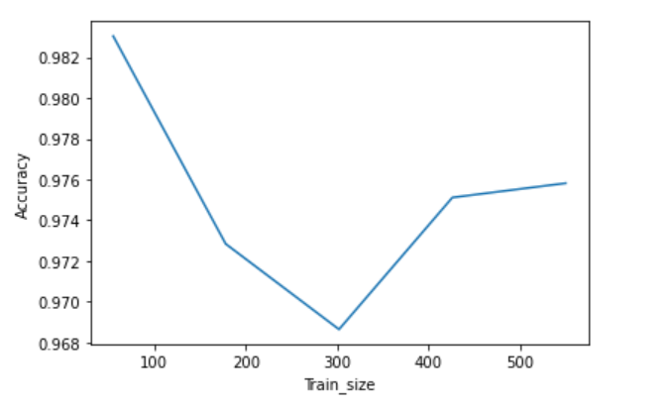
COMP 6630 Final Project Presentation
Experiment (Neural Network)
 | precision | recall | f1-score | support
Class0 | 0.95 | 0.95 | 0.95 | 42
Class1 | 0.97 | 0.97 | 0.97 | 72
Accuracy |  |  | 0.96 | 114
Macro avg | 0.96 | 0.96 | 0.96 | 114
weighted avg | 0.96 | 0.96 | 0.96 | 114
Figure 3:Learning Curve for Neural Network

Slide 7
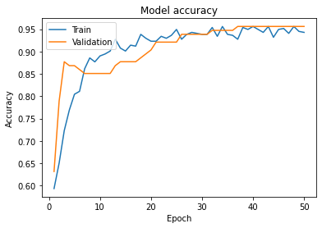
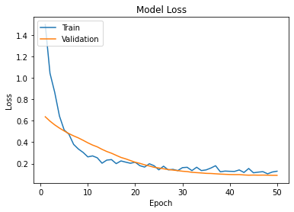
COMP 6630 Final Project Presentation
Experiment (CNN)

Slide 8
COMP 6630 Final Project Presentation
Conclusion
Best performance algorithm: Neural Network
Deep learning algorithm CNN can take in an input image, assign learnable weights and biases to various aspects and be able to differentiate one from another.
Neural Network can perform well in approximating functions and solving variety of problems.
Fundamental machine learning algorithms, like KNN and NBC, are applied as baseline methods in many problems. But it doesn’t mean they are not a competitive candidate to solve problems.
Machine learning have huge potentials in healthcare industry.

Slide 9
COMP 6630 Final Project Presentation
What We Learned
Four machine learning algorithms are studied
How to do research from scratch.
Results visualization.
Teamwork

Slide 10
COMP 6630 Final Project Presentation
Reference
Hiba Asria. & Hajar Mousannif. & Hassan Al Moatassime.(2016)Using Machine Learning Algorithms
for Breast Cancer Risk Prediction and Diagnosis. In The 7th International Conference on Ambient Systems, Networks and Technologies (ANT 2016) Procedia Computer Science vol 83, page 1064-1069. ISSN 1877-0509.
Meriem AMRANE. & Saliha OUKID. (2018) Breast Cancer Classification Using Machine Learning. 2018
Electric Electronics, Computer Science, Biomedical Engineerings’ Meeting 10.1109/EBBT.2018.8391453.
Li Shen. & Laurie R. Margolies. (2019) Deep Learning to Improve Breast Cancer Detection on Screening
Mammography. Scientific Reports volume 9, Article number: 12495.
https://towardsdatascience.com/coding-neural-network-forward-propagation-and-backpropagtion-ccf8cf369f76

