Slide 1
COMP 6630 Final Project Presentation
Breast Cancer Detection Using AI Models
Ken Chen
Donglai Liu
Junyao Yang

Slide 2
COMP 6630 Final Project Presentation
Introduction
Breast Cancer
Multifactor
Occurrence and Severity
Millions of patients per year
High death rate
Machine Learning
Detection
Prediction

Slide 3
COMP 6630 Final Project Presentation
Datasets
Wisconsin Breast Cancer database
Digitized image of a fine needle aspirate (FNA) of a breast
Describe characteristics of the cell nuclei present in the image
Data Design
32 Attributes
569 instances
No missing values
Benign or Malignant

Slide 4
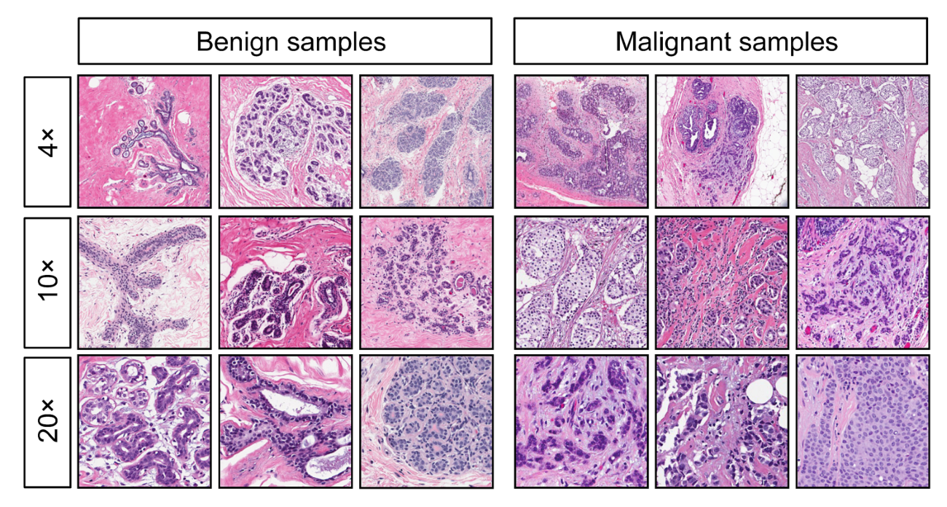
COMP 6630 Final Project Presentation
Image Example

Slide 5
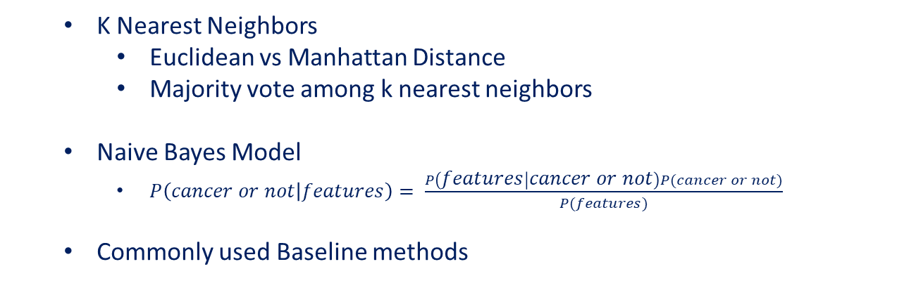
COMP 6630 Final Project Presentation
Our Baseline Approach:
K Nearest Neighbors
Euclidean vs Manhattan Distance
Majority vote among k nearest neighbors
Naive Bayes Model
$P\left(cancer or not | features\right)= \frac{P\left(features | cancer or not\right)P(cancer or not)}{P(features)}$
Commonly used Baseline methods

Slide 6
COMP 6630 Final Project Presentation
Experiments
Parameters | Description | Default | Range
Train vs Test | Train Test sample ratio | 0.2 | None
k | Num of neighbors | 5 | 5, 7, 9, 11,13, 15
…
Model | Accuracy
KNN Euclidean | 0.94
KNN Manhattan | 0.95
NBC | 0.95

Slide 7
COMP 6630 Final Project Presentation
To Be Continued
Feature Selection
ANN Model
CNN Model
Evaluation

