Slide 1
UNCLASSIFIED
11 SEP 2020
Modern Data Science Techniques for Visualization
James R. Cutler, NETCOM Data Science Directorate
For Public Release

Slide 2
Overview
Why not use regression and its coefficients?
Random Forests: one of many modern Data Science techniques
Feature Importance
SHAP
What it is
General concepts
Just how bad is linearity for prediction accuracy?
LIME
Permutation Feature Importance
A Rapidly Expanding Field
Wrap up
Questions

Slide 3
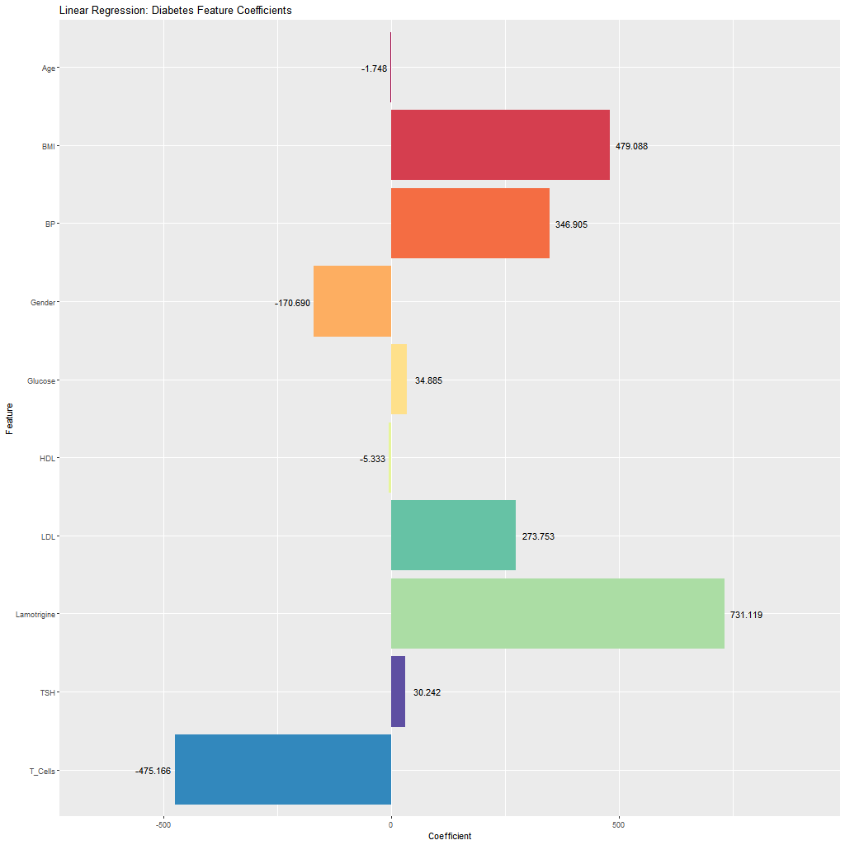
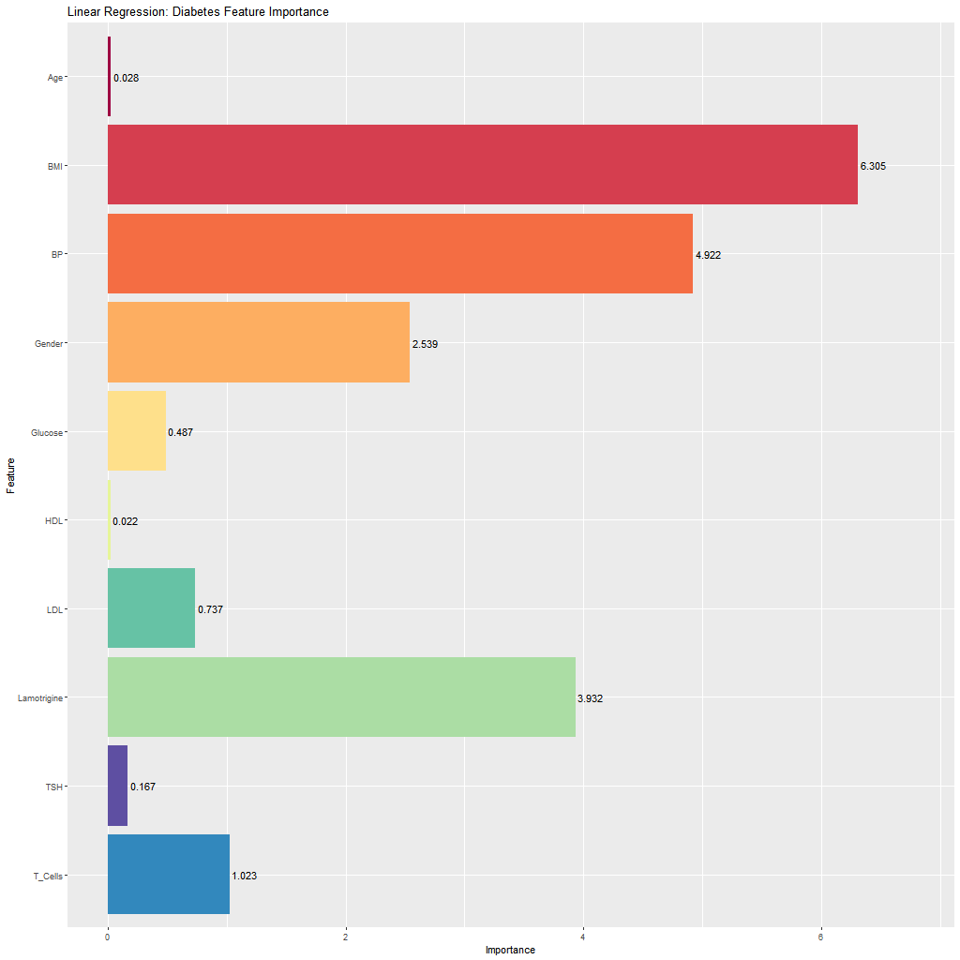
Linear Regression Coefficients vs. Importance
Units of measurement can change relative coefficients (all these predictors were standardized)
Importance is the absolute value of the t-statistic for each model parameter used (caret definition)
Notes:
Coefficients are THE reason most non-data scientists want you to use regression. I hope to give you ammo to convince others that regression is rarely a good idea.
Lamotrigine’s coefficient is only 2.7 times larger than LDL’s but the chances (converting t-stats to p-values) that Lamotrigine’s value does not effect the outcome is 1 in 20,000 (0.005%) while the chances are more 1 in 4 that LDL’s value does not effect the outcome.
Note that it is pure coincidence that the coefficient values look so similar to the importances.

Slide 4
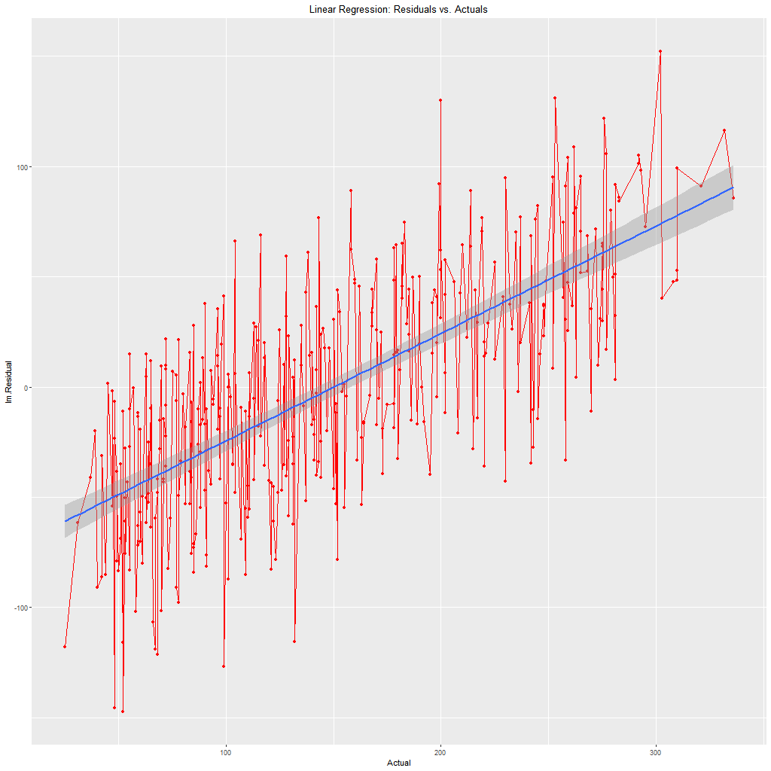
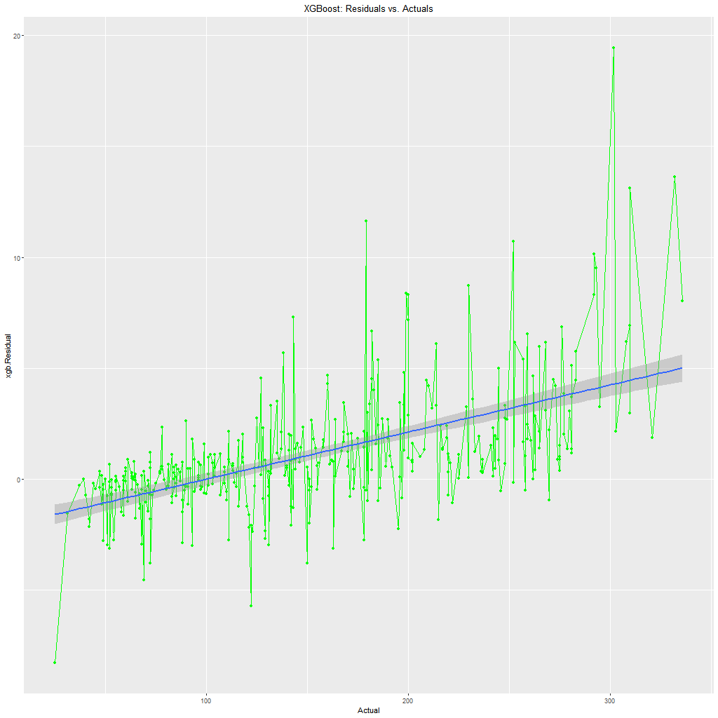
Linearity, Heteroscedasticity, and Multicollinearity
Linear, logistic, generalized and almost all regressions – even non-linear - require linearity
Both have heteroscedasticity but…
Math breaks down for Linear/Logistic regression
Non-linear Data Science methods do not care!
Notes:
Linear regression’s problems that most all modern Data Science algorithms are immune to:
Even so-called non-linear regression is really linear: it assumes the model can be approximated by a first order Taylor series (a linear function)
To support linearity then, we have to plot each X vs. y and transform as needed to approximate a linear relationship.
Interactions are nowhere near as important to modern Data Science algorithms (modelling interactions will sometimes improve a modern model slightly but not very much)
With or without interactions, you have to worry about (multi)collinearity which means step-wise regression

Slide 5
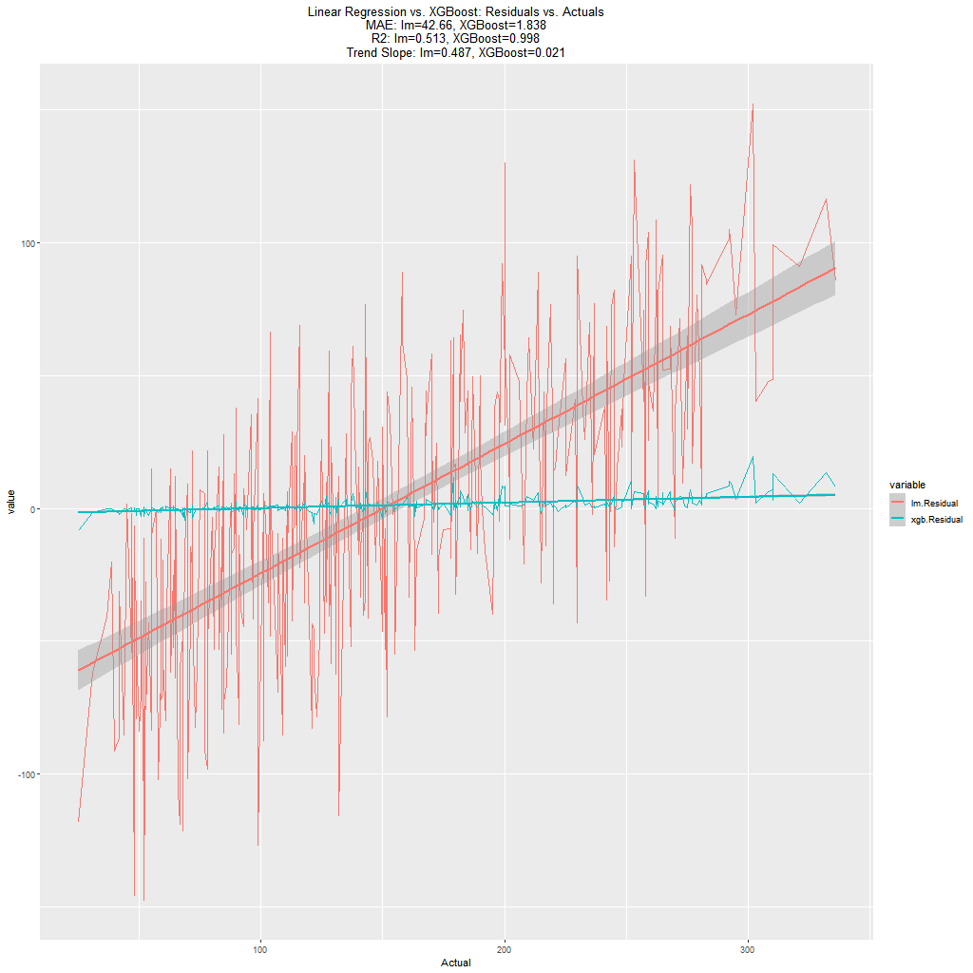
Side-by-side comparison
MAE: 23 times larger
R²:
Linear regression can’t explain 49% of the variance.
XGBoost can’t explain 0.2% of the variance.
Slope of residual’s trend is 23 times larger for Linear Regression and the confidence interval is much larger.
Is XGBoost hard to use? It took
25 lines of code and a single parameter change to produce these results
30 minutes to write code using samples found on internet

Slide 6
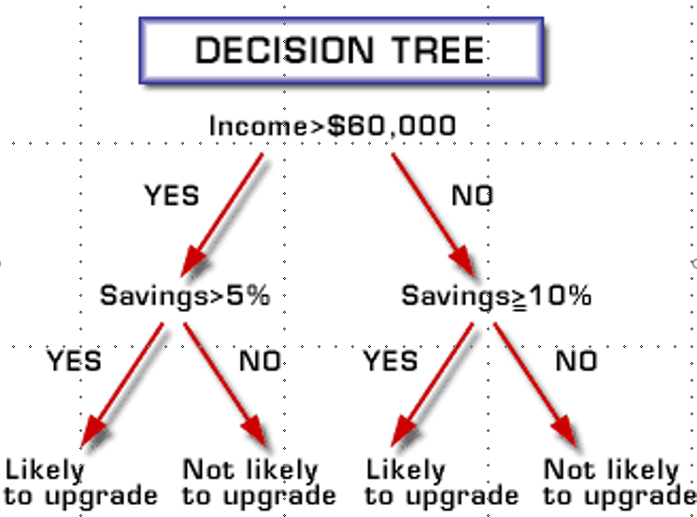
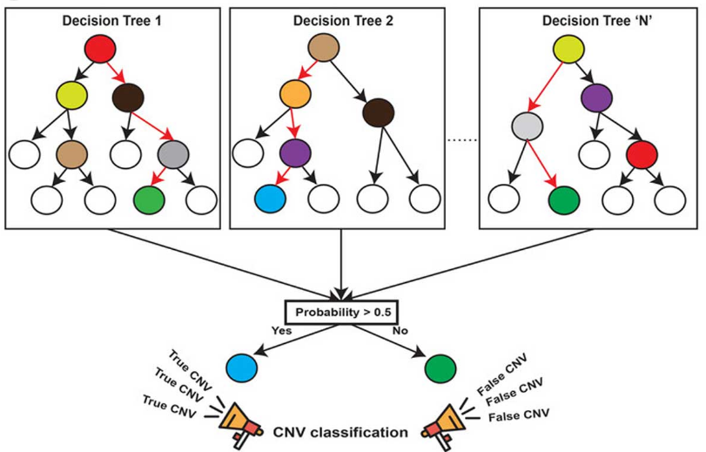
Trees and Forests
Decision tree basics
Many ways to build (information gain, minimum description length, chi-square independence, gini, …)
Random Forests:
Random forests are made up of large numbers of decision trees. Each gets a vote in the final prediction.
Bagging: Random selection (with replacement) of rows
When deciding on the split condition at each node, limit the options to a randomly selected subset of the features
Extremely Random Trees (ExtraTrees):
Each tree uses all observations instead of a subset (no bagging)
At each node, a subset of features is chosen, for each feature a split point is randomly chosen, all the candidates are evaluated and the one with the highest score is chosen.
Notes:
Note the word “likely” in the leaves of the tree. Leaves are almost never pure. The goal is to make them as pure as possible within other constraints: MDL, tree depth, balance of tree, …
Information gain is the decrease in entropy. Entropy can be thought of as the minimum number of bits of information needed to represent the class for a randomly selected observation.
Minimum Description Length: Smallest tree to represent (mostly) properly assigning observations to leaves (categorizing or “binning” numeric y values)

Slide 7
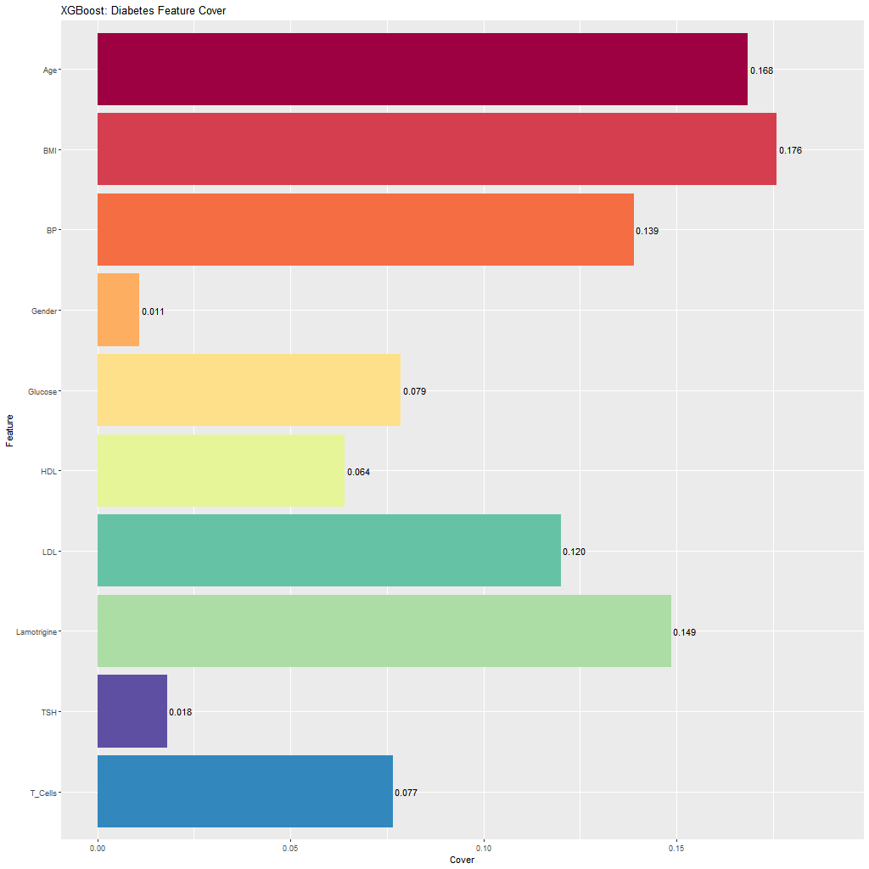
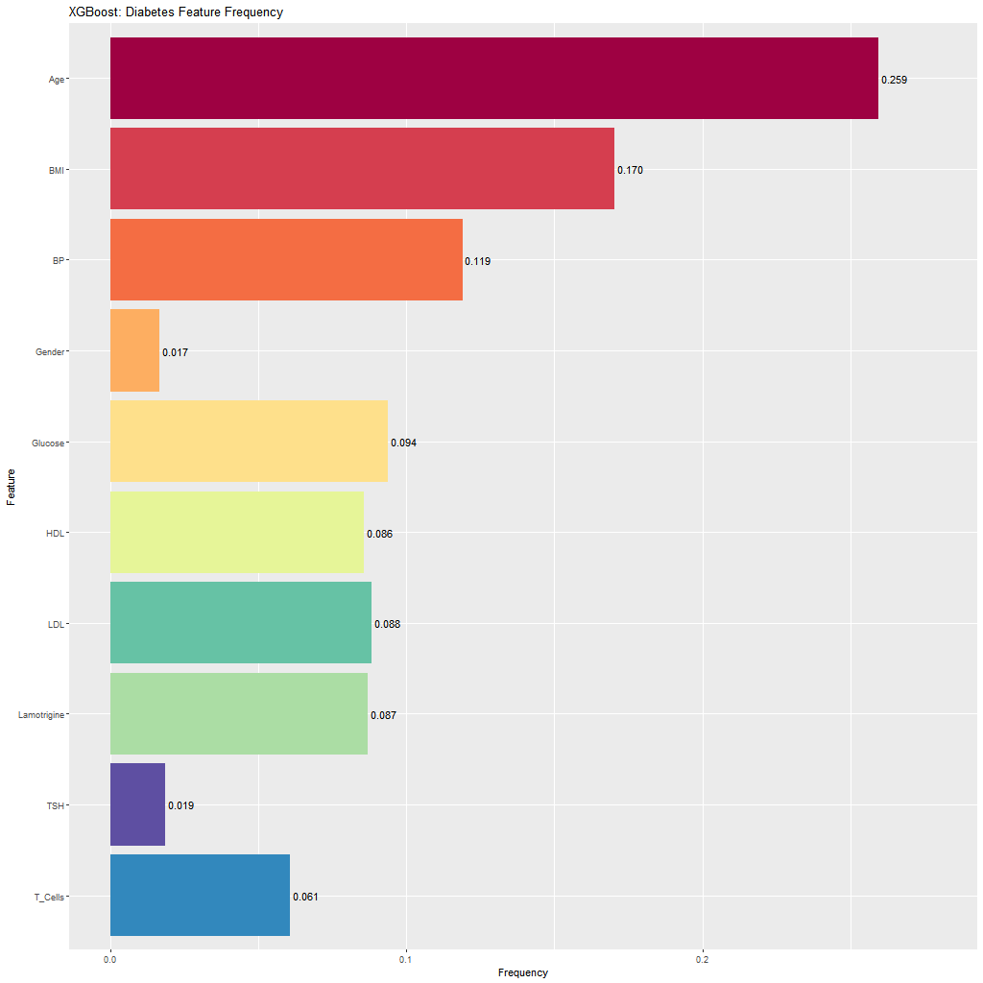
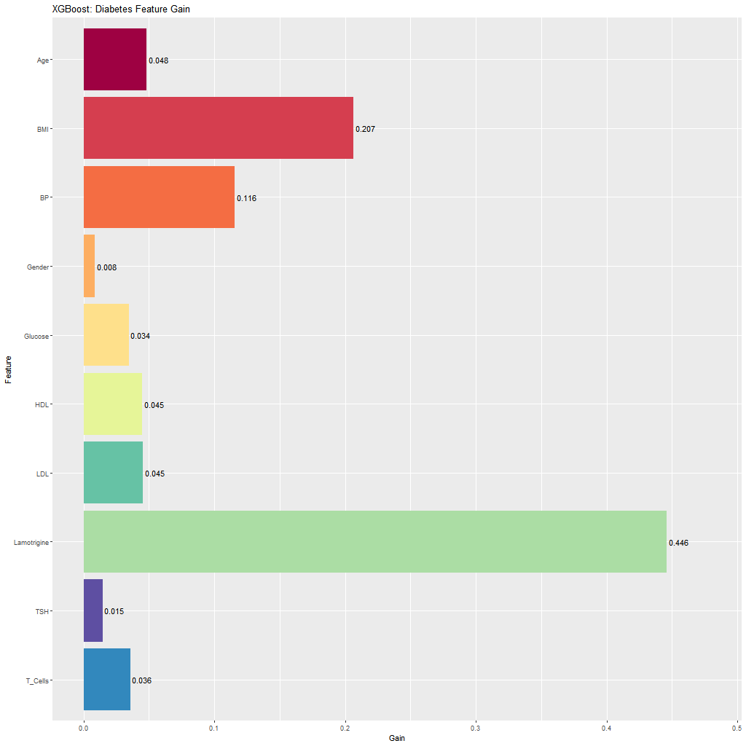
Feature importance for Trees and Forests
Feature importance in a tree (for a forest summarize across all trees):
Cover: How many observations ended up in a leaf because of the feature
Frequency/Weight¹: How many nodes use the feature
Gain²: How much more accurate (information gain, chi-square test, gini, …) does this feature make the tree’s predictions across all nodes it appears in?
¹Interchangeable terms: Frequency is usually used in R and Weight is usually used in Python; ²Gain is almost always the best measure of feature importance.
Notes:
In each graph, the values sum to 1
Gain is NOT synonymous with Information Gain.
Age shows how different Cover and Frequency can be from Gain. Lamotrigine shows how different Cover and Frequency can be from each other.
10 lines of code to produce these graphs

Slide 8
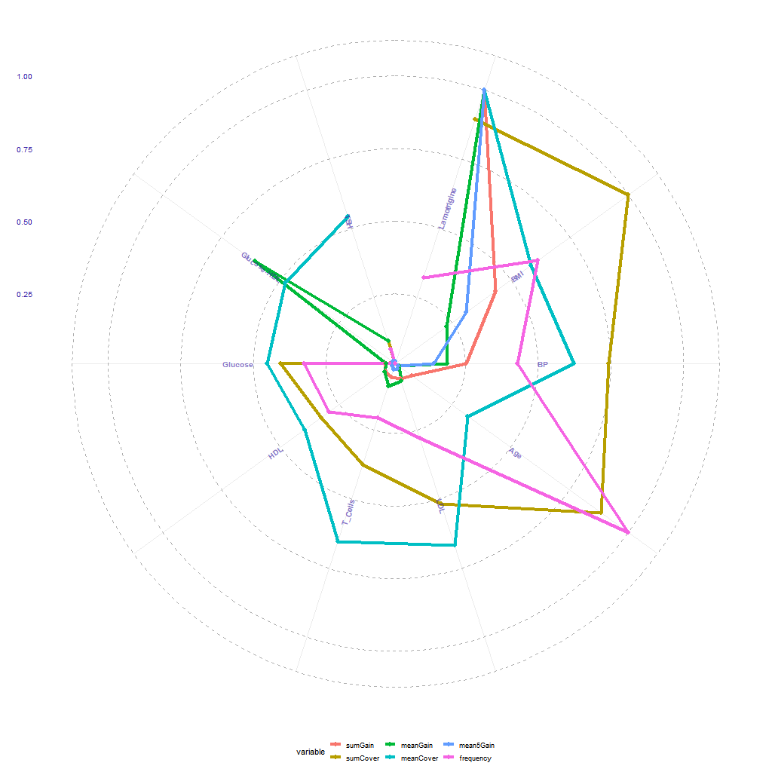
Feature Importance Radar Plot
The features are the spokes of the wheel and the lines connect the values of the various measures from one feature to the next. Values are scaled from 0:max to 0:1 with the next to outermost ring being 1.
sumGain - sum of all the feature’s Gain values
meanGain - mean of all the feature’s Gain values
mean5Gain - mean of the 5 highest Gains of the feature.
sumCover - sum of all the feature’s Cover values
meanCover - mean of all the feature’s Cover values
frequency - How many nodes use the feature
Notes:
meanGain is sumGain/Frequency: If feature X contributes a gain of 200 at a single node out of 100 nodes, then its meanGain is 200 rather than 2.
Cover: How many observations ended up in a leaf because of the feature
Frequency: How many nodes use the feature
Gain: How much more accurate (information gain, chi-square independence, gini, …) does this feature make the tree’s predictions across all nodes it appears in?

Slide 9
SHAP: SHapley Additive exPlanations
SHAP values work for all Data Science models, not just trees and forests.
Game theory: Alice and Bob as a team on a game show. Out of 10 questions:
Both Alice and Bob know the answer for 4 of the questions
Only Alice knows the answer for 3 questions
Only Bob knows the answer for 1 question
How do we apportion the rewards?
If Alice always gets to answer first, her score is 7 and Bob’s is 1
If Bob always gets to answer first, his score is 5 and Alice’s is 3
SHAP values¹ are computed in a similar way to stepwise regression.
A feature is removed and the change in the value of each prediction is computed.
Just as with Alice and Bob, the order that features are removed will change the delta assigned to the feature. Therefore, every possible permutation of feature removals is done and the results combined.
They can be computed for individual observations, groups of observations, or the entire set of observations.
SHAP values are, by their definition, very susceptible to collinearity. If Frances knows everything Alice does, they would each get half the points. However, if you restrict SHAP to the “top N” features provided by XGBoost, you are probably safe as it is designed (according to its authors) to select features in such a way as to eliminate collinear ones.
Notes:
¹Game Theory solution produced by Lloyd Shapley in 1953. Used to implement SHAP values for black box models in 2017 by S. Lundberg, S Lee, A Unified Approach to Interpreting Model Predictions

Slide 10
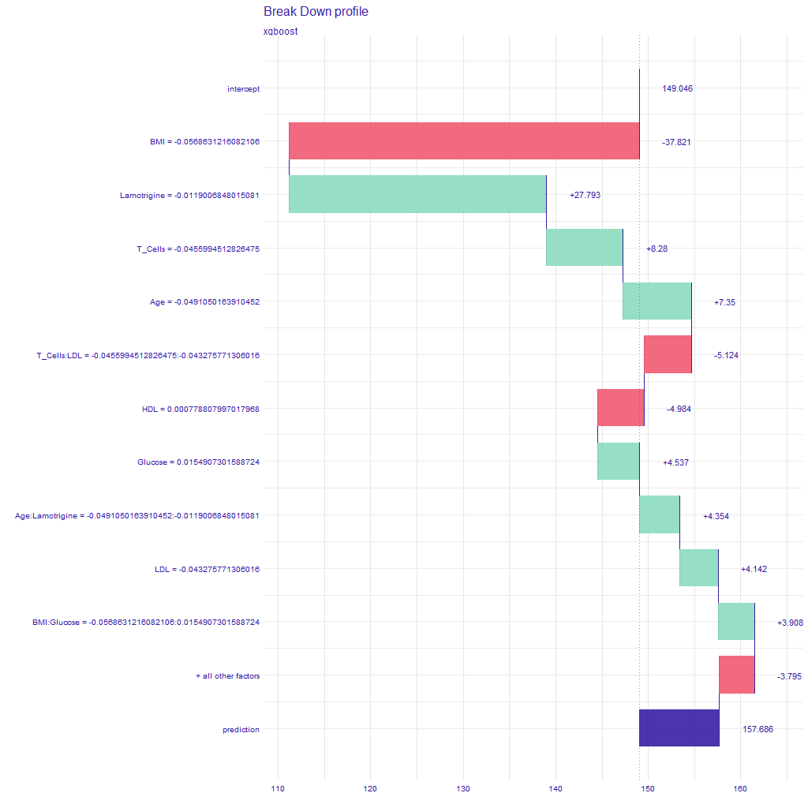
SHAP Waterfall Plot
This shows the magnitude, from largest to smallest, and the cumulative effects of the SHAP values on a single observation’s prediction.
The intercept row at the top, showing 149.046, represents the average actual y-value across all observations.
Except for the bottom two rows, each subsequent horizontal bar is a feature or interaction.
The y-axis labels show the feature or interaction and the feature values for this observation.
The SHAP values are shown to the right of each bar.
The width of the bar also shows the SHAP value.
The color of the bar indicates the sign of the value.
The next-to-bottom row is the accumulation of all the SHAP values too small to conveniently show.
The bottom row shows the value of the prediction on the right. The purple bar is the accumulation of all the individual SHAP values and shows the magnitude of the overall effect.

Slide 11
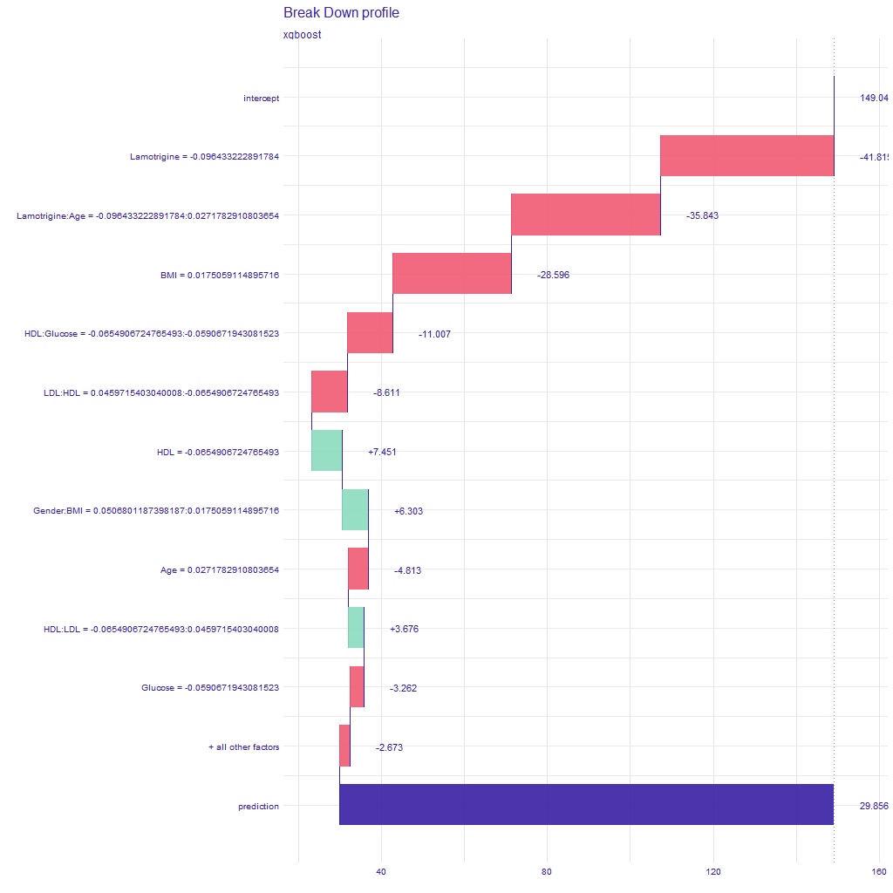
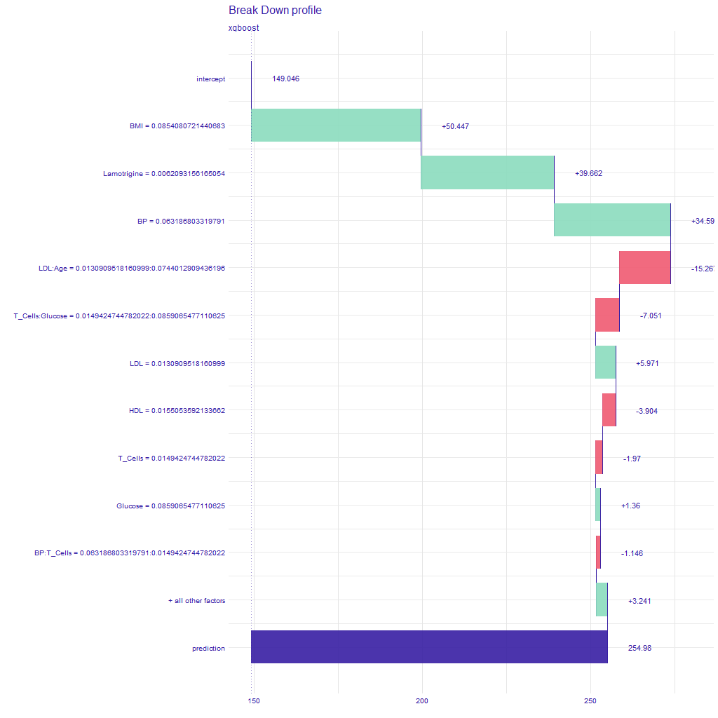
SHAP Waterfall Plots for the Min and Max Predictions
Note that the range of values covered by the x-axis are not the same.

Slide 12
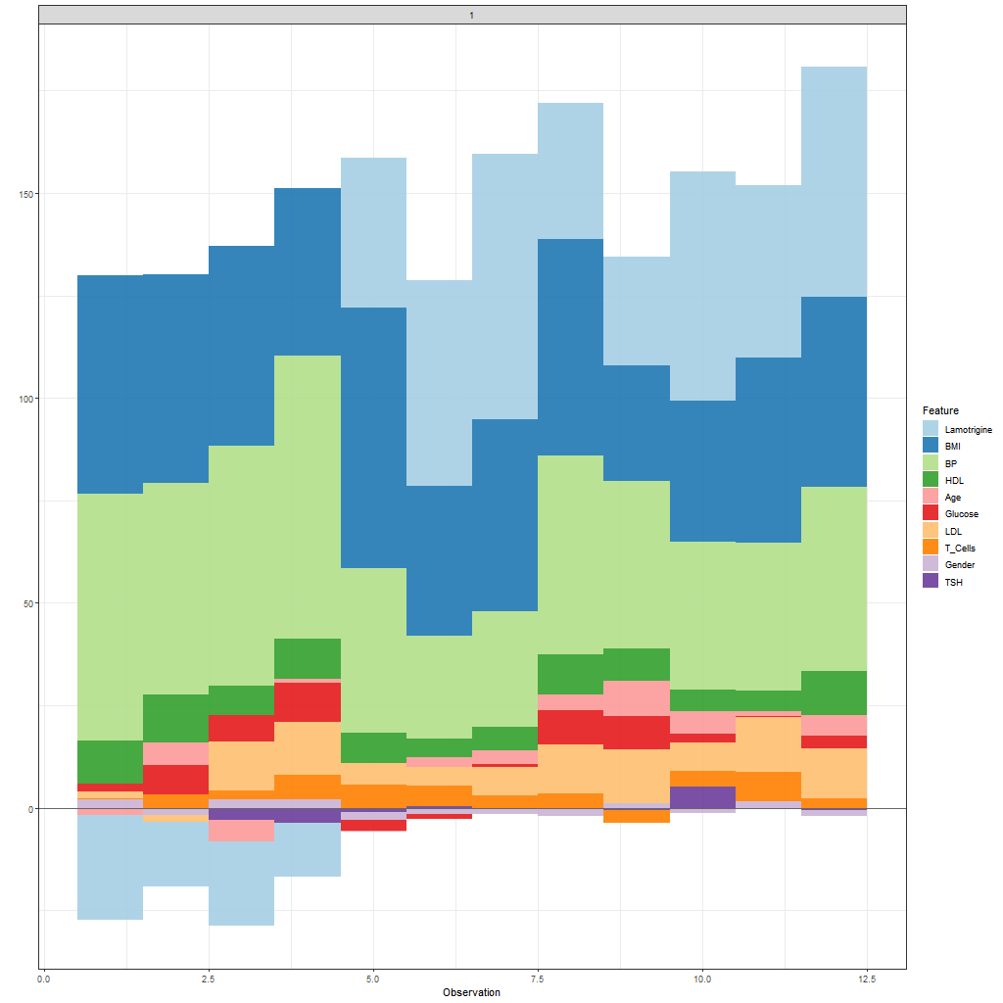
SHAP Force Plot for Select Observations
Each vertical bar is an observation.
The force plot shows the contribution of each feature to an observation’s prediction.
If the feature appears above the x-axis it means the feature made the prediction higher and conversely for below.
The height of the feature’s bar indicates the impact.
You can see that T-Cells, LDL, Age, HDL, TSH, and Glucose have pretty consistently small impacts.
Lamotrigine, Age, Glucose, LDL, T-Cells, Gender, and TSH appear on both sides of the x-axis.
You can plot any number of observations.
Notes:
This shows force plots for 12 observations I chose at random, but you could choose ones of specific interest. The plot is

Slide 13
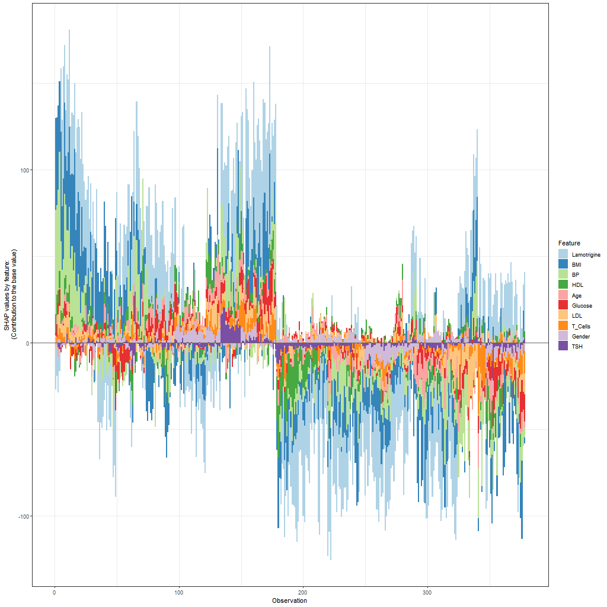
SHAP Force Plot Across All Observations
Each vertical bar is an individual observation. The observations are in the order they appeared in the input dataset.
Again, above the x-axis means the feature made the prediction higher and conversely for below.
Again, the height of the feature’s bar indicates the relative impact.
Looking at Lamotrigine:
Sometimes it has a large positive impact
Sometimes it has a large negative impact
Sometimes it has small impact (around observation 180)

Slide 14
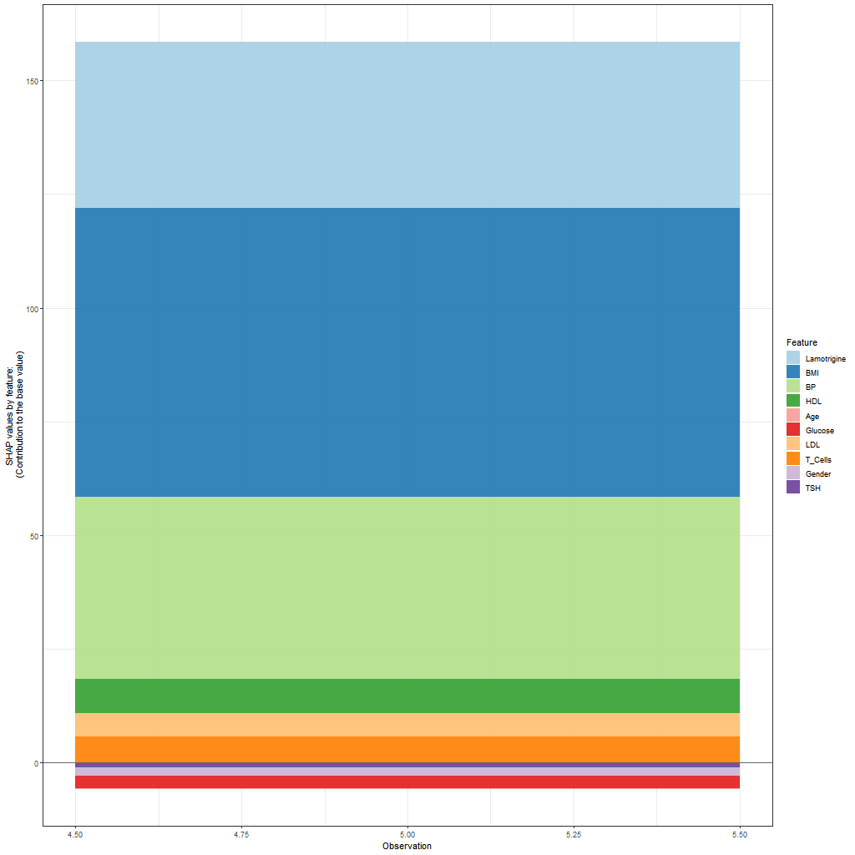
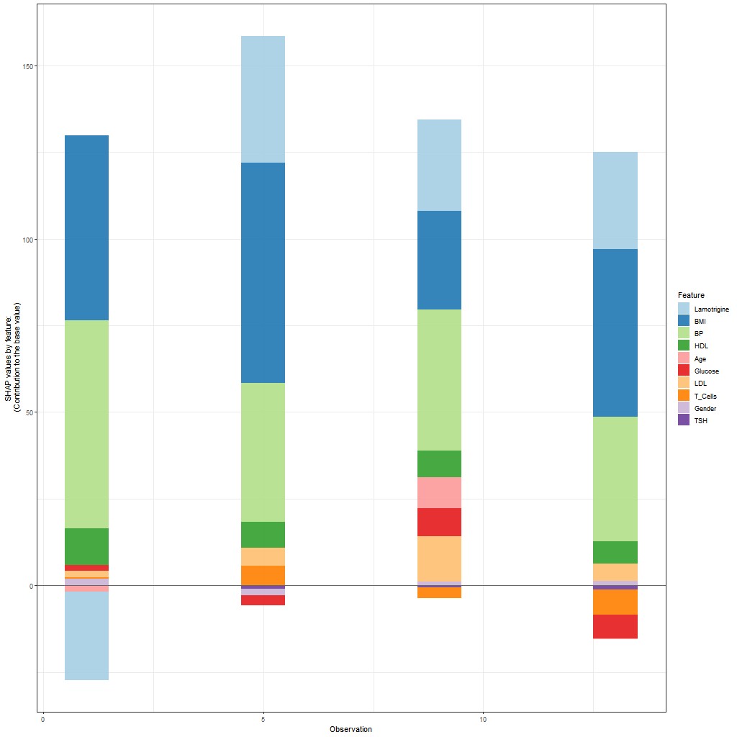
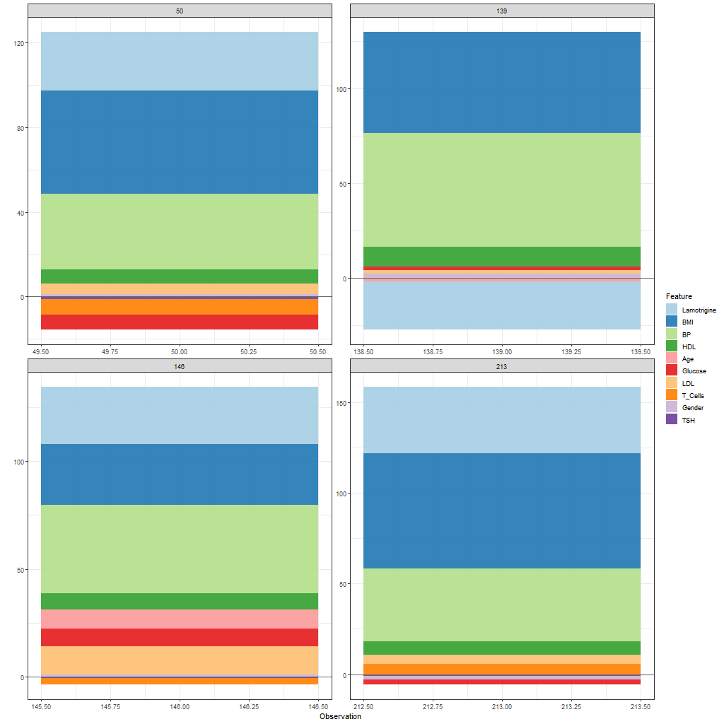
SHAP Force Plot Options
You can plot a single observation
You can plot multiple observations as bars in a single chart
You can plot multiple observations as a grid of individual plots

Slide 15
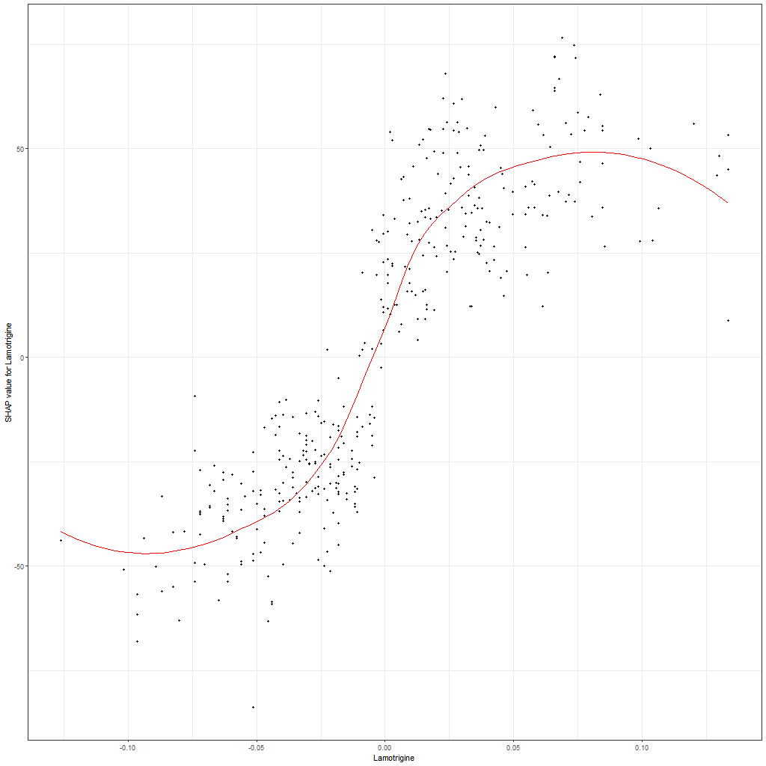
SHAP Value Plot for Lamotrigine
A SHAP value plot shows how the SHAP value for a feature changes in relation to the value the feature.
The red line is the LOESS curve.
The x-axis is the Lamotrigine value.
The y-axis is the SHAP value for Lamotrigine
The dots show the SHAP values for the individual observations.
Unlike the force plot (repeated below), the observations are ordered by the value of Lamotrigine.
Notes:
LOESS (locally estimated scatterplot smoothing) curve: A local approximation of the best y value above each x value using a first or second degree polynomial approximation on the k-nearest neighbors. Invented in 1964 and popularized around 1979.

Slide 16
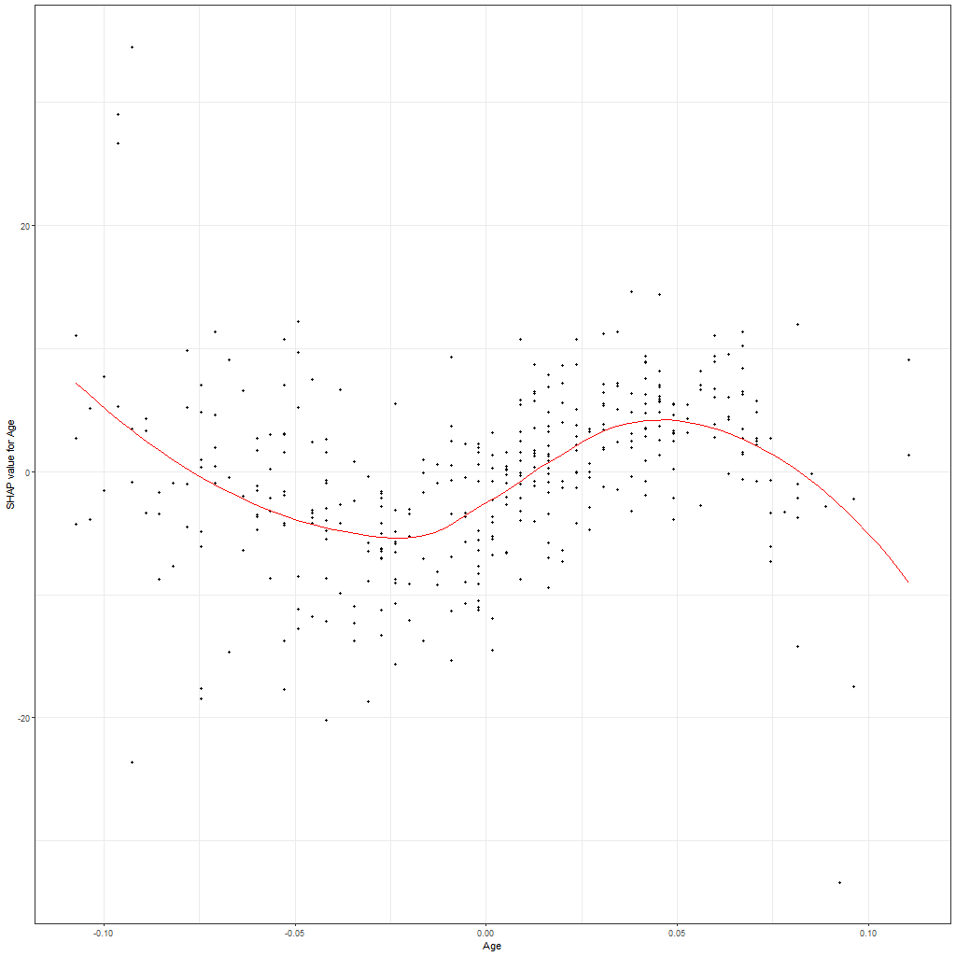
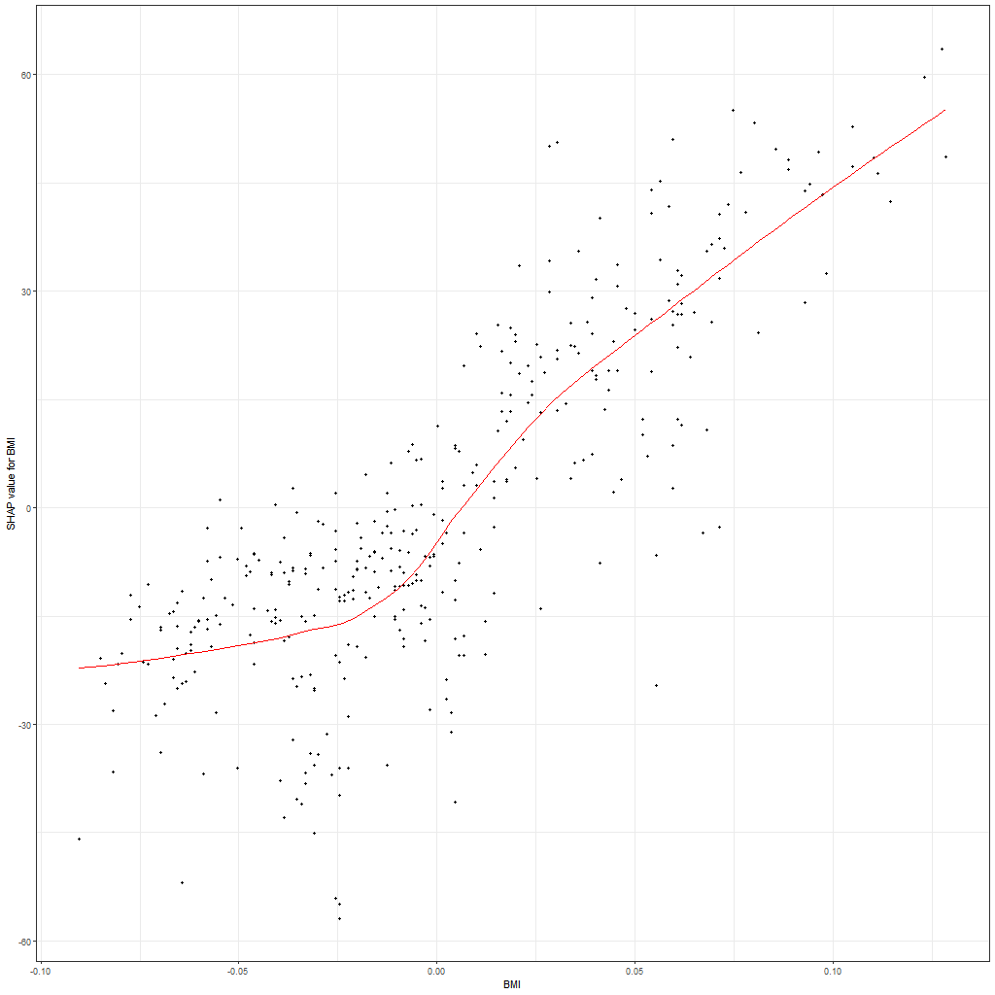
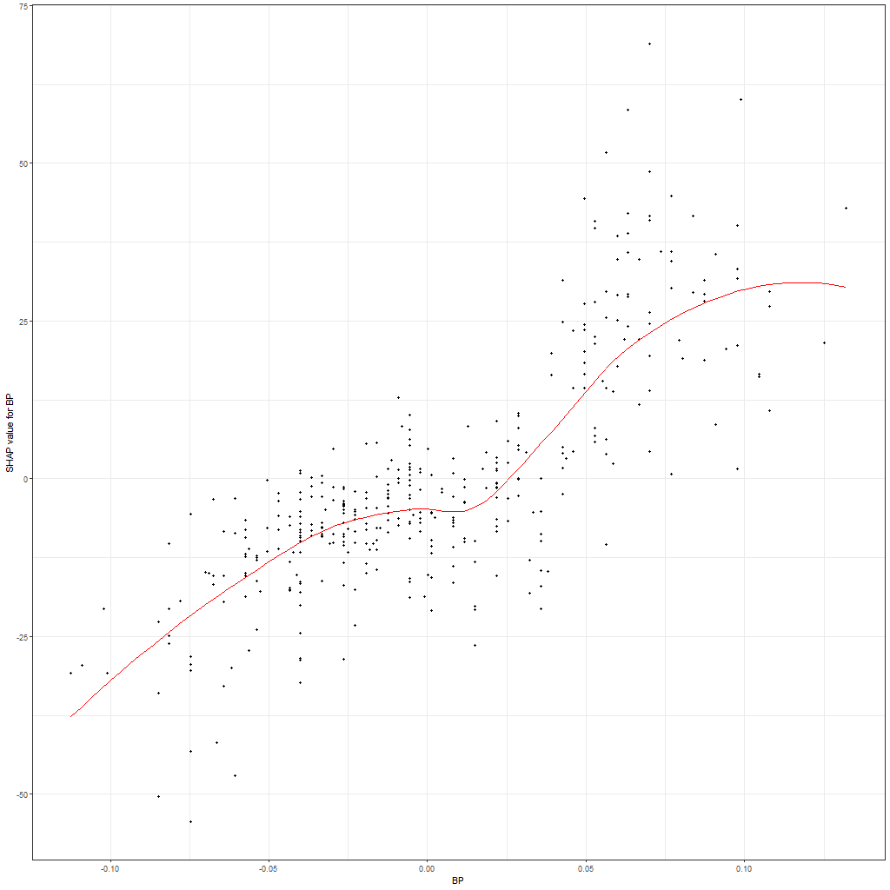
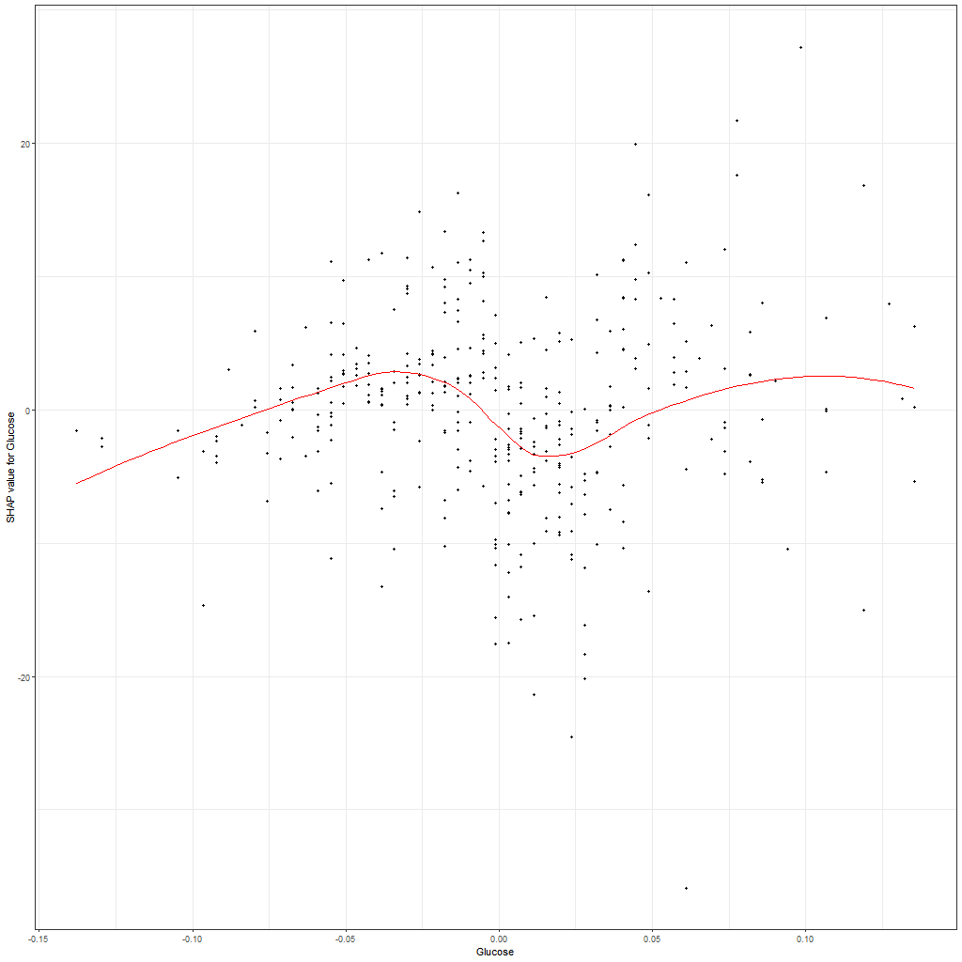
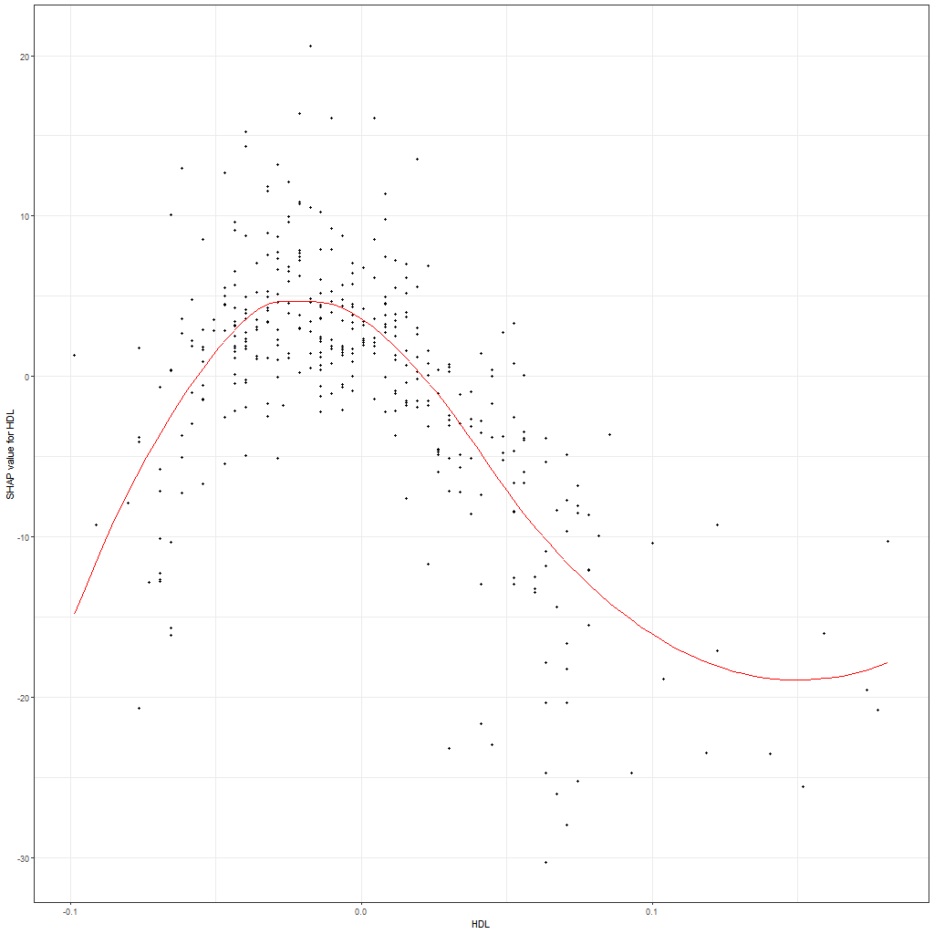
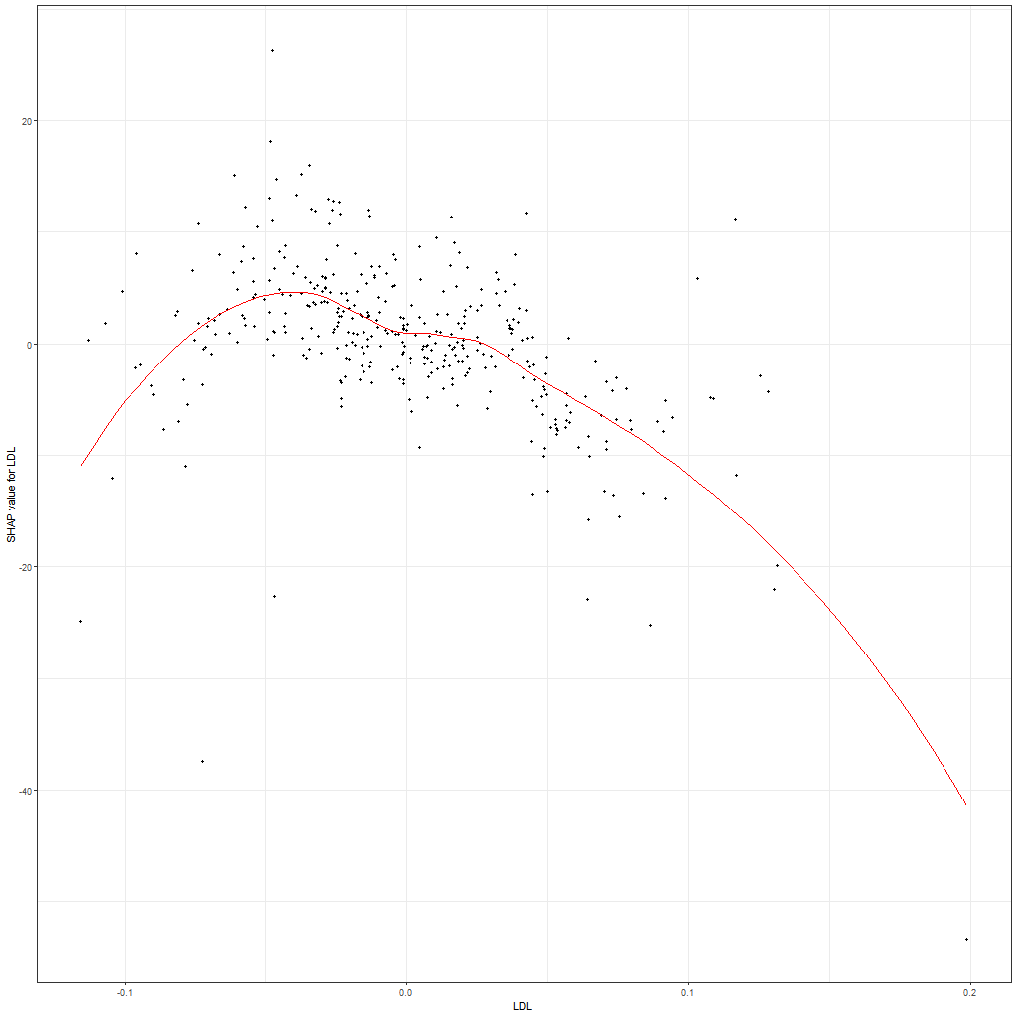
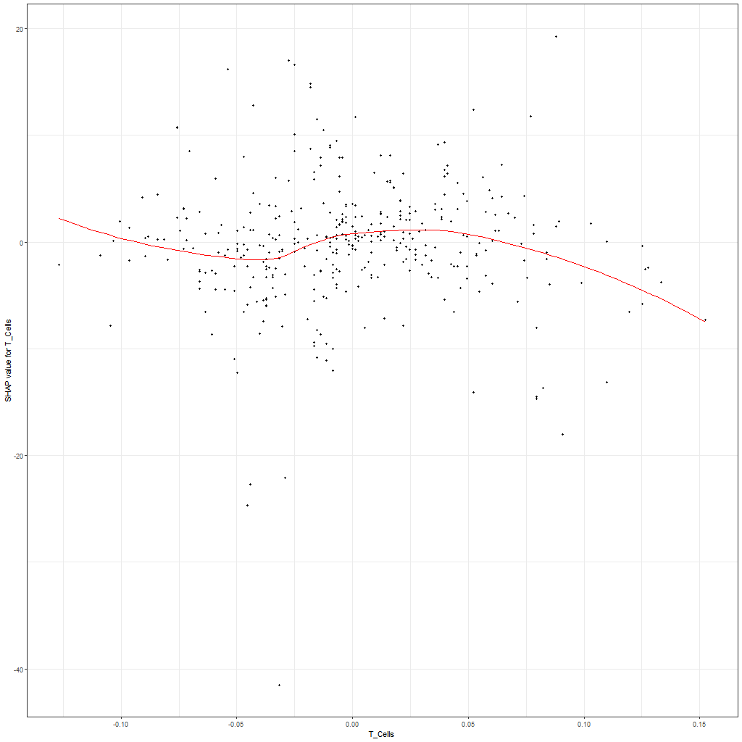
SHAP Value Plots
Each plot is for a different feature. As you can see from the LOESS curves, the importance of a feature in a prediction is not fixed or even a simple linear or low-degree polynomial relationship.

Slide 17
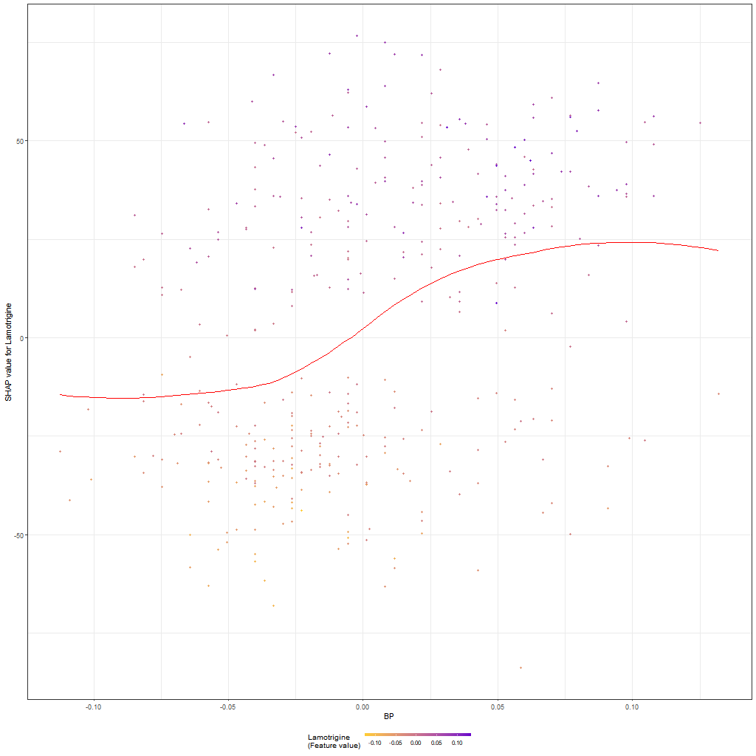
SHAP Dependence Plot for Lamotrigine vs. BP
A SHAP dependence plot shows how the SHAP value for one feature changes in relation to the value of another feature.
The red line is the LOESS curve.
The x-axis is the BP value.
The y-axis is the SHAP value for Lamotrigine
The color of the dots shows the size of Lamotrigine’s value: the color scale is at the bottom center.

Slide 18
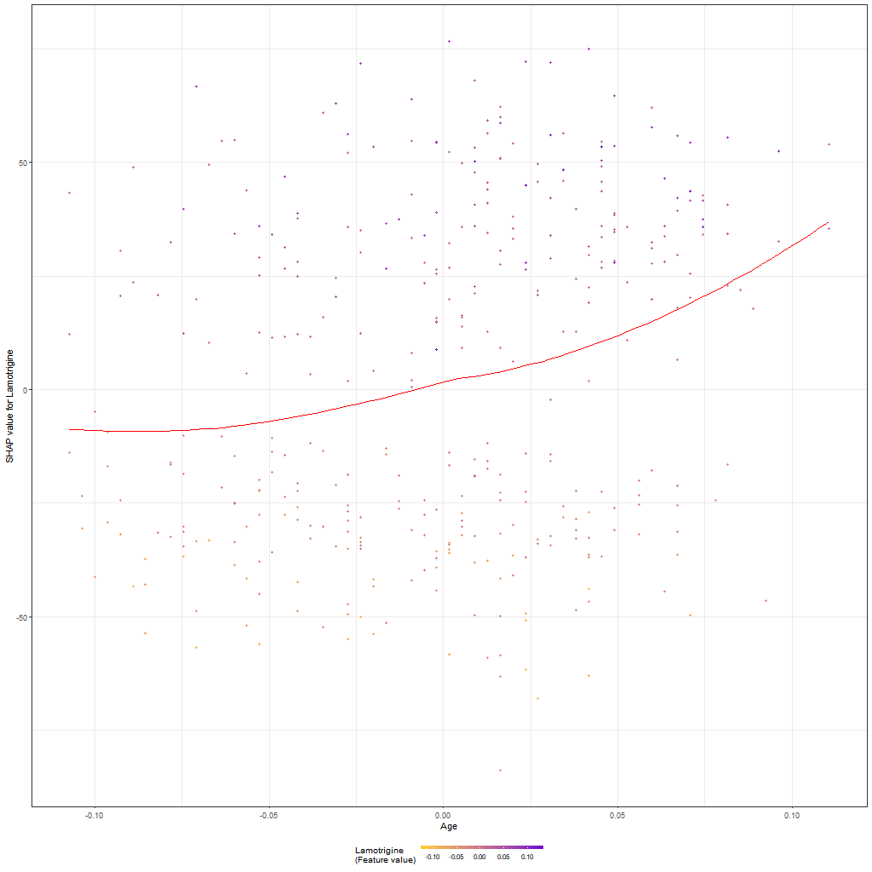
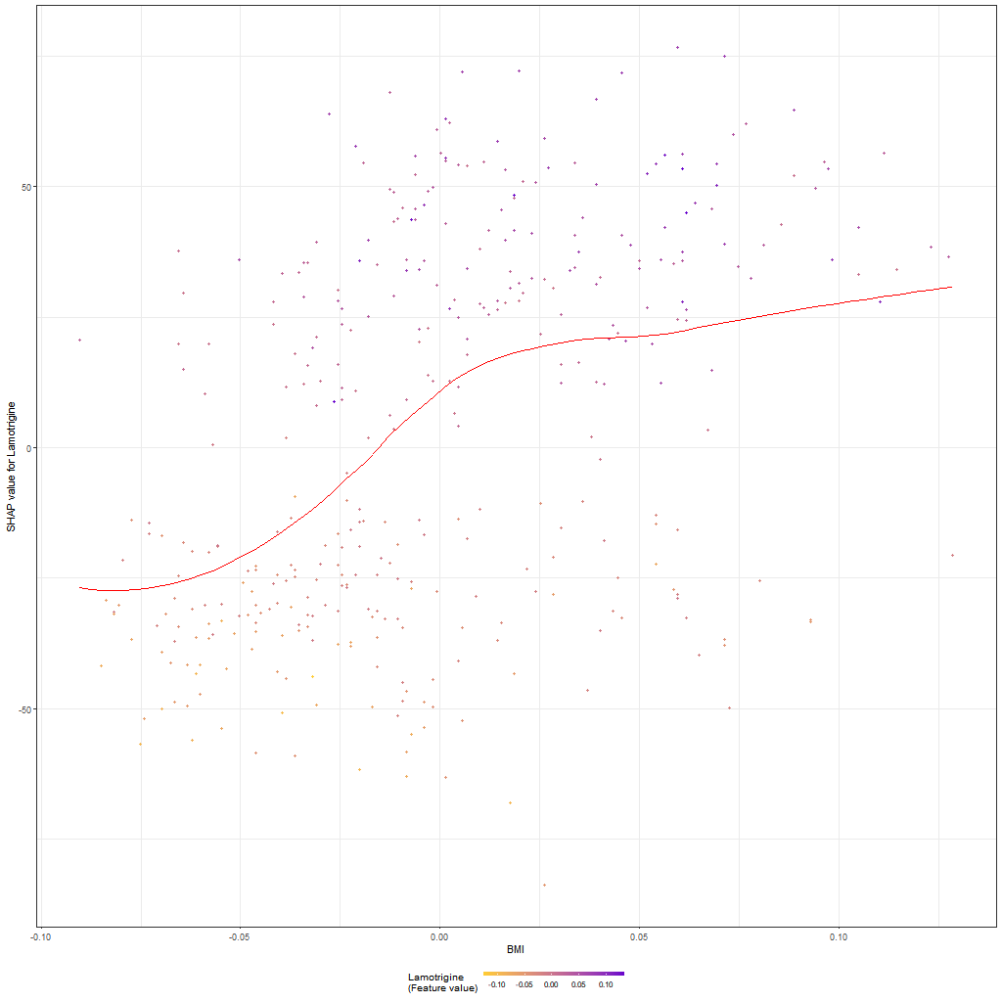
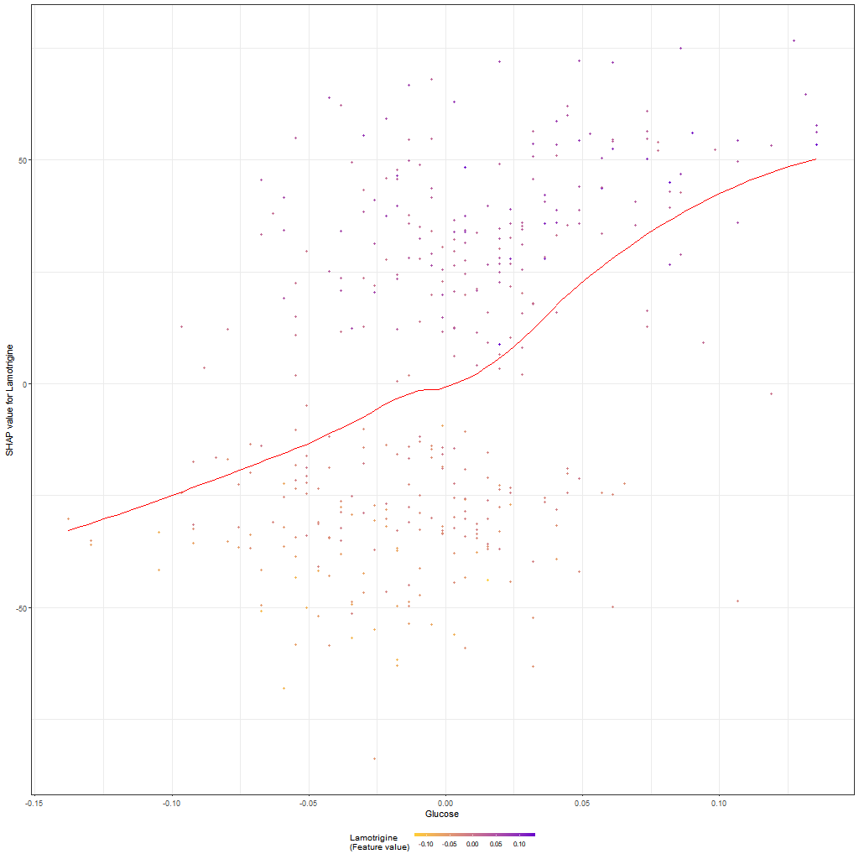
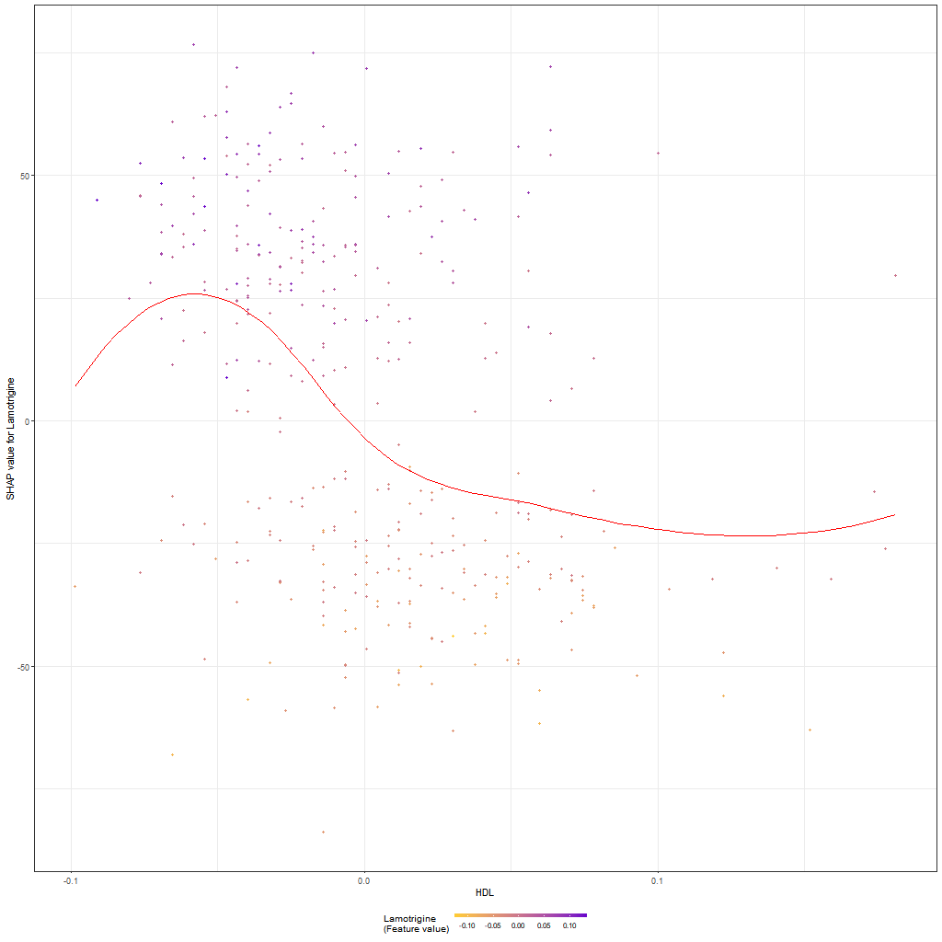
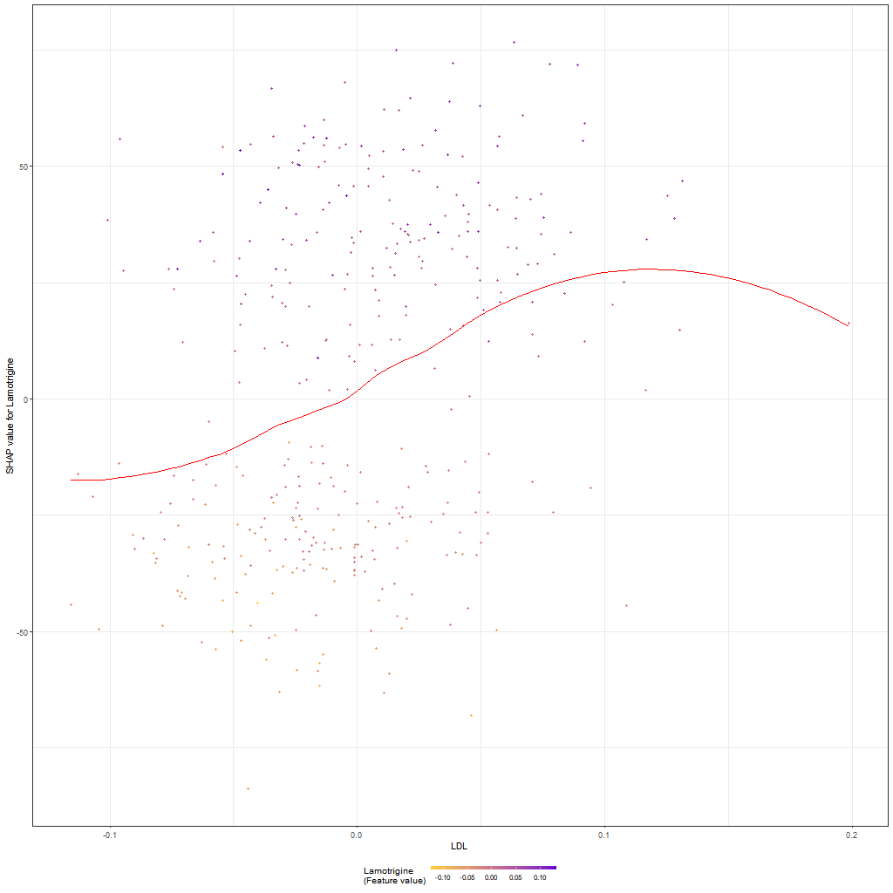
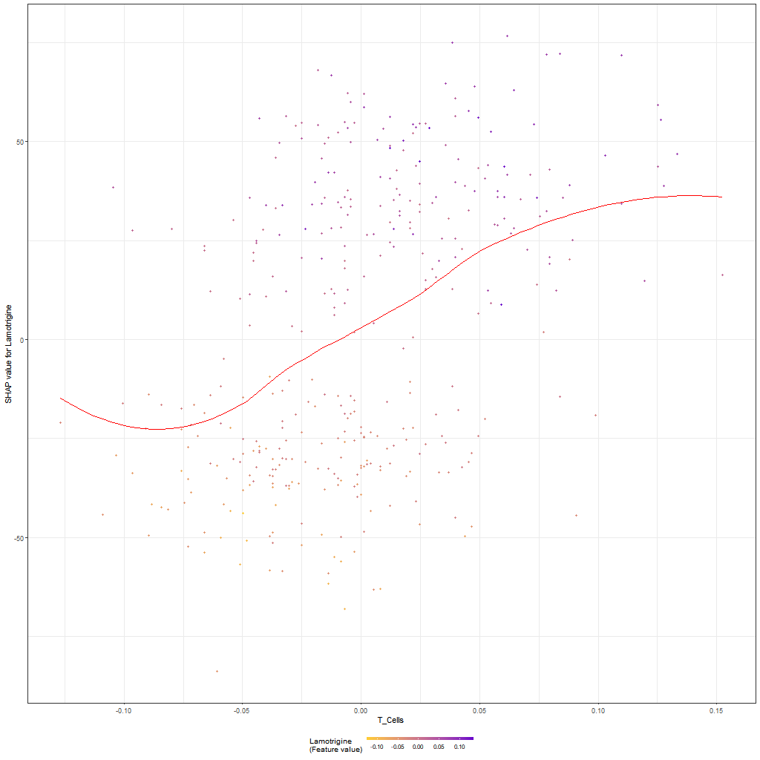
SHAP Dependence plots for Lamotrigine
Each of these dependence plots has a different feature on the x-axis. As you can see from the LOESS curves, the importance of Lamotrigine in a prediction is not fixed or even a simple linear or polynomial relationship relative to any other feature.

Slide 19
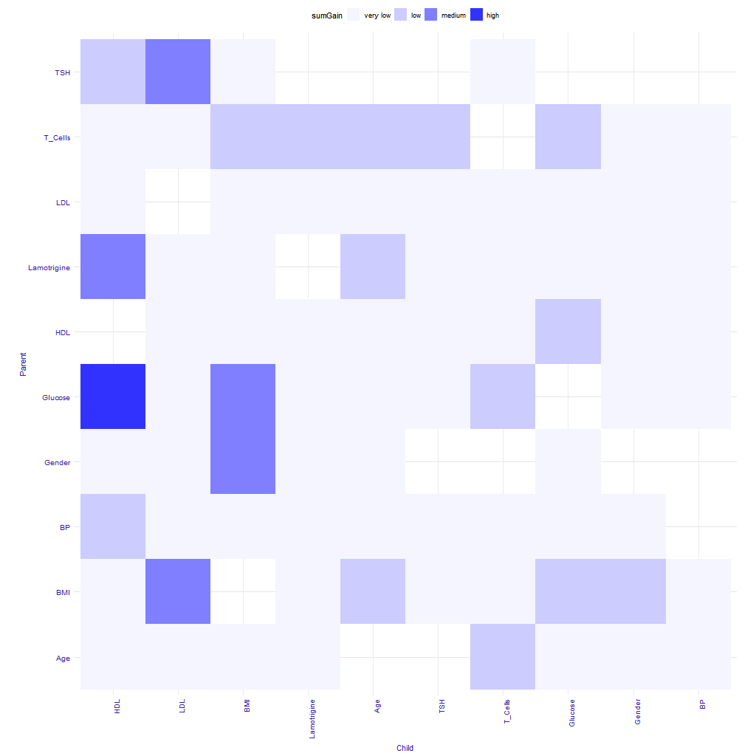
SHAP Feature Interaction Heatmap
As we’ve seen from the SHAP dependence plots, the SHAP value for feature Q at value q can change based on the value of another feature R.
For each pair of features, Q and R, the SHAP value of all pairs of values are computed. The resulting SHAP values are summed. The relative magnitude of these sums are shown for each pair of features.
The interaction of Glucose and HDL cause large changes in the SHAP values.
The interaction of TSH and Lamotrigine cause almost no change in the SHAP values.
Notes:
Note that because of the way SHAP values are computed, the value of feature A vs. feature B can be different than the value of B vs. A.
More info in the EIX package vignette.

Slide 20
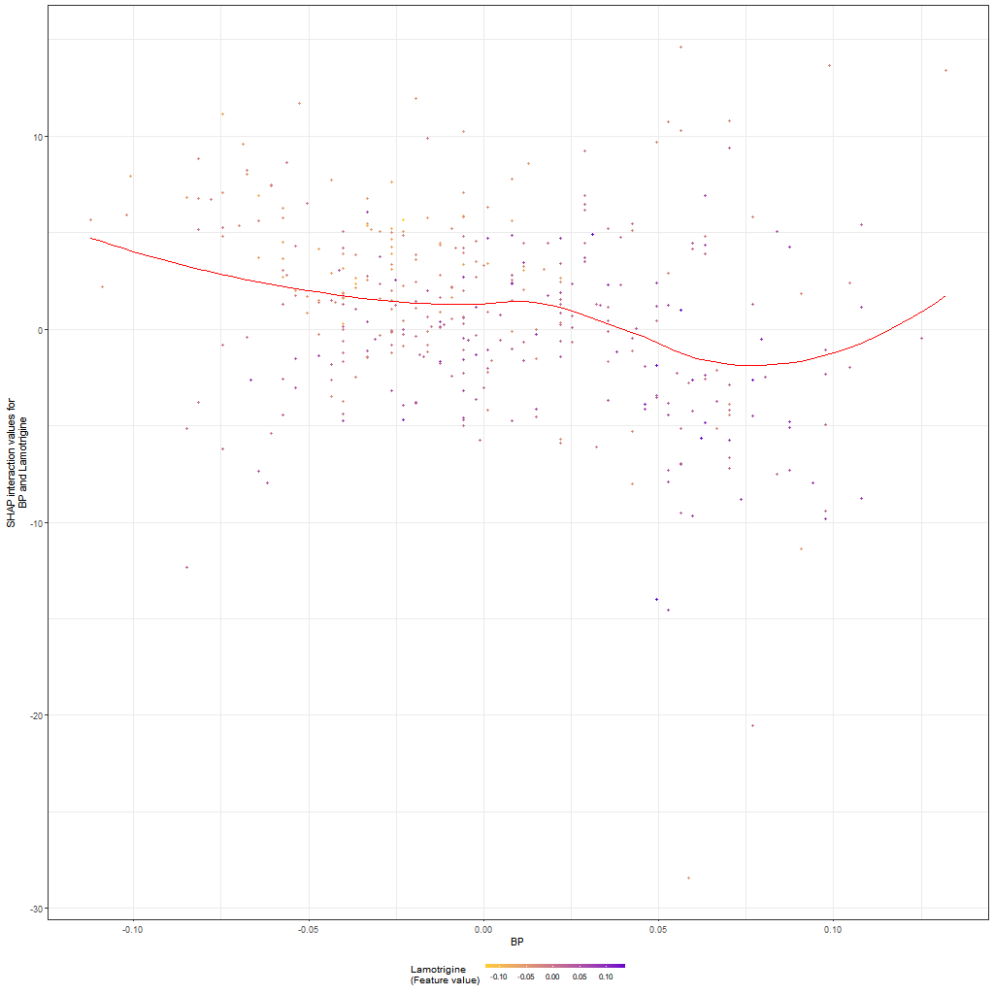
SHAP Interaction Plot for Lamotrigine vs. BP
A SHAP interaction plot shows how the SHAP value changes in relation to the interaction of two features.
The red line is the LOESS curve.
The x-axis is the BP value.
The y-axis is the SHAP value for the interaction of Lamotrigine and BP
The color of the dots shows the size of Lamotrigine’s value: the scale is at the bottom center.
Below is the dependence plot for the two features.

Slide 21
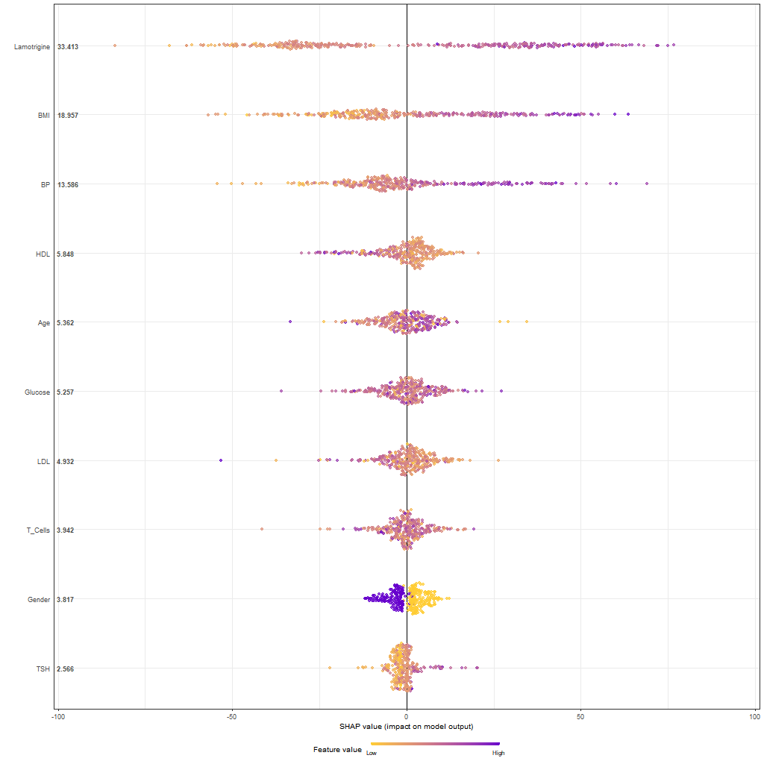
SHAP Summary Chart
This gives you a general idea of how the SHAP values for each feature are related to the feature’s values.
Each row is a feature and the values are the mean SHAP value for the feature.
Each dot is an observation. The observations are in a different order in each row.
The SHAP Force Plot is repeated below for comparison.
Notes:
Note the color bar at the bottom.
Starting with an easy one: A low value of Gender (yellow) results in a small positive on the prediction and a high value of Gender (purple) results in a slightly smaller prediction.
Lamotrigine:
Darker purple (higher values) are pretty well correlated with larger positive values on the prediction.
Note there is one dark purple dot just to the right of the center.

Slide 22
LIME: Local Interpretable Model-agnostic Explanations
Currently only implemented for trees/forests, text neural networks (NNs), and visual NNs.
The technique is extensible to other black box methods.
The assumption behind LIME is that any N-dimensional function can be accurately approximated by a linear function for small regions of hyper-space (already demonstrated to be overly optimistic and the inventors are working to extend to non-linear approximators).
For trees/forests, for each feature, Q, it changes each unique value to another value and determines the change in the predictions.¹
For text NNs, it changes or removes n (configurable) random words at a time from a sentence and determines the change in the predictions. ¹
For visual NNs, it “grays out” areas or pixels of an image and determines the change in the predictions.¹
Notes:
¹It repeats this a configurable number of times and aggregates the results as appropriate.

Slide 23
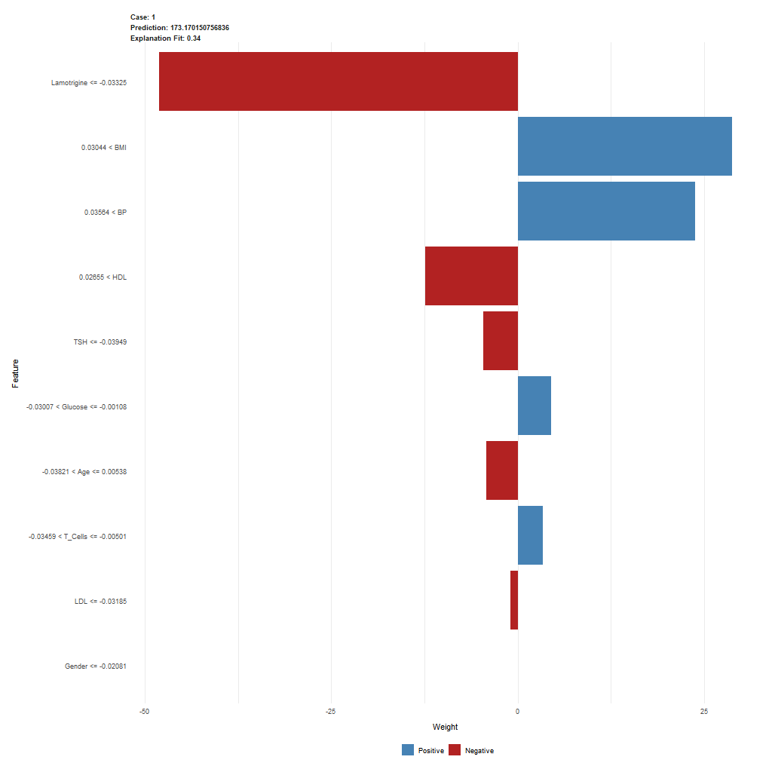
LIME: Single Observation Plot
The case number does not match up with the original observation numbers.
The prediction is the prediction of the actual model.
The Explanation Fit is the R² of the various perturbations.
The x-axis shows the weight/importance of the feature in the prediction.
Y-axis labels are shown in decreasing order of magnitude (of the absolute values) of the feature’s weight.
The y-axis label also shows the value(s) that LIME found to give the maximum weight to the feature.
Lime does not currently support feature interactions.
Notes:
These are not like SHAP values (as in the waterfall plot) – they don’t add up and give you the actual prediction. Rather, this says “If the Lamotrigine value is wrong, there will be a large negative impact on the prediction of your model’s prediction for this observation AND if the T_Cells value is wrong there will be a small positive impact on your model’s prediction for this observation

Slide 24
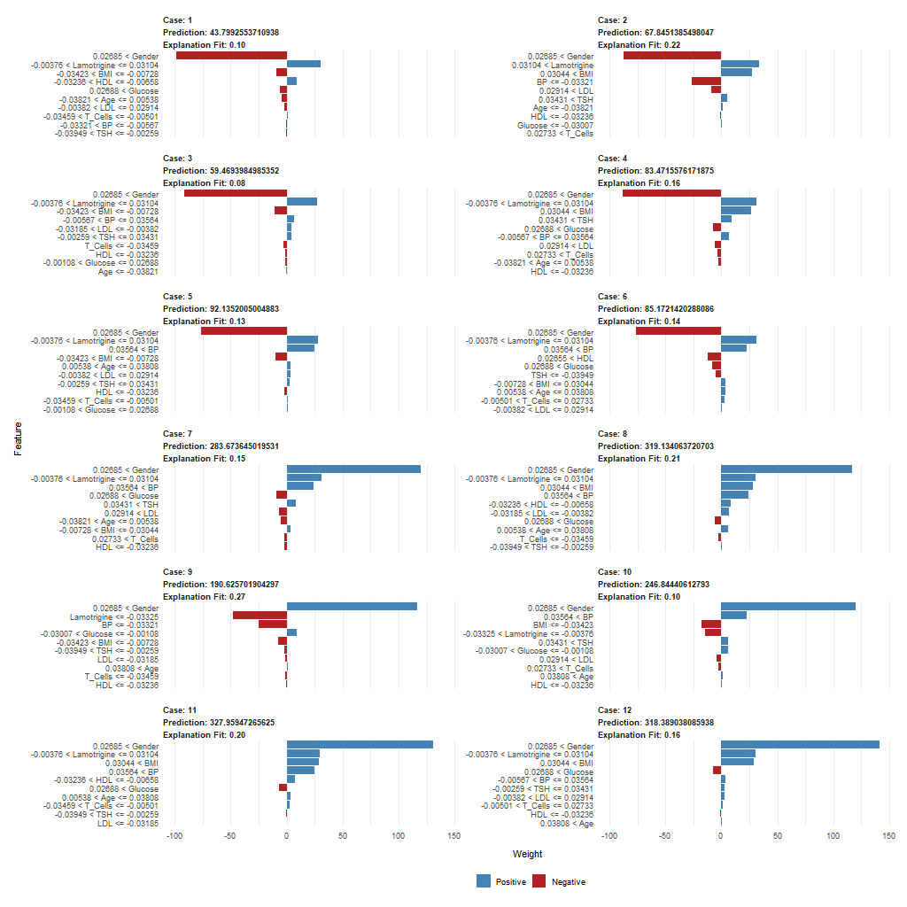
LIME: Twelve Observations - Separate Plots
Each individual plot is the same as the single observation plot just shown.
The features change their vertical position on the y-axis. (The relative weights of the features vary from one observation to the next.)
The values of a feature that cause its reported weight can be different from one observation to the next.
Notes:
This is similar to what we saw with SHAP values: they can vary widely in value from one observation to the next.

Slide 25
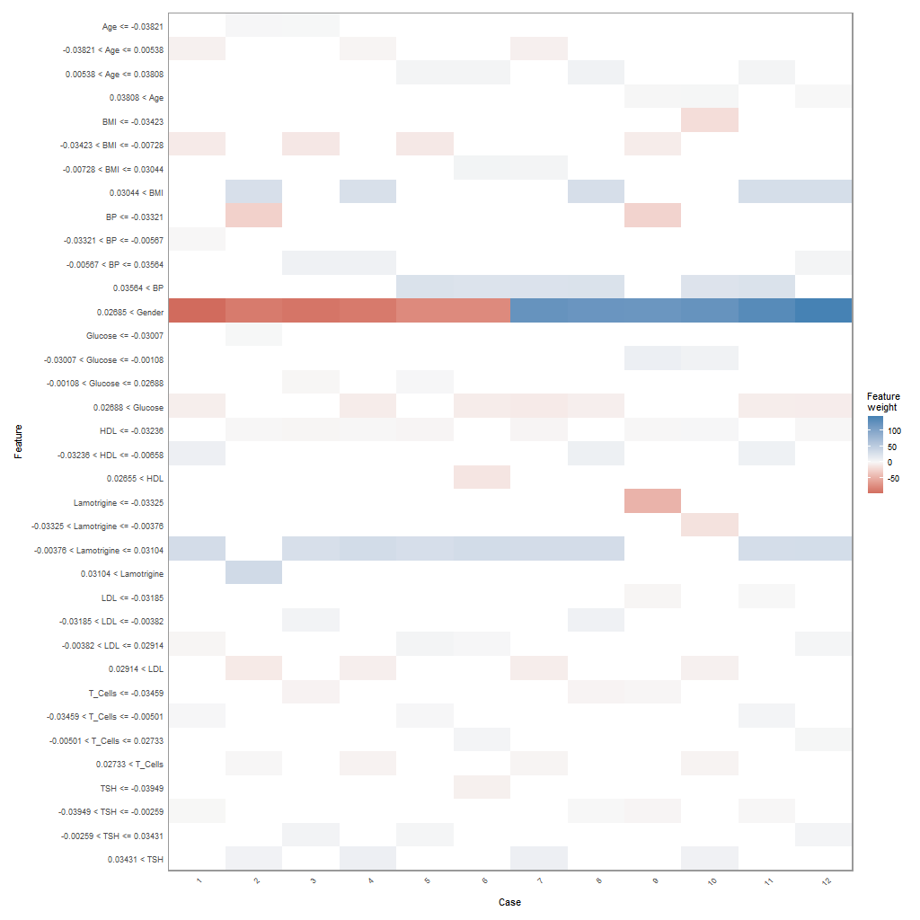
LIME: Twelve Observations - Combined Heatmap Plot
This is for the same twelve features as the previous plot and the case numbers can be used to match them up.
The y-axis labels are sorted top to bottom in alphabetical order by the feature name.
Whereas there are only 10 features, this plot has 36 rows, because each observation can have a different “greatest change” value range for each feature.
Note that Gender only gets a single row.
The color scale for the heatmap is at the middle right.

Slide 26
Permutation Feature Importance
For one feature at a time, randomly permute the values in the feature’s column then run the existing model on the new data and compute the change in accuracy.
Do step 1 multiple times for each feature.
If you’re going to be fair, as SHAP is, you have to do steps one and two for all possible permutations of feature orders and average the results for each feature.
This has the same problems with collinearity that SHAP does.¹
Invented before either SHAP or LIME and not necessarily replaced by them.
Notes:
¹Don’t forget XGBoost’s supposed immunity to collinearity. It applies here as well.
For each feature, LIME changes all values x1 to x1’ for x1…xN. Permutation Feature Importance just randomly rearranges the values in a column.

Slide 27
A Rapidly Expanding Field
ceterisParibus¹ - present model responses around selected points in a feature space.
DALEX: moDel Agnostic Language for Exploration and eXplanation
RISE: It’s saliency maps show the original picture with a heatmap superimposed to show how much each pixel contributed to the classification.
Captum: From Facebook, it explains decisions made by PyTorch neural networks
IBM’s AI Explainability 360 toolkit
Microsoft’s InterpretML
Automated Concept-based Explanation (ACE): from Google and Stanford
Notes:
1Ceteris paribus from the Latin "holding other things constant" or, more colloquially, "all else being equal."

Slide 28
Random Suggestions
Perfectly linear relationships are rare in the real world.¹
You can use the ideas and plots presented here to try to show the “error of their ways” to die-hard regression coefficient fans.
If you are going to use any modern Data Science methods, you MUST learn about test sets, cross validation, and other Data Science basics.²
XGBoost:
You can almost always get significantly better results with less work using XGBoost instead of regression or even Random Forests.
Tons of examples for R and Python on the web.
You can have it working on your own data in 30 minutes or less. BUT then you have to tune it.
Comes with a large variety of built-in distributions (Poisson, gamma, Tweedie, …), and evaluation metrics (AUC, R²…) and it is easy to write code to provide your own evaluation metric, and Jacobian and Hessian matrices.
The XGBoost watch set is a powerful extension to cross validation and well worth learning.
SHAP values are a good way to see non-linearities in the relationships between your data and the dependent variable.
If SHAP values or other methods show sufficient linearity you can always switch to regression.
SHAP and LIME can help but they have their own weaknesses.
Notes:
¹And testing for and handling non-linearity is a very labor intensive process.
2Look up these terms as well as over-fitting, under-fitting, bias, and variance.

Slide 30
Appendix
R packages used: caret, data.table, EIX, graphics, lime, Matrix, plotly, SHAPforxgboost, xgboost
The diabetes data is a publicly available open source dataset available at:
https://www4.stat.ncsu.edu/~boos/var.select/diabetes.tab.txt
Also available from Google, scikit-learn, Stanford, and other sites.
All figures were generated by code written by the POC or are public domain.
The code is not available.

