Slide 1
UNCLASSIFIED
06 NOV 2020
Easily Automating R Scripts on Windows
James R. Cutler, NETCOM Data Science Directorate
For Public Release

Slide 2
Overview
Calling Your Script from the Command Line
Sample Invocations
Setting an Environment Variable for Easier Invocations
Using Environment Variables
Invoking Non-functions and Seeing Errors
You Can Pipe the Output
The Magic on the R side: the Setup() function
You Write Your R Functions the Same as Always
Task Scheduler
sample01.bat
Questions

Slide 3
Calling Your Script from the Command Line
"C:\Program Files\R\R-3.5.2\bin\x64\Rscript.exe" "C:\Army\SourceCode\R\RscriptCallFromCommandLine\sample01.r" --RscriptRun="Goodbye('Earth')"
---------------------------------------------------------------------------
This is installed when you install R. You have to find it on your hard drive.
This is the full path to your script file.
--RscriptRun is the flag that specifies what function to run in the script and what parameters to pass it. You specify the value just as you would on the R console except you surround it with double-quotes.
Goodbye() is the function.
'Earth' is the argument passed to it.
Recommendation: use single quotes within the double-quotes

Slide 4
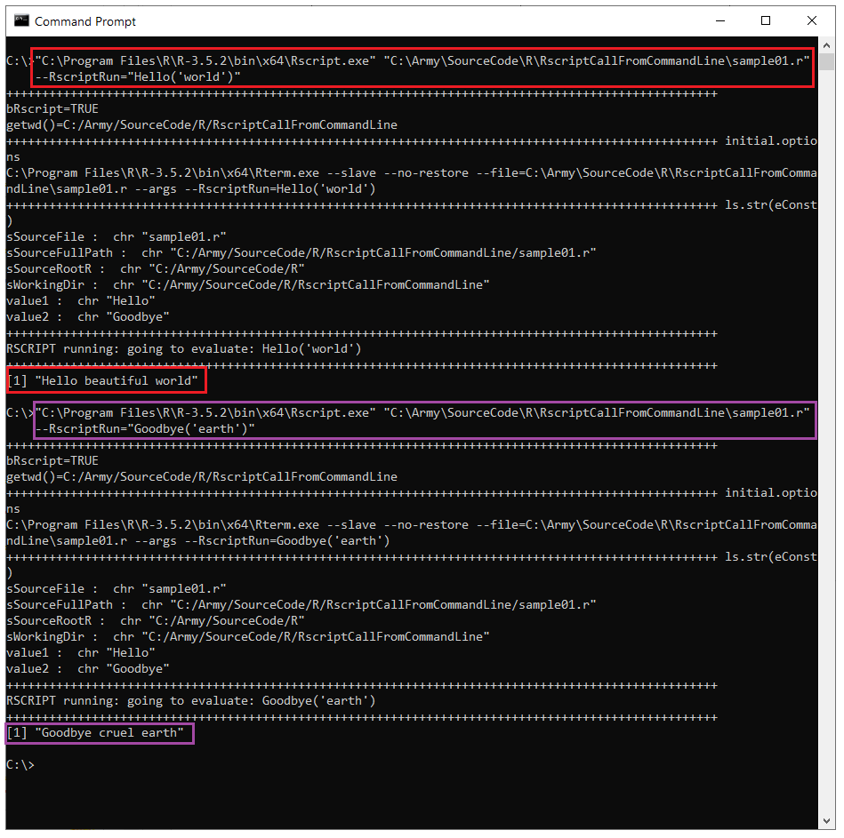
Sample Invocations
--RscriptRun="Hello('world')" results in [1] "Hello beautiful world"
--RscriptRun="Goodbye('earth')" results in [1] "Goodbye cruel earth"
Nothing else changed in the two invocations

Slide 5
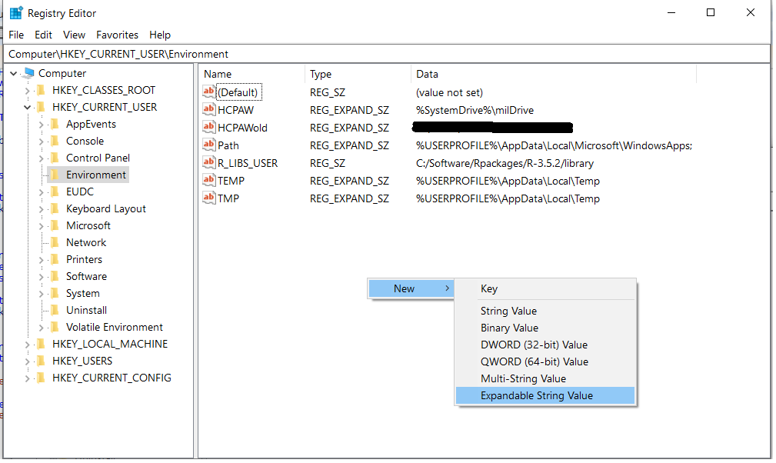
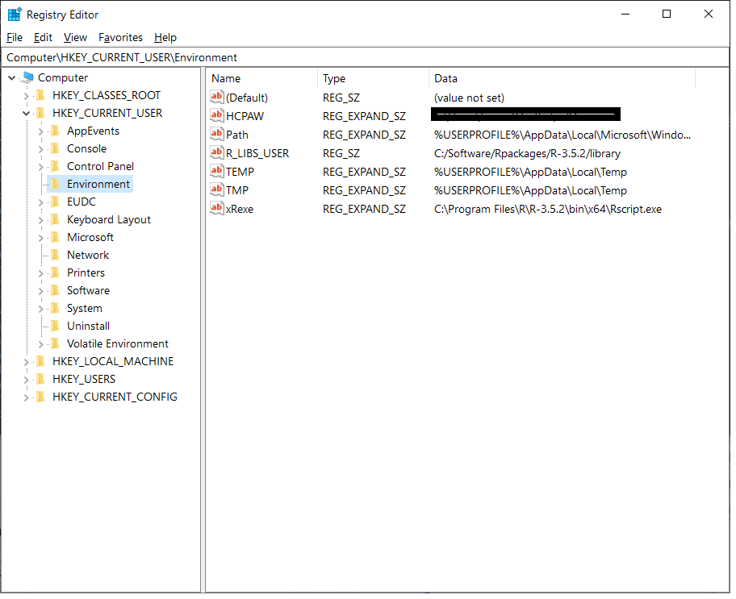
Setting an Environment Variable for Easier Invocations
Open regedit.exe (Registry Editor)
Navigate to HKEY_CURRENT_USER\Environment
Right-click and select Expandable String Value
This allows you to use other environment variables in your value
As you can see in the TEMP variable.
Name the variable whatever you wish.
I prefer to put x at the front of the name of all my variables to prevent conflict with system variables.
I named the variable xRexe.
Variable names are NOT case sensitive.
You will have to reboot to activate the value

Slide 6
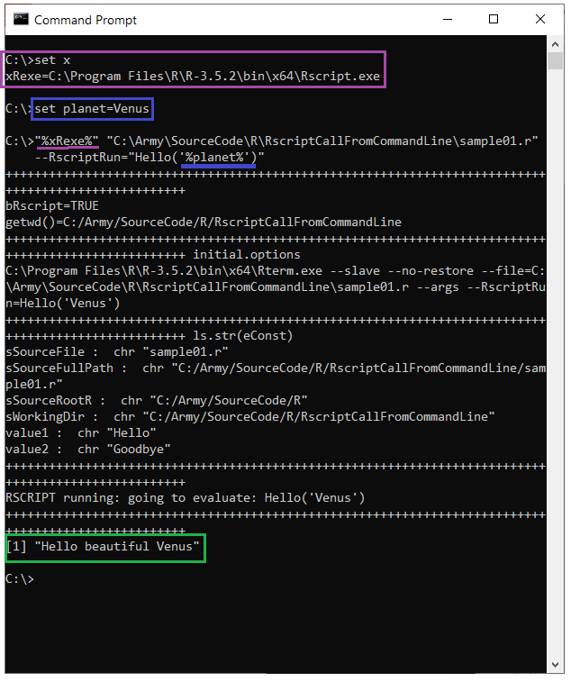
Using Environment Variables
set x shows us that our registry value is in effect
We set the planet variable to simplify the command further
Out comes the text showing our function was called

Slide 7
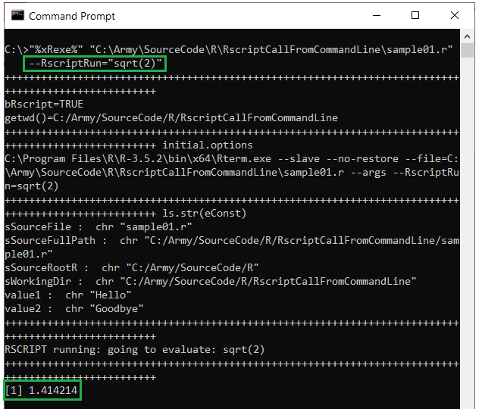
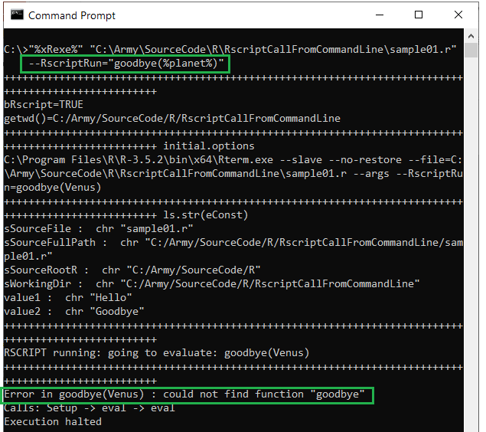
Invoking Non-functions and Seeing Errors
You can invoke anything you would on the console – not just your own functions.
If you mis-spell something you will get an error (notice goodbye is not capitalized).

Slide 8
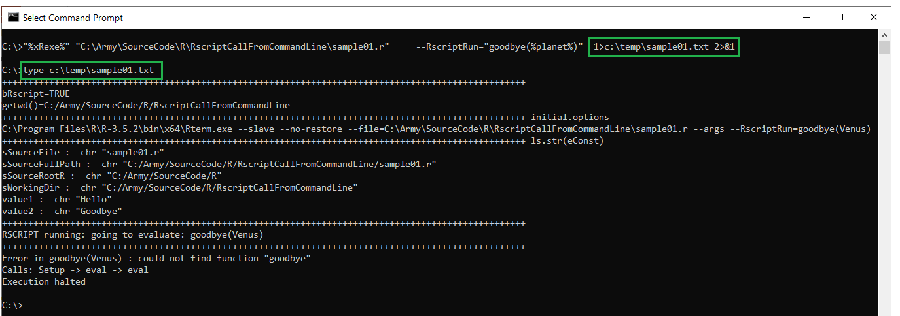
You Can Pipe the Output
1>file-path – specify the path where normal output goes
2>&1 – put the error output in the same file as the normal output
2>another-file-path – specify the path where error output goes

Slide 9
The Magic on the R side: the Setup() function
The Setup() function performs the magic.
You can copy it into your own script unchanged and have the ability to call any of your functions from the command prompt.
ALL your code should always live inside a function.
Just good coding practice.
Any code outside a function will be executed when RScript.exe “sources” your script.
Code outside a function can make breakpoints behave strangely
If you don’t normally use functions:
Just add the line MyFunction <- function() { above the first line of your code and add the line } after the last line of your code.
Then use --RscriptRun="MyFunction()" to call your code from the command line.
Which brings us to the other change to your script:
At the bottom of your script, outside any function, add the line Setup()
sample01.r is a template: replace Hello() and Goodbye() with your code.

Slide 10
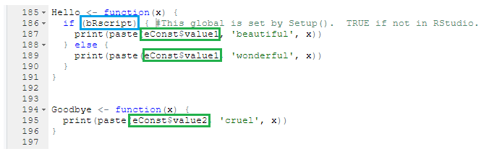
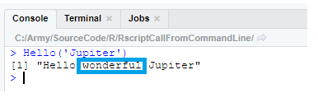
You Write Your R Functions the Same as Always
Here are the definitions of the Hello() and Goodbye() functions we’ve been using.
They are no different from any other R function.
Note that each time we ran Hello() from the command line, the adjective was “beautiful” but on the R console it is “wonderful”.
I use the magic function to set up everything needed by the other functions whether they’re running in RStudio or from the command prompt.
Again, ALL your code should live inside a function.
bRscript is a global R variable your code can use to determine whether it is running as a script.
eConst is a global R environment created by the magic function.
You can put whatever you wish in it
You do NOT need to use these.

Slide 11
Task Scheduler
On a government computer you almost certainly do not have access to the Windows Task Scheduler app. If you can get access use the following as the command:
cmd.exe /S /C "..." where … is the command you typed on the command prompt EXACTLY as you typed it on the command prompt. In other words, you don’t double up double quotes or make any other changes.
If your command prompt version is:
"%xRexe%" "%MyScriptPath%" --RscriptRun="%MyCall%"
Then your Task Scheduler app command is:
cmd.exe /S /C ""%xRexe%" "%MyScriptPath%" --RscriptRun="%MyCall%""
Note the double double-quotes before %xRexe% and after %MyCall%
NOTE: If you set up your scheduled task to run under the system account, then any environment variables you use must be defined for all users and network shares and SUBST drives will not be available.

Slide 12
sample01.bat
In the supplied code, this is named sample01.txt because government computers can be persnickety about files with the .BAT extension.
You generally cannot run batch files on government computers but, if you can, this is a nice wrapper.
Features
Allows you to run multiple instances of your script simultaneously and concurrently modify it in RStudio
Automatically creates a unique log file with a descriptive name for each run and does the piping for you
At home, I have a customized copy for each script and pass the function and arguments as parameters rather than hard coding them in the script.
It is dumbed down to work on government machines. If you cannot run batch files, copy the entire contents to the clipboard and paste into a command prompt.

