Slide 1

Unlocking AI: An Introduction to Artificial Intelligence & Prompt Engineering
“A brief overview of the concepts shaping our future”

Slide 2
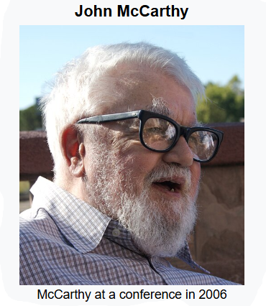
What is Artificial Intelligence (AI)?
John McCarthy (1927–2011) was an American computer scientist and cognitive scientist
He coined the term "Artificial Intelligence" in 1956 during the Dartmouth Conference
which is considered the founding event of AI as a field of study
AI is the science of making computers mimic human intelligence.
It’s about creating systems that can learn, reason, perceive, and act.

Slide 3
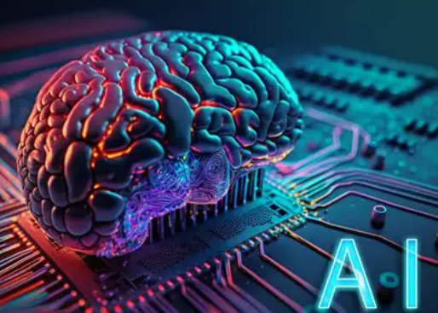
Types of AI
Machine Learning (ML): The most common type. Systems learn directly from data and patterns (e.g., your email spam filter).
Deep Learning (DL): A subfield of ML that uses complex "neural networks" to solve advanced problems (e.g., self-driving cars).
Natural Language Processing (NLP): The ability for AI to understand and process human language (e.g., Siri, Alexa, Google Translate).

Slide 4
Introduction to Prompt Engineering
A prompt is the instruction you give to an AI, especially a Generative AI like ChatGPT.
It is the art and science of crafting effective prompts to get the desired output from an AI is called as Prompt Engineering.
Think of it as learning how to ask the right questions to get the best answers.
Example: Lets understand minute difference between the prompts about “Dog”
Weak Prompt: "Tell me about dogs." (Too broad)
Strong Prompt: "Act as a veterinarian. Write a 3-bullet-point summary of the main exercise needs for a healthy 5-year-old Golden Retriever."

Slide 5
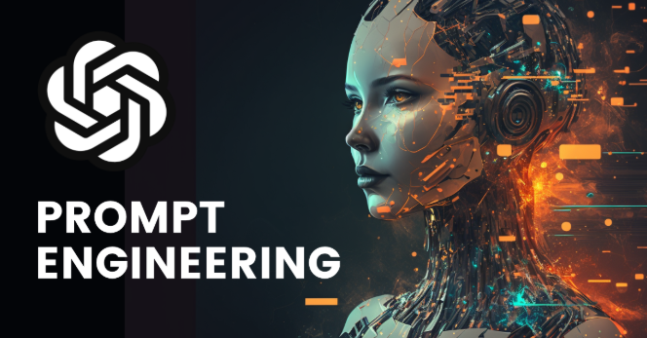
Importance of AI
Efficiency & Automation: AI handles repetitive, time-consuming tasks (like data entry or customer service FAQs) so humans can focus on complex, creative problems.
Speed & Accuracy: AI can process and analyze massive datasets far faster and often with fewer errors than humans.
Personalization: It powers the recommendation engines we use every day (e.g., Netflix, Spotify, Amazon).
Problem-Solving: AI is used to tackle huge challenges, from discovering new medicines to modeling climate change.

Slide 6
Importance of Prompt Engineering
Unlocks AI's Potential: A powerful AI is useless if you can't get what you want from it. Good prompting is the key.
Improves Accuracy & Relevance: Specific prompts reduce the chance of the AI "hallucinating“
(making up facts) or giving generic, unhelpful answers.
Saves Time & Money: Getting the right output on the first try (instead of 10) makes using AI far more efficient.
Reduces Bias: By carefully framing a prompt, you can guide the AI to provide a more balanced
and less biased response.

Slide 7
Key Concepts & Techniques
.
AI Concepts:
Training Data: AI learns from data. The quality and quantity of this data are crucial
Neural Network: The brain-inspired structure used in Deep Learning to find patterns.
Prompt Engineering Techniques:
Be Specific & Clear: Provide details. (e.g., "Write a 100-word product description" vs. "Write a description").
Give Context: Provide necessary background information. (e.g., "Our target audience is new homeowners...").
Provide Examples (Few-shot): Give the AI a sample of the output format you want.
Assign a Role: Tell the AI who to be. (e.g., "Act as an expert copywriter...").
.

Slide 8
Applications Across Industries
Finance: Used for fraud detection, algorithmic trading, and personalized financial advice.
Content Creation: Prompt engineering is used daily by marketers, writers, and designers to draftarticles, create images, and write code.
Customer Service: AI-powered chatbots (guided by prompts) handle customer queries 24/7.
Education: Personalized learning paths and AI tutors that adapt to a student's pace.
Healthcare: AI helps in diagnosing diseases from scans (like X-rays) and personalizing treatment plans.

Slide 9
Future Scope
The Future of AI:
AI will become more integrated into our daily lives, like electricity or the internet.
Advancements will lead to more capable systems, though "human-level" AI is still a long-term, complex goal.
The Future of Prompt Engineering:
This is a booming and essential skill.
As AI becomes more common, the people who know how to communicate with it effectively (prompt engineers) will be in high demand across all industries.
Conclusion: Learning the basics of AI and prompt engineering is no longer just for techies; it's becoming a fundamental skill for everyone

