Slide 1

Open Science in Practice: Collaborative Research with Git
K8F6106
HT2026
Niklas Edvall, PhD
niklas.edvall@ki.se
Andreas Gerhardsson, PhD
andreas.Gerhardsson@ki.se

Slide 2
Mini-project and data overview
Niklas Edvall

Slide 3
Requirements for passing course
Write a pipeline to analyze a dataset
Minimum analysis is one figure + one ”result”
Data goes in → Result report comes out
In a public repo on GitHub
Plausible commit history
One branch + merge
Well organized – no monoliths
Well documented (README) and commented

Slide 4
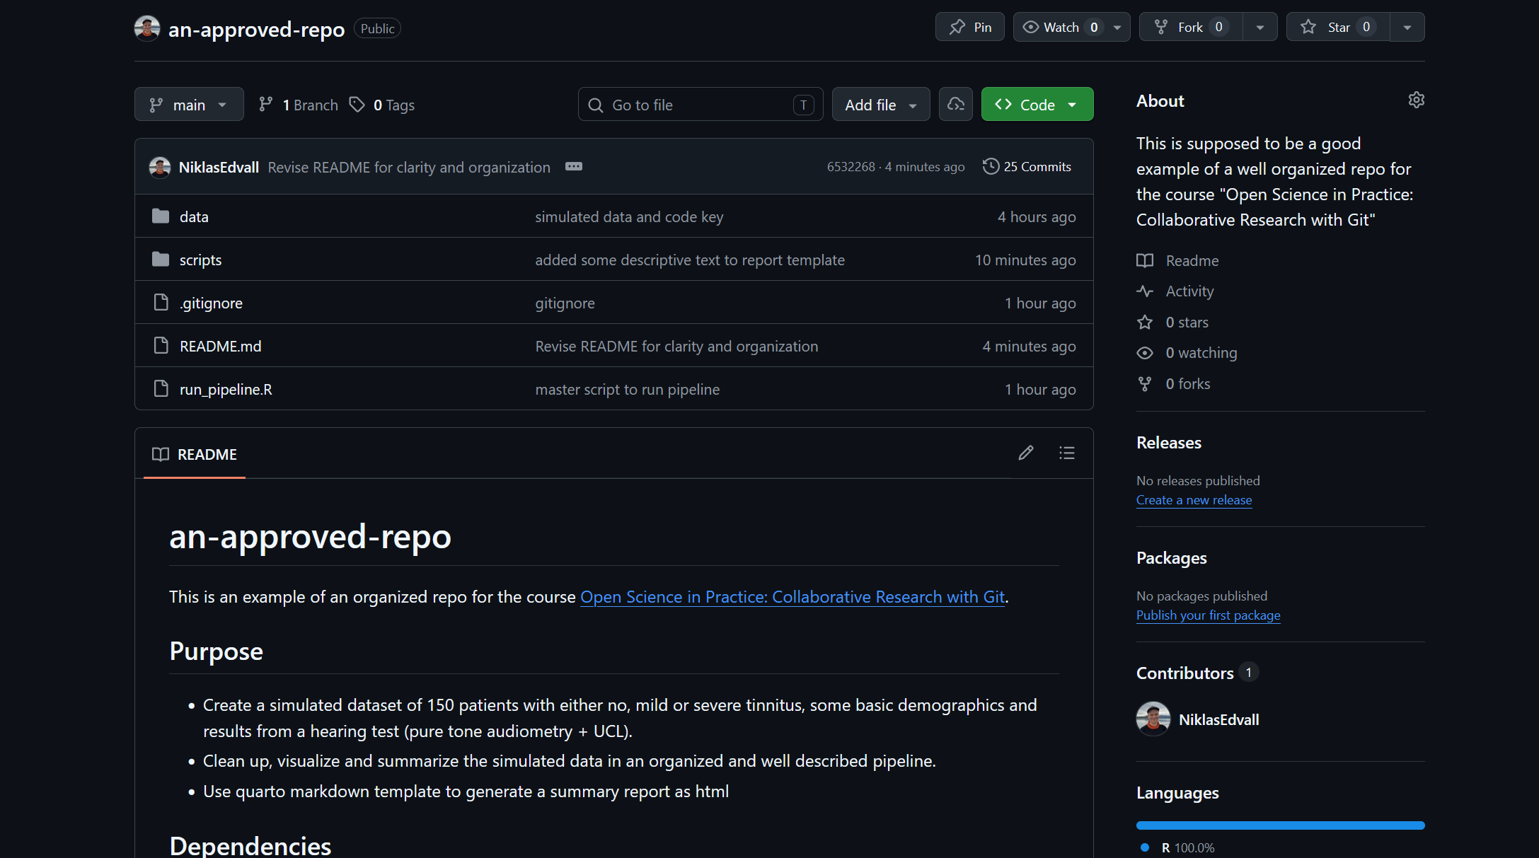
https://github.com/NiklasEdvall/an-approved-repo

Slide 5
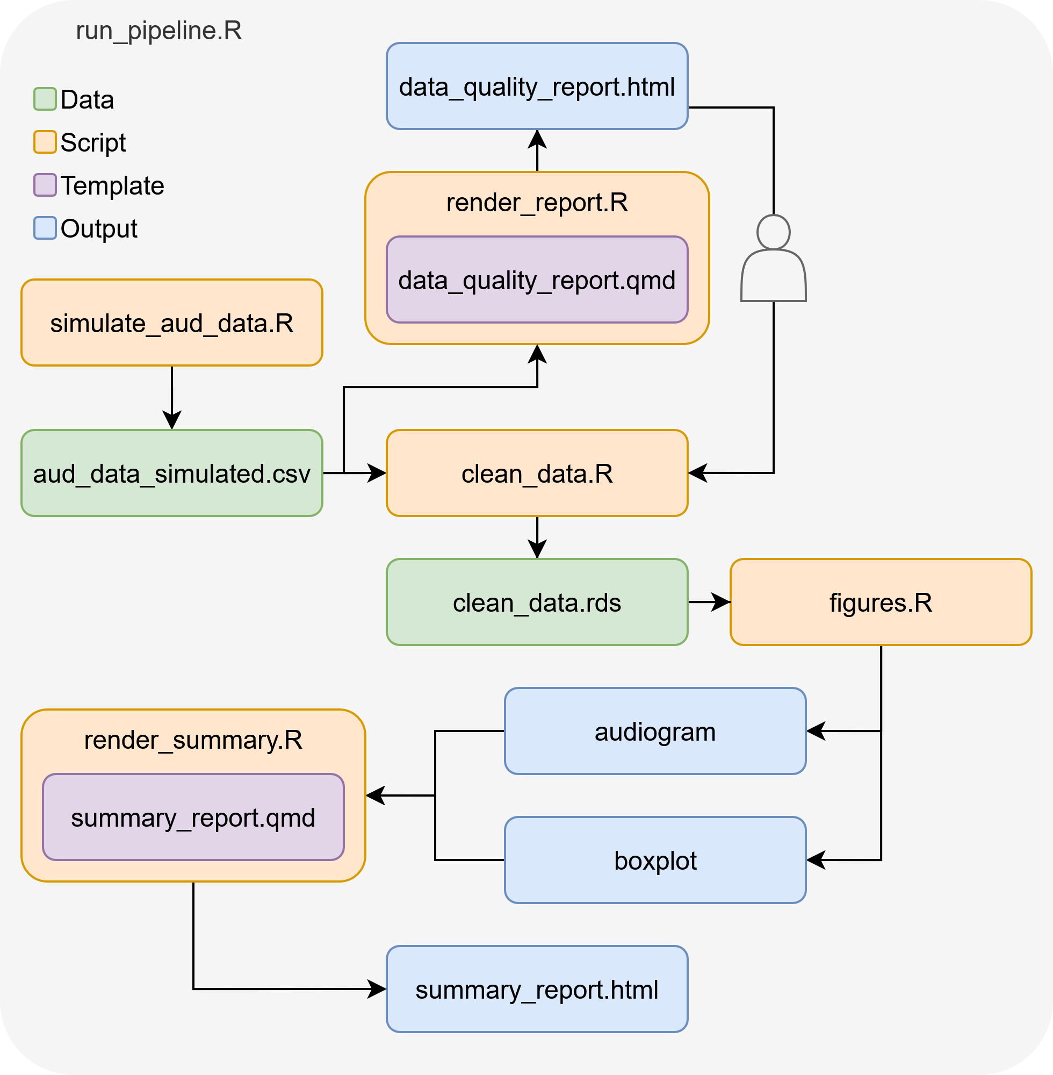


Slide 6
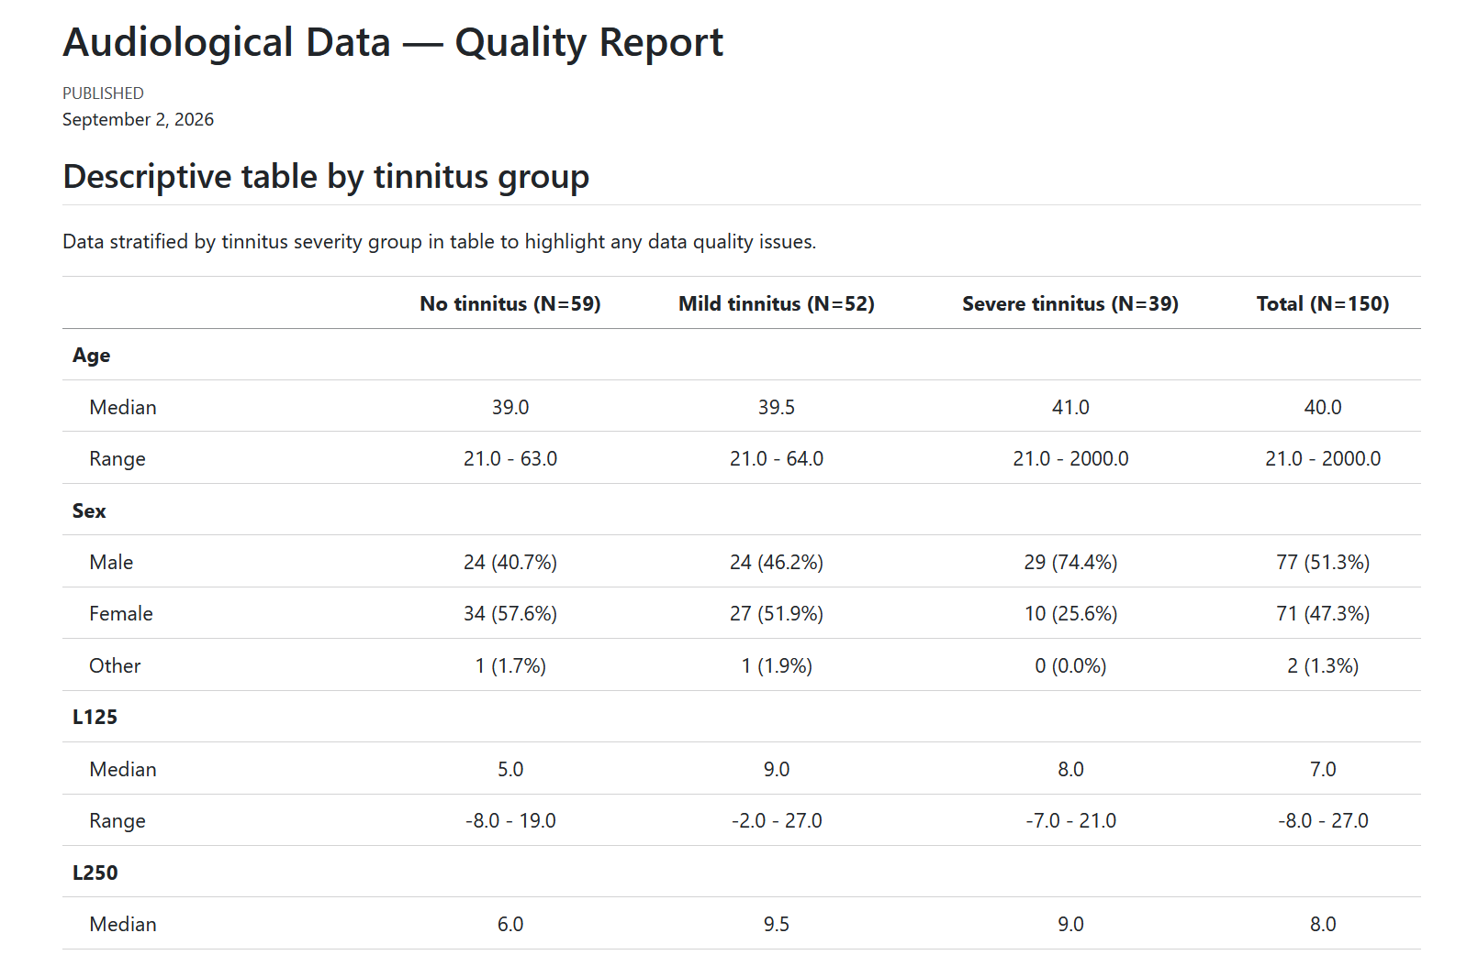

Slide 8
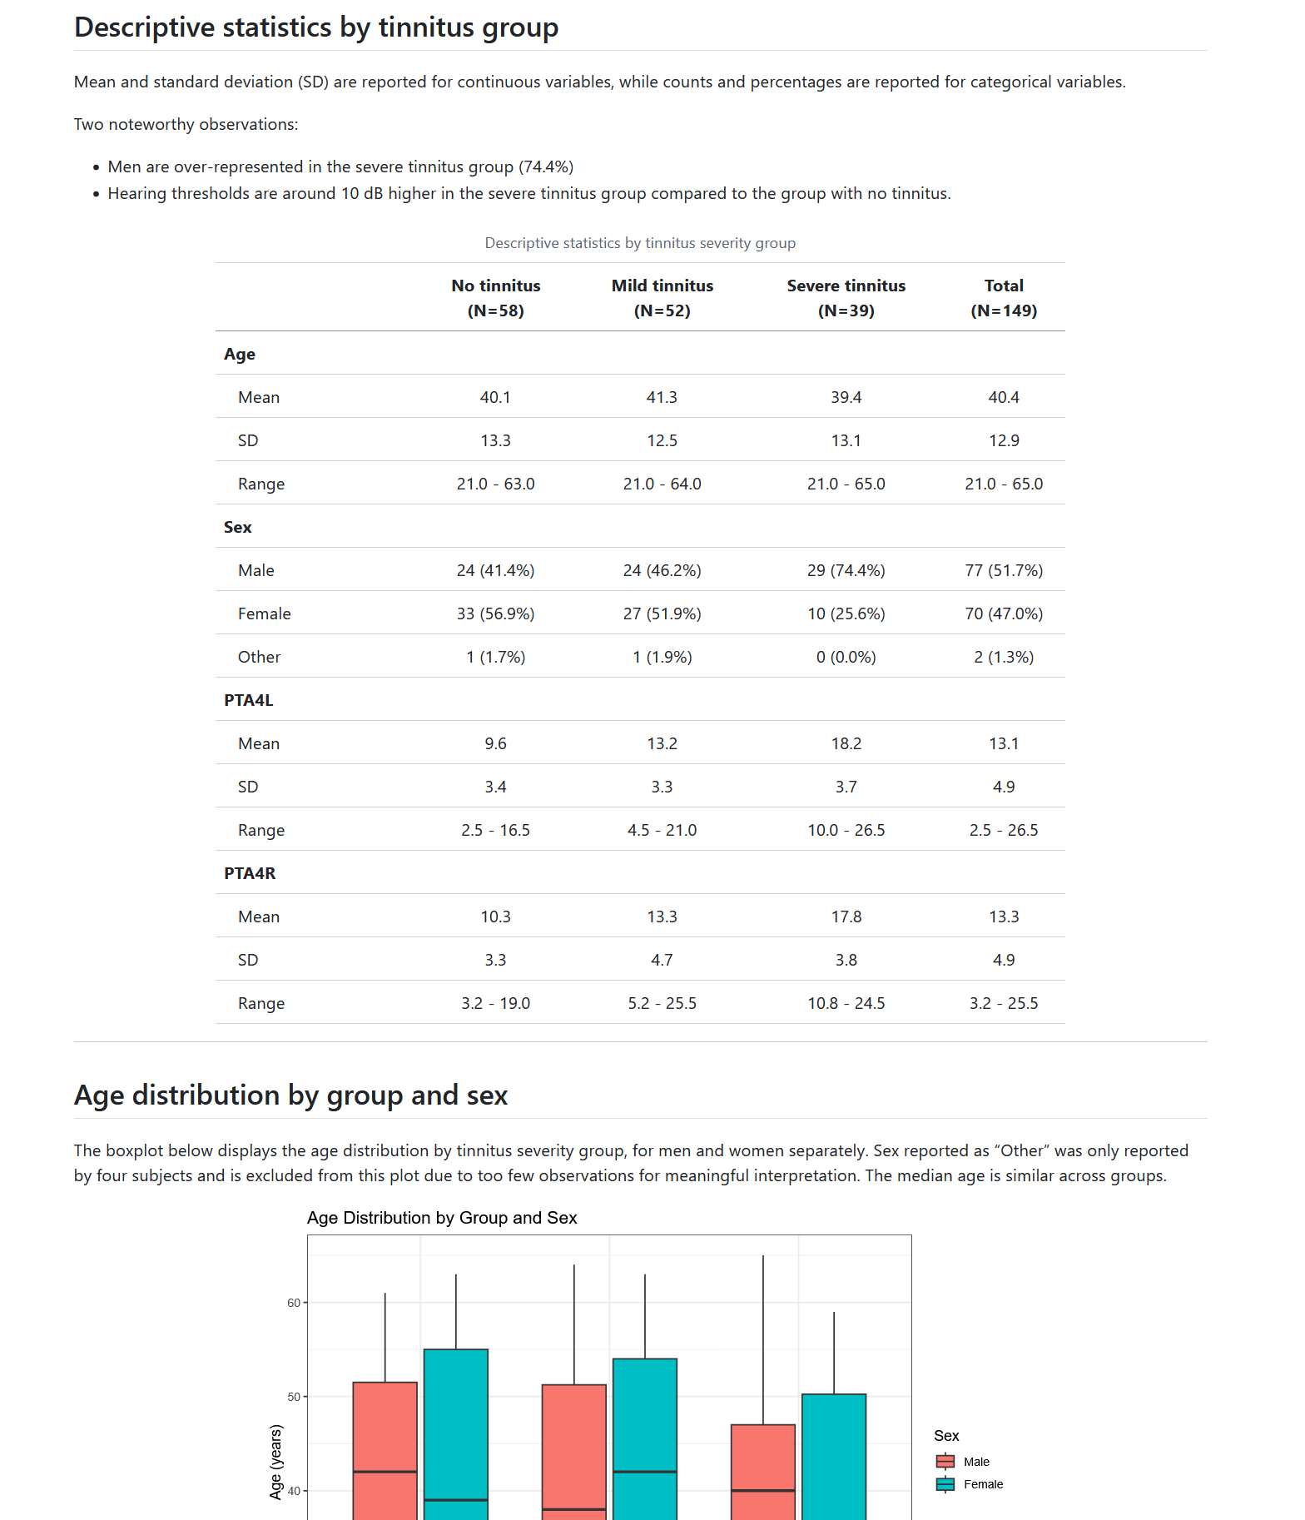
SUMMARY REPORT

Slide 9




Simulating data
Design experiment
Collect data
Wait what?
Actually collect data
Add experiment or group
Now! THIS is data!
Poster presentation in Berlin
Analyze data
SUBMIT PAPER
Write manuscript
Re-analyze
data

Slide 10

Simulating data
Design experiment
Collect data
Wait what?
Simulate data
Actually collect data
Add experiment or group
Now! This is data!
Poster presentation in Berlin
Write analysis pipeline
SUBMIT PAPER
Write manuscript
Re-analyze
data

Slide 11
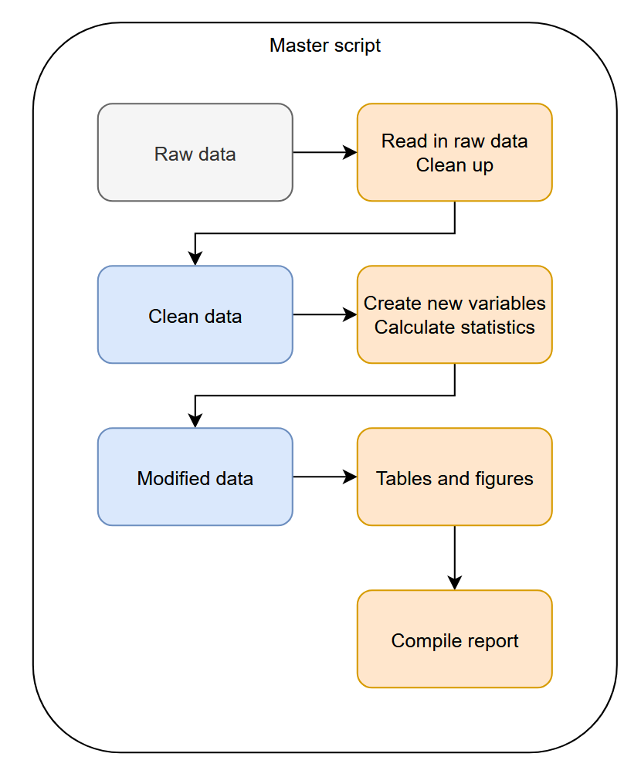
Dataset 1
Survey of staff and students energy-levels and general well-being.
Items
Sex, age, position, screen time, sleep,
WHO-5: The World Health Organization-Five Well-Being Index
PHQ-4: Patient Health Questionnaire for Depression and Anxiety
To-dos:
Clean up data
Calculate questionnaire scores
Look for something to report
For example:
Are teachers or students happier?
Do men or women sleep better?
Is there a relationship between sleep and well-being?

Slide 12
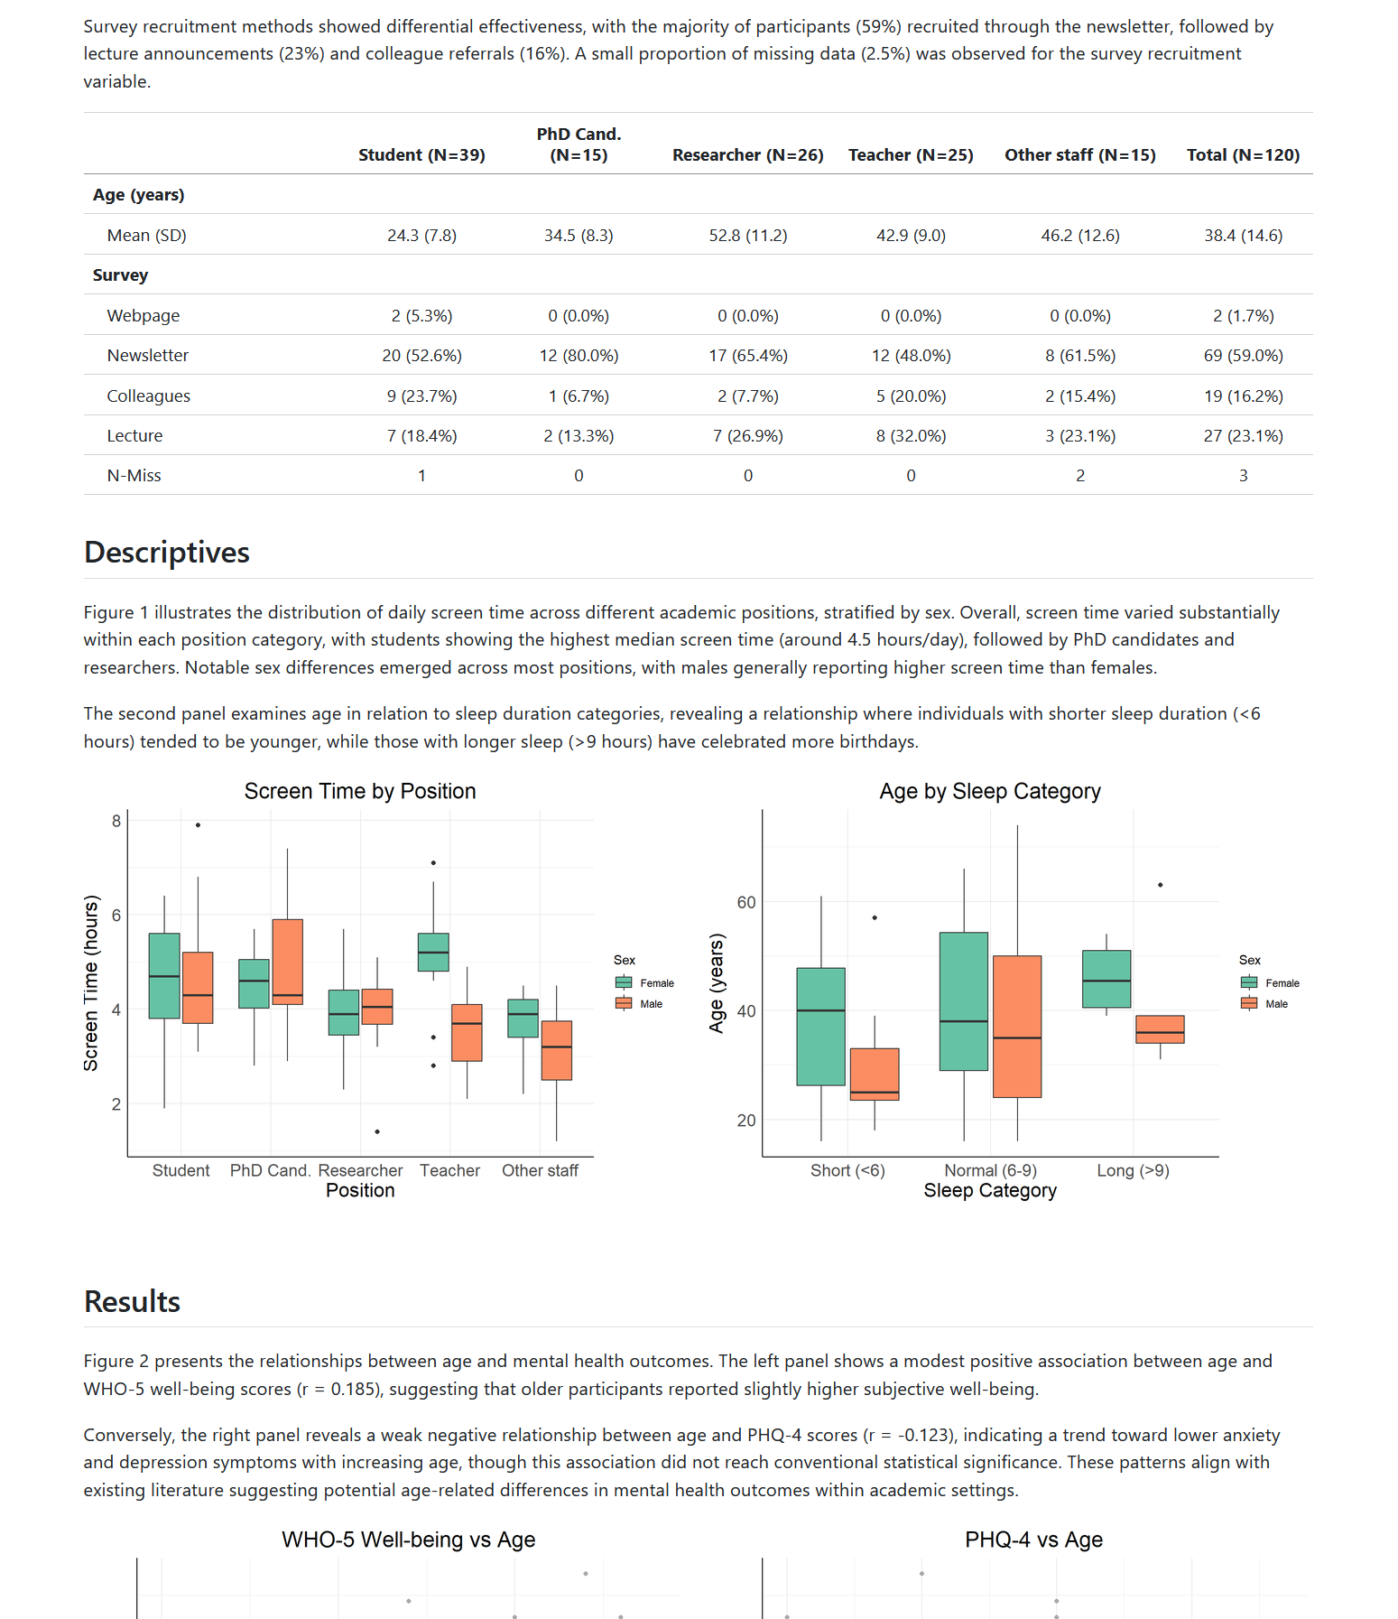
SUMMARY REPORT

Slide 13
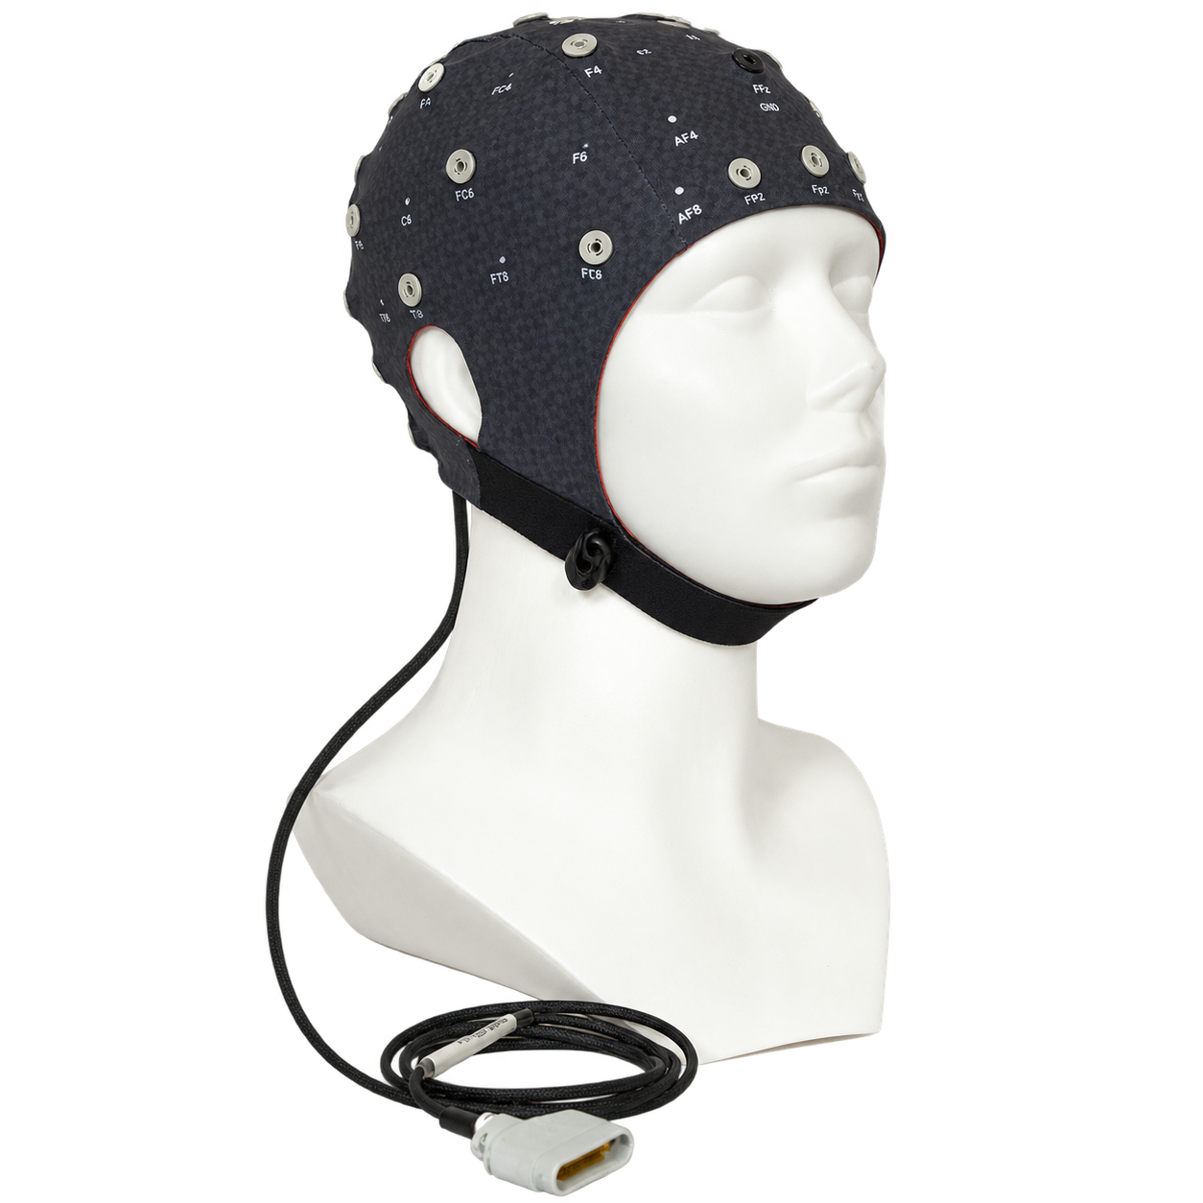
Dataset 2
EEG during n-back task pre and post training.
Items:
dataset-2-key.xlsx
group_data.csv – ID, sex, age, training days completed
sub-01_ses-01_task-nback_behav.csv
sub-01_ses-01_task-nback_eeg.csv
n-back = 1
4
5
1
6
6
8

Slide 14
Dataset 2
EEG during n-back task pre and post training.
Items:
dataset-2-key.xlsx
group_data.csv – ID, sex, age, training days completed
sub-01_ses-01_task-nback_behav.csv
sub-01_ses-01_task-nback_eeg.csv
n-back = 2
8
9
1
3
4
3
5
1

Slide 15
Dataset 2
EEG during n-back task pre and post training.
Items:
dataset-2-key.xlsx
group_data.csv – ID, sex, age, training days completed
sub-01_ses-01_task-nback_behav.csv
sub-01_ses-01_task-nback_eeg.csv
To-dos:
Aggregate subject+session data
Are all trials valid?
Calculate amplitude response from ERP
Relationship between EEG and training?
Relationship between EEG and performance?

Slide 16
Dataset 3
Heart attack events in Sweden 2023-2025
Sex, birthdate, height, weight, bloodpressure, physical activity, smoking, alcohol, incident date, time to treat, incident outcome, death date

Slide 17
Dataset 3
Heart attack events in Sweden 2023-2025
Sex, birthdate, height, weight, bloodpressure, physical activity, smoking, alcohol, incident date, time to treat, incident outcome, death date

Slide 18
Dataset 4
Items:
simulated-dataset-4-sweden.csv
simulated-dataset-4-spain.csv
dataset-4-sweden-key.csv
dataset-4-spain-key.csv
To-dos:
Merge datasets
Clean up
Are Swedish people morning people?
Do men sleep longer than women?
Do young people stay up longer?

Slide 19
Dataset 4

Slide 20
Open Science in Practice: Collaborative Research with Git
K8F6106
HT2026
Niklas Edvall, PhD
niklas.edvall@ki.se
Andreas Gerhardsson, PhD
andreas.Gerhardsson@ki.se

