Slide 1

Target Audience for Direct Marketing in Starbucks Rewards Mobile App
Katerina Bosko, PhD
- September 2019 -

Slide 2
Contents
Problem Statement
Dataset Overview
Data Cleaning
Feature Engineering
Explorative Data Analysis
Data Pre-Processing
Modelling
Conclusions

Slide 3
Problem Statement
Goal:
Target Audience For A Marketing Campaign
Questions:
- Which Customers Love Coupons?
- Which Don’t?
- What Types of Offers Send to Whom?
Solution:
Customer Segmentation
Using PCA & K-means Clustering
Metrics:
Response Rate (RR)
Conversion Rate (CVR)

Slide 4

Dataset Overview
portfolio.json (10 offers x 6 fields) - offer types sent during 30-day test period (bogo, discounts, informational offers)
profile.json (17000 users x 5 fields) - demographic profile of app users (age, income, gender, membership duration)
transcript.json (306648 events x 4 fields) - event log on transactions, tracking of offers received, viewed, completed

Slide 5
Data Cleaning
Challenge: improper tracking of offers viewed & offers completed
Impact: correct tracking could save $70,000 per month

Slide 6
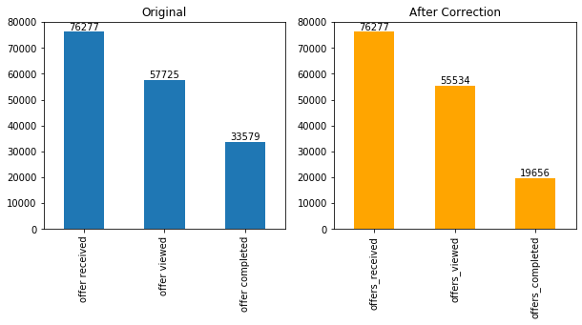
Data Cleaning Results

Slide 7
Feature Engineering
Calculated 27 new Features for Each Customer
total_amount
offers_received
offers_viewed
offers_completed
transactions_num
bogo_received
bogo_viewed
bogo_completed
avg_order_size
discount_received
discount_viewed
discount_completed
avg_reward_size
informational_received
informational_viewed
avg_bogo_size
avg_discount_size
total_rewarded
total_bogo
total_discount
offers_rr
bogo_rr
discount_rr
informational_rr
offers_cvr
bogo_cvr
discount_cvr

Slide 8

Explorative Data Analysis
Average Starbucks Rewards App Customer:
middle-aged (median - 55 years)
$64000 income
spent $104.44 in total
got $5.6 rewarded
made 8 transactions spending $13.34 per order
received 4-5 offers, viewed 3 offers, completed 1 offer
Metrics:
Response Rate (RR) - 73% of offers received
Conversion Rate (CVR) - 34% of offers viewed

Slide 9
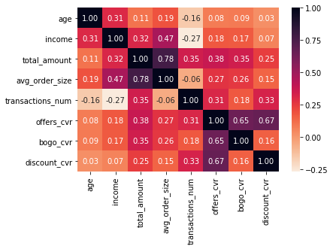
Explorative Data Analysis
Correlation Matrix:
Not demographics,
but spending habits correlate more with
Conversion Rates.

Slide 10
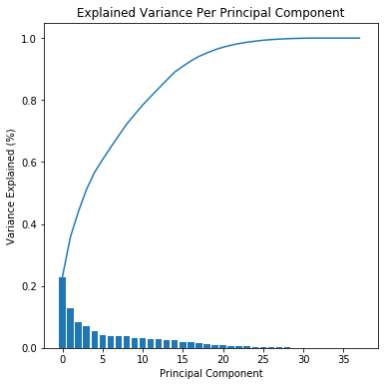
Data Pre-processing
Imputed Missing Values (12.8% of data in the profile dataset)
One Hot Encoded Categorical Features
Scaled Features with Standard Scaler
Reduced Dimensionality with PCA:
kept the first 10 components that in total captured almost 80% of the variance in the data.

Slide 11
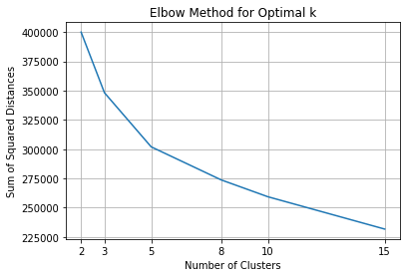
Modelling
Run K-Means Clustering on Pre-Processed Data
Decided upon Optimal Cluster Number:
Elbow Method – 3 or 5 clusters
Silhouette Score – for 3 higher than for 5
Visual Validation – 3 better than 5
Decision: 3 clusters

Slide 12
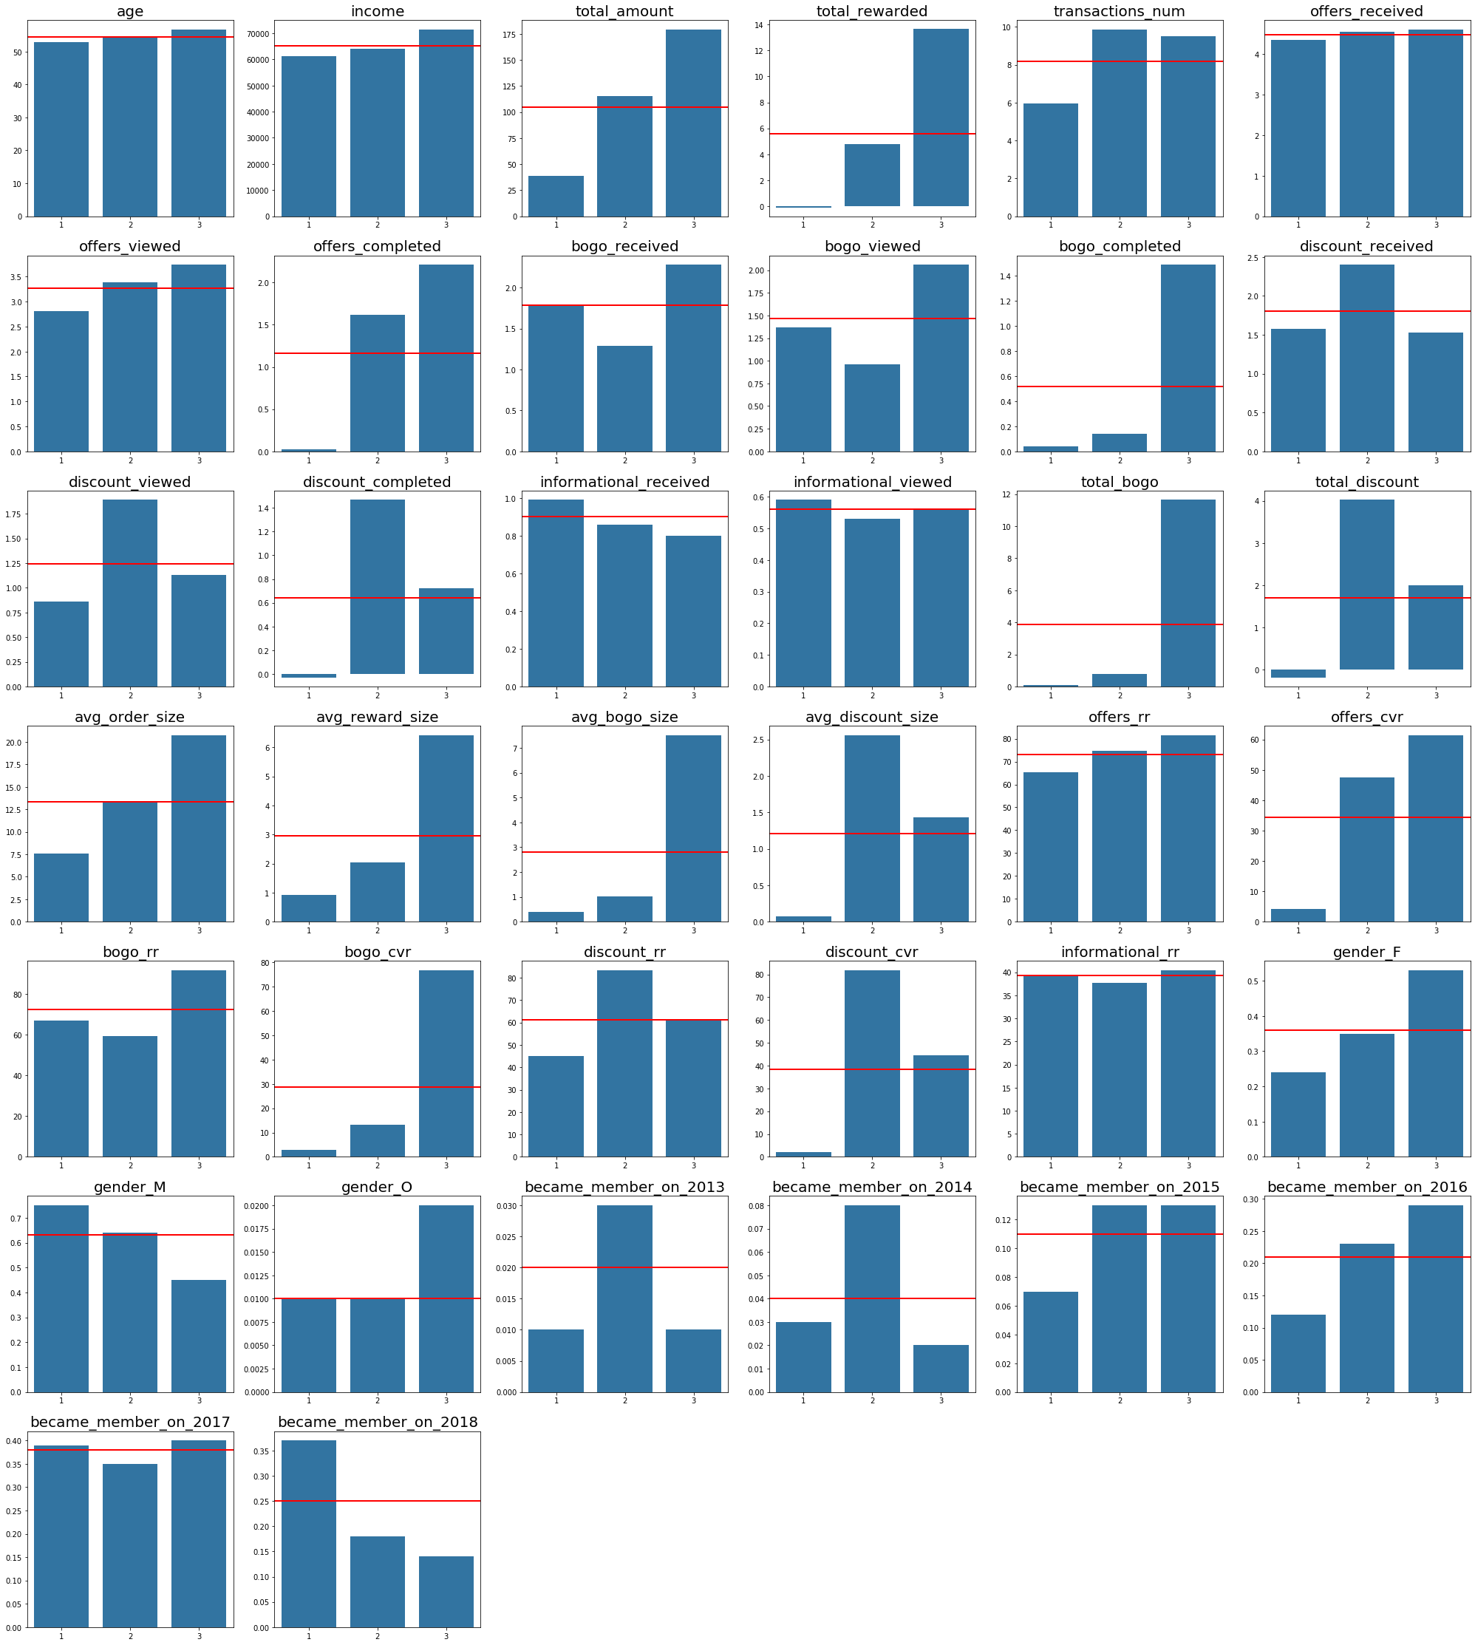
Modelling Results
Cluster 1 - “Disinterested”:
This group of customers are predominantly male that just recently became members. They tend to spend not much with below average number of transactions and small average order size. Although slightly more than 60% in this group view offers, they don’t complete them.
Cluster 2 - “Discount-Type”:
This group of customers are also mostly male but with the longest membership status (since 2013/2014). They tend to receive more discounts, which they love and actively complete. Their spending habits are slightly above average - they make small orders but buy frequently.
Cluster 3 - “Bogo-Type”:
This is the only segment where female dominate over male. The customers in this group tend to be older and have higher income. They are loyal customers for few years already. They spend a lot - make huge orders and buy frequently. With such spending habits, no wonder that they are interested in bogo and get rewarded the most. They complete bogo offers way beyond average, but also react to discounts from time to time.

Slide 13
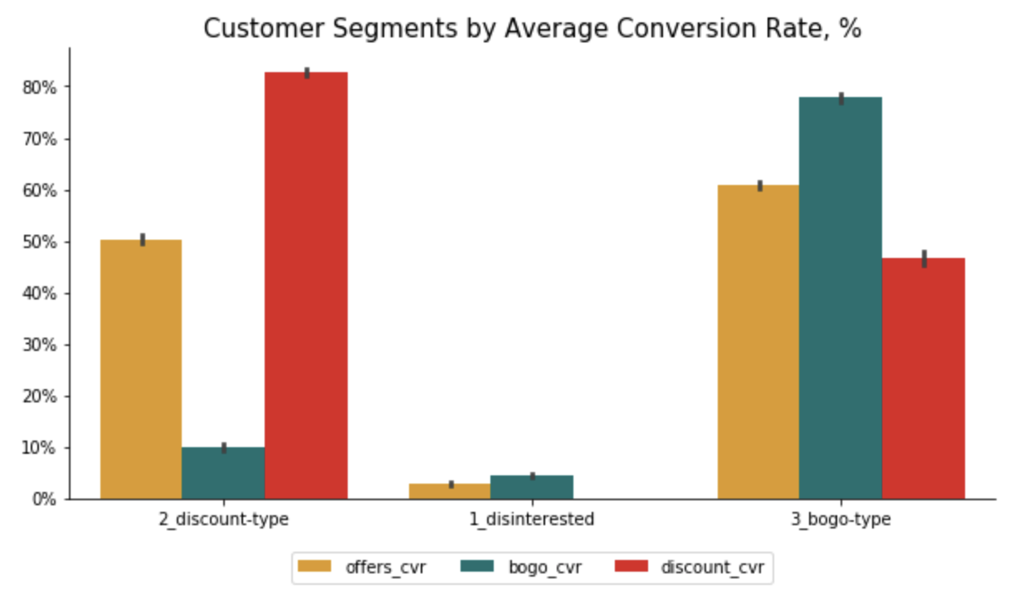
Business CASE Conclusion
3 Customer Segments:
- Disinterested (~40%)
- Discount-Type (~31%)
- Bogo-Type (~29%)
Next Step:
A/B testing
with push notifications

Slide 14

TECHNICAL Conclusion
Performed full Analysis Cycle
cleaning & preprocessing the data
dealing with missing values
feature engineering
feature scaling
one hot encoding
dimensionality reduction
clustering
Automated Reporting by refactoring & writing functions

