Slide 1
Developing OWL Ontologies with Protégé 4
Simon Jupp, Bio-health Informatics Group, University of Manchester
simon.jupp@manchester.ac.uk
Timothy Redmond,
Stanford Centre for Biomedical Research,
Stanford University
tredmond@stanford.edu

Slide 2
About this tutorial
Quick tour of OWL
Introduction to Protégé 4 interface
How to build OWL ontologies in P4
Compositional approach
Compositional lego

Slide 3
Why Pizzas?
Pizzas have been used in Manchester tutorials for years.
Pizzas were selected as a domain for several reasons:
They are fun
They are internationally known
They are highly compositional
They have a natural limit to their scope
They are fairly neutral
Although arguments still break out over representation
Even pizzas can do this - its an inevitable part of knowledge modelling
ARGUING IS NOT BAD!

Slide 4
Knowledge Representation before OWL
Long history of Ontology development (predates computer science)
Various ways to represent ontological structures
Frames – easy to understand, good infrastructure: problem - inflexible
Semantic networks – problem – NO semantics! Different conclusions from different reasoners!
Object Orientated Databases (O2) – similar to Frames
Description Logics
Syntax consists of unary predicators, binary relations and a set of constructors
e.g., LOOM, CLASSIC, DAML-OIL
Latest standard
OWL

Slide 5
OWL (Web Ontology Language)
Latest standard in ontology languages from the World Wide Web Consortium (W3C)
Logic based ontology language
OWL ontologies can be thought of as a set of logical statements
#1: People attend Intro to OWL course
#2: Simon attending Intro to OWL course
Infer: Simon is a Person
OWL corresponds to a highly expressive Description Logic
Many construct (Intersection, conjunction, union and disjunction, negation or complement, and restrictions …)
Each with a well defined formal meaning that facilitates reasoning
Notes:
OWL-Lite and OWL-DL have well understood, formal semantics, with their foundations being Description Logics. This means these species are amenable to automated reasoning.

Slide 6
What do we do with OWL?
Semantic Web
Creating a integrated Web of data
Terminology building
Can be simple is-a hierarchies
Rich and highly axiomatised for complex reasoning
OWL is used as a schema language
e.g., Database alignment, Alternative to UML
Ontology driven applications
e.g., medical form generation
Instance classification
e.g., classifying proteins on functional groups
Others???….
Notes:
Build an ontology to drive form generation and data input system
I’m going to input data about male and Blood pressure
Here is a list of other things that you may wish to capture if you are recording blood pressure

Slide 7
OWL Constructs Overview
Person
lives_in
Country
Elvis
Belgium
Holger
lives_in
Paraguay
Class (concept, category, type)
Kylie
Latvia
S.Claus
China
Hai
lives_in
Individual (instance)
has_pet
has_pet
Flipper
arrow = relationship
label = Property
has_pet
Animal
Rudolph
Notes:
Properties are binary relationship

Slide 8
More Information about OWL
W3C OWL Web Site
http://www.w3.org/2004/OWL/
CO-ODE Web Site
http://www.co-ode.org
Protege-OWL Web Site
http://protege.stanford.edu/plugins/owl

Slide 9
Overview
Protégé Introduction
Subsumption
Creating a Class Hierarchy
Consistency
Disjointness
Relationships & Properties
Restrictions
Polyhierarchies - Issues

Slide 10

…
Is a knowledge modelling environment
Is free, open source software
Is developed by Stanford / Manchester
Has a large user community (approx 30k)
Protégé 4 built solely on OWL modelling language
Supports development of plugins to allow backend / interface extensions

Slide 11
Subsumption
Superclass/subclass relationship, “is-a”
All members of a subclass can be inferred to be members of its superclasses
Thing: superclass of all OWL Classes
A
A subsumes B
A is a superclass of B
B is a subclass of A
All members of B are also members of A
B

Slide 12
Labels – so what?
Humans might be able to interpret what the labels mean and how they are defined, but the computer cannot.
Names/labels alone only have meaning to humans (and are often ambiguous)
A
B
C
D
Pizza
PizzaBase
PizzaTopping

Slide 13
Disjointness
OWL assumes that classes overlap
FruitTopping
VegetableTopping
= individual
This means an individual could be both a VegetableTopping and a FruitTopping at the same time
We want to state this is not the case
Notes:
encourage

Slide 14
Disjointness
If we state that classes are disjoint
FruitTopping
VegetableTopping
= individual
This means an individual cannot be both a FruitTopping and a VegetableTopping at the same time
We must do this explicitly in the interface
How about TomatoTopping?

Slide 15
Consistency Checking
We’ve just created two statements
Fruit and vegetable toppings are different things
Tomato is a type of both
We’d like to be able to check the logical consistency of our model
This is one of the tasks that can be done automatically by software known as a Reasoner
Being able to use a reasoner is one of the main advantages of using a logic-based formalism such as OWL (and why we are using OWL-DL)

Slide 16
Reasoners and Protégé
Protégé-OWL supports the use of reasoners: Pellet, FaCT++ and Hermit
This means that the reasoner you choose is independent of the ontology editor, so you can choose the implementation you want depending on your needs (e.g., some may be more optimised for speed/memory, others may have more features)

Slide 17
Relationships in OWL
In OWL-DL, relationships can only be formed between Individuals or between an Individual and a data value.
Relationships are formed along Properties
We can restrict how these Properties are used:
Globally – by stating things about the Property itself
Or locally – by restricting their use for a given Class

Slide 18
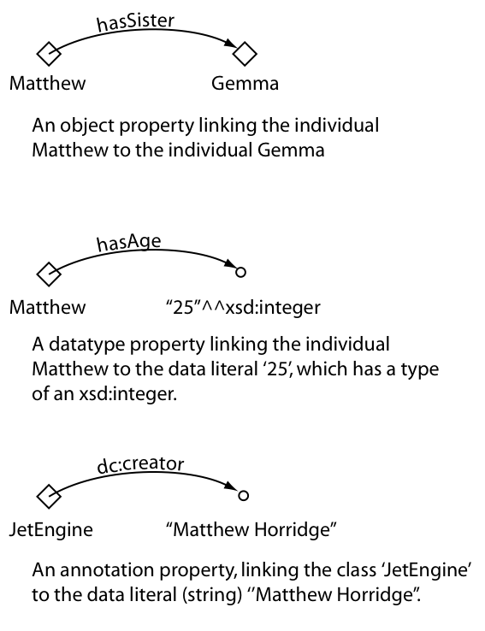
OWL Properties
Object Property
Data-type Property
Annotation Property

Slide 19
Properties
e.g., hasPart, isInhabitedBy, isNextTo, occursBefore
Object Properties are used to relate Individuals
We often say that Individuals are related along a given property
Relationships in OWL are binary:
Subject → predicate → Object
Individual a → hasProperty → Individual b
simon_jupp → givesTalk → k-cap_tutorial_2009

Slide 20
Types of Properties
hasParent
Inverse
Functional (also known as single valued properties)
Matthew
Dorothy
hasChild
Peggy
hasBirthMother
Implies that Peggy and Margaret are the same individual
Dorothy
hasBirthMother
Margaret
Notes:
hasBase is functional

Slide 21
Other Types of Properties in OWL
Inverse Functional
Transitive
Symmetric
Asymmetric
Reflexive
Irrefelxive
Notes:
hasBase is functional

Slide 22
Restricting Classes with Properties
We now have a property we want to use to describe Pizza individuals
To do this, we must go back to the Pizza class and add some further information
This comes in the form of Restrictions
We create Restrictions using the Class Description View
Conditions can be any kind of Class – you have already added Named superclasses in the Class Description Frame. Restrictions are a type of Anonymous Class

Slide 23
Existential Restrictions
All Pizzas have a Topping which is a PizzaTopping
Pizza has an existential restriction:
“hasTopping some PizzaTopping”
PizzaBase
hasBase
hasTopping
Pizza
PizzaTopping
hasTopping
X
hasTopping
X
= individual
hasTopping

Slide 24
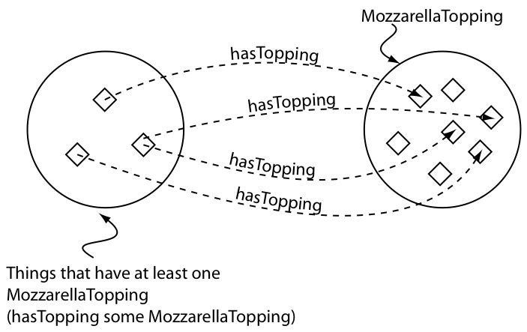
Anonymous Classes
We can talk about classes of things without explicitly naming them

Slide 25






Primitive vs Defined
Sharks
Blue Things
“Natural Kinds”
“Smart Class” Acts like a query
Like primitive, but also:
define necessary conditions that are also sufficient to recognise a member
Eg have colour Blue
Describe the necessary features of the members
Eg live underwater
“All sharks live underwater, but not everything that lives underwater is a shark”
“All things that have colour blue are members of this class”

Slide 26
CheesyPizza
A CheesyPizza is any pizza that has some cheese on it
We would expect then, that some pizzas might be named pizzas and cheesy pizzas (among other things later on)
We can use the reasoner to help us produce this polyhierarchy without having to assert multiple parents

Slide 27
Reasoner Classification
The reasoner has been able to infer that anything that is a Pizza that has at least one topping from CheeseTopping is a CheesyPizza
The inferred hierarchy is updated to reflect this and moved classes are highlighted in blue

Slide 28
Why? Defined Classes
Each set of Necessary & Sufficient conditions is an Equivalent Class
Pizza
hasTopping some CheeseTopping
Pizza
CheesyPizza
CheesyPizza is equivalent to the intersection of Pizza and hasTopping some CheeseTopping
Classes, all of whose individuals fit this definition are found to be subclasses of CheesyPizza, or are subsumed by CheesyPizza

Slide 29
Defined Classes
We’ve created a Defined Class, CheesyPizza
It has a definition. That is at least one Necessary and Sufficient condition
Classes, all of whose individuals satisfy this definition, can be inferred to be subclasses
Therefore, we can use it like a query to “collect” subclasses that satisfy its conditions
Reasoners can be used to organise the complexity of our hierarchy
It’s marked with an equivalence symbol in the interface
Defined classes are rarely disjoint

Slide 30
Define a Vegetarian Pizza
Not as easy as it looks…
Define in words?
“a pizza with only vegetarian toppings”?
“a pizza with no meat (or fish) toppings”?
“a pizza that is not a MeatyPizza”?
More than one way to model this
Let’s model a Vegetarian Pizza
Notes:
English definitions on whiteboard

Slide 31
Intersection Classes
Intersection Classes are formed by combining two or more classes with the intersection (AND) operator.
Human
Male
Intersection of Human and Male

Slide 32
Union Classes
aka “disjunction”
This OR That OR TheOther
A or B includes all individuals of class A and all individuals from class B and all individuals in the overlap (if A and B are not disjoint)
B
A
Commonly used for:
Covering axioms
Closure

Slide 33
Complement Classes
A complement class is specified by negating another class. It will contain the individuals that are not in the negated class.
Woman
Professor
Woman and (not Professor)

Slide 34
DeMorgan’s Law
not (A and B) = not A or not B
not (A or (B and C)
= not A and not (B and C) =
not A and (not B or not C)
not (hasTopping some X) = hasTopping only (not X)

Slide 35
Universal Restrictions
We need to say our VegetarianPizza can only have toppings that are vegetarian toppings
We can do this by creating a Universal or only restriction
We’ll first look at an example…

Slide 36
What does this mean?
We have created a restriction: hasBase only ThinAndCrispy on Class RealItalianPizza as a necessary condition
RealItalianPizza
hasBase
ThinAndCrispy
hasBase
hasBase
hasBase
“If an individual is a member of this class, it is necessary that it must only have a hasBase relationship with an individual from the class ThinAndCrispy”

Slide 37
What does this mean?
We have created a restriction: hasBase only ThinAndCrispy on Class RealItalianPizza as a necessary condition
DeepPan
RealItalianPizza
hasBase
ThinAndCrispy
hasBase
hasBase
hasBase
hasBase
No individual of the RealItalianPizza class can have a base from a class other than ThinAndCrispy”
NB. DeepPan and ThinAndCrispy are disjoint

Slide 38
VegetarianPizza Classification
Nothing classifies under VegetarianPizza
Actually, there is nothing wrong with our definition of VegetarianPizza
It is actually the descriptions of our Pizzas that are incomplete
The reasoner has not got enough information to infer that any Pizza is subsumed by VegetarianPizza
This is because OWL makes the Open World Assumption

Slide 39
Open World Assumption
In a closed world (like DBs), the information we have is everything
In an open world, we assume there is always more information than is stated
Where a database, for example, returns a negative if it cannot find some data, the reasoner makes no assumption about the completeness of the information it is given
The reasoner cannot determine something does not hold unless it is explicitly stated in the model

Slide 40
Open World Assumption
Typically we have a pattern of several Existential restrictions on a single property with different fillers – like primitive pizzas on hasTopping
Existential restrictions should be paraphrased by “amongst other things…”
Must state that a description is complete
We need closure for the given property

Slide 41
Closure
This is in the form of a Universal Restriction with a filler that is the Union of the other fillers for that property
Closure works along a single property

Slide 42
Primitive Classes
All classes in our ontology so far are Primitive
We describe primitive pizzas
Primitive Class = only Necessary Conditions
They are marked as plain orange circles in the class hierarchy
We condone building a disjoint tree of primitive classes

Slide 43
Asserted Polyhierarchies
We believe asserting polyhierarchies is bad
We lose some encapsulation of knowledge
Why is this class a subclass of that one?
Difficult to maintain
Adding new classes becomes difficult because all subclasses may need to be updated
Extracting from a graph is harder than from a tree
Let the reasoner do it!

Slide 44
What we haven’t done
Cardinality
Interesting Pizza equivalentTo Pizza that hasTopping min 4 PizzaTopping
Datatypes
LargePizza equivalentTo Pizza that hasDiameter > 12
Individuals
ItalianPizza equivalentTo Pizza hasCountryOfOrigin value Italy
OWL 2

