Slide 1
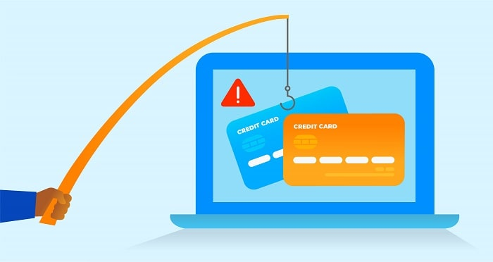

Machine Learning Technique For Detecting Banking Fraud Based On Big Data Analysis
Presented By,
Deepu K (19030141CSE078)
Darshan K (19030141CSE079)
Varun Tejas K S (19030141CSE084)

Slide 2
Overview
Banking / Financial Institutes plays a significant role in providing financial service.
To maintain the integrity, bank/institute must be careful when investing in customers to avoid financial loss.
Before giving credit to borrowers, the bank must come to about the potential of customers.
The term credit scoring, determines the relation between defaulters and loan characteristics.

Slide 3
Goal
The model we built here will use all possible factors to predict data on customers to find who are defaulters and non-defaulters next month.
The goal is to find the whether the clients are able to pay their next month credit amount.
Identify some potential customers for the bank who can settle their credit balance.
To determine if their customers could make the credit card payments on-time.
Default is the failure to pay interest or principal on a loan or credit card payment.

Slide 4
Process Design
The process is done by Supervised learning Algorithm.
The idea behind using this is we have a prior knowledge on our output values.
It acts as a guide to teach the algorithms what conclusion it should come up with.
Common algorithms in supervised learning includes logistic regression, naive bayes, support vector machines and decision tree classifier.

Slide 5
Approach Design
Preparation
of data
Applying models
Analyse the Best model
Comparing the applied models
Evaluation Model

Slide 6
Dataset Overview
Oriented: UCI Machine Learning Repository. (Link)
Attributes: 24
Tuples: 30,000
Non-default
Default
Customers data
Non-default
Customers data
Non-default
Non-default

Slide 7
Continue…
Independent variables:
Customer ID
Credit limit
Gender
Age
Marital status
Level of education
History of their past payments made (April to September) (g1 to g6)
Amount of bill statement (h1 to h6)
Amount of previous payment (i1 to i6)
Dependent variables:
default – A customer who will be default next month payment (0: no, 1: yes)

Slide 8
Data Preprocessing
Data set is divided in 60:40 ratio for train and test respectively.
ID column was dropped as its unnecessary for our modeling.
The attribute name ‘PAY_0’ was converted to ‘PAY_1’ for naming convenience.
Pay_0: No consumption of credit card=-2, Pay duly(paid on time)=-1, payment delay for one month=1, payment delay for two months=2, payment delay for nine months and above=9.
Marital Status 0 is converted to value 3 (Others).
No Null values in dataset.
Robust Scaler – It is used to convert variable in the same scale. Ex. in Limit Balance column there are different range of values which are converted in proper scale.

Slide 9
Feature Engineering
Education
Gender
Marital status
Education | Value
Graduate | 1
University | 2
High School | 3
Others | 4
Gender | Value
Male | 1
Female | 2
Marital Status | Value
- | 0
Married | 1
Single | 2
Others | 3

Slide 10
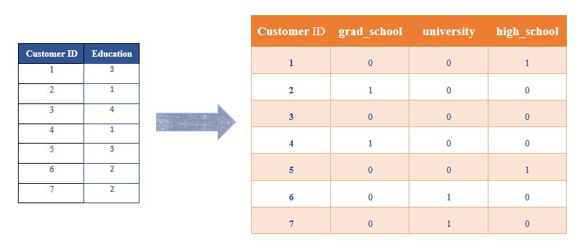
One-Hot Encoding
The process in which Categorical variables are converted into a form, where we can apply algorithms to do prediction easily.
(n-1) features
Ex. There are 4 features in Education → Converted to 3 features (n-1)

Slide 11
Evaluation Process
Evaluation Metrics:
Accuracy: Accuracy determine how often the model predicts default and non-default correctly.
Precision: Precision calculates whenever our models predicts it is default how often it is correct.
Recall: Recall regulate the actual default that the model is actually predict.
Precision Recall Curve: PRC will display the tradeoff between precision and recall threshold.
Cross Validation:
K Fold cross validation; k = 5

Slide 12
Confusion Metrics
True Positive – A person who is defaulter and predicted as defaulter.
True Negative – A person who is non-defaulter and predicted as non-defaulter.
False Positive – A person who is predicted defaulter is non-defaulter.
False Negative – A person who is predicted non-defaulter is defaulter.
# | Non-defaulter (predicted) - 0 | Defaulter (predicted) - 1
Non-defaulter (actual) - 0 | TN | FP
Defaulter (actual) - 1 | FN | TP

Slide 13
Conclusion
We investigated the data, checking for data unbalancing, visualizing the features and understanding the relationship between different features.
We used both train-validation split and cross-validation to evaluate the model effectiveness to predict the target value, i.e. detecting if a credit card client will default next month.
We then investigated five predictive models:
We started with Logistic Regression, Naïve bayes, SVM, KNN, Classification Tree and ANN accuracy is almost same.
We choose based model based on minimum value of False Negative value.
This would also inform the issuer’s decisions on who to give a credit card to and what credit limit to provide.

Slide 14
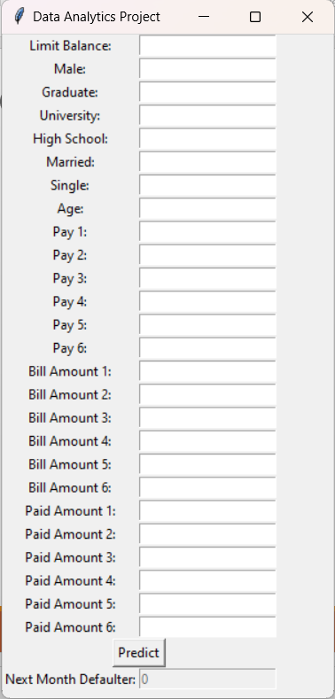
Demo

Slide 15
References
Li, Xiao-Lin, and Yu Zhong. An overview of personal credit scoring: techniques and future work. Journal: International Journal of Intelligence Science ISSN 2163-0283. 2012.
Federal Reserve. (2017) “Report to the Congress on the Profitability of Credit Card Operations of Depository Institutions”.
Taiwo Oladipupo Ayodele. (2010) “Types of Machine Learning Algorithms”, New Advances In Machine Learning, Yagang Zhang (Ed.), Intech
Default Credit Card Clients Dataset, https://www.kaggle.com/uciml/default-of-credit-card-clients-dataset/
Davis J., Goadrich M. The Relationship Between Precision-Recall and ROC Curves. ACM New York, NY, USA 2006. ISBN:1-59593-383-2.
Arlot, Sylvain, and Alain Celisse. A survey of cross-validation procedures for model selection. eprint arXiv:0907.4728. DOI:10.1214/09-SS054.
https://www.analyticsvidhya.com/blog/2016/03/introduction-deep-learning-fundamentals-neural-networks/

Slide 16
THANK YOU

