Slide 1
Embedded Vision
Session 2
What is Embedded Vision
© Dieter Kiermaier, Creative Commons BY-CN 3.0 license
Last Update: 12/1/17

Slide 2
Agenda
What is Embedded Vision
computing vision frameworks
Introduction into Basler Products
short overview about pylon
install pylon SDK
first steps and ensure the installation works
check if the Basler camera is correctly recognized by your system
how to use PylonViewer

Slide 3
What is Embedded Vision
There is a trend for miniaturization and for highly specific computer vision systems. Following this trend and build highly adapted systems for dedicated use cases refer to as “Embedded Vision” (1)
Computer Vision is the transformation of data from a still or video camera into either a decision or a new representation (2)
(1) Baslerweb.com
(2) Learning OpenCV (Adrian Kaehler, Gary Bradski)

Slide 4
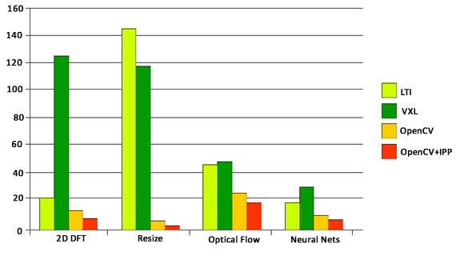
Computer Vision Frameworks
OpenCV vs VXL vs LTI: Performance Test (1)
Decision for
OpenCV is
easy
(1) http://aishack.in/tutorials/opencv-vs-vxl-vs-lti-performance-test/

Slide 5
Install and setup pylon on your DB4
Follow Session 2 LAB1 description to perform the following tasks:
  Downloading and installing pylon for aarch64

Slide 6
Connecting the Camera
Connecting the hardware
  Ensure the device is present via checking kernel dmsg output after connecting the USB cable:
    linaro@linaro-alip:~$ dmesg | grep daA
    [ 10.234151] usb 1-1.4: Product: daA2500-14uc

Slide 7
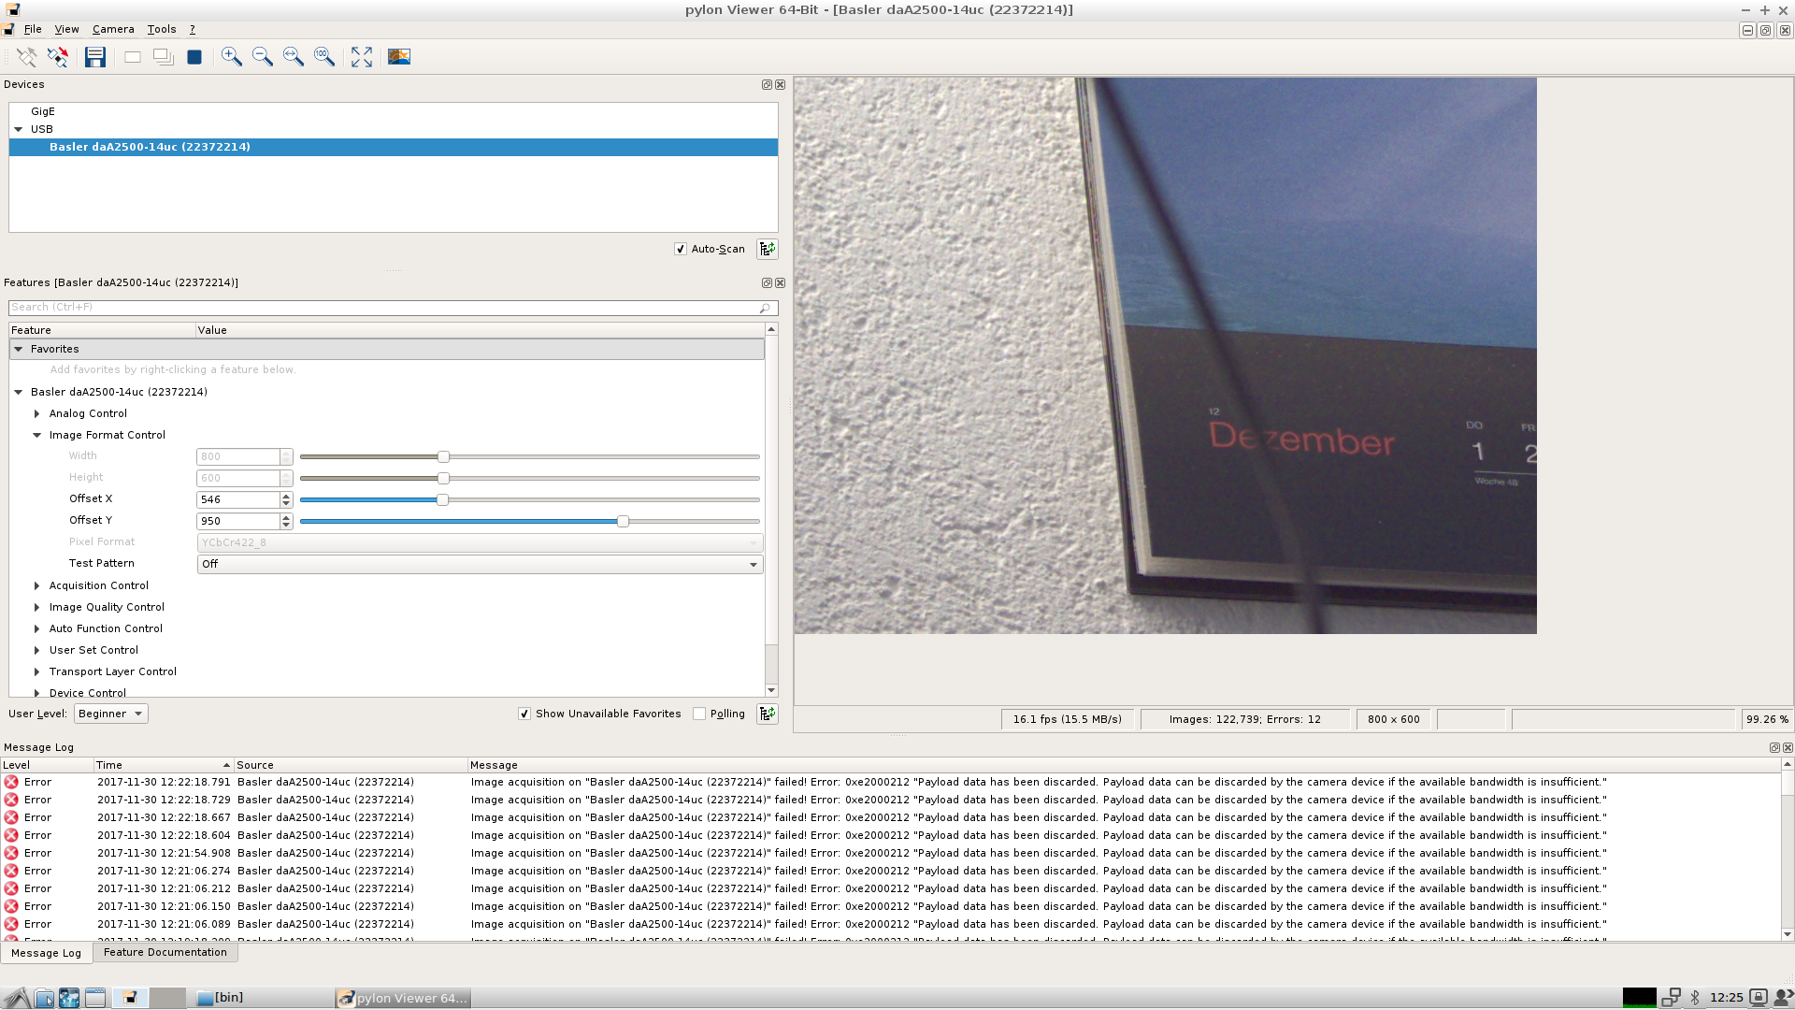
Start pylon-Viewer
Start typing following commands:
dieter:> cd /opt/pylon/bin
dieter:> ./pylon-Viewer

Slide 8
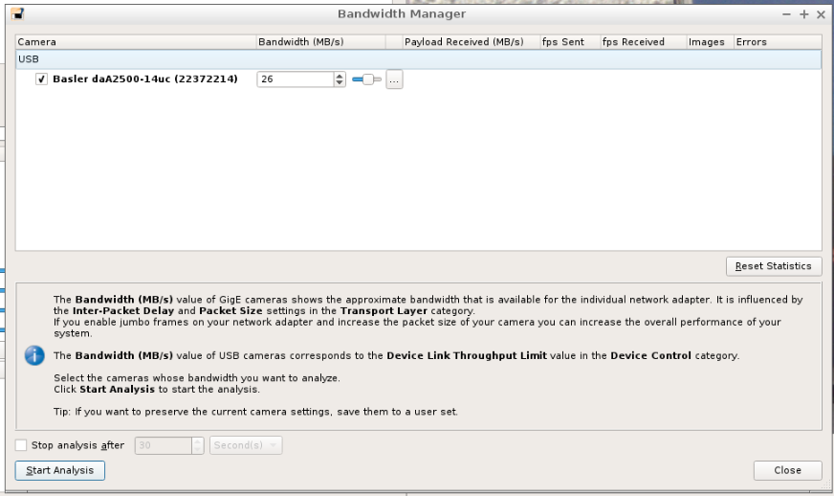
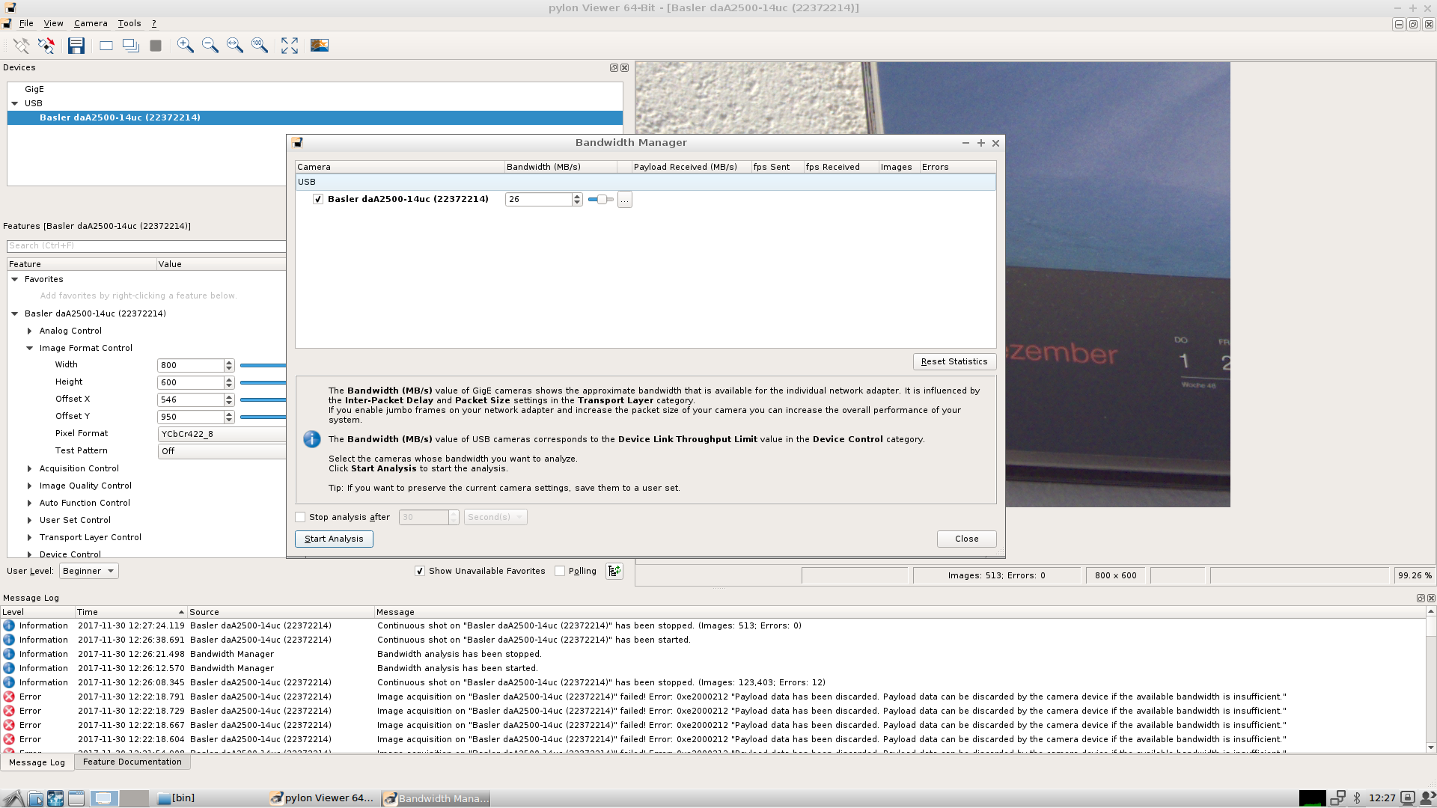
Setup pylon-Viewer
Select “Tools → Bandwith Manager”

Slide 9
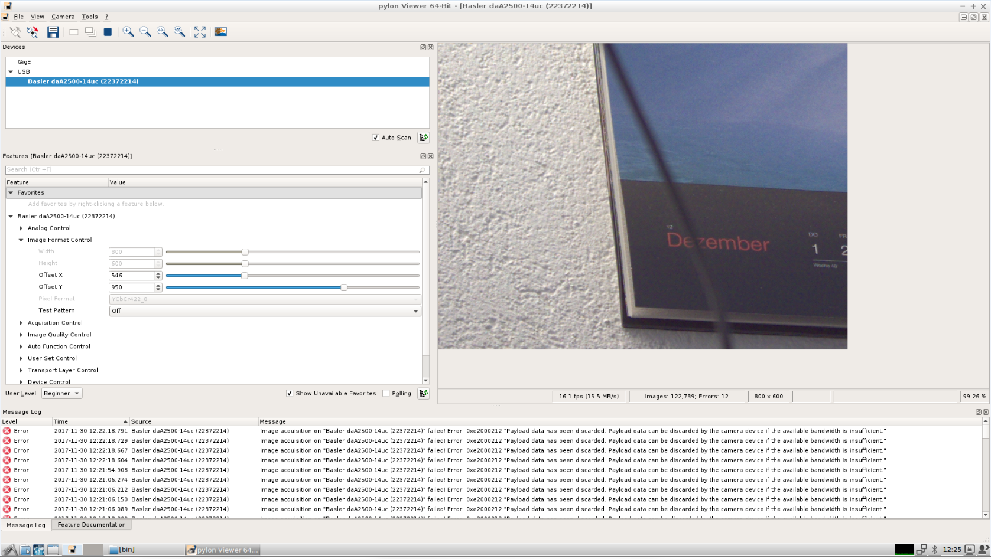
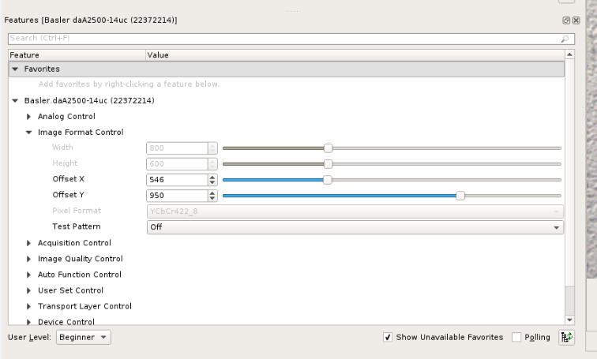
Setup pylon-Viewer – define visible area of the sensor
Go to feature list
Change
Image Format control

