Slide 1
Embedded Vision
Session 1
Introduction and Hardware Overview
© Dieter Kiermaier, Creative Commons BY-CN 3.0 license
Last Update: 11/26/17

Slide 2
Agenda
Used Hardware
  Geniatech DB4 (Developer Board based on SD-410)
  Basler Camera
Bring up of the DB4 and flash Linaro Debian
pre requisites and installation of required software

Slide 3
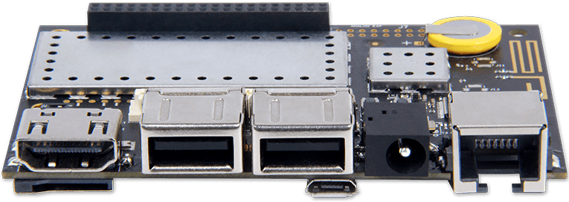
Overview about used Hardware
For this training we will use a combination of a professional Basler Camera and production grade Embedded Linux Board called DB4 from Geniatech
HDMI Port
USB 1 / 2
MicroSD Card
Power
Ethernet
USB OTG

Slide 4
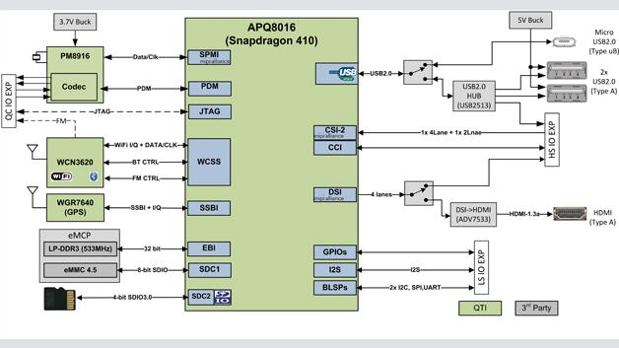
Developer Board 4 based on Dragonboard 410c
Additional
USB – Ethernet
Bridge
2GB DDR
16GB eMMC
https://www.geniatech.com/product/developer-board-4/
http://www.elektroniknet.de/embedded/alternativen-zu-maker-boards-127992.html

Slide 5
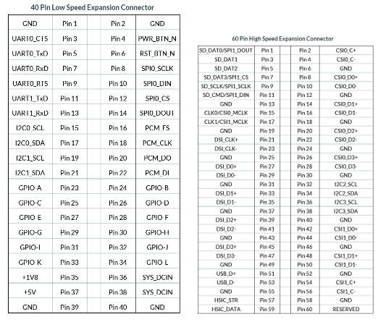
Developer Board 4 – I/O
Debug
Console
Caution:
All I/Os are working on 1.8V logic level!

Slide 6
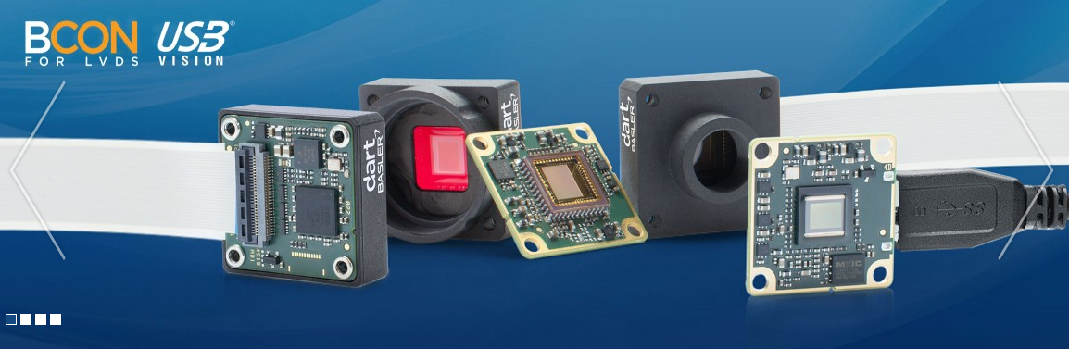
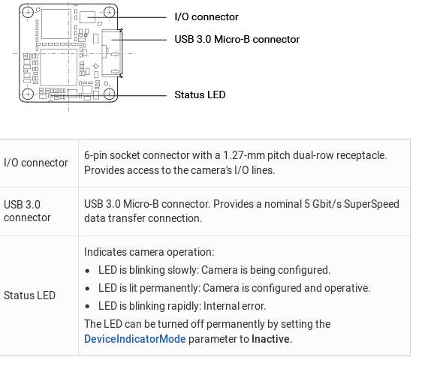
Camera: Basler dart USB-3 Vision Camera
Advantages of the USB 3.0 interface (USB 3.1 Gen 1) include:
Transfer bandwidths up to 350 MB/s
Outstanding real-time compatibility
High stability and very good error handling
Simple integration into all image processing applications (3rd party libraries)
Standardization through USB3 Vision
Sources: Basler Website
Notes:
Why USB-3 Vision?
Portable industrial standard (GeniCam) which allows end user to chose from a vide variety of available solutions targeted for industrial / long term availability!

Slide 7

Bring-Up of DB 4 – Prepare SD-Card
Booting from SD-Card to unbrick / reflash your board:
  Download debian Image
  Writing image to SD-Card
  Unplug power connector
  Configure DIP Switches
  Plug SD-Card and boot your board
Warning:
All data on SD-Card will be lost!
Refer to LAB1 for Details:
https://github.com/dieter-k/EmbeddedVision_Intro_1/EmbeddedVision_Session-1/EmbeddedVision_Session-1_LAB1.md

Slide 8
Bring-Up of DB 4- Install required software
Once the DB4 is booting with Linaro Debian we need to install some more software packages:
  Basic software packages to allow native compilation
  Basler pylon SDK (Software Development Kit)
  Compile OpenCV
Refer to LAB2 for Details:
https://github.com/dieter-k/EmbeddedVision_Intro_1/EmbeddedVision_Session-1/EmbeddedVision_Session-1_LAB2.md

