Slide 1
Summarization of Content
Presented by Kalden Yugyel Dorji
For Cotiviti

Slide 2
Importance of Summarization in healthcare
Consolidates data from electronic health records, insurance claims, and policy documents
Reduces redundancy and improves information clarity
Enhances decision-making and care coordination

Slide 3
AI-Driven summarization for claims management
AI tools reduce administrative burdens by automatically summarizing policy details
Improved accuracy and efficiency in claims processing
Simplifies complex policy language for better stakeholder understanding

Slide 4
POC: Automation in summarization
Text Summarizer Tool built with Python
Utilizes NLTK for natural language processing
Tkinter provides the graphical user interface

Slide 5
POC: Key functionalities of the text summarizer
Text Processing: Tokenizes text and removes stopwords using NLTK
Summarization Algorithm: Calculates word frequency to generate a concise summary
User Interface: Built with Tkinter and includes export features

Slide 6
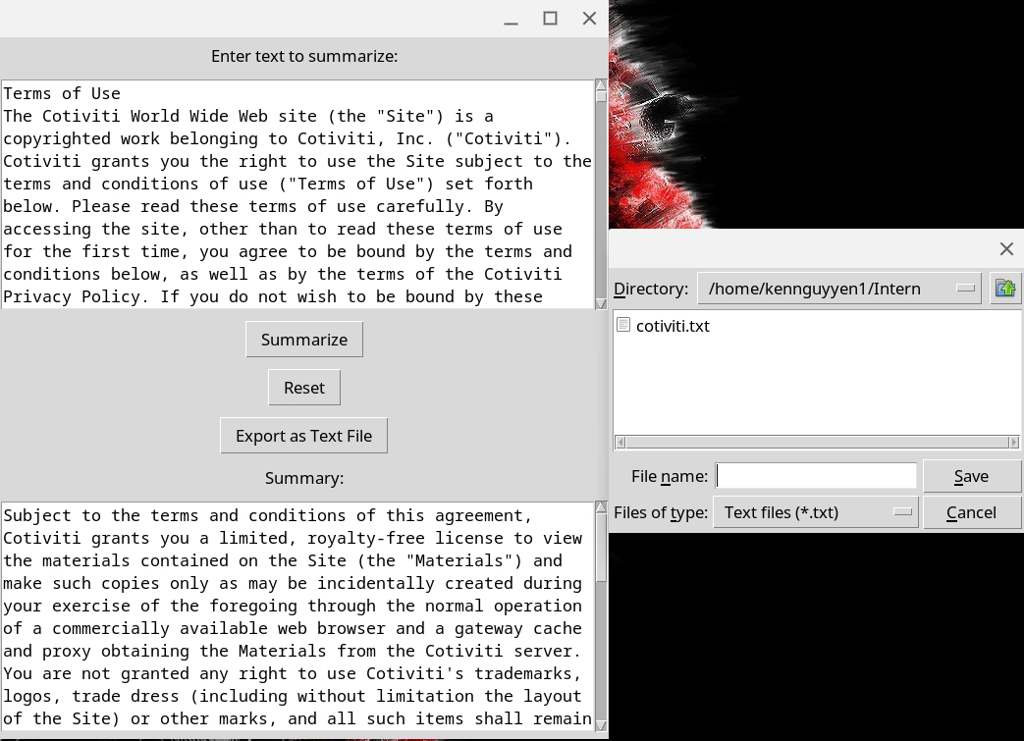
POC: Example run

Slide 7
POC: Application in healthcare
Automates the summarization of important documents
Reduces manual workload, improves accuracy and efficiency
Facilitates better-informed decision-making through clear, concise summaries

Slide 8
Strategic opportunities for cotiviti
Enhance client engagement through better communication
Investment opportunities in AI firms or in-house AI talent

Slide 9
Integration challenges
Potential job displacement for claims specialists
Importance of high-quality datasets and licensed content
Integration with existing Insurance Management Systems requires careful planning

Slide 10
Conclusion
AI driven summarization improves efficiency, accuracy, and understanding
Careful consideration of challenges ensures successful integration
Strategic investment in AI positions healthcare organizations for long-term success

