Slide 1

CUDA STUDY
Day 1

Slide 2
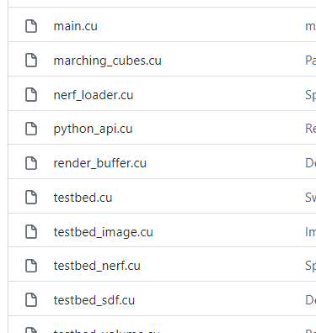
Why CUDA?

Slide 3
Goal
고성능, 고효율 GPU 소프트웨어 만드는 것
CUDA C/C++ 에 익숙해지기
GPU 가 어떻게 작동하고, 이에 맞추어 최적화 하는 방법
Principles & Patterns of Parallel Programming
살짝 추상화 된 수준에서도 공부할… 욕심 (Thrust, Triton)
CUBLAS, CUSOLVER, cuFFT,

Slide 4
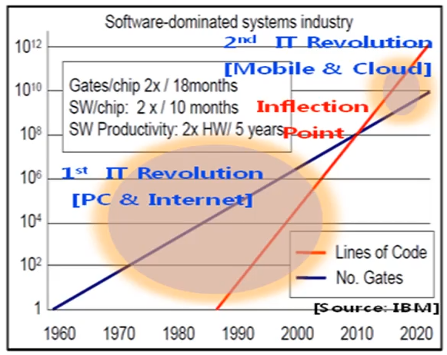
Moore’s Law at stake…
Notes:
SW : 2x / 10 monts
Gates : g

Slide 5
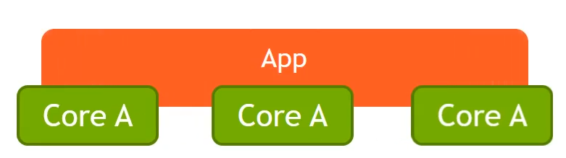
Solution : Make app run on multiple cores

Slide 6
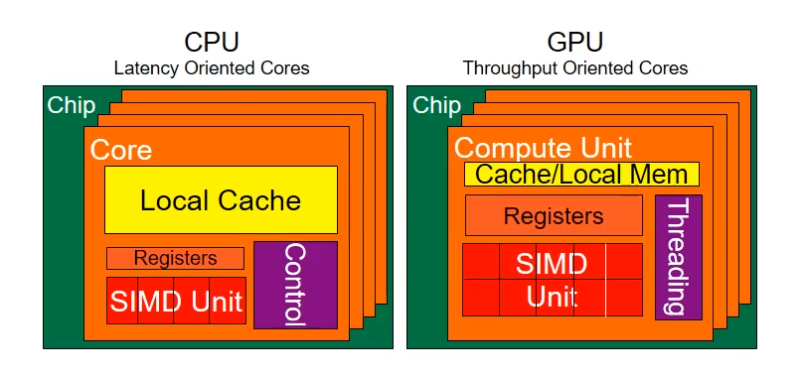
CPU vs GPU
CPU > GPU * 10 (In sequential)
GPU > CPU * 10 (In throughput)

Slide 7
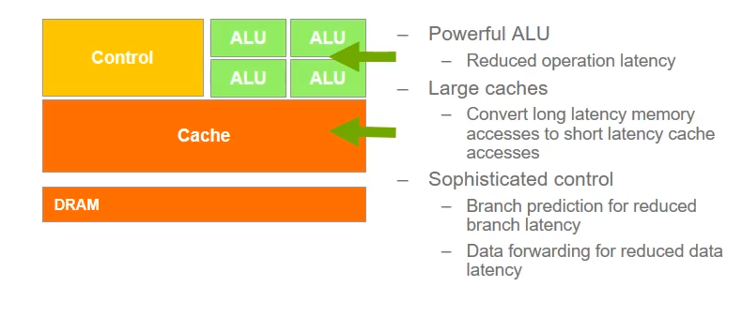
CPU (Host)
Notes:
Reuse data
“branch prediction”, “data forwarding”

Slide 8
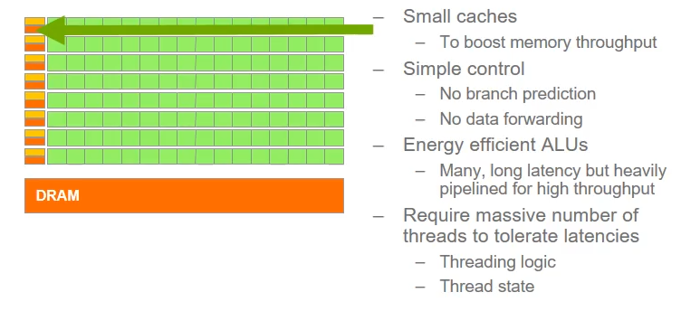
GPU (Device)

Slide 9
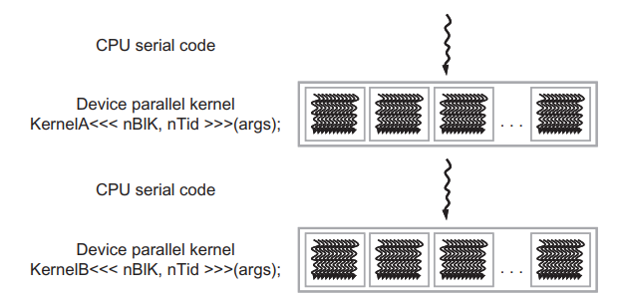

Slide 10
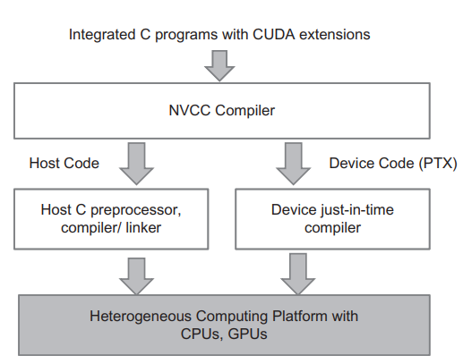
CUDA C/C++

Slide 11
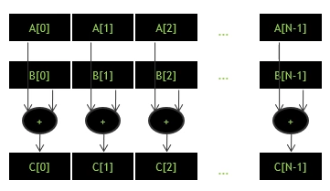
Goal: c = a + b (vector addition)

Slide 12
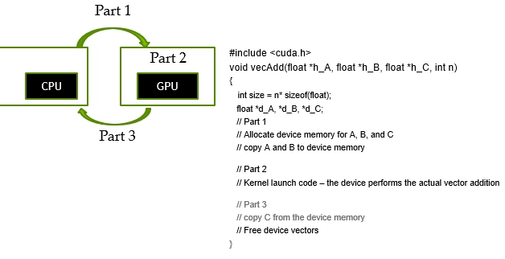
vecAdd CUDA Code
.to(device) 랑 익숙하쥬?

Slide 13
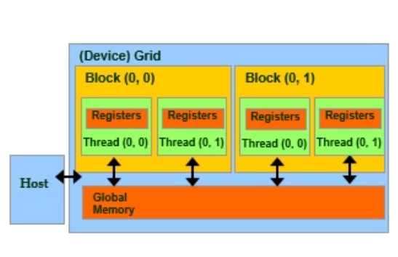
Memory 구조 간단한 소개
Grid : GPU
Device Code 는 Register, Shared Memory, Global Memory
Host Code 가 데이터를 Global Memory 로 이동 할 수 있음

Slide 14
Basic CUDA C/C++ API: Memory
cudaMalloc() : Malloc, but in cuda…
→ Double Pointer (address of pointer to allocated obj)
cudaFree() : Free, but in cuda…
Pointer to freed object
cudaMemcpy() : …
→ Src ptr, dst ptr, size

Slide 15
따라해보아요 cuMalloc
int main() {
float* a, * b, * out;
float* d_a, * d_b, * d_out; // Allocate host memory
a = (float*)malloc(sizeof(float) * N);
b = (float*)malloc(sizeof(float) * N);
out = (float*)malloc(sizeof(float) * N); // Initialize host arrays
for (int i = 0; i < N; i++) {
a[i] = 1.0f;
b[i] = 2.0f;
} // Allocate device memory
cudaMalloc((void**)&d_a, sizeof(float) * N);
cudaMalloc((void**)&d_b, sizeof(float) * N);
cudaMalloc((void**)&d_out, sizeof(float) * N);

Slide 16
따라해보아요 cudaMemcpy
// Transfer data from host to device memory
cudaMemcpy(d_a, a, sizeof(float) * N, cudaMemcpyHostToDevice);
cudaMemcpy(d_b, b, sizeof(float) * N, cudaMemcpyHostToDevice);
// Executing kernel
vector_add << <1, 1 >> > (d_out, d_a, d_b, N);
// Transfer data back to host memory
cudaMemcpy(out, d_out, sizeof(float) * N, cudaMemcpyDeviceToHost);

Slide 17
따라해보아요 cudaFree
// Deallocate device memory
cudaFree(d_a);
cudaFree(d_b);
cudaFree(d_out);

Slide 18
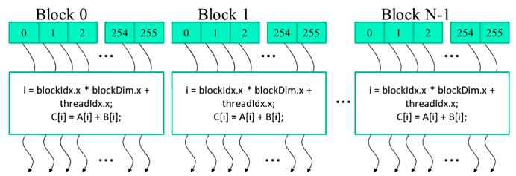
Kernels & Launching them
같은 GPU 에서 배정한 thread 들은 같은 Kernel 을 실행시킴
Grid > Block > thread
BlockIdx, ThreadIdx
Within a block → Shared Mem, Atomic Operations, barrier Sync

Slide 19
따라해보아요 Kernel Function
__global__ void vector_add_slow(float* out, float* a, float* b, int n) {
for (int i = 0; i < n; i++) {
out[i] = a[i] + b[i];
}
}
vs
__global__ void vector_add_fast(float* out, float* a, float* b, int n) {
int i = blockIdx.x * blockDim.x + threadIdx.x;
if (i < n) {
out[i] = a[i] + b[i];
}
}
vector_add_fast << < (N / 256) + 1, 256 >> > (d_out, d_a, d_b, N);

Slide 20
따라해보아요 blockIdx, ThreadIdx
__global__ void matrix_add(float *a, float *b, float *c)
{
int i = blockIdx.x * blockDim.x + threadIdx.x;
int j = blockIdx.y * blockDim.y + threadIdx.y;
c[i * N + j] = a[i * N + j] + b[i * N + j];
}
// Executing kernel
dim3 threadsPerBlock(16, 16);
dim3 numBlocks(1 + N / threadsPerBlock.x, 1 + N / threadsPerBlock.y);
matrix_add<<<numBlocks, threadsPerBlock>>>(d_a, d_b, d_c);

Slide 21
쿠다 설치후
nvcc -o addition_parr addition_parr.cu

Slide 22
Unified Memory
cudaMallocManaged(void ** ptr, size_t size)
“CUDA MANAGED” memory

Slide 23
따라해보아요
cudaMallocManaged((void**)&a, sizeof(float) * N);
cudaMallocManaged((void**)&b, sizeof(float) * N);
cudaMallocManaged((void**)&out, sizeof(float) * N);
// Initialize host arrays
for (int i = 0; i < N; i++) {
a[i] = 1.0f;
b[i] = 2.0f;
}
// Executing kernel
vector_add << <1, 1 >> > (out, a, b, N);
cudaDeviceSynchronize();
cudaFree(a);
cudaFree(b);
cudaFree(out);

Slide 24
API Error checks
cudaError_t err = cudaMalloc((void**)&d_A, size);
if (error != cudaSuccess) {
printf(“ %s in %s at line %d\n”, cudaGetErrorString(err),
__FILE__, __LINE__);
exit(EXIT_FAILURE);
}

Slide 25
Reference
http://gputeachingkit.hwu.crhc.illinois.edu/

