Slide 1
A Machine Learning Framework for Predicting and Ranking the Quality of University Websites
A Seven-Dimension Scoring Model and a Comparative Study of Twelve Regression Algorithms
Machine Learning Laboratory · CSE 4112
Submitted By:
Submitted To:
Dr. Muhammad Aminul Haque Akhand
Professor, Department of CSE,
KUET
Nabil Faiyaz Sadi
Lecturer, Department of CSE,
KUET
Faisal Ahmed 2107061
Al Shariar Hossain 2107066
Md. Rubayet Nabil 2107073
Khadimul Islam Mahi 2107076
Abhijeet Deb Nath 2107083
Afifa Sultana Offa 2107087
Department of Computer Science and Engineering, KUET
‹#›

Slide 2
Agenda
1
Related works
6
Why the algorithms differ
2
Dataset and preprocessing
7
Bangladesh case study
3
The scoring model and its label
8
Sensitivity, ablation and rankings
4
Train / test protocol and models
9
Work distribution
5
Results and model comparison
10
Limitations and conclusion

Slide 3
The Problem and Our Two-Stage Framework
A university website is often the only thing a prospective student sees before applying. Can its quality be measured automatically?
Stage A: SCORING & RANKING
INPUT
MODEL
OUTPUT
69 collected landing-page attributes
Transparent seven-dimension scoring model
score 0–100 · grade A+…F
global / regional / country rank
Stage B: MACHINE LEARNING
INPUT
Algorithm
Score
Comparison
12 regression algorithms trained on the same split
Predict website_score
Compare R², MAE, RMSE and Spearman rank agreement
71 predictive features
Example programmes: yes · departments: yes · admissions policy: yes · menu: 6 items · no search box
last notice: 30 days · mobile 75 · contrast 13.3:1 · HTTPS: yes · 0 broken links
→ 82.2 / 100 · grade A · global rank 141 of 1,225
Supervised regression. Spearman ρ is the headline metric, because the deliverable is a league table.

Slide 4
Related Works
The studies that shaped our attribute set and our method
P1
Mukanda et al. (2022)
Usability of Kenyan university sites
source of our technical and usability attributes
P2
Rashida et al. (2021)
Bangladesh content / performance framework
our principal baseline for the attribute schema
P3
Saleh et al. (2022)
Six-factor website quality model
information, content, usability, appearance, interaction, function
P4
Biyyapu et al. (2023)
ML on completeness features
motivates our move from counting to a learned score
P5
Webometrics (2024)
External ranking benchmark
used for construct-validity reference only, never as a feature
Common thread — Prior studies provide measurable criteria for website quality, including content availability, usability, accessibility, technical performance and completeness.
The gap we address — Most prior approaches rely on manual evaluation, feature counting or fixed weighted formulas. Our work adds a controlled machine-learning comparison and asks how different model families learn a scoring function containing thresholds, saturation effects and hard caps.

Slide 5
Dataset Information
1,230
1,225
69
71
6
landing pages
crawled
after cleaning
measured
attributes
features given
to the model
world regions
~200 each
The 69 attributes, as collected
B1
Header & navigation
6
B2
Rankings & recognition
9
B3
Notices & updates
6
B4
Events & media
9
B5
Page content
15
B6
Footer
5
B7
Visual design
3
B8
Service interaction
4
B9
Technical performance
5
B10
SEO metadata
3
B11
Accessibility
4
Three kinds of attribute — binary flags, counts, and measurements.

Slide 6
Dataset Information — Collection and Coverage
Six team members, one world region each — 1,230 university landing pages
 | Team member | Region | Sites
M1 | Md. Rubayet Nabil | North America | 202
M2 | Abhijeet Deb Nath | Western & Northern Europe | 207
M3 | Afifa Sultana Offa | Eastern & Southern Europe | 201
M4 | Faisal Ahmed | Asia (East & Southeast) | 200
M5 | Al Shariar Hossain | South & Central Asia + Oceania | 212
M6 | Khadimul Islam Mahi | Latin America & Africa | 208
One collector per region
Coverage is balanced and the workload even.
But it also means collector and region are perfectly confounded, which is why load time is standardised within region.
1,230 collected · 1,225 after deduplication
How each page was captured
—
Automated extraction — a script visited each landing page and recorded 69 attributes: presence flags, counts and measurements.
—
English version preferred where the site offered one, so content attributes are comparable across regions.

Slide 7
Data Preprocessing — Cleaning
Issue found | Scale | Action taken
Constant / empty columns | 3 | Dropped — zero variance, no information
Exact duplicate column | 1 | a62_load_speed_s was identical to load_time_s
External ranking values | 95–99% null | Dropped — measure prestige, not the website
Duplicate sites | 10 rows → 5 | Deduplicated on the resolved URL, not the entry URL
Notice dates after the crawl | 284 | Censored to the crawl date, and flagged
Regional labels in 'country' | 169 | Flagged — no country ranking produced for them
1,230 × 85 → 1,225 universities × 71 features
Nothing was corrected silently — every step is logged.
Deduplicating on final_url is what catches aun.edu.eg and aun.edu.eg/main as one site.

Slide 8
Data Preprocessing — Missing Values
Why we rejected median imputation
The median of notice_recency_days is 1 day. Median-filling would record the 468 universities with no dated notice anywhere as having posted yesterday — handing the strongest freshness signal to the sites that earned it least.
So each is filled at its worst defensible value instead
Attribute | Rows | Filled with | What absence actually means
notice_recency_days | 468 | 3650 days | no dated notice exists anywhere
a72_alt_text_pct | 4 | 0 % | no image carries a text alternative
a53_contrast_ratio | 1 | 1.0 : 1 | no readable text block was found
A *_was_missing flag is computed BEFORE the fill, so "never measured" stays recoverable.

Slide 9
Data Preprocessing — Feature Engineering and Pipeline
Four engineered features
Feature | How it is computed | Why
notice_recency_days | crawl date − last notice date | turns an absolute date into staleness
load_time_z_region | z-score of load time within region | removes the collector confound
broken_links_log | log(1 + broken links) | 81% are zero; one site has 1,129
*_was_missing × 3 | indicator computed before the fill | keeps "never measured" recoverable
The full preprocessing pipeline
Clean
Fill
Engineer
Withhold
Split
Scale
drop, dedupe,
censor, flag
worst-case, not
median
4 derived
features
IDs, geography,
curve outputs
80 / 20
stratified
inside the CV
fold only
Two decisions matter most. Scaling is fitted INSIDE each cross-validation fold, never on the whole dataset — otherwise the validation fold leaks into training. And the outputs of the scoring curves are withheld, so the model has to recover the curve shapes from raw attributes.

Slide 10
The Scoring Model
Score = min ( 28·D₁ + 22·D₂ + 15·D₃ + 15·D₄ + 10·D₅ + 7·D₆ + 3·D₇ , cap )
D₁
Academic information
28
What can I study, and who teaches it?
D₂
Admission support
22
How do I apply, and what will it cost?
D₃
Currency and activity
15
Is this institution alive and current?
D₄
Navigation and findability
15
Can I find what I need?
D₅
Usability and accessibility
10
Can I use it, on any device?
D₆
Technical and discoverability
7
Does it work, and can it be found?
D₇
Identity and transparency
3
Is it clear who they are?
Content the applicant came for is half the score (D₁+D₂ = 50). Weights were fixed by a stated rule before any score was computed.

Slide 11
Which Attributes Enter the Label — and Which Do Not
20 excluded — each for a stated reason
51 attributes build the score
Reason for exclusion | n | Example
Prestige leakage | 2 | a07_qs_badge
Quality not judgeable | 7 | a54_banner_carousel
No applicant need | 3 | a61_testimonials
Depth count of a scored flag | 2 | a12_accred_count
Too rare to carry weight | 2 | a59_feedback_form
Redundant with a scored one | 1 | broken_links_log
Measurement metadata | 3 | *_was_missing
Dim | Dimension | Attrs | Pts
D₁ | Academic information | 6 | 28
D₂ | Admission support | 7 | 22
D₃ | Currency and activity | 9 | 15
D₄ | Navigation and findability | 6 | 15
D₅ | Usability and accessibility | 6 | 10
D₆ | Technical and discoverability | 7 | 7
D₇ | Identity and transparency | 10 | 3
An attribute worth collecting should either be used or excluded for a reason. All 71 still go to every model as input — only the target omits these 20.
Audit: the 20 excluded average |r| = 0.14 with the score, against 0.31 for the 51 that are scored.

Slide 12
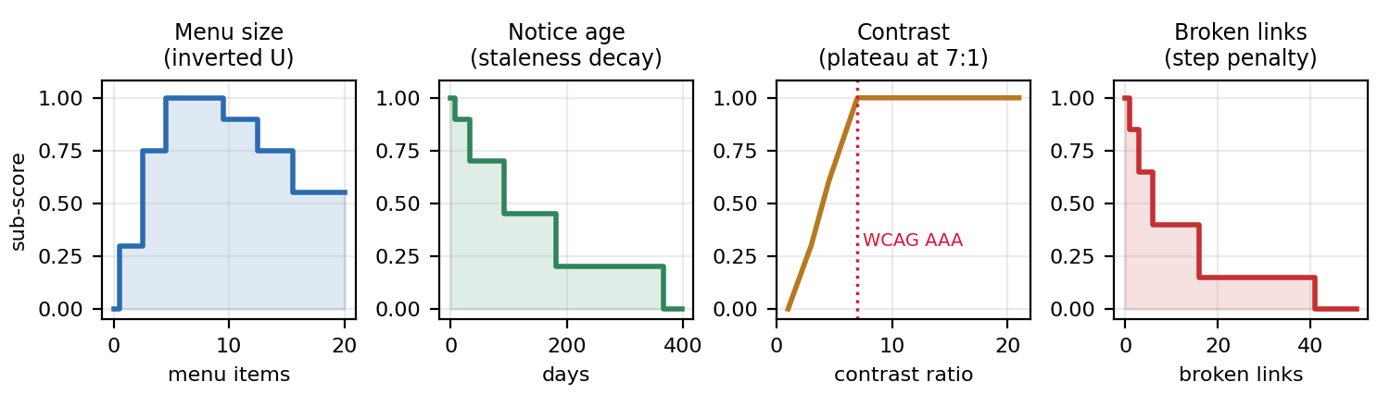
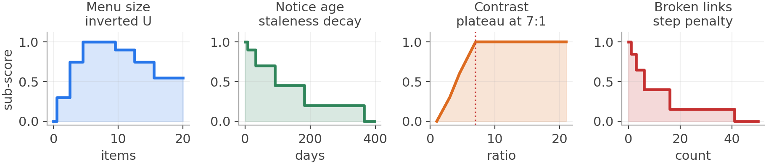
Six Attributes Do Not Reward Linearly
—
Menu size — a 20-item menu is a wall of links, not better navigation than 7 items.
—
Notice age — "recent" and "abandoned" are plateaus with a cliff between them.
—
Contrast — WCAG AAA is 7:1; beyond it, more contrast is not a better read.
—
Broken links — one is an oversight, forty is neglect. Not proportional.
Two more are not plotted: events are scaled by whether they carry a date, and alt-text coverage is concave (√). No monotone function can express an inverted U — this is what separates the model families later.

Slide 13
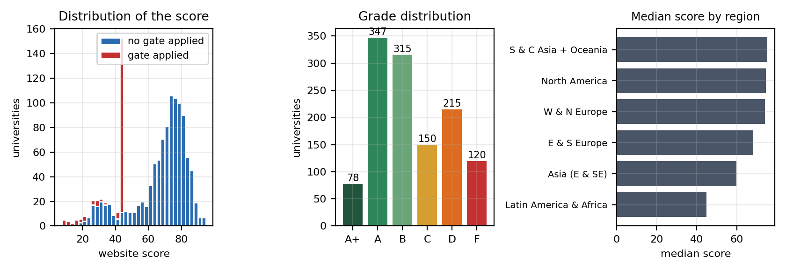
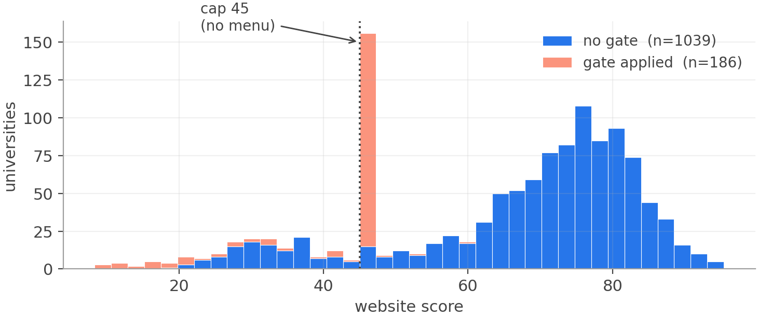
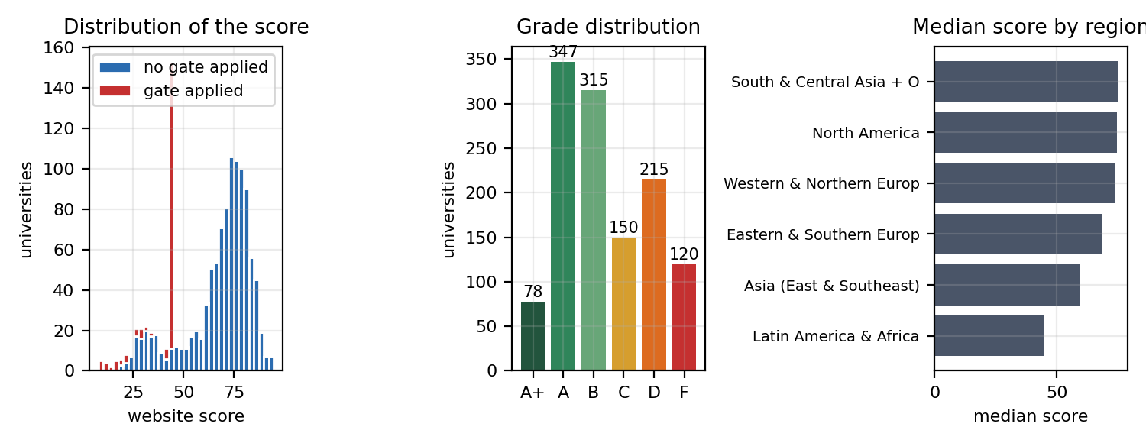
Two Gates: Some Failures Are Not Trade-offs
no primary navigation → cap 45
no HTTPS → cap 60
a site that cannot be navigated cannot serve an applicant
should not be trusted with an application form
Gates applied
182
no menu · cap 45
14
no HTTPS · cap 60
186
in total · 15.2%
Mean score 40.2 for gated universities against 68.1 for the rest.

Slide 14
Worked Example — KUET
What the crawler recorded
Dimension | Sub-score | ×w | Points
D₁ Academic | 0.920 | 28 | 25.76
D₂ Admission | 0.850 | 22 | 18.70
D₃ Currency | 0.908 | 15 | 13.62
D₄ Navigation | 0.600 | 15 | 9.00
D₅ Usability | 0.749 | 10 | 7.49
D₆ Technical | 0.707 | 7 | 4.95
D₇ Identity | 0.890 | 3 | 2.67
programmes · departments · faculty · library
yes
admissions policy · notices · scholarships
yes
careers page · prospectus
no
menu 6 items · search box
no search
last notice
30 days
mobile 75 · contrast 13.3:1 · HTTPS · 0 broken
ok
no gate applied → 82.18 / 100 · grade A
Why 4th in Bangladesh and not 1st? D₄ = 0.60 — no search box, no breadcrumb, no footer sitemap, and a notice board 30 days old.
Global rank 141 of 1,225.

Slide 15
What the Accuracy Does — and Does Not — Mean
1
The label is an arithmetic function of the features.
A flexible enough model can in principle reconstruct it exactly, so R² = 0.993 is not evidence that website quality is predictable in general.
2
So the question is stated narrowly.
Given a scoring function with thresholds, saturations and two hard gates, which families of algorithm can recover it — and why do the others fail? That question is not circular.
3
The model never sees the answer.
Sub-scores, response-curve outputs and the gate flag are all withheld. It receives raw attributes only, and must recover the structure itself.
4
20 of the 71 features are distractors.
They do not enter the label at all, so the model must also work out which attributes are irrelevant.
5
Recovery is demonstrably not automatic.
R² across the eleven real algorithms spans 0.768 to 0.990, and that spread sits on one identifiable subpopulation — the gated sites.
6
The remedy is a label that is not a function of the features.
Human ratings, or blind pairwise judgements fitted with a Bradley–Terry model. That is the first item of future work.

Slide 16
Train / Test Protocol — with a Country Holdout
981
244
42
22
training universities
80%
test universities
20%
random seed
reproducible
Bangladeshi universities
all held out
Stratified on score band — and every Bangladeshi university forced into the test set
Score band | < 35 | 35–50 | 50–65 | 65–75 | 75–85 | 85 +
train | 10.0 % | 17.6 % | 12.4 % | 25.5 % | 28.0 % | 6.4 %
test | 9.0 % | 17.2 % | 11.9 % | 26.2 % | 29.5 % | 6.1 %
Model selection and the 81-combination grid search both ran on 5-fold cross-validation INSIDE the training set.
Largest band drift caused by the country holdout: 1.2 percentage points.

Slide 17
Models Used — Twelve Algorithms, Six Families
Baseline
Linear
Instance
Kernel
Neural
Tree
Ensemble
Mean predictor
Linear Regression
k-NN (k=5)
SVR (RBF, C=100)
MLP (128, 64)
Decision Tree
Random Forest
Ridge (α=1)
Extra Trees
Lasso (α=0.1)
Gradient Boosting
LightGBM
Identical training data for every algorithm
—
Scaling is applied inside a pipeline for distance-, kernel- and gradient-based methods — so the scaler is fitted on the training fold only, never the validation fold.
—
Tree models get no scaling — they are invariant to monotone rescaling of inputs.
—
k-NN and the single Decision Tree are included deliberately — they fail in instructive ways.

Slide 18
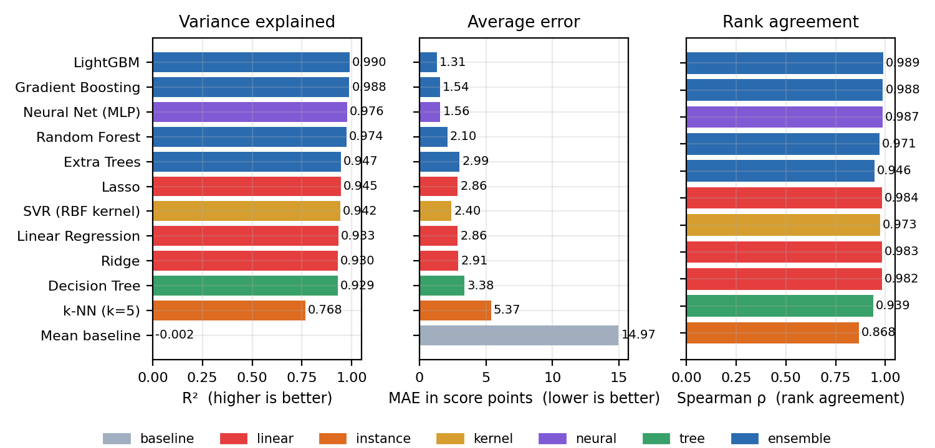
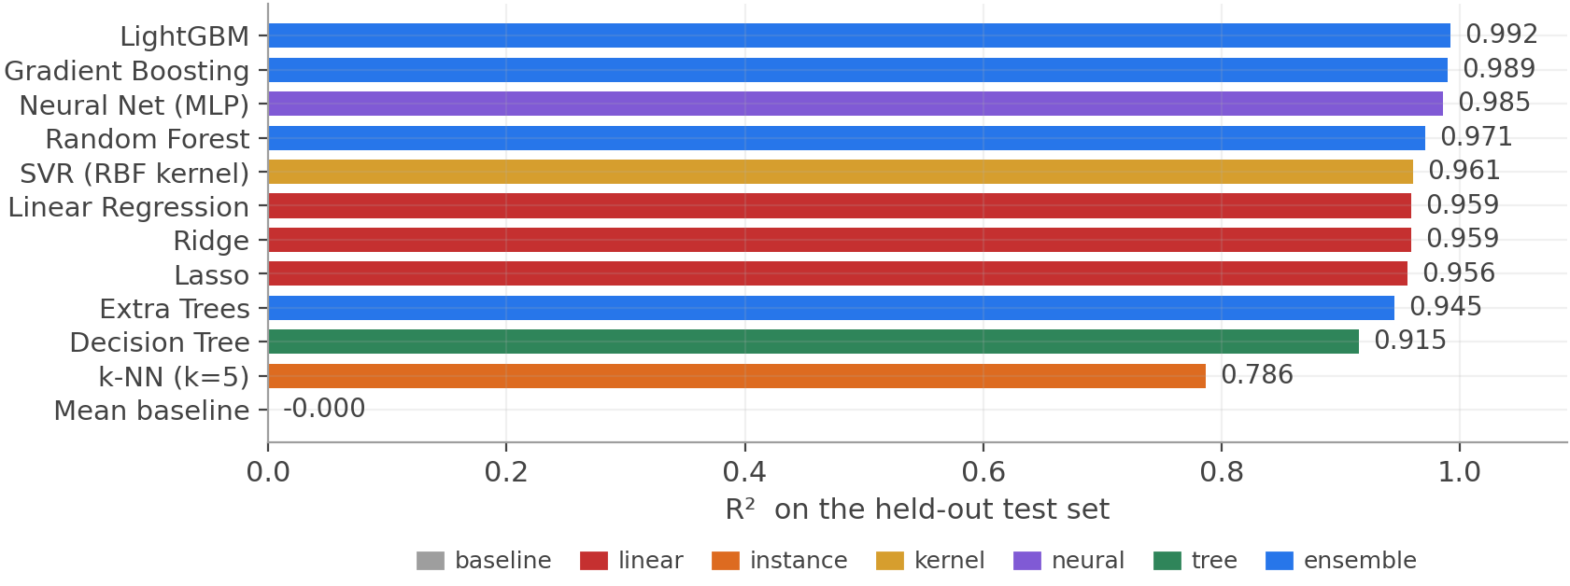
Comparison Between Models
Read this as
•
Every algorithm beats the mean baseline decisively.
•
Gradient-boosted ensembles lead on all four metrics.
•
k-NN is the clear worst — in a 71-dimensional, mostly binary space Euclidean distance is a poor measure of similarity. The curse of dimensionality.
R² spans 0.768 to 0.990 — on identical data. The next section explains why.

Slide 19
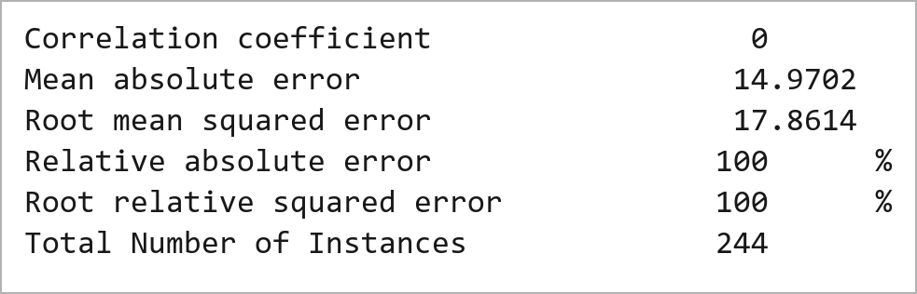
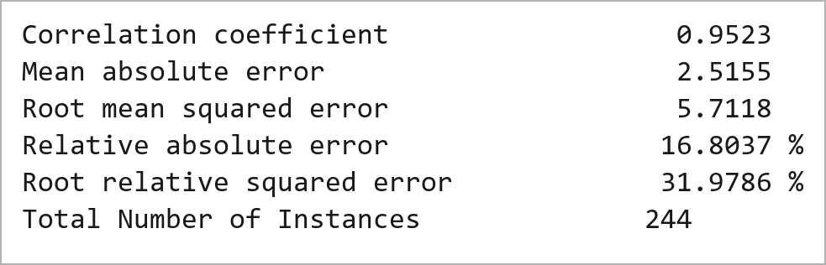
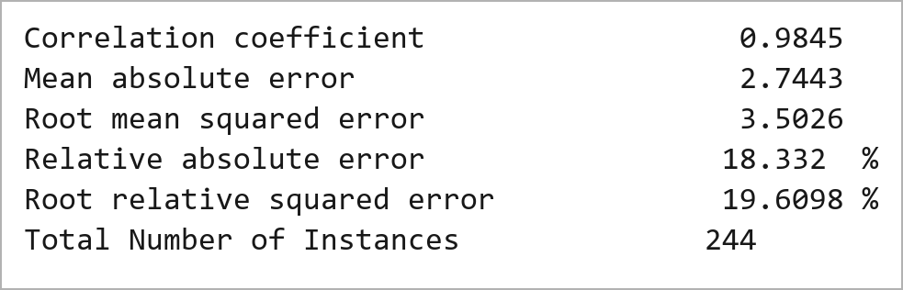
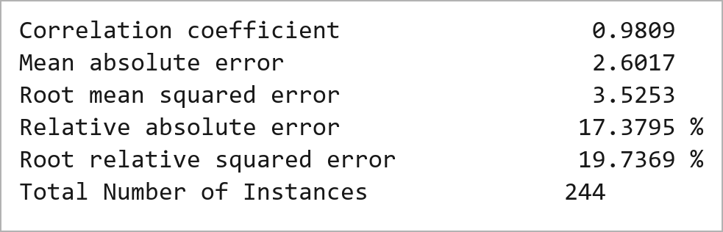
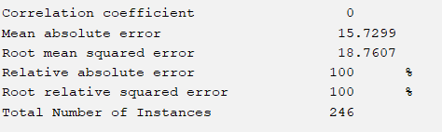
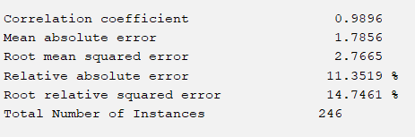
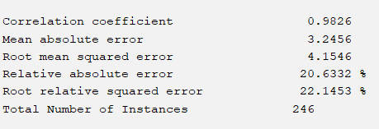
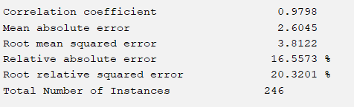
Weka Equivalent Model Results
Mean Baseline → ZeroR
SVR with RBF Kernel → SMOreg
RandomForest
Bagging → Bagging (REPTree)

Slide 20
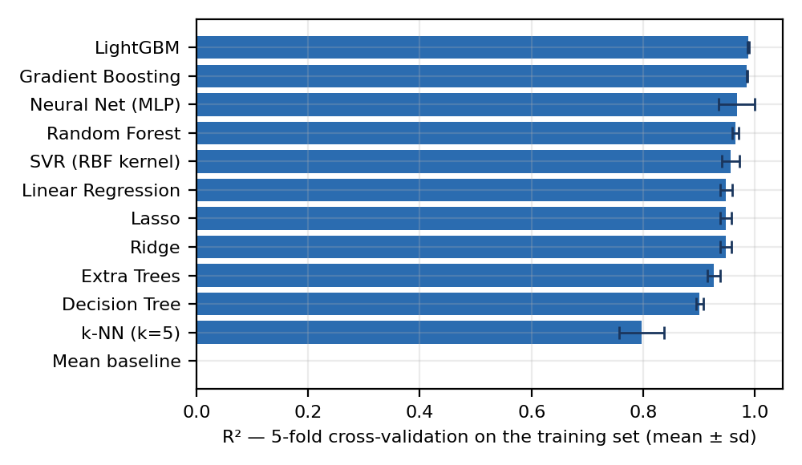
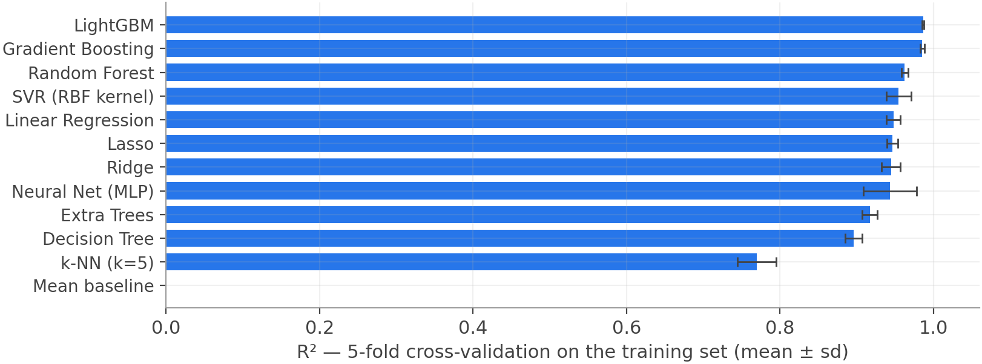
Cross-Validation — Is the Ordering Real?
5-fold, training set only
Split the 981 training universities into 5 parts. Train on 4, validate on 1. Repeat 5 times and average.
Every university is used for validation exactly once.
ρ = 0.909
agreement between the CV
ordering and the test ordering
LightGBM is not only the best but the most stable — 0.9880 ± 0.0018, the smallest spread of any model.

Slide 21
Tuning and Final Evaluation
Grid search — 81 combinations, 5-fold CV
Held-out test set — used once
Parameter | Searched | Chosen
n_estimators | 300 · 600 · 900 | 900
learning_rate | 0.03 · 0.05 · 0.1 | 0.05
num_leaves | 15 · 31 · 63 | 15
min_child_samples | 5 · 10 · 20 | 5
0.9925
1.15
R²
MAE (points)
0.9918
84.8 %
More trees (900) but simpler ones (15 leaves) — many weak learners, the classic boosting configuration.
Spearman ρ
within ±2 points
On 244 universities the model had never seen — including all 22 from Bangladesh — its prediction was on average within 1.15 points of the true score on a 0–100 scale.
RMSE 1.54 · Kendall τ 0.930 · 99.6% of predictions within ±5 points.

Slide 22
Bangladesh Case Study — 22 Universities the Model Never Saw
Accuracy on the country holdout
The strictest generalisation test in the project
Metric | Bangladesh (22) | Rest of test
MAE (points) | 0.65 | 1.20
R² | 0.9963 | —
Spearman ρ | 0.9898 | —
Largest error | 1.40 | —
0.65
0.996
MAE (points)
R²
0.990
100 %
Every Bangladeshi university was removed from training by construction; the build script asserts none reaches the training set.
Spearman ρ
within ±2 points
A random 20% test set still lets a model lean on near-neighbours — another campus on the same template, crawled by the same collector. Here there are none.
Largest single error 1.40 points · the model is more accurate here than on the rest of the test set, because 17 of the 22 sit in a dense, well-populated band.

Slide 23
Bangladesh — Where the Websites Gain and Lose
National ranking (every position out-of-sample)
Sub-score profile vs the global top 100
# | University | Score
1 | North South University | 86.8
2 | RUET | 83.8
3 | BRAC University | 82.4
4 | KUET | 82.2
5 | CUET | 81.4
18 | BUET (grade B) | 66.8
20= | BAU · East West · IUT (gated) | 45.0
Dim | BD | Top 100 | Gap
D₁ Academic | 0.943 | 0.993 | −1.40
D₂ Admission | 0.585 | 0.811 | −4.97
D₃ Currency | 0.765 | 0.865 | −1.50
D₄ Navigation | 0.594 | 0.780 | −2.79
D₅ Usability | 0.688 | 0.833 | −1.45
D₆ Technical | 0.866 | 0.862 | +0.03
D₇ Identity | 0.813 | 0.811 | +0.01
Mean 71.8 against a world mean of 63.9 — comfortably above average, with 6 of the 22 inside the global top 200.
The gap to the top 100 is 12.1 points, and 7.8 of it is admission support and navigation: a menu, a search box, a breadcrumb trail and a linked admissions policy.

Slide 24
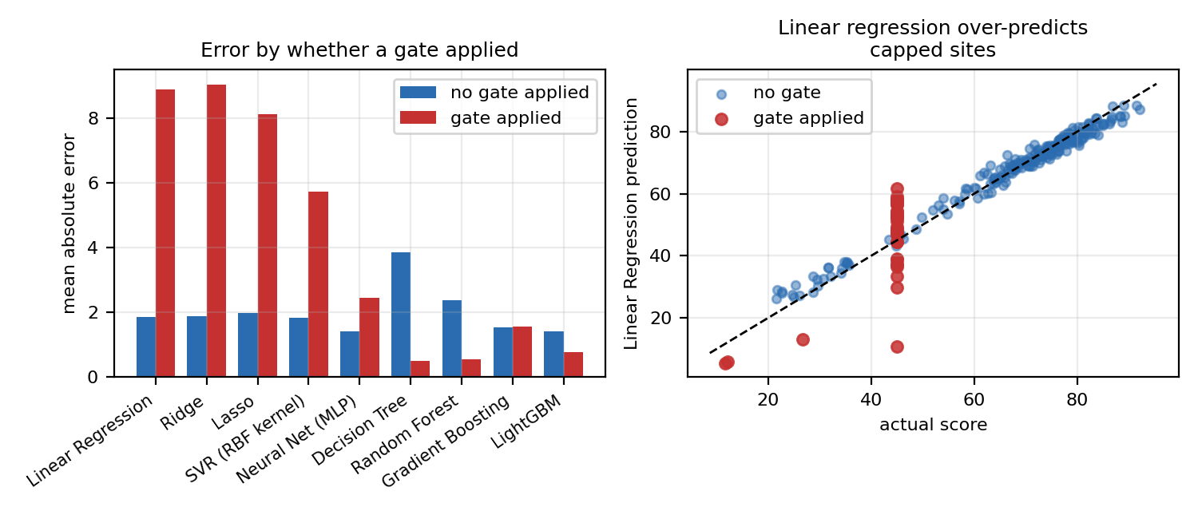
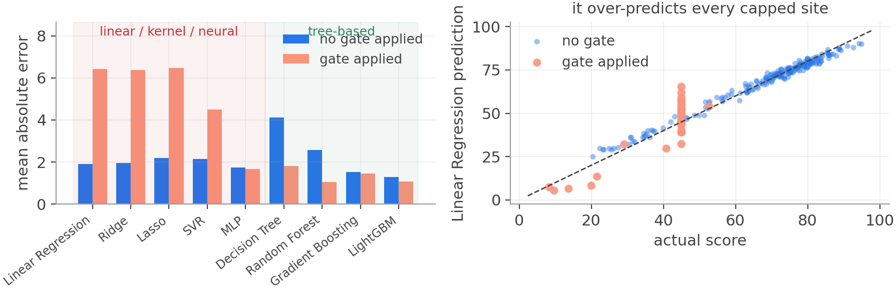
Why the Algorithms Differ
All twelve saw identical data — yet R² ranged from 0.77 to 0.99. Where does the gap come from?
A linear model computes a weighted sum. It cannot express “whatever else is true, stop here”. A decision tree can — a split IS that statement.
On the 35 gated test universities: Linear Regression MAE 8.88 vs 1.85 elsewhere (4.8×). LightGBM 0.77 vs 1.40.

Slide 25
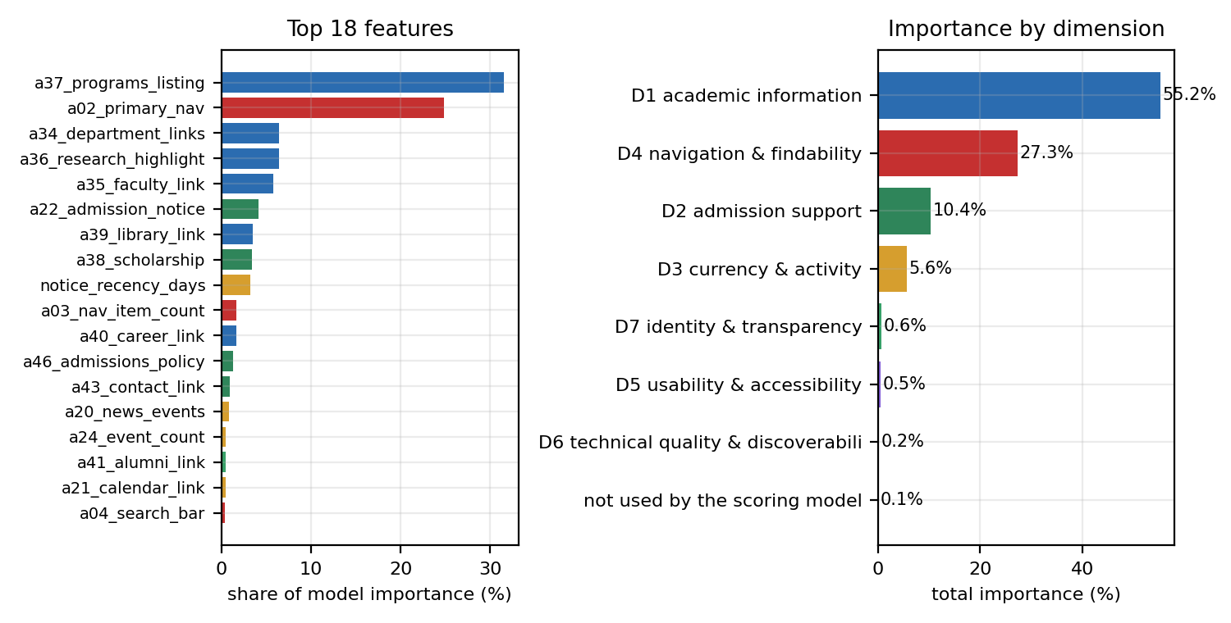
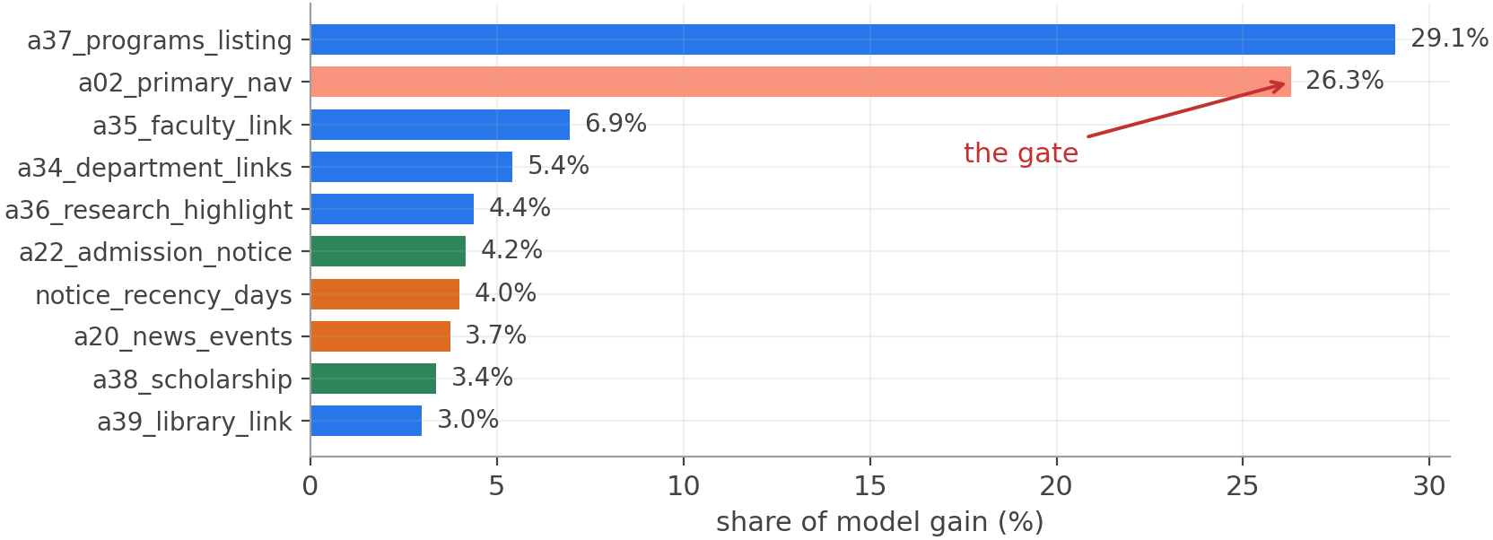
What Drives a Website's Score
Measured by gain
How much each split reduced the loss — not how often a feature was used.
Under the default split-count measure, load time looked like the top feature. Under gain it is below 1%.
The model found the gate
a02_primary_nav = 24.9% of all gain — far beyond its 3.75 arithmetic points inside D₄.
27 of the 71 features contribute less than 0.01%.

Slide 26
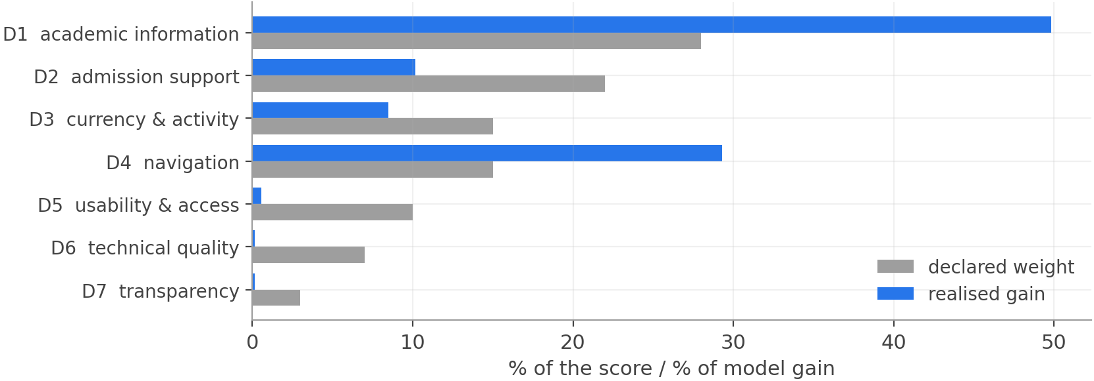
A Declared Weight Is Not a Realised Influence
Why the gap?
A dimension can only separate universities to the extent that they actually differ on it.
98.9% of sites have HTTPS.
93.2% have accessible design.
88.2% have a research page.
D₅ + D₆ + D₇ carry 20 points of the scoring model but drive only 1.4% of what the model uses — almost every university scores alike on them. They still belong in the score: a site that failed them should be penalised. D₄ is inflated because the gate lives there.

Slide 27
How Much of the Ranking Is Our Weights?
Perturb all seven weights at random — 300 draws per level
Ablation — which blocks does the model need?
Perturbation | Spearman ρ | Top 10 kept
±10% | 0.9995 | 95 %
±20% | 0.9986 | 92 %
±30% | 0.9969 | 90 %
±50% | 0.9924 | 86 %
0.997
90 %
ρ at ±30%
top ten retained
+4.89
+1.83
Even at ±30%, far more disagreement than a second analyst would introduce, the league table barely moves.
MAE cost of
deleting D₄
MAE cost of
deleting D₁
Deleting D₄ costs more than deleting D₁ even though D₁ carries almost twice the weight — because the gate lives in D₄ and it is the sharpest boundary in the data.
This is the one result that does not depend on the label being learnable: it is a property of the ranking itself.

Slide 28
The Rankings
Global top 8
Bangladesh — 22 universities
# | University | Score
1 | Eotvos Lorand University (HU) | 94.9
2 | University of New England (AU) | 94.4
3 | University of Strasbourg (FR) | 93.7
4 | University of Porto (PT) | 93.4
5 | Nanyang Technological Univ. (SG) | 92.9
6 | Gauhati University (IN) | 92.7
7 | RWTH Aachen University (DE) | 92.5
8 | University of Leicester (UK) | 92.1
# | University | Global | Score
1 | North South University | 44 | 86.8
2 | RUET | 107 | 83.8
3 | BRAC University | 139 | 82.4
4 | KUET | 141 | 82.2
5 | CUET | 173 | 81.4
6 | Univ. of Professionals | 186 | 81.0
7 | AIUB | 201 | 80.8
8 | Patuakhali S&T University | 273 | 78.6
Three ranking types — global (all 1,225), regional (six regions), country (18 countries with n ≥ 20, covering 779 universities).
Read the bottom of the ranking with care — about 2% of universities returned almost nothing to the crawler. Those are extraction failures, not bad websites.

Slide 29
Work Distribution Among Teammates
Data collection — one region per member
Analysis — carried out jointly
Team member | Roll | Region collected | Sites
Md. Rubayet Nabil | 2107073 | North America | 202
Abhijeet Deb Nath | 2107083 | Western & Northern Europe | 207
Afifa Sultana Offa | 2107087 | Eastern & Southern Europe | 201
Faisal Ahmed | 2107061 | Asia (East & Southeast) | 200
Al Shariar Hossain | 2107066 | South & Central Asia + Oceania | 212
Khadimul Islam Mahi | 2107076 | Latin America & Africa | 208
-
Attribute schema
agreed as a team from the literature
-
Cleaning & preprocessing
reviewed together, one script
-
Scoring model
weights and gates agreed jointly
-
Modelling & evaluation
shared, single reproducible pipeline
Total 1,230 sites — balanced coverage, even workload
-
Report & presentation
written and reviewed together
Because each member covered exactly one region, coverage is balanced and the workload even — but collector and region become perfectly confounded, which is why load time is standardised within region.

Slide 30
Limitations
1
The label is an arithmetic function of the features.
So the accuracy figures measure how recoverable that function is, not how predictable website quality is in general.
2
The dataset cannot see visual design.
Every attribute is a flag, a count or a measurement. Clutter and layout are not in the 71 columns — which is also why seven media and visual attributes are excluded from the label.
3
About 2% of rows are extraction failures.
JavaScript-rendered pages the crawler could not read. Because the navigation gate fires on exactly that failure, they are indistinguishable from genuinely unnavigable sites.
4
The weights are a judgement — but a bounded one.
At ±30% on every weight the ranking still holds at ρ = 0.997. Excluding 20 attributes is also a judgement; a28_contests is the most arguable.
5
Region and collector are perfectly confounded.
Each of six collectors covered one region, so load time is region-standardised. The Bangladesh result is also one country, not a general claim about transfer.
6
The crawl is a single snapshot.
Freshness attributes would differ on another day.

Slide 31
Conclusion
1,225
12
0.9925
1.15
universities
scored
algorithms
compared
R² on held-out
data
MAE in score
points
What we found
—
A seven-dimension scoring model grounded in what a prospective student needs turns 71 measurable attributes into a 0–100 score; 51 of them enter the label, and the other 20 are excluded for stated reasons.
—
Tuned LightGBM recovers that score from raw attributes with an average error of 1.15 points and orders the universities at ρ = 0.992.
—
The comparison is the interesting half — the spread across algorithm families is the concrete inability of an additive model to represent a threshold.
Future work — an independent label (human ratings or pairwise judgements) · screenshot features · a rendering crawler

Slide 32
References
P1
Mukanda, F., Mbuguah, S. & Wabwoba, F. (2022). Usability evaluation of university websites. International Journal of Computer Trends and Technology, 70(2), 1–9.
P2
Rashida, M. et al. (2021). A quantitative evaluation of university websites in Bangladesh. Computers, 10(5), 57.
P3
Saleh, A. et al. (2022). A quality model for university websites. Indonesian Journal of Electrical Engineering and Computer Science, 25(1), 511–520.
P4
Biyyapu, S. et al. (2023). Machine learning for website completeness assessment. Computers, 12(9), 181.
P5
Ranking Web of Universities (Webometrics). Methodology. https://www.webometrics.info
P6
Lundberg, S. M. & Lee, S.-I. (2017). A unified approach to interpreting model predictions. Advances in Neural Information Processing Systems, 30, 4765–4774.
P7
Ke, G. et al. (2017). LightGBM: a highly efficient gradient boosting decision tree. Advances in Neural Information Processing Systems, 30, 3146–3154.
P8
Pedregosa, F. et al. (2011). Scikit-learn: machine learning in Python. Journal of Machine Learning Research, 12, 2825–2830.

Slide 33
Thank You
Questions & Discussion

