Slide 1
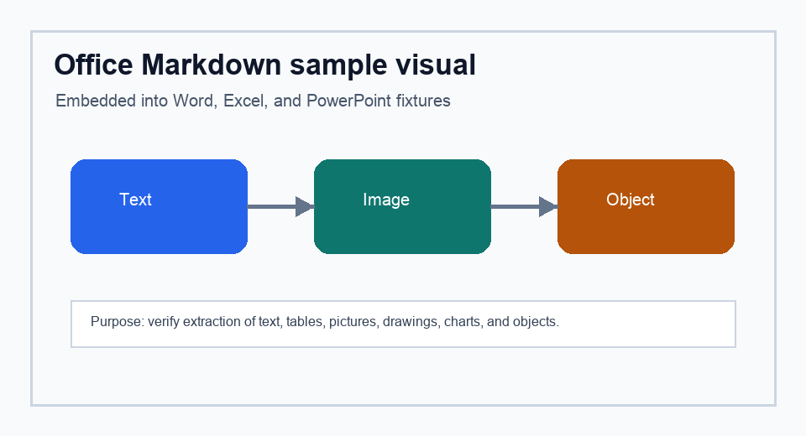
Office Markdown fixture
PowerPoint sample with text, table, image, shapes, chart, notes, and an embedded object relationship.
Element | Expected extension signal
Image | slide-001-image-001.png
Table | Markdown table rows
Embedded object | slide-001-object-001.bin
Speaker notes | Notes section in Markdown
Object placeholder
Relationship patched after export
Visible image asset
Notes:
Speaker note: confirm Markdown extraction includes this note and the embedded object asset.

Slide 2
Chart and shape coverage
Native chart plus editable shape callouts exercise common PowerPoint drawing paths.
Picture
Shape
Embedded part
Notes:
Speaker note: chart relationships are expected to be recorded as unsupported chart visuals.

