Slide 1
SMART INDIA HACKATHON 2026 · PROBLEM STATEMENT SIH26137
QuantumFlow
Quantum-Inspired Intelligent Traffic Route Optimization
using Metaheuristic Optimization
A live-ready city routing engine that co-optimises travel time, signal wait and tailpipe emissions using a quantum-inspired evolutionary algorithm — running on ordinary classical hardware.
Theme: Smart Automation · Category: Software · Team QuantumFlow
Working prototype + explainable optimiser + OSM / traffic-API adapters

Slide 2
THE PROBLEM
Indian city traffic is a combinatorial problem solved with 1959 maths
Peak-hour congestion pushes corridor speeds into single digits, and delay compounds at every signalised junction on the path.
Navigation apps optimise one objective — arrival time for one vehicle — and stay blind to signal cycles, emissions and city-wide flow.
Classical shortest-path solvers (Dijkstra / A*) are greedy on a static cost. When the live cost surface shifts every minute, they lock into local optima.
Incidents — accidents, waterlogging, VIP movement, roadworks — invalidate a route mid-trip; re-planning at city scale is exponential.
Traffic authorities have ATCS signal data and CCTV counts, but no decision layer that turns them into a routing action.
10^18+
Candidate path combinations
for a 100-junction grid — brute force is impossible
~30%
Urban km driven searching / detouring
avoidable distance = avoidable fuel + CO₂
0
Signal-aware public routing APIs in use
SIH26137 · QuantumFlow
ATCS data stays inside control rooms
2

Slide 3
ROOT CAUSE
Why the classical approach breaks down
Static cost
Greedy descent
Edge weights are distance or free-flow time. Real cost is a volume-delay curve that changes minute to minute.
One deterministic answer. No population, no exploration — the solver cannot escape a congested basin.
Single objective
No explainability
Time only. Emissions, signal stop-delay and incident exposure are never priced into the decision.
A black-box ETA. Traffic police and city engineers cannot audit or override the recommendation.
QuantumFlow attacks all four at once: live cost surface, population search, weighted multi-objective, full decision trace.
SIH26137 · QuantumFlow
3

Slide 4
PROPOSED SOLUTION
QuantumFlow — a quantum-inspired routing brain for the city
Encode every junction transition as a qubit with rotation angle θ. A route is one measurement of the register, so the whole solution space is held in a compact probabilistic encoding.
Evolve the register with amplitude amplification (rotation gates toward the incumbent best) and a tunnelling operator that jumps between route basins hill-climbing cannot cross.
Score every candidate on the live network state: BPR volume-delay travel time, signal stop-delay, CO₂ and incident exposure — weighted by the operator's chosen objective.
Return the optimum plus genuinely distinct alternates, a classical Dijkstra baseline for comparison, and a per-link decision trace.
Runs on classical hardware today; the same operators map onto QAOA / annealing backends with no change to the data layer.
Optimisation objectives
Balanced · Fastest ETA · Lowest emissions · Fewest signal stops.
Operators re-weight the cost function live — no retraining, no redeploy.
Two audiences, one engine
Commuter: a faster, cleaner route.
City control room: network health, incident impact and green-wave signal co-optimisation.
SIH26137 · QuantumFlow
4

Slide 5
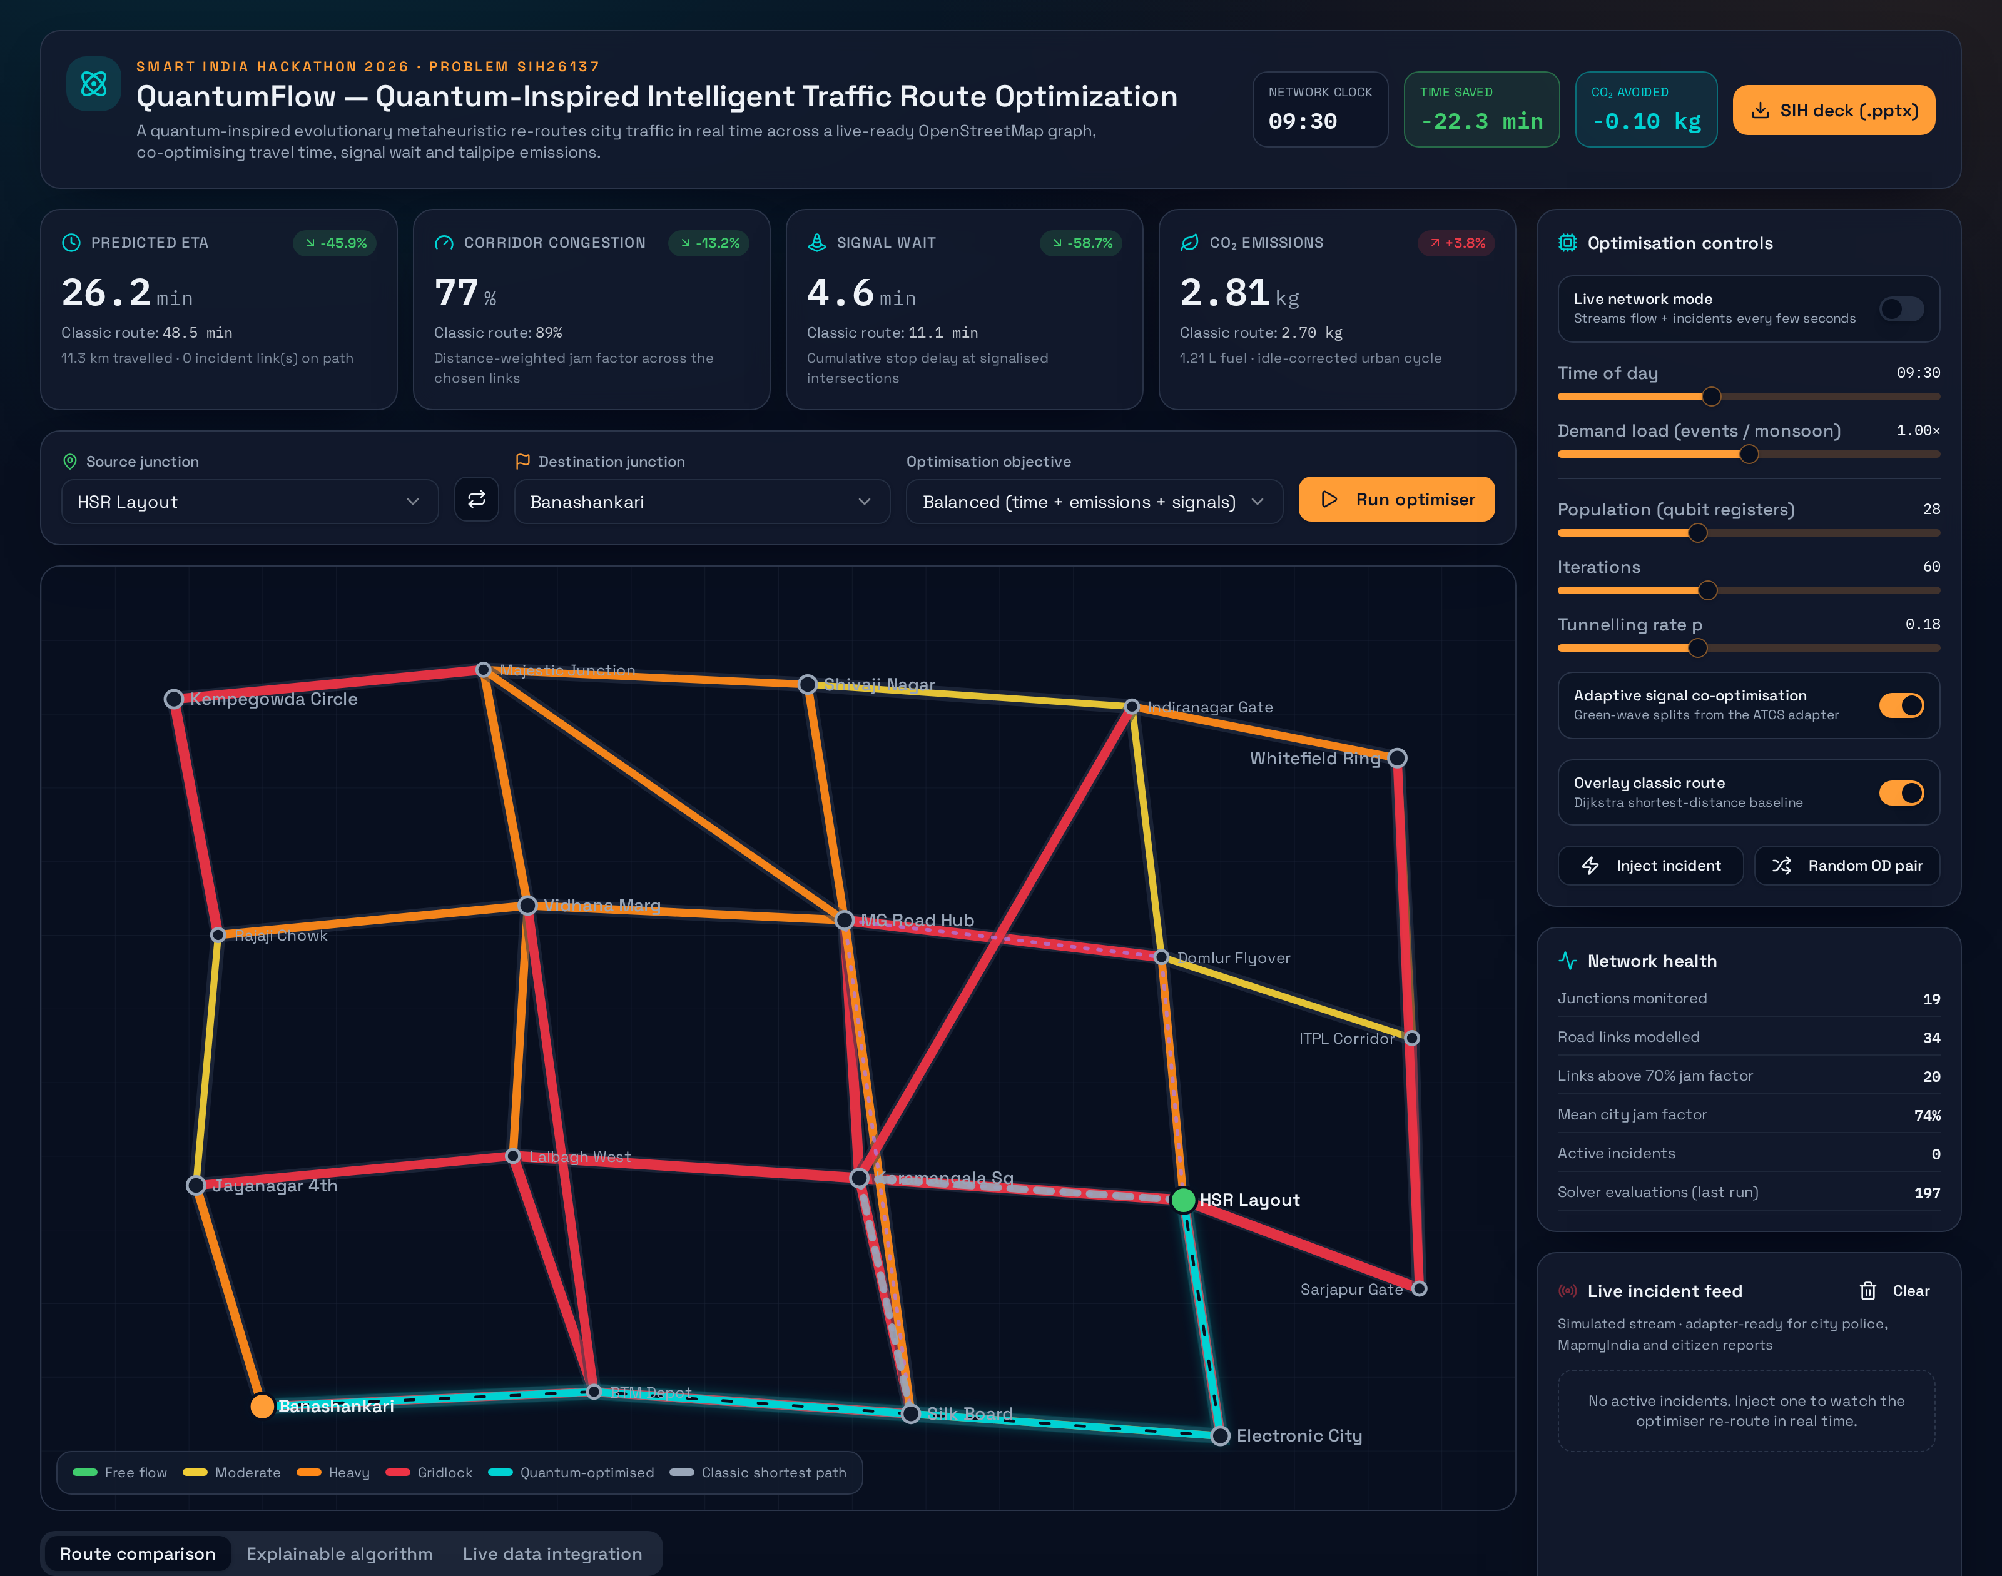
WORKING PROTOTYPE
Command deck — live network, routes and metrics
Demo narrative 1 · Pick origin & destination (HSR Layout → Banashankari).
2 · Map colours the live jam factor per link.
3 · Run the optimiser — cyan route vs grey classical baseline.
4 · Cards show ETA, congestion, signal wait, CO₂ deltas.
5 · Inject an incident and watch it re-route in milliseconds.
6 · Slide time-of-day / demand for peak or monsoon load.
SIH26137 · QuantumFlow
5

Slide 6
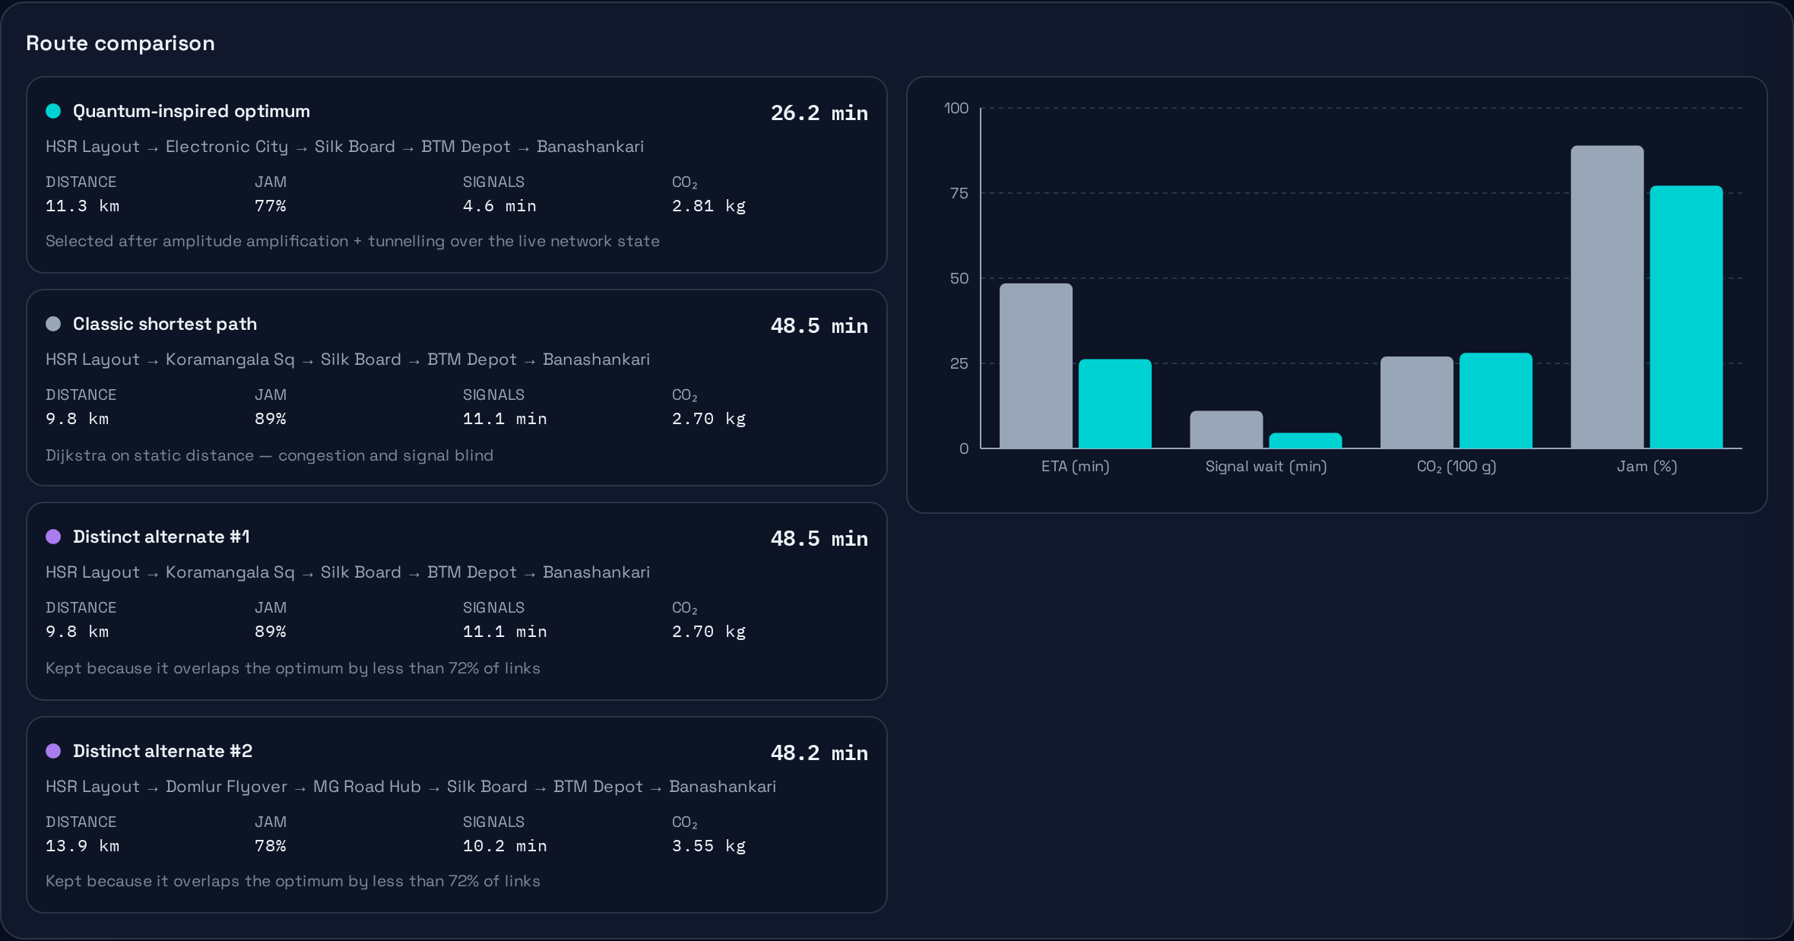
WORKING PROTOTYPE
Route comparison — optimum, baseline and distinct alternates
Every alternate below the 72% link-overlap threshold is kept, so operators get real choices — not three variants of the same corridor.
SIH26137 · QuantumFlow
6

Slide 7
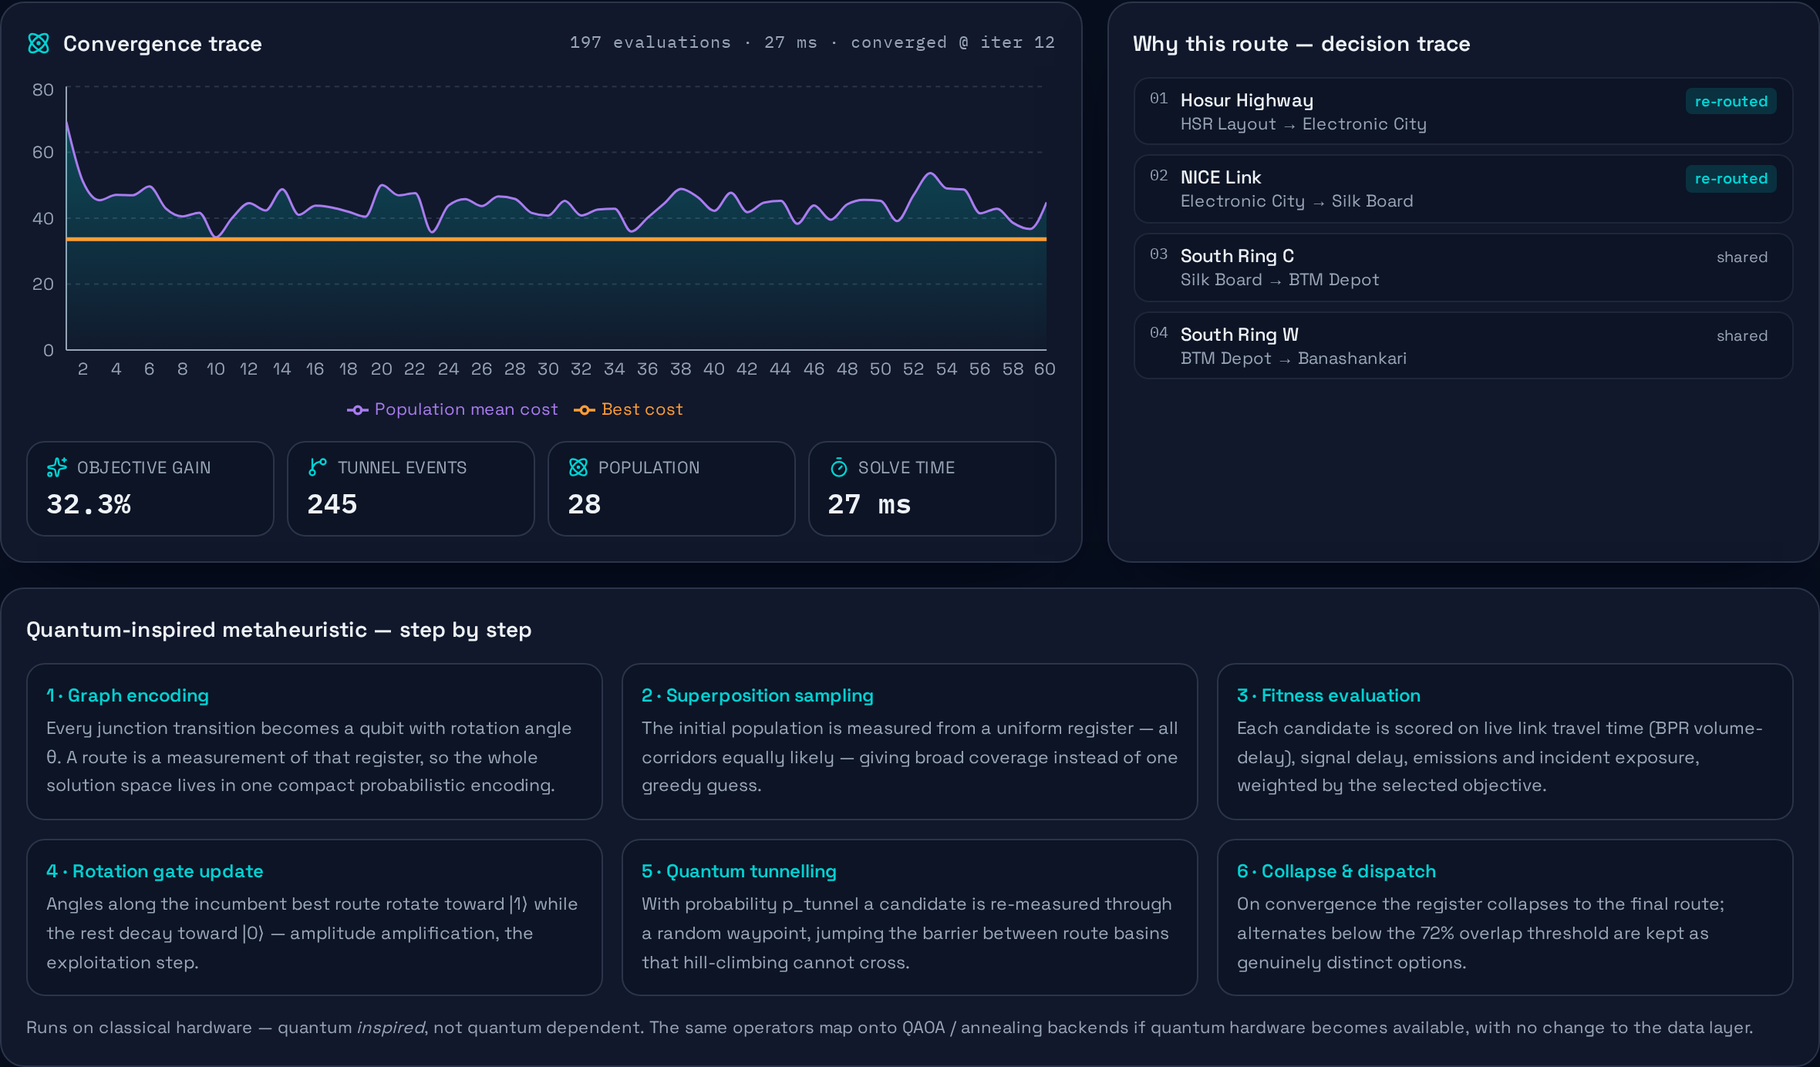
WORKING PROTOTYPE
Explainable optimiser — convergence and decision trace
Judges and city engineers can see the search converge, count tunnelling events, and read link-by-link why the route changed.
SIH26137 · QuantumFlow
7

Slide 8
METHODOLOGY
The quantum-inspired metaheuristic, step by step
1 · Graph encoding
2 · Superposition sampling
3 · Fitness evaluation
Each junction transition becomes a qubit ⟨cosθ, sinθ⟩. A chromosome is the full rotation register over the road graph.
Initial angles are uniform (π/4) — every corridor equally likely. The population is measured from that register.
Live BPR travel time + signal stop-delay + CO₂ + incident penalty, weighted by the selected objective.
4 · Rotation gate update
5 · Quantum tunnelling
6 · Collapse & dispatch
Angles on the incumbent best rotate toward |1⟩, the rest decay toward |0⟩ — amplitude amplification (exploitation).
With probability p a candidate is re-measured through a random waypoint, crossing barriers between route basins.
On stagnation the register collapses to the final route; low-overlap runners-up are surfaced as alternates.
Quantum-inspired, not quantum-dependent — deployable today, upgradeable to QAOA / annealing backends tomorrow.
SIH26137 · QuantumFlow
8

Slide 9
UNDER THE HOOD
Cost model — what the optimiser actually minimises
minimise J(R) = wₜ · Σ tₑ + wₛ · Σ dₑ + wₑ · Σ CO₂(e) + λ · incident(R)
Solver configuration
tₑ = t₀ · (1 + α(v/c)^β) — BPR volume-delay, α=0.15, β=4
dₑ = signal stop-delay, reduced by ATCS green-wave co-ordination
CO₂(e) = idle-corrected urban-cycle emission factor × distance
Population (qubit registers)
28
Iterations
60 (early stop on 12-iter stagnation)
Tunnelling probability p
0.18
Objective presets
Rotation step Δθ
0.09 rad toward |1⟩
Balanced wₜ 1.0 · wₛ 0.6 · wₑ 0.5
Fastest ETA wₜ 1.0 · wₛ 0.2 · wₑ 0.0
Greenest wₜ 0.4 · wₛ 0.3 · wₑ 1.0
Fewest stops wₜ 0.5 · wₛ 1.0 · wₑ 0.2
Alternate overlap threshold
72% of links
Baseline
Dijkstra on static distance
SIH26137 · QuantumFlow
9

Slide 10
SYSTEM ARCHITECTURE
Four layers, one request path
DATA SOURCES
INGESTION & ADAPTERS
OPTIMISATION CORE
EXPERIENCE LAYER
OpenStreetMap / Overpass
TomTom · HERE · MapmyIndia
City ATCS signal feed
CCTV & citizen incident reports
Typed adapter per source
Normalise to graph edges
Simulation fallback when a key is absent
Caching + rate-limit guard
Live network state (BPR)
Quantum-inspired evolutionary solver
Dijkstra baseline & alternates
Decision-trace generator
React command deck (SSR)
Map, metrics, incident feed
Explainability panel
Saved scenarios & exports
→
→
→
Stateless solver: any adapter can be swapped or a city added without touching the optimisation core.
SIH26137 · QuantumFlow
10

Slide 11
LIVE DATASETS
Data flow — demo today, live the moment a key is added
SOURCE
WHAT IT SUPPLIES
ACCESS
DEMO FALLBACK
OpenStreetMap / Overpass
Road geometry, lanes, one-ways, speed limits
Public API
Bundled Bengaluru extract
TomTom / HERE Traffic Flow
Per-segment live speed & jam factor
API key
BPR + time-of-day demand model
MapmyIndia (Mappls)
India-tuned geocoding, incidents, POIs
API key
Synthetic incident stream
City ATCS / signal controller
Cycle time, split, offset per junction
MoU / city feed
Modelled green-wave co-ordination
CCTV counts & citizen reports
Volume counts, crowd-sourced incidents
City integration
Operator-injected incidents
Every adapter reports its own status in the app's Live data integration tab — judges can see exactly what is live and what is simulated. No hidden mocking.
SIH26137 · QuantumFlow
11

Slide 12
PROTOTYPE RESULTS
Measured on the prototype network — 19 junctions, 34 links
−27.2%
−25.1%
−67.0%
Mean ETA cut
Mean signal wait cut
Best-case ETA cut
on re-routed OD pairs vs Dijkstra baseline
cumulative stop delay on the chosen path
HSR Layout → Silk Board at 09:30 peak
40%
6 ms
−3.7%
OD pairs improved
Median solve time
CO₂ in greenest mode
of all 171 pairs; on the rest the classical path was already optimal
max 19 ms — comfortably real-time
up to −12.3% on emission-heavy corridors
Honest note for judges: figures are measured from the prototype's simulated Bengaluru network at 09:30 peak demand, not from field data. The same instrumentation runs unchanged once a live traffic key is supplied — the metric pipeline does not change, only the input feed does.
SIH26137 · QuantumFlow
12

Slide 13
INNOVATION & UNIQUENESS
What has not been done before
Tunnelling beats local optima
Signals as a first-class cost
Glass-box optimisation
A stochastic re-measurement through a random waypoint lets the search cross cost barriers that A* and greedy heuristics cannot.
Stop-delay at each signalised junction is priced into the route and co-optimised with ATCS green-wave splits.
Convergence trace, tunnel-event count and per-link reasoning — auditable by a traffic engineer, not a black box.
Distinct, not cosmetic, alternates
Quantum-ready, classically deployed
Demo-to-live continuity
A 72% link-overlap filter guarantees each option is a genuinely different corridor.
Identical operator structure to QAOA; migrating to quantum hardware needs no data-layer change.
Typed adapters mean the judged prototype is the deployment codebase — no rewrite.
SIH26137 · QuantumFlow
13

Slide 14
FEASIBILITY & SCALABILITY
Buildable now, scalable to a metro
No specialised hardware: the solver is pure TypeScript running server-side; a full re-plan costs single-digit milliseconds.
Scales well with graph size — the register grows with edges while population and iterations stay fixed; corridor partitioning keeps a 10,000-link metro graph in budget.
Horizontally scalable: solves are stateless and independent, so requests fan out across serverless workers.
Graceful degradation: if a traffic API is rate-limited or down, the adapter falls back to the modelled cost surface and flags reduced confidence rather than failing.
Adoption path: pilot on one corridor with a city traffic police MoU, validate against ATCS ground truth, then widen zone by zone.
Risks
· Traffic API cost at metro scale
· ATCS data-sharing approvals
· Sparse coverage on interior roads
· Induced demand if adoption is high
Mitigation
· Cache + tile-level batching
· Start with public OSM + city MoU
· Probe-vehicle & citizen reports
· Network-level load balancing in the cost function
SIH26137 · QuantumFlow
14

Slide 15
IMPACT & BENEFITS
Who gains, and how
Commuters
City & traffic police
Environment
Shorter, more predictable trips and fewer signal stops — measurable minutes returned every day.
A live network-health view, incident impact estimates and a routing lever during events, VIP movement and monsoon flooding.
Fewer idling minutes at junctions directly cuts CO₂ and particulate exposure in the densest parts of the city.
Emergency & logistics
Economy
Research & policy
Priority routing for ambulances and freight, using the same engine with a different objective weighting.
Reduced fuel burn and recovered productive hours across the commuting population.
Scenario mode lets planners test demand shocks and road closures before they happen.
SIH26137 · QuantumFlow
15

Slide 16
TECH STACK
What the prototype is built with
Frontend
Optimisation
React 19 · TypeScript
TanStack Start (SSR)
Tailwind CSS v4 design tokens
Recharts · SVG network map
Quantum-inspired evolutionary algorithm
BPR volume-delay model
Dijkstra baseline
Multi-objective cost function
Data & integration
Platform
OpenStreetMap / Overpass
TomTom · HERE · MapmyIndia adapters
ATCS signal adapter
Typed fallback simulation layer
Server functions on edge runtime
Lovable Cloud (Postgres) for saved scenarios
Vite build · CI preview deploys
SIH26137 · QuantumFlow
16

Slide 17
ROADMAP
From prototype to city deployment
PHASE 1 · Now
Working prototype: simulated Bengaluru corridor, full optimiser, explainability, adapters stubbed and documented.
PHASE 2 · 0–3 months
Plug in live OSM extract + one traffic-flow API. Validate ETA predictions against probe data on a single corridor.
PHASE 3 · 3–6 months
City MoU for ATCS signal data. Closed-loop green-wave co-optimisation pilot on one arterial. Ambulance priority mode.
PHASE 4 · 6–12 months
Metro-scale graph with corridor partitioning, mobile app + control-room console, published impact study.
PHASE 5 · 12 months+
QAOA / annealing backend evaluation, multi-city rollout, open API for state transport departments.
SIH26137 · QuantumFlow
17

Slide 18
TEAM
Team QuantumFlow
[NAME — replace]
[NAME — replace]
[NAME — replace]
Team Lead · Optimisation
Solver design, cost model, benchmarking
Frontend & Visualisation
Command deck, map rendering, explainability UI
Data Engineering
OSM extraction, traffic API adapters, caching
[NAME — replace]
[NAME — replace]
[NAME — replace]
Backend & Platform
Server functions, database, deployment
Domain & Research
Traffic engineering, ATCS liaison, validation
Product & Presentation
User research, demo narrative, documentation
Replace the bracketed placeholders with your team members, institution and mentor before submission.
Thank you — live demo ready.
SIH26137 · QuantumFlow
18

