Slide 1


ChecksumGuard:
Automatic Integrity Verification and Reporting
IV Year B.Tech II Semester– Major Project Review (Review-2)
Team Members Details
Pilli Arun Kumar – 20N31A6252
Kotha Karthik – 20N31A6234
B. Madhu Kumar – 20N31A6206
B. Shashi Kumar – 20N31A6203
IV Year B.Tech – CSE Cyber Security
Under the Guidance of
S Vishwanath Reddy
Assistant Professor
Department of Emerging Technologies

Slide 2
Outline
Abstract
Introduction
Existing System
Proposed System
Difference between Existing and Proposed
Literature Review
Architectural Diagram
Technical Requirement Specification
Other System Diagrams
Test Cases
Status of the Project

Slide 3
Abstract
ChecksumGuard Overview:
Being designed for Windows environments.
Addresses the critical need for file and folder integrity.
Implements automated checksum generation and verification.
Automated Checksum Generation and Verification:
Generates unique hash values for selected folders and files.
Acts as digital fingerprints to encapsulate data integrity at a specific point in time.
Seamlessly integrates into daily workflow through user configuration.
Minimizes manual effort for integrity checks, providing a proactive data security approach.
Reporting Functionality:
Verifies file integrity and generates comprehensive reports.
Reports detail the status of each file or folder.
Reports are forwarded through email for prompt notification of potential changes.

Slide 4
Introduction
ChecksumGuard is introduced as a robust solution designed specifically for Windows environments.
The application aims to address the critical need for ensuring the integrity of files and folders within a system.
ChecksumGuard operates by implementing an automated checksum generation and verification mechanism.
The core functionality involves generating unique hash values, acting as digital fingerprints that encapsulate the integrity state of data at a specific point in time.
Through user configuration, the process seamlessly integrates into the daily workflow, automating the generation and verification of checksums.
A notable feature is the reporting functionality, not just verifying file integrity but also generating comprehensive reports detailing the status of each file or folder.
These reports are conveniently disseminated through email.

Slide 5
Existing System
Manual hash generation using external tools or commands.
Lack of a user-friendly file selection interface.
Limited to specific hash algorithms.
Users must manage and document hash values manually.
Limited automation; users need to execute commands for each file.
No option to save or export hash values.
No integration with email for easy sharing.

Slide 6
Proposed System
Graphical user interface for file selection.
Options to select single files or entire folders.
Supports multiple hash algorithms simultaneously.
Displays hash values in the application.
Allows users to save hash values to a text file.
Integrated email functionality for sharing hash values.
Automatic local file deletion after email sending.
Basic error handling for email operations.

Slide 7
Existing <vs> Proposed System
List out the differences between proposed and existing application..

Slide 8
Literature Review
S. NO | Title | Authors and year | Advantages | Disadvantages | Future Scope
1 | Cryptographic hash functions: cryptanalysis, design and applications. | PhD thesis, Queensland University of Technology. | Provides an in-depth analysis of cryptographic hash functions. | They are vulnerable to various types of attacks, such as collision attacks, preimage attacks. | The article could explore the applications of cryptographic hash functions in emerging fields, such as blockchain etc.
2 | Performance Analysis of Cryptographic Hash Functions Suitable for Use in Blockchain. | International Journal of Computer Network & Information Security, 2021 | Evaluates the performance of cryptographic hash functions in the context of blockchain applications. | They have limited output sizes, which may reduce their security or efficiency. | Propose new methods or techniques to improve the security or performance.

Slide 9
S. NO | Title | Authors and year | Advantages | Disadvantages | Future Scope
3 | Enhancing file system integrity through checksums. | G Sivathanu, CP Wright, E Zadok – 2004. | Addresses the importance of ensuring file system integrity through the use of checksums. | It is not compatible with some existing protocols or applications. | Extend the design and the implementation of NC-Checksum to support other types of network coding.
4 | RIVA: Robust Integrity Verification Algorithm for High-Speed File Transfers. | Batyr Charyyev, Stevens Institute of Technology, Hoboken, USA, Engin Arslan, University of Neveda, Reno, USA. | Introduces RIVA, a new algorithm for enhancing file transfer integrity. | New algorithm consisting of many issues related to performance etc. | Implementation and testing of RIVA in various high-speed file transfer scenarios.

Slide 10
Architecture Diagram or
System Diagram

Slide 11

System Architecture
ChecksumGuard
File/Folder
Calculate Hash
Verify
Configuration
File System
Algorithms
SHA512
MD5
…….
Task Scheduler
{#} Hash value
Report
Email Credentials
Send
Save

Slide 12
Technical Requirements Specifications

Slide 13
Software Requirement Specifications (SRS)
Operating System:
Windows Environment
Programming Language:
Python 3.9
Integrated Development Environment (IDE):
Visual Studio Code
Hashing Library:
hashlib
Email Library:
smtplib

Slide 14
Hardware Requirement Specifications
Mention only the Major Hardware Used to develop the application like System or Processor configuration, RAM, HDD Capacity Required, IoT Devices details etc…

Slide 15
Application Modules
File and Folder selection module
Checksum calculation module
Hash Values file generation and saving module
Email dispatch module
Verification module
Reporting module
Configuration module

Slide 16
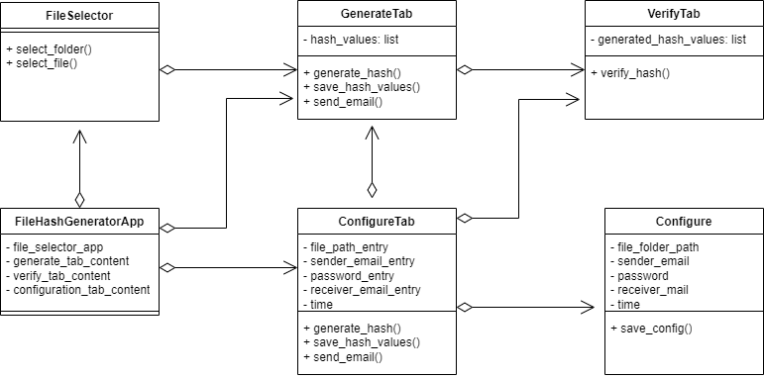
Class Diagram

Slide 17

Use-Case Diagram
Select File/Folder
Generate Hash
Save Hash Values
Send Email
Sender
Configure Automation
Receiver
Receive Mail
Verification

Slide 18
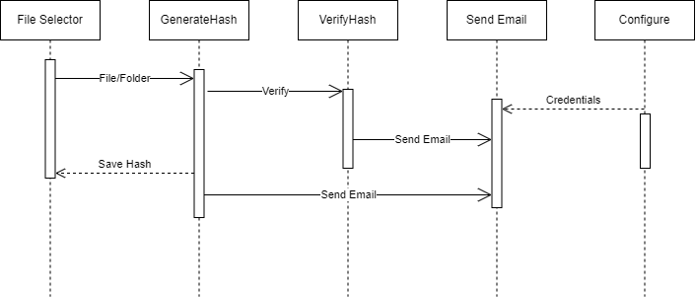
Sequence Diagram

Slide 19
Conclusion
"ChecksumGuard: Automatic Integrity Verification and Reporting" is designed for Windows environments, offering a solution to enhance data integrity.
Key functionalities include the generation of unique hash values, configurable storage, and automated verification at scheduled intervals.
The integration of email capabilities allows seamless sharing of hash values, promoting communication and collaboration among users.
The user-friendly interface ensures accessibility, providing a straightforward experience for users.
Emphasis on security is evident through the implementation of encryption and secure transmission protocols for handling sensitive data.
The application's versatility makes it a reliable choice for users across various industries.
Future enhancements, guided by user feedback, may introduce features like cloud storage integration and expanded reporting options.

Slide 20
Testing and Test Cases

Slide 21
Status of the Application Development
SRS finished
80% of project development done

Slide 22
Tentative Date of Application Completion
The application will be completed by 25th of February 2024

Slide 23
Thank you
Pilli Arun Kumar – 20N31A6252
Kotha Karthik – 20N31A6234
B. Madhu Kumar – 20N31A6206
B. Shashi Kumar – 20N31A6203

