Slide 1
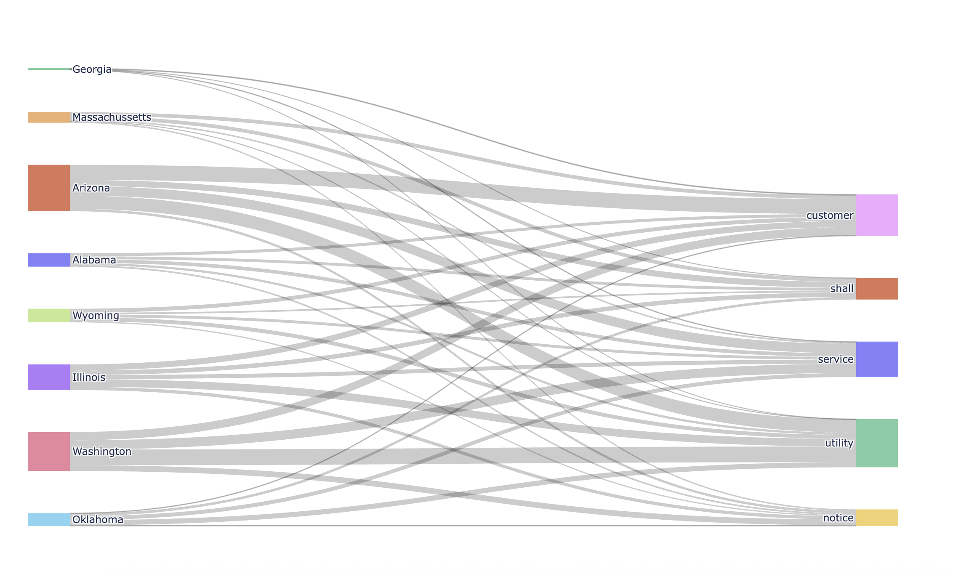
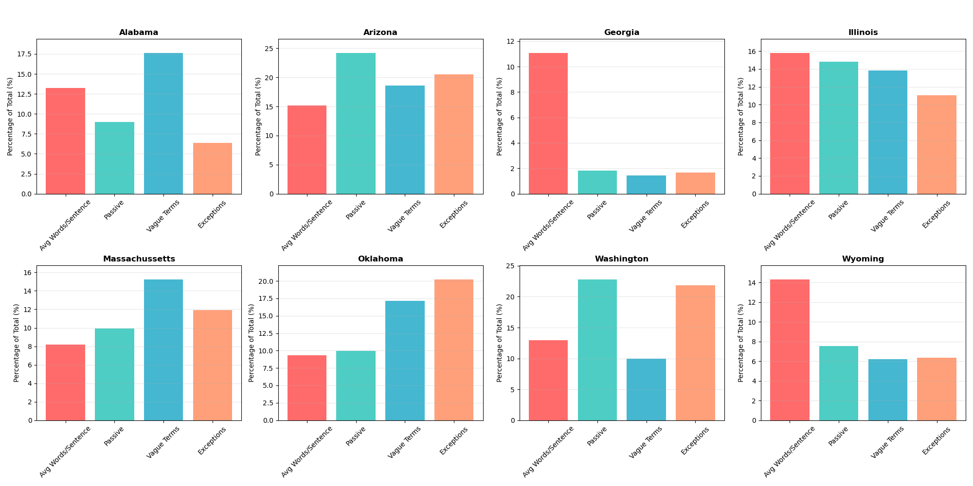
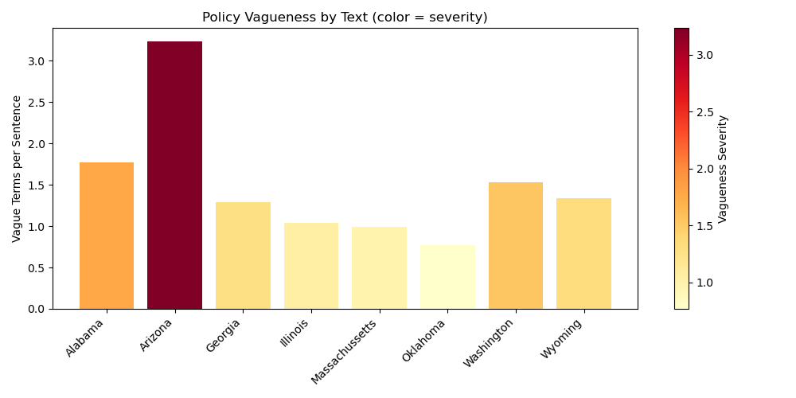
Mentor Name. :
Subject/Category :
Class : Group # :
Analyzing Language in Policy Text
Kate Lautenbach
Background, Motivation, and Goals
The collection of texts are policies that dictate the restrictions on utility companies to keep utilities on in extreme weather circumstances. It is inspired by a friend and current IU student who has collected a list of all the policies/state codes and is using non-coding methods to determine which states have the best and worst protections.
Figure 1
A Sankey diagram of the top five most common words over all the texts
Findings and Products
Figure 3
Bar charts of each policies use of passive voice, clause separating punctuation, number of words per sentence, and instances of exceptions withing the policy. These are normalized by what percentage of instances each policy has of all the texts so the metrics can be shown correctly scaled
Process and Methods
The parameters examined for this project were punctuation that indicates multiple clauses (semicolons, colons, and commas). These words assume exceptions to a policy, the use of passive voice, the number of words per sentence, and words that invite vague and lax interpretations of the policy. The first three all lead to convoluted and confusing sentences, which make the policy hard to read. The latter allows for more loopholes or, at the very least, an unfair interpretation of the policy that reduces the protections provided.
Figure 2
A heat map that shows how vague each states policies are.
Conclusion and Next Steps
It would be helpful to research more terms to match to the text for exceptions and vagueness, as well as look into the linguist tree to measure the complexity of the sentence rather than more general and less specific attributes. Also, when the research becomes available a list of the best and worst policies would be interesting to compare to these scores.

