Slide 1
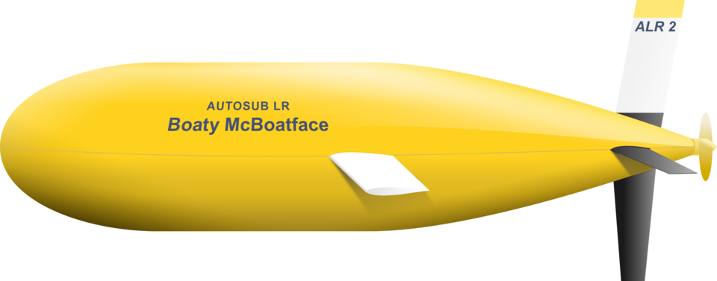
Skillspire: AI & ML
Final Project:
Yacht or Not? Boat Image Classification
Ken Lindsay
Image courtesy of:
https://en.wikipedia.org/wiki/Boaty_McBoatface

Slide 2
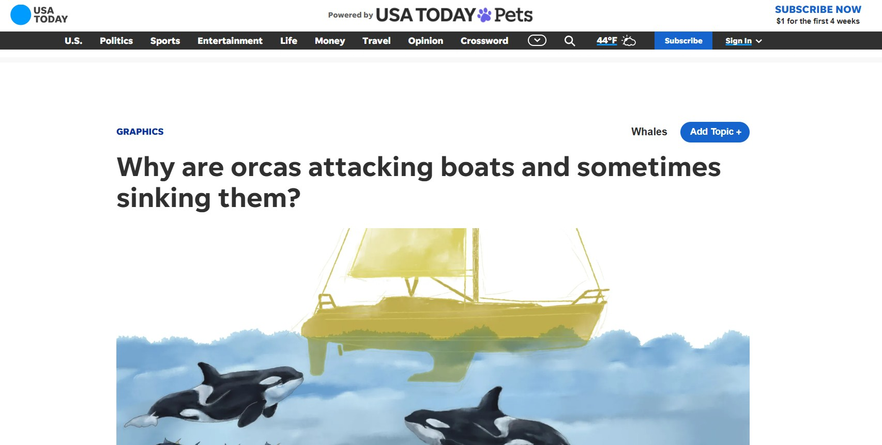
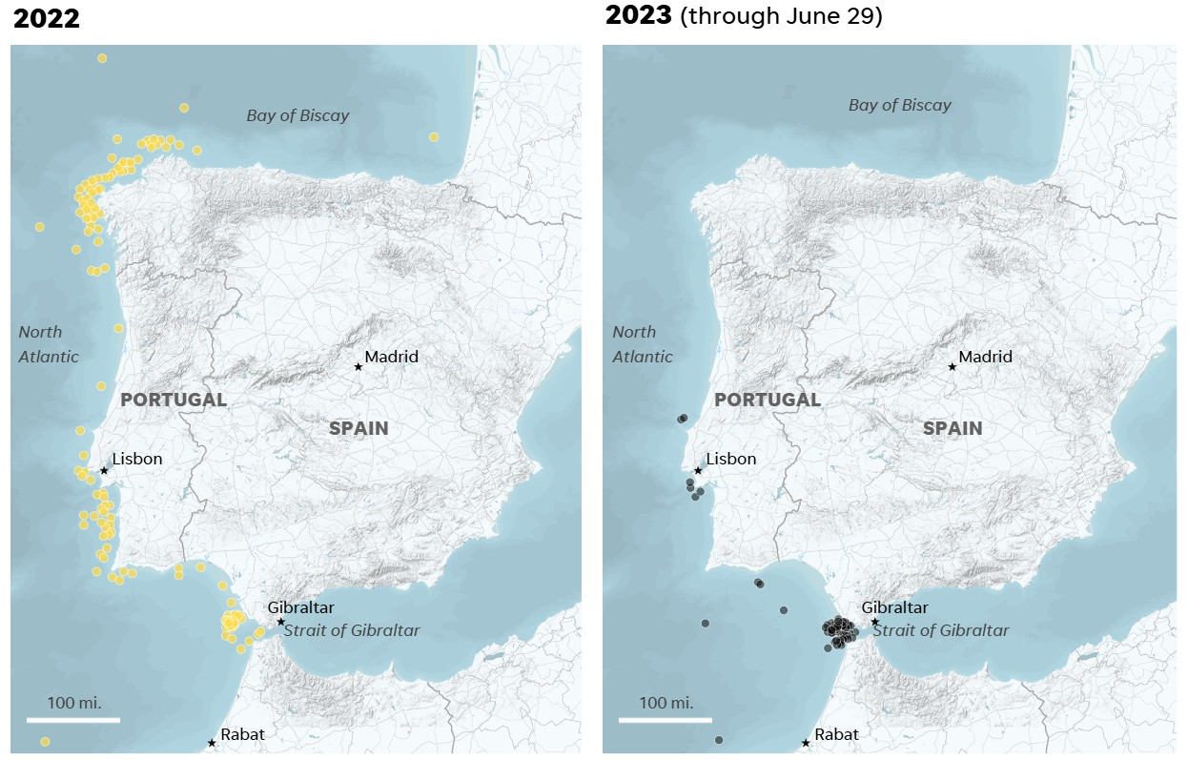
Boat Identification: Yacht or Not?
A little background
and inspiration…
Could we use a basic image classifier model to identify ship type based on an image dataset of boats of interest?
Images referenced from:
https://www.usatoday.com/story/graphics/2023/07/08/why-killer-whales-attack-boats/70364629007/

Slide 3
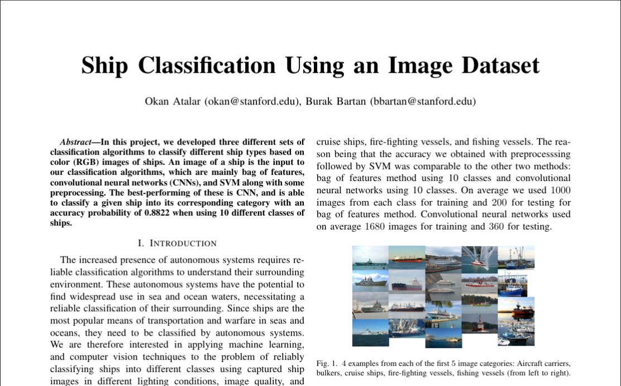
Selecting a Boat Image Dataset
Kaggle Dataset used in a previous hackathon:
https://www.kaggle.com/datasets/arpitjain007/game-of-deep-learning-ship-datasets
8932 Images of 5 Data types…
5 Classifications of boats:
Cargo
Military
Carrier
Cruise
Tanker
Historical datasets for models of high accuracy and diversity of classification are much larger than this.

Slide 4
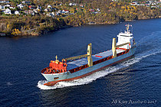
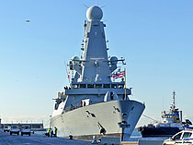
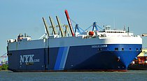
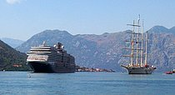
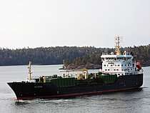
Boat Image Classes
1. Cargo
2. Military
3. Carrier
4. Cruise
5. Tanker
I say?! Am I not a boat?!

Slide 5
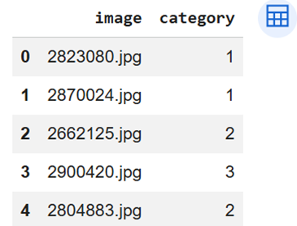
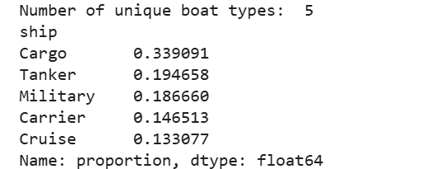
Data File Structure
Using a folder containing all images, the representative training, test, and validation datasets are generated using a “.csv” file with image name and category.
Note: I considered this approach as opposed to ‘ImageFolder’ methods which already parsed data in individual train, test, and validation folders with subfolders for categorization.
What worked best for you?

Slide 6
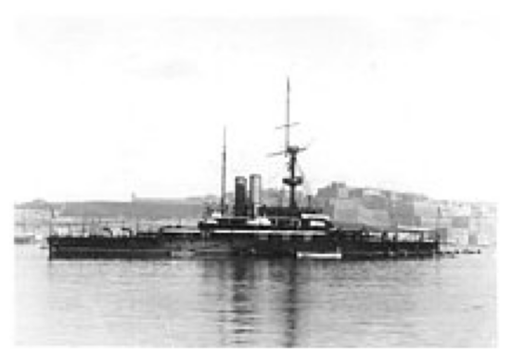
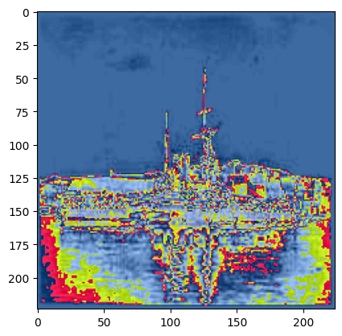
Transforming image to tensor
Following image resizing and transfer to RGB based tensor, I then took that tensor and previewed the image from tensor format as I was curious to see what the code was looking at.

Slide 7
General Model Stats / Configuration
Batch of images shape: torch.Size([32, 3, 224, 224])
Batch of labels shape: torch.Size([32])
Train samples: 4376, Val samples: 938, Test samples: 938
CrossEntropyLoss
Adam Optimizer
4 layered CNN
Trained for 30 Epochs.
Rationale for set-up:
# of Epochs guidance:
10-50 for < 10,000 images
50-200 for > 10,000 images
100-500 for >100,000 images
4 Layer configuration is nimble enough for basic image classification.
Time and processing power is definitely a factor!

Slide 8
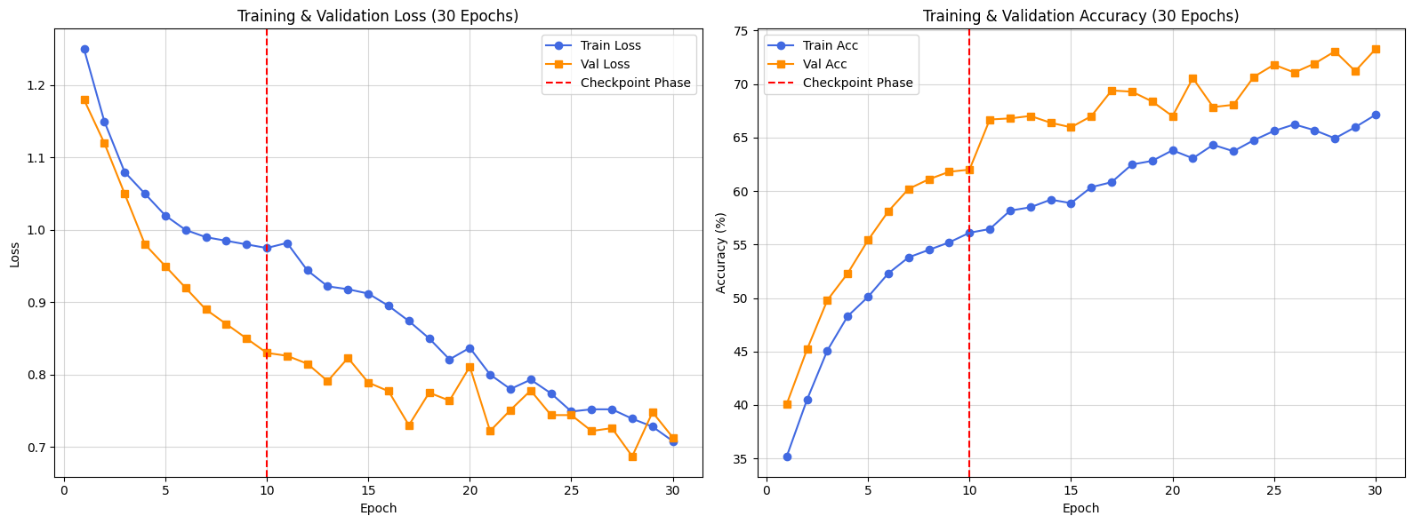
Model Loss and Model Accuracy
Due to time constraints, the model was limited to 30 epochs, but even then, there were significant diminishing returns towards the final epoch.

Slide 9
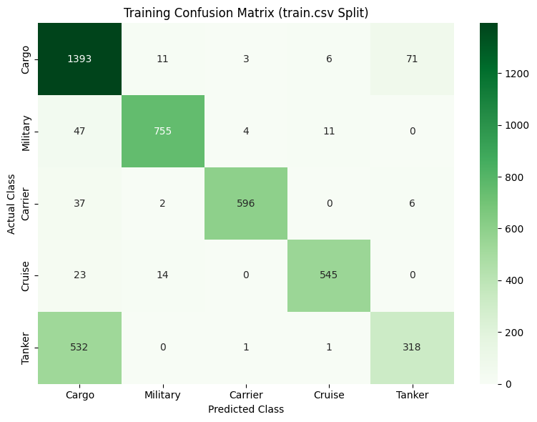
Confusion Matrix Observations
1. Cargo
5. Tanker
As there were more cargo ships represented in the dataset and the overall similarity of the dataset images, the low resolution of the model as it stands may not be sufficient.

Slide 10
General Observations
Total Trainable Parameters: 3,309,957
Average Inference Speed: 29.87 ms per image
Accuracy: 73.27% based on 938 validation images.

Slide 11
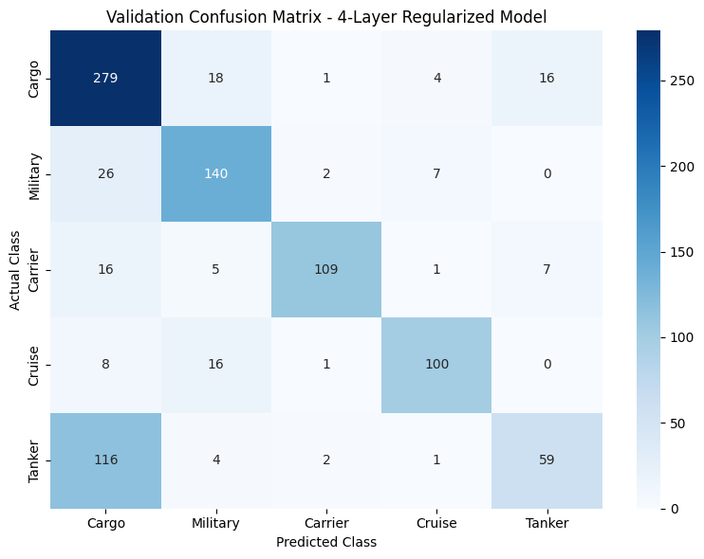
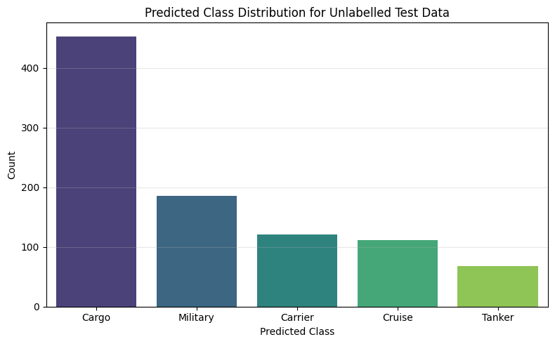
Validation Data Results

Slide 12
Takeaways and after actions
Building a CNN takes a lot longer than I thought!
Testing various model configurations to see which one works for your dataset.
Epochs for training can take quite awhile for even a relatively basic CNN.
Learning new skills as you go!
Would like to incorporate transfer of layers to more CNN models such as ResNet18 or 50.
(A head to head comparison would have been a great addition!)
Fine tune and increase diversity of classifiers to include other ship types, so as to ultimately answer the question:
Yacht or Not?

Slide 13
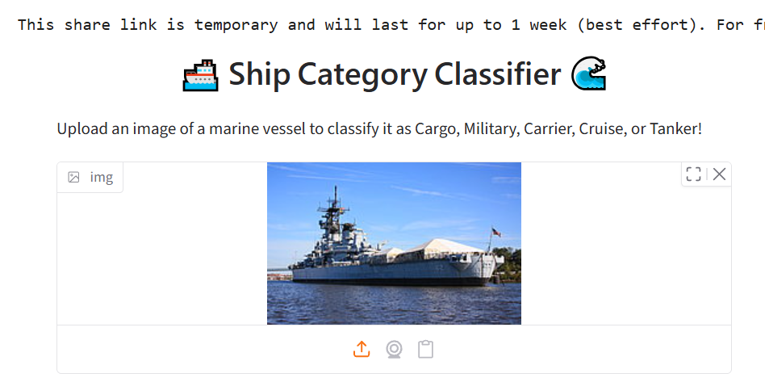
Reference Material
Reference Images used:
Dataset Reference:
1. Cargo - 299281
2. Military - 2799238
3. Carrier - 2867453
4. Cruise - 1607915
5. Tanker - 2902674
https://www.kaggle.com/datasets/arpitjain007/game-of-deep-learning-ship-datasets

