Slide 1
























PYEXPO25
Genius innovation leaves behind a legacy...
Team ID: T026
Team Name: Hack Hustlers
PS Number: PYS114
PS Title: Student Innovation
Domain: Computer Vision (CV – AI & ML)
Category: Software

Slide 2
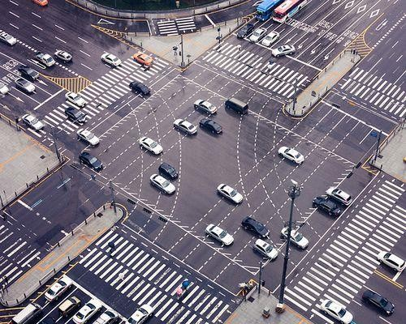
Problem Statement:
Congestion levels and traffic is reduced by analyzing and manipulating the signal timings in each lane of the junction.
Traffic signals contain the same timings for the red and green lights
which may waste time.
Vehicles in the busier lane may waste time while the other free lanes are left free.
In case of Road Rules Violation, Automated traffic violation detection is implemented to inform the traffic controller/headquarters.

Slide 3



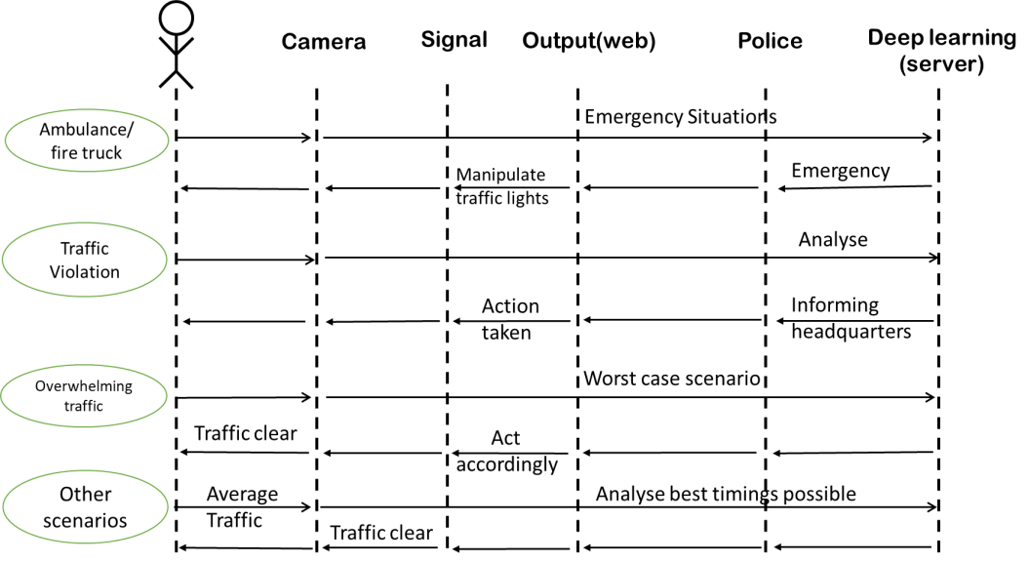







Proposed Solution and overview:
Manipulating the signal timings to match the traffic of
each lane using DEEP LEARNING.
The green signal of the busier lane is allocated with extra timings to clear the traffic on that lane.
The timings of the signal for the other lanes are also
adjusted accordingly to clear the traffic in that junction.
Automated Traffic violation detection – to inform the traffic controller/headquarters in case of violation of road rules

Slide 4







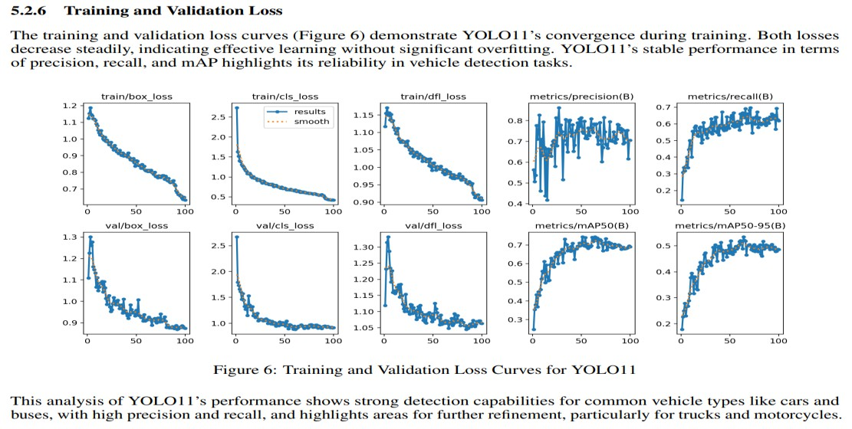












Data And Model :
Data Sources: coco datasets (pretrained model data set)
Model: YOLO11 (Vehicle detection · Deep learning · Intelligent transportation systems · Autonomous driving
· Object detection · Real-time detection · Computer vision).
Highlight preprocessing, training methods, or tools (e.g., PyTorch, TensorFlow).

Slide 5

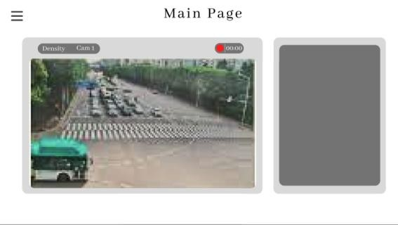

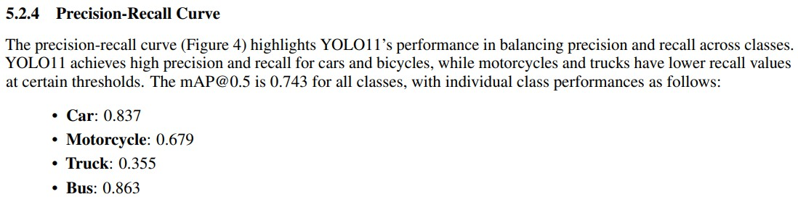
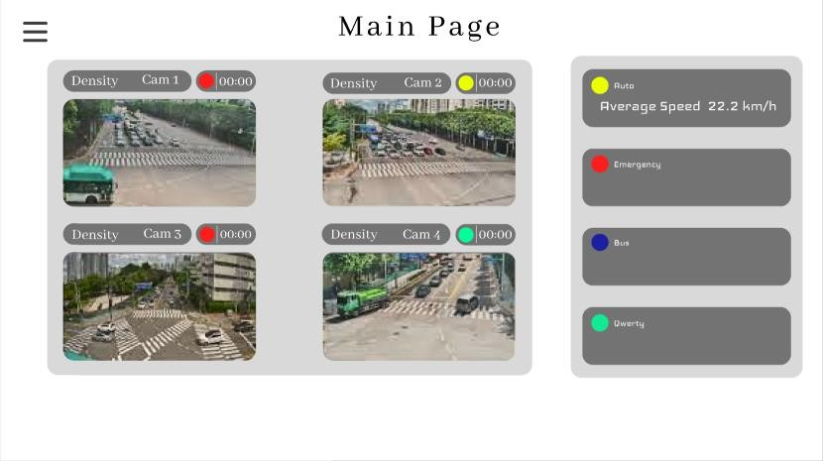
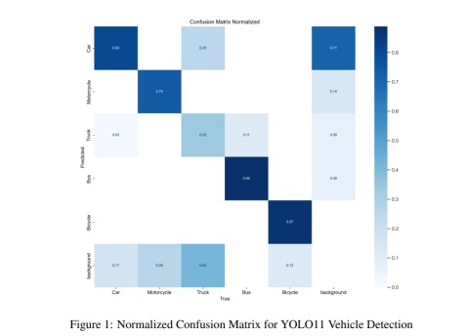

Result & Evaluation:
Show performance metrics (e.g., accuracy, F1-score, ROC curve).
Visualizations (e.g., confusion matrix, graphs) to back your claims.

Slide 6
Impact and Benefits:
Impactful problem solving – Signal control optimization.
Alignment with Smart City goals.
Focused scope: Reduces man power by controlling signal autonomously.
Ethical Considerations & Real-world Applications:
Augmented waiting time for vehicles in the lane with less traffic.
It can be implemented and used in real-world traffic junctions to clear traffic.

Slide 7
Team Member Details:
Name | Roll No | Dept
Deepak K M | 24UCS121 | CSE
Mirdula R | 24UCY127 | CYS
Logesh Raj B | 24UCY125 | CYS
Jaisurya S | 24UCY114 | CYS
Piriya Dharshini L K | 24UCY135 | CYS

Slide 8
THANK YOU !

