Slide 1
Handwritten Text Recognition Using Neural Networks
Presented By,
Karthikeyan Mehaligam
801210897
University of North Carolina at Charlotte

Slide 2
Motivation
Handwritten character recognition is a popular subject of research. The habit of handwriting remains with everyone, but people want to have those handwritten copies converted into electronic copies which can be shared and stored.
The concept of handwriting character recognition refers to the ability of a computer to detect, interpret and convert handwritten input from various sources such as touch screens, images, and documents.

Slide 3
Problem Statement
This project focuses on developing a Handwriting character recognition system that will convert lecture notes into electronic documents.
As a part of this project, Artificial Neural networks will be used for converting handwriting recognition and to convert them.

Slide 4
Data
DataSet : Link
The Dataset contains 26 folders(one for each alphabet) containing handwritten images which are 28x28 pixels in size.
Each image is stored as Gray-level.
The images are stored in csv format. We can use CSVTOImages script to convert the csvfile to actual image in pg format.

Slide 5
Literature Survey
R. R. Ingle, Y. Fujii, T. Deselaers, J. Baccash and A. C. Popat, "A Scalable Handwritten Text Recognition System," 2019 International Conference on Document Analysis and Recognition (ICDAR), 2019, pp. 17-24, doi: 10.1109/ICDAR.2019.00013.
Sara Aqab, Muhammad Usman Tariq, "Handwriting Recognition using Artificial Intelligence Neural Network and Image Processing", (IJACSA) International Journal of Advanced Computer Science and Applications, Vol. 11, No 7, 2020
R. Vaidya, D. Trivedi, S. Satra and P. M. Pimpale, "Handwritten Character Recognition Using Deep-Learning," 2018 Second International Conference on Inventive Communication and Computational Technologies (ICICCT), 2018, pp. 772-775, doi: 10.1109/ICICCT.2018.8473291.

Slide 6
A Scalable Handwritten Text Recognition System
This paper address the problems faced when trying to incorporate a HTR capability to a large scale OCR system. It tries to fix the problem of finding sample data for training and testing the machine by proposing a data pipeline which helps in collecting data from online sources.
They also introduce a line recognition model based on neural networks without recurrent connections. Their proposed model achieves a comparable accuracy with the LSTM-based model.

Slide 7
Handwriting Recognition using Artificial Intelligence Neural Network and Image Processing
This paper proposes the development of a Handwriting recognition system using artificial neural network and explains about the advantages of using artificial neural network. It also discusses about the efficiency of using this method comparing with other techniques. This paper gives a clear idea on the methodology, design and architecture that can be used to create such system.

Slide 8
Selected Paper
Sara Aqab, Muhammad Usman Tariq, "Handwriting Recognition using Artificial Intelligence Neural Network and Image Processing", (IJACSA) International Journal of Advanced Computer Science and Applications, Vol. 11, No 7, 2020

Slide 9
Proposed Solution
This project aims in using Artificial Neural Networks to improve the efficiency of Handwriting Recognition system.
To build a system which can help in converting handwritten notes to a digital document from an image.

Slide 10
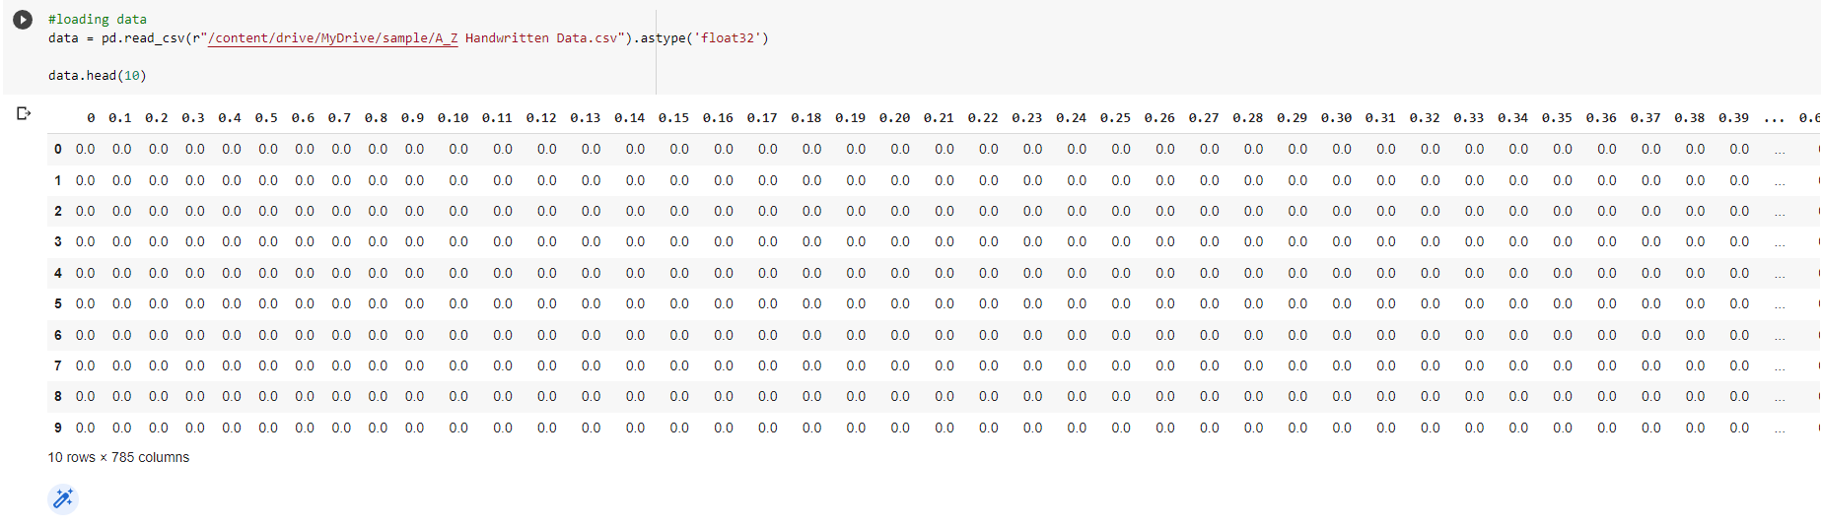
Sample Data View

Slide 11
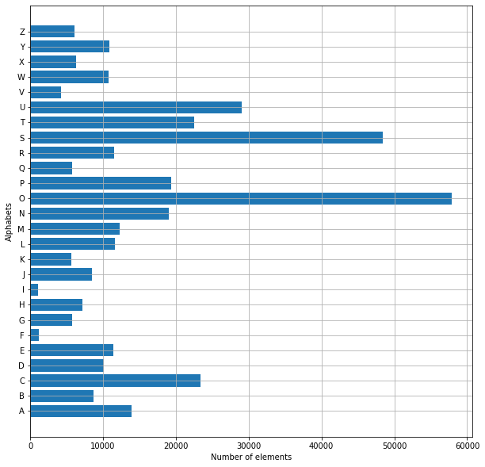
Count of Sample Data Used

Slide 12
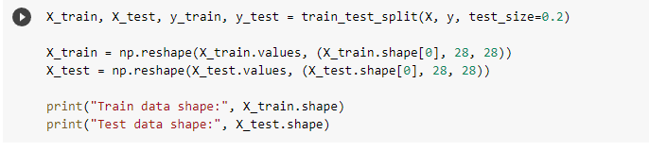
Splitting Sample Data into Train and Test Data

Slide 13
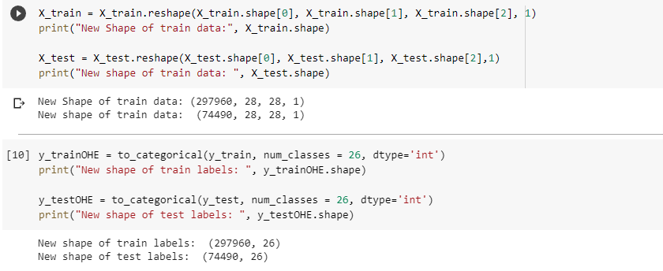
Reshaping the Data

Slide 14
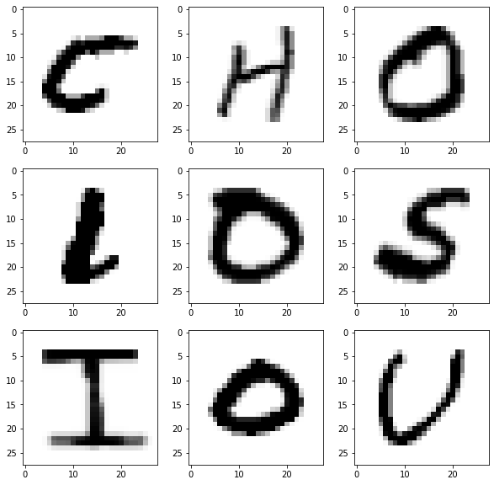
Extracted Data from CSV file

Slide 15
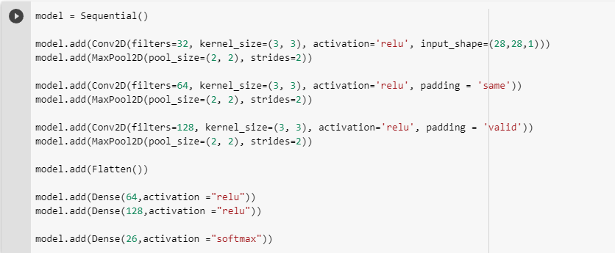
Model Creation

Slide 16
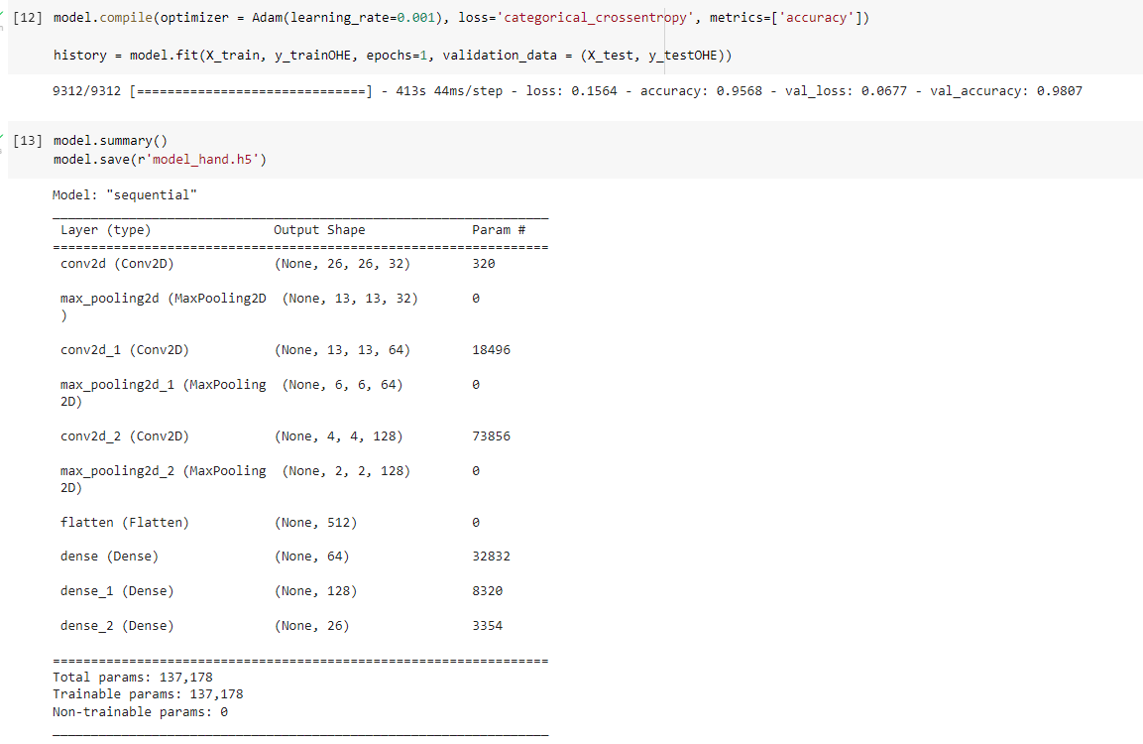
Model Training and Accuracy

Slide 17
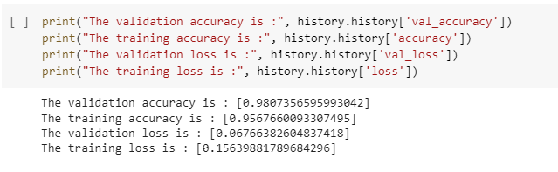
Accuracy

Slide 18
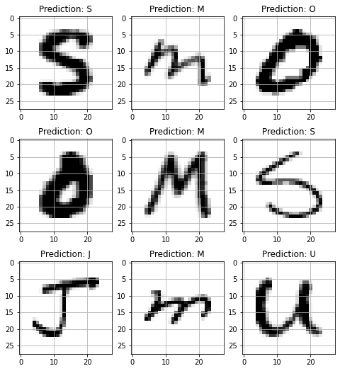
Prediction on Test Data

Slide 19
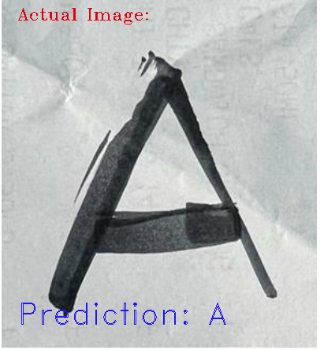
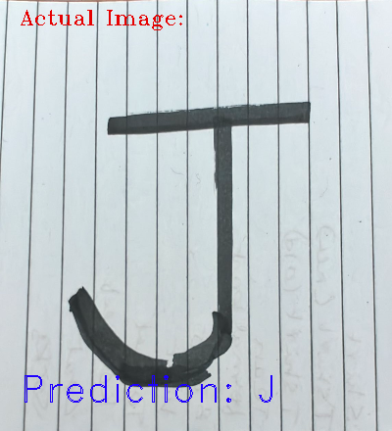
Prediction result on other samples

Slide 20
Future Work
Support to Predict numbers and symbols
Conversion of paragraphs from images to documents.
Application with Realtime conversion and Clipboard feature.

Slide 21
Citations
R. R. Ingle, Y. Fujii, T. Deselaers, J. Baccash and A. C. Popat, "A Scalable Handwritten Text Recognition System," 2019 International Conference on Document Analysis and Recognition (ICDAR), 2019, pp. 17-24, doi: 10.1109/ICDAR.2019.00013.
Sara Aqab, Muhammad Usman Tariq, "Handwriting Recognition using Artificial Intelligence Neural Network and Image Processing", (IJACSA) International Journal of Advanced Computer Science and Applications, Vol. 11, No 7, 2020

Slide 22
References
https://www.kaggle.com/sachinpatel21/az-handwritten-alphabets-in-csv-format
https://data-flair.training/blogs/handwritten-character-recognition-neural-network/

