Slide 1
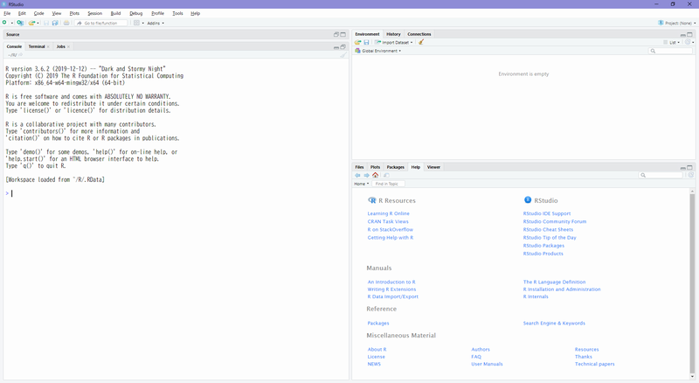
A
C
B
D

Slide 2
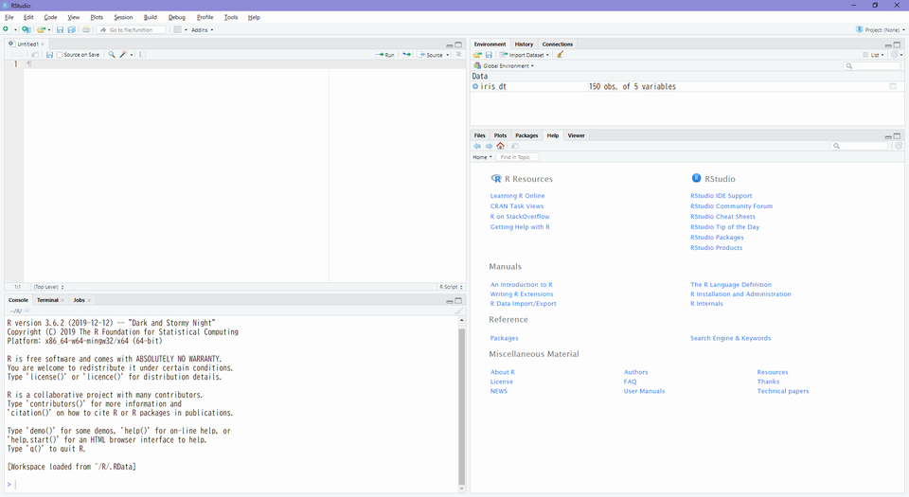

Slide 3
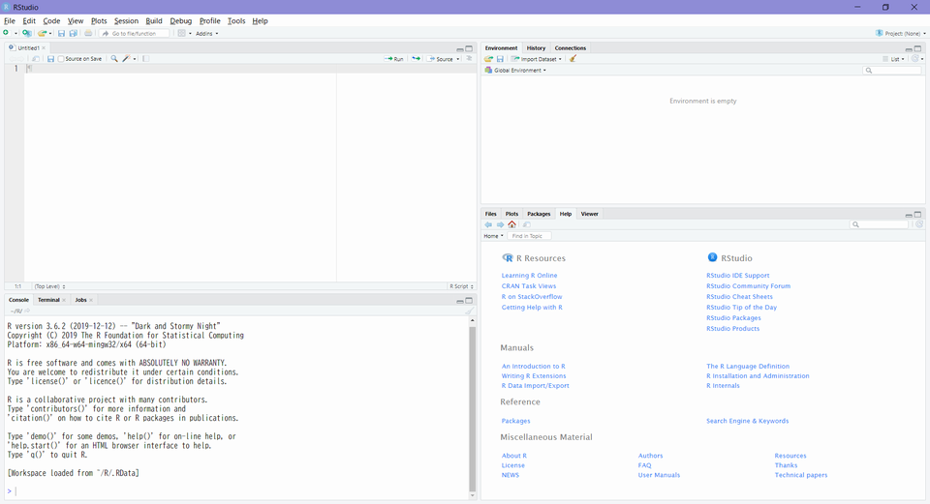
Source Editor
Data Viewer
Environment
History
Connections
Build
VCS(Git or SVN)
File
Plots
Packages
Help
Viewer
Console
Terminal
R Markdown
Jobs

