Slide 1
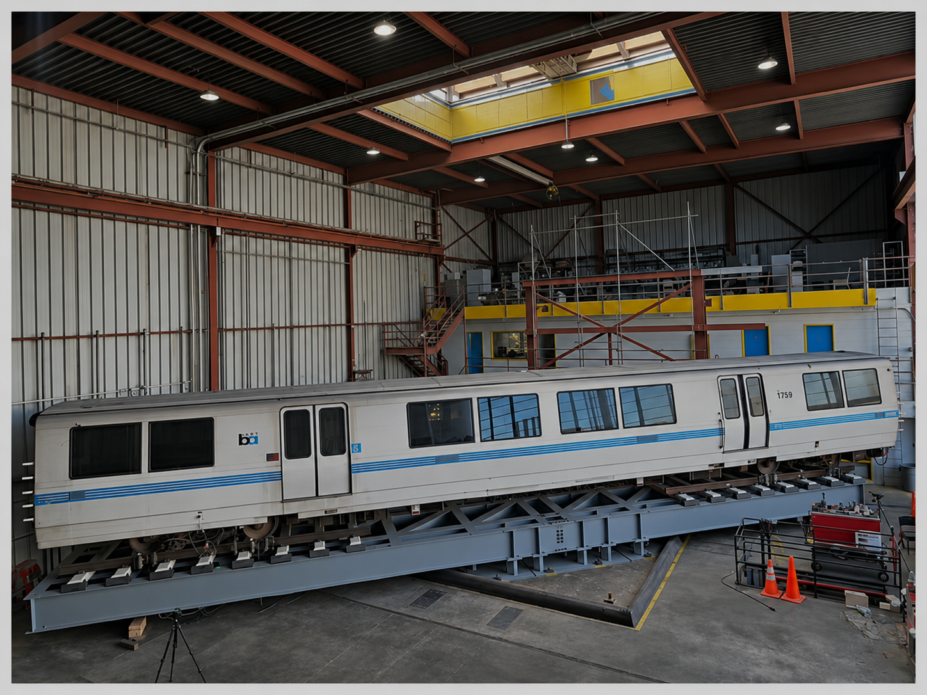
SHAKING-TABLE
TESTS OF A
BART RAILCAR
Earthquake early warning, resilience
and shaking-table experiments
Khalid M. Mosalam
PEER Center · UC Berkeley
Laboratory demonstrations | November 9–10, 2026
Notes:
Welcome to PEER, where we are conducting full-scale shaking-table tests of a BART railcar to better understand seismic performance and support earthquake early warning decisions.

Slide 2
Monday, November 9 | Agenda
Time
Activity
11:00–11:40
Welcome, 15 min overview, setup walk through, posters and Q&A
11:40–12:10
Live shaking-table demonstration: Set 6 + white noise
12:10–12:30
Future collaboration discussion
12:30–1:00
Laboratory tour: Building 484 and other test specimens
Demonstration timing
Four earthquake motions ≈ 9 min; white noise ≈ 6 min; transitions ≈ 10 min.
11
Notes:
We will begin with a brief overview of the research, observe the railcar demonstration, discuss opportunities for future collaboration, and conclude with a lab tour.

Slide 3
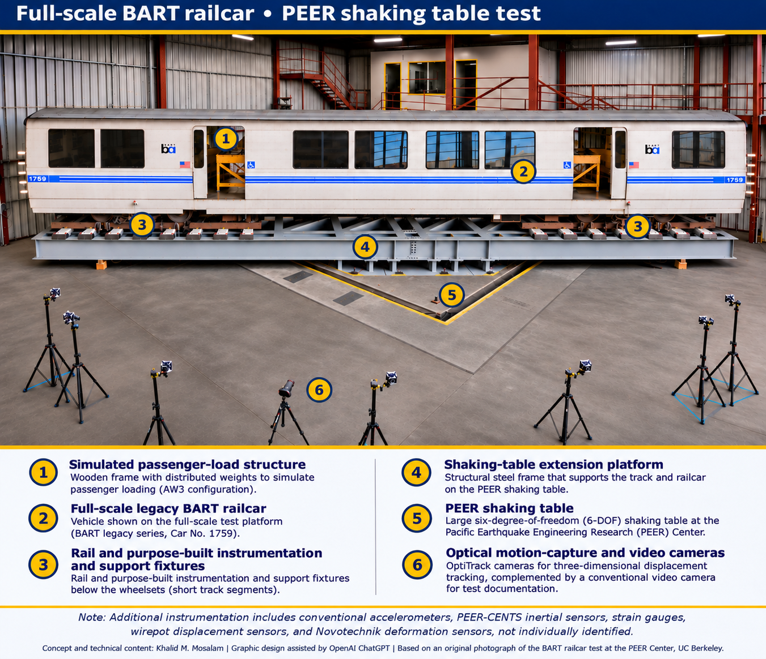
BART Railcar | PEER Shaking-Table Testing
2
Notes:
This unusual experiment brings a full-scale BART railcar into our six-degree-of-freedom shaking-table lab to investigate its response under controlled earthquake motions.

Slide 4
Why Test a BART Railcar?
Earthquake early warning can trigger train slowdowns or stops.
Large-scale testing helps evaluate railcar response and establish defensible shaking thresholds.
Research balances passenger safety, infrastructure resilience, and transit operations.
4
Notes:
Our ultimate goal is to establish technically defensible earthquake shaking thresholds that protect passengers and infrastructure while minimizing unnecessary interruptions to BART operations.

Slide 5
The Overall PEER-BART Research Program
Literature review + numerical simulations + large-scale experiments
Evidence to assess & improve BART shaking thresholds while balancing safety and service continuity
Three complementary experimental programs support the development of evidence-based earthquake early warning thresholds.
BALLASTED TRACK
AERIAL STRUCTURES
FULL-SCALE RAILCAR
Track response and potential ballast disturbance
Seismic damage and implications for train passage
Vehicle response, rocking and potential uplift
Today’s live railcar demonstration is one component of this larger program.
5
Notes:
The broader research combines numerical modeling with three complementary experimental programs involving ballasted track, aerial structures, and the railcar itself.

Slide 6
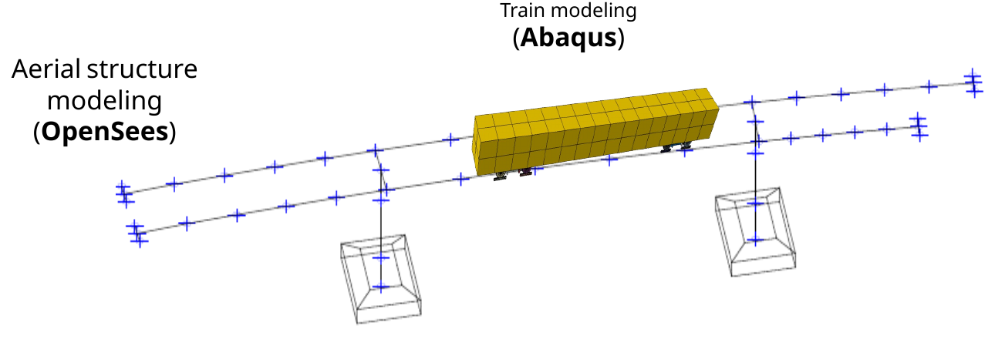
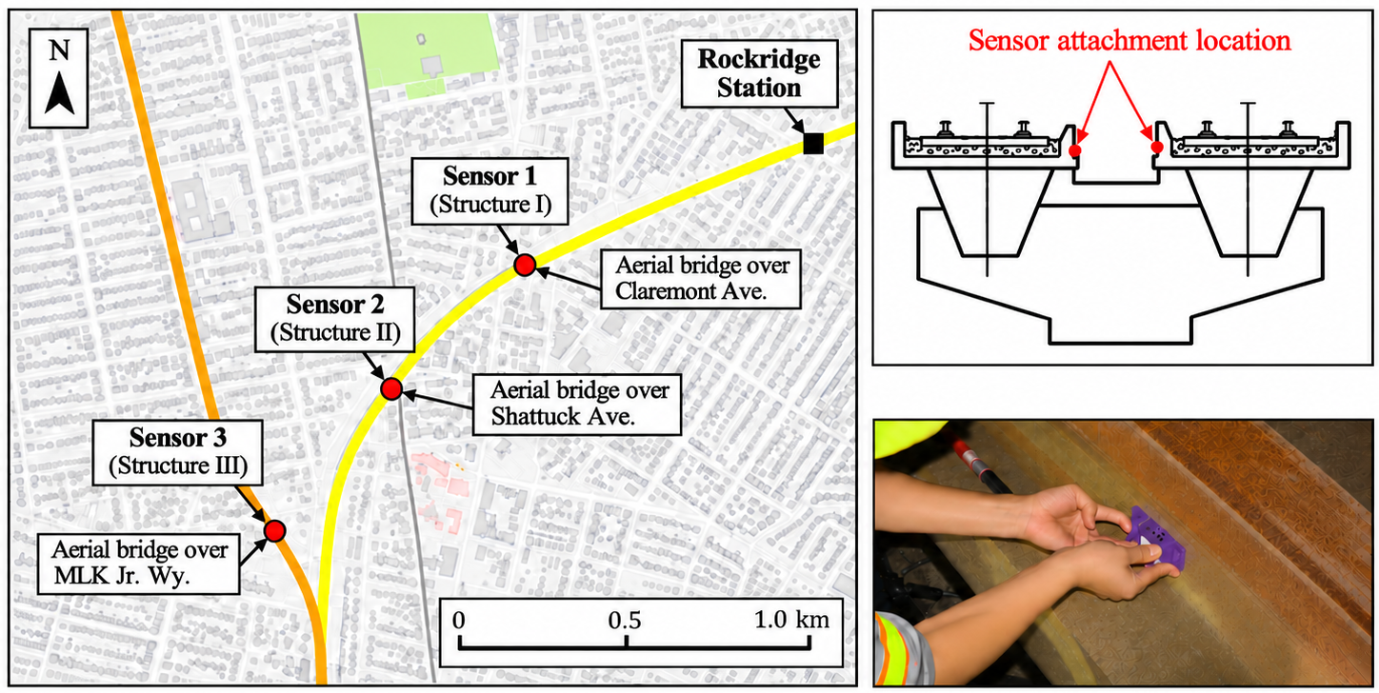
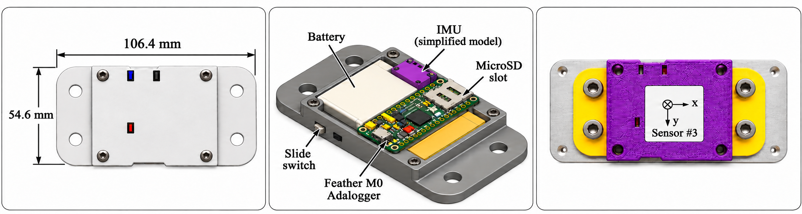
From Numerical Models to Large-Scale Experiments
Analytical and field studies
Aerial structures modeled in OpenSees and railcars in Abaqus, supported by PEER-CENTS field measurements.
PHASE II · MODELED AERIAL SITES
Rockridge area · three structures
I · Claremont Ave. (straight)
II · Shattuck Ave. (curved)
III · MLK Jr. Way (long-span)
Simulations of varying earthquake intensities helped inform the experimental program, including selection of the prototype aerial structure.
6
Notes:
We developed numerical models of BART aerial structures and railcars, supported by field measurements, to guide the design and interpretation of the experimental studies.

Slide 7
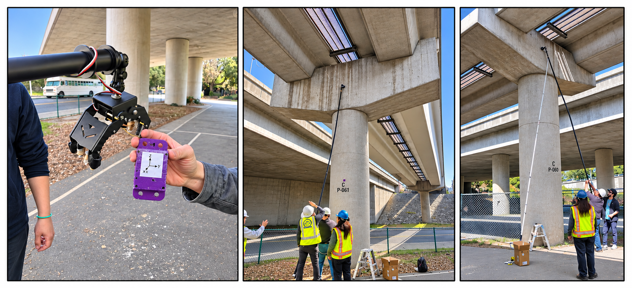
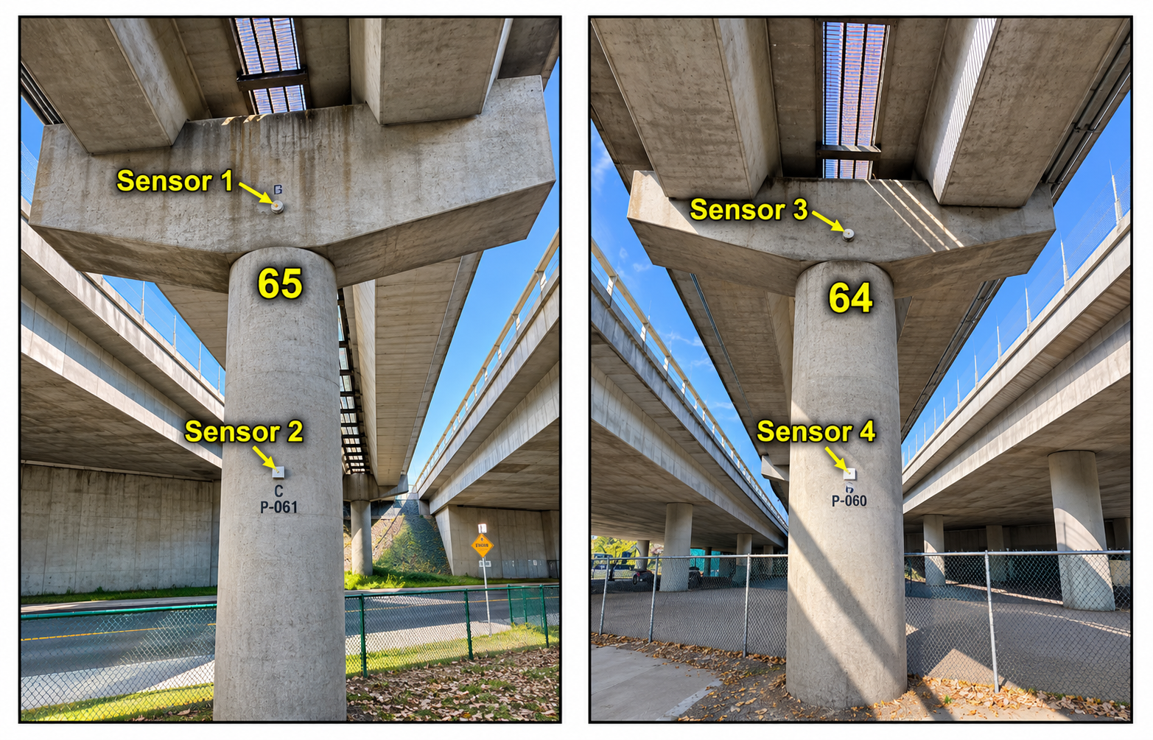
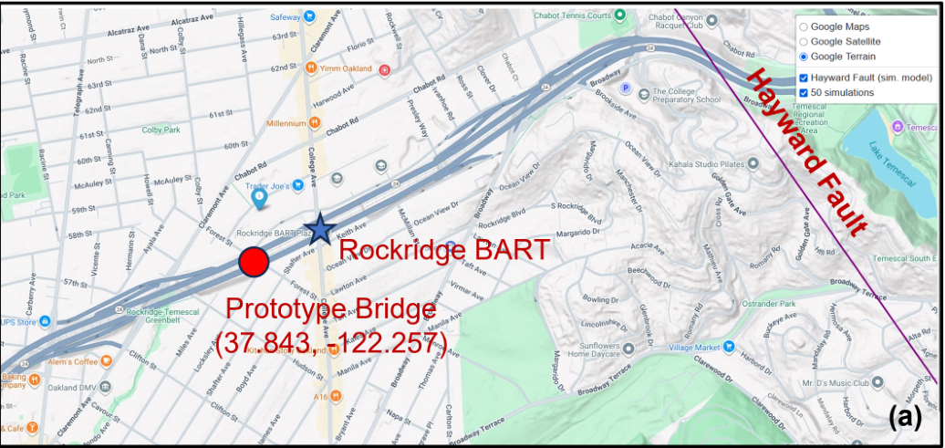
BART Field Tests · PEER-CENTS and Robotic Deployment
Prototype aerial structure · sensor placement and vibration measurements
In-house robotic arm and flexible pole used to install and retrieve PEER-CENTS units.
Sensors placed at difficult-to-access column and cap-beam locations.
Field vibration measurements supported identification of structural dynamic characteristics.
PROTOTYPE SITE · ROCKRIDGE
37.843° N, 122.257° W · Column 65
7
Notes:
At the Rockridge prototype site, we deployed PEER-CENTS sensors using robotic and wireless sensing methods to measure structural vibrations and characterize the dynamic properties of the aerial structure.

Slide 8
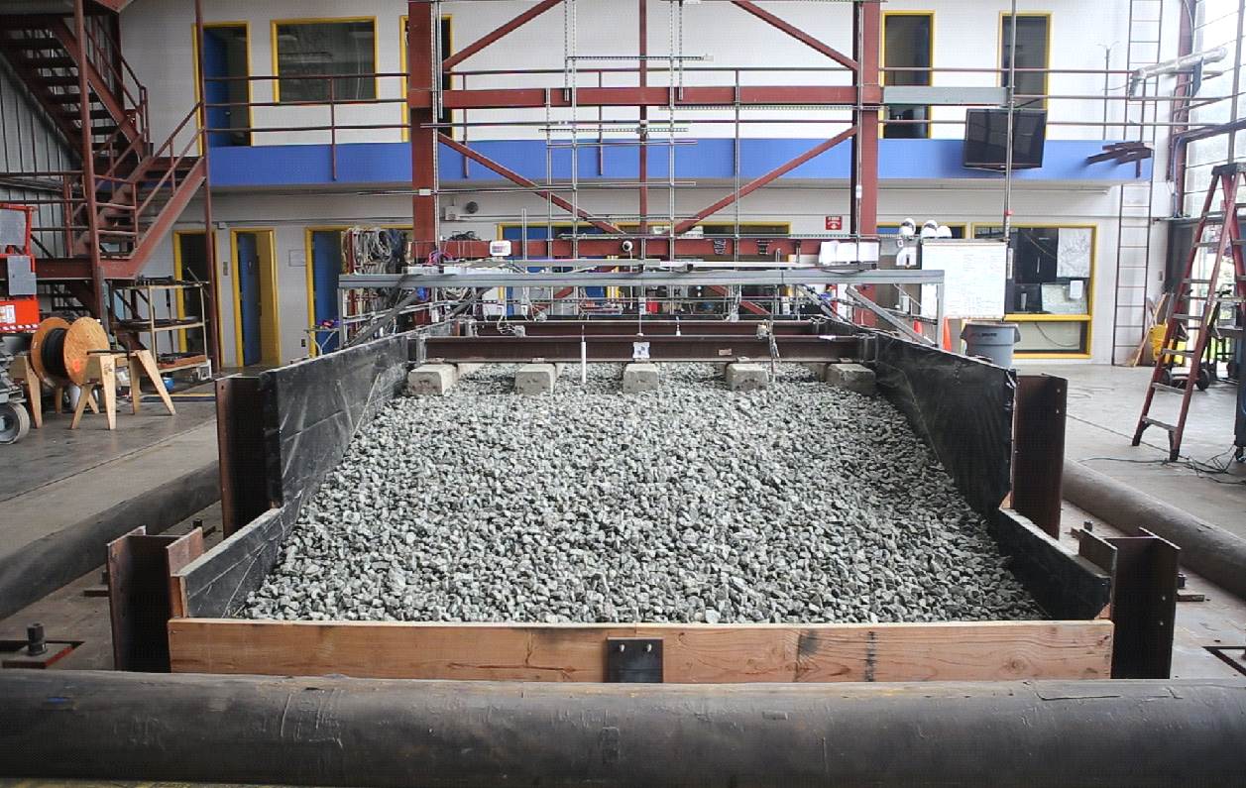
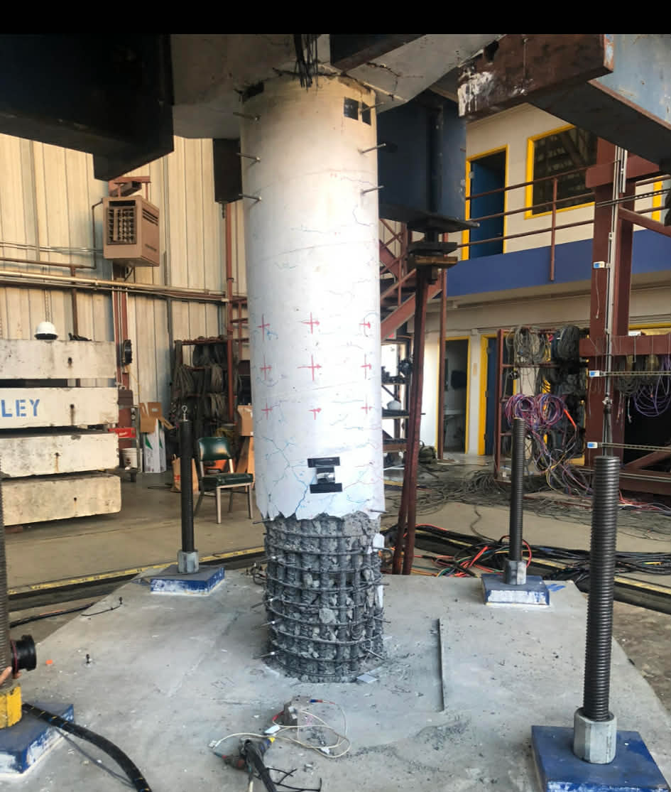
Earlier PEER Shaking-table Experiments
Three complementary experimental programs underpin the current railcar tests.
BALLASTED TRACK TESTS
AERIAL STRUCTURE / COLUMN TESTS
Shaking of instrumented track and ballast to assess disturbance and track performance.
Large-scale structural-component tests (based on field tests) to study damage, structural response, and train passage.
8
Notes:
Before the current railcar experiments, we conducted shaking-table tests of ballasted track and structural components to investigate earthquake-induced damage and operational implications.

Slide 9
AW3 Loading and Scale of the Experiment
AW3 test configuration | force (kip / kN) and equivalent mass (metric tonnes)
Legacy BART railcar
60 kips
267 kN
27.2 t
Simulated seated-passenger load
7 kips
31 kN
3.2 t
Simulated standing-passenger load
30 kips
133 kN
13.6 t
Railcar + passenger loading
97 kips
431 kN
44.0 t
Rails and ties
11 kips
49 kN
5.0 t
Extension platform
40 kips
178 kN
18.1 t
Total test assembly: ~148 kips | ~658 kN | ~67.1 metric tonnes
PEER: Largest U.S. indoor six-degree-of-freedom shaking table; 100,000-lb specimen at 1.5g.
Berkeley Engineering (2022): Specimens up to 150,000 lb (68.0 metric tonnes) can be tested.
9
Notes:
The fully loaded experimental assembly weighs approximately 148 kips, or 67 metric tonnes, illustrating the exceptional scale and complexity of this experiment.

Slide 10
Instrumentation and 3D Optical Motion Capture
360 Hz
OptiTrack PrimeX 22 cameras record reflective markers.
Optical capture
Marker placement
12 markers
4
4
4
Car body
Trucks
Support frame
Other sensors
Wire potentiometers, accelerometers, strain gauges, PEER-CENTS inertial sensors, and displacement sensors.
12
Notes:
We combine conventional sensors with a high-speed OptiTrack system to measure the three-dimensional motions of the railcar body, trucks, and supporting frame.

Slide 11
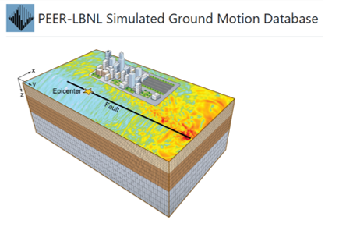
Test Matrix | Broader Program and Selected Demo and its Sequence
Previously completed in AW3: Ballasted Track Sets 1–8 (MMI 3.7–9.1) and Aerial Structure Sets 1–2 (MMI 4.2–6.0), with no damage or major issues reported.
Selected for this demo: Ballasted Track Set 6 (Level 4), four recorded/simulated rail-acceleration motions.
MMI range for Set 6: 6.4–7.9.
1989 Loma Prieta — Los Gatos Station
Simulated M7.2 Hayward/M7.2 Calaveras mainshock sequence — Fremont BART Station
1979 Imperial Valley — El Centro Array #8
Simulated M7.0 Hayward rupture — Rockridge area (PEER–LBNL SGMD)
White-noise characterization test following Set 6
10
Notes:
Today's demonstration uses selected earthquake motions from the broader experimental program, followed by a white-noise test to characterize the system's dynamic response.
MMI (Modified Mercalli Intensity) describes how strongly an earthquake is felt at a particular location and its observed effects on people, objects, and buildings.
MMI uses a scale from I (not felt) to XII (extreme destruction). Our demonstration motions today span approximately MMI 6.4–7.9, corresponding broadly to strong through very strong shaking, approaching severe shaking at the upper end. An important distinction is that a magnitude 7 earthquake does not produce MMI VII everywhere. The intensity varies with distance from the fault, local soil conditions, and other factors. For our simulated motions, MMI values are empirically estimated from ground-motion characteristics rather than directly observed damage.

Slide 12
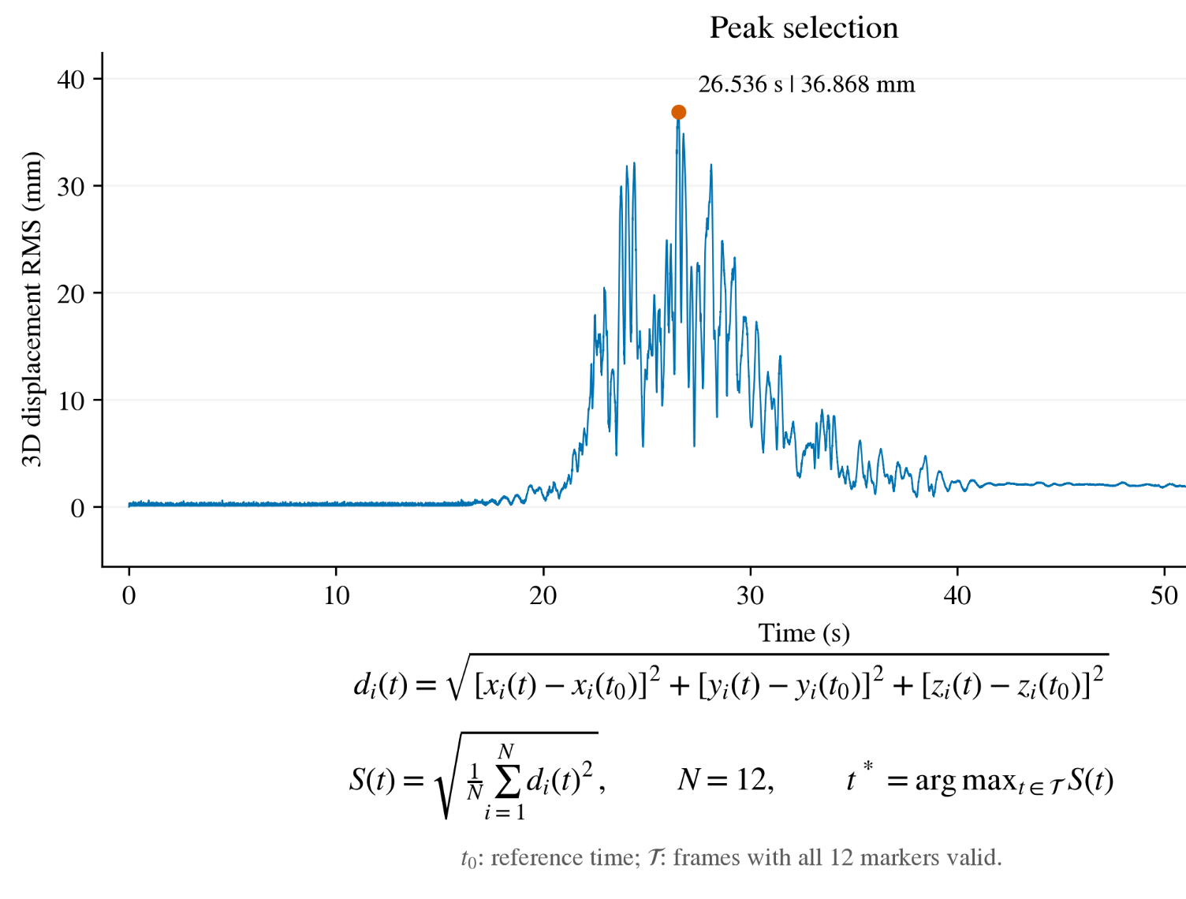
OptiTrack | Preliminary Displacement Measurements
OptiTrack records 3D marker trajectories from the railcar, trucks, and support frame.
Common peak-response time: ~26.5 s.
Results are preliminary.
13
Notes:
These preliminary displacement measurements illustrate how optical motion capture can reveal the spatial and temporal response of different railcar components.
More details in the poster.

Slide 13
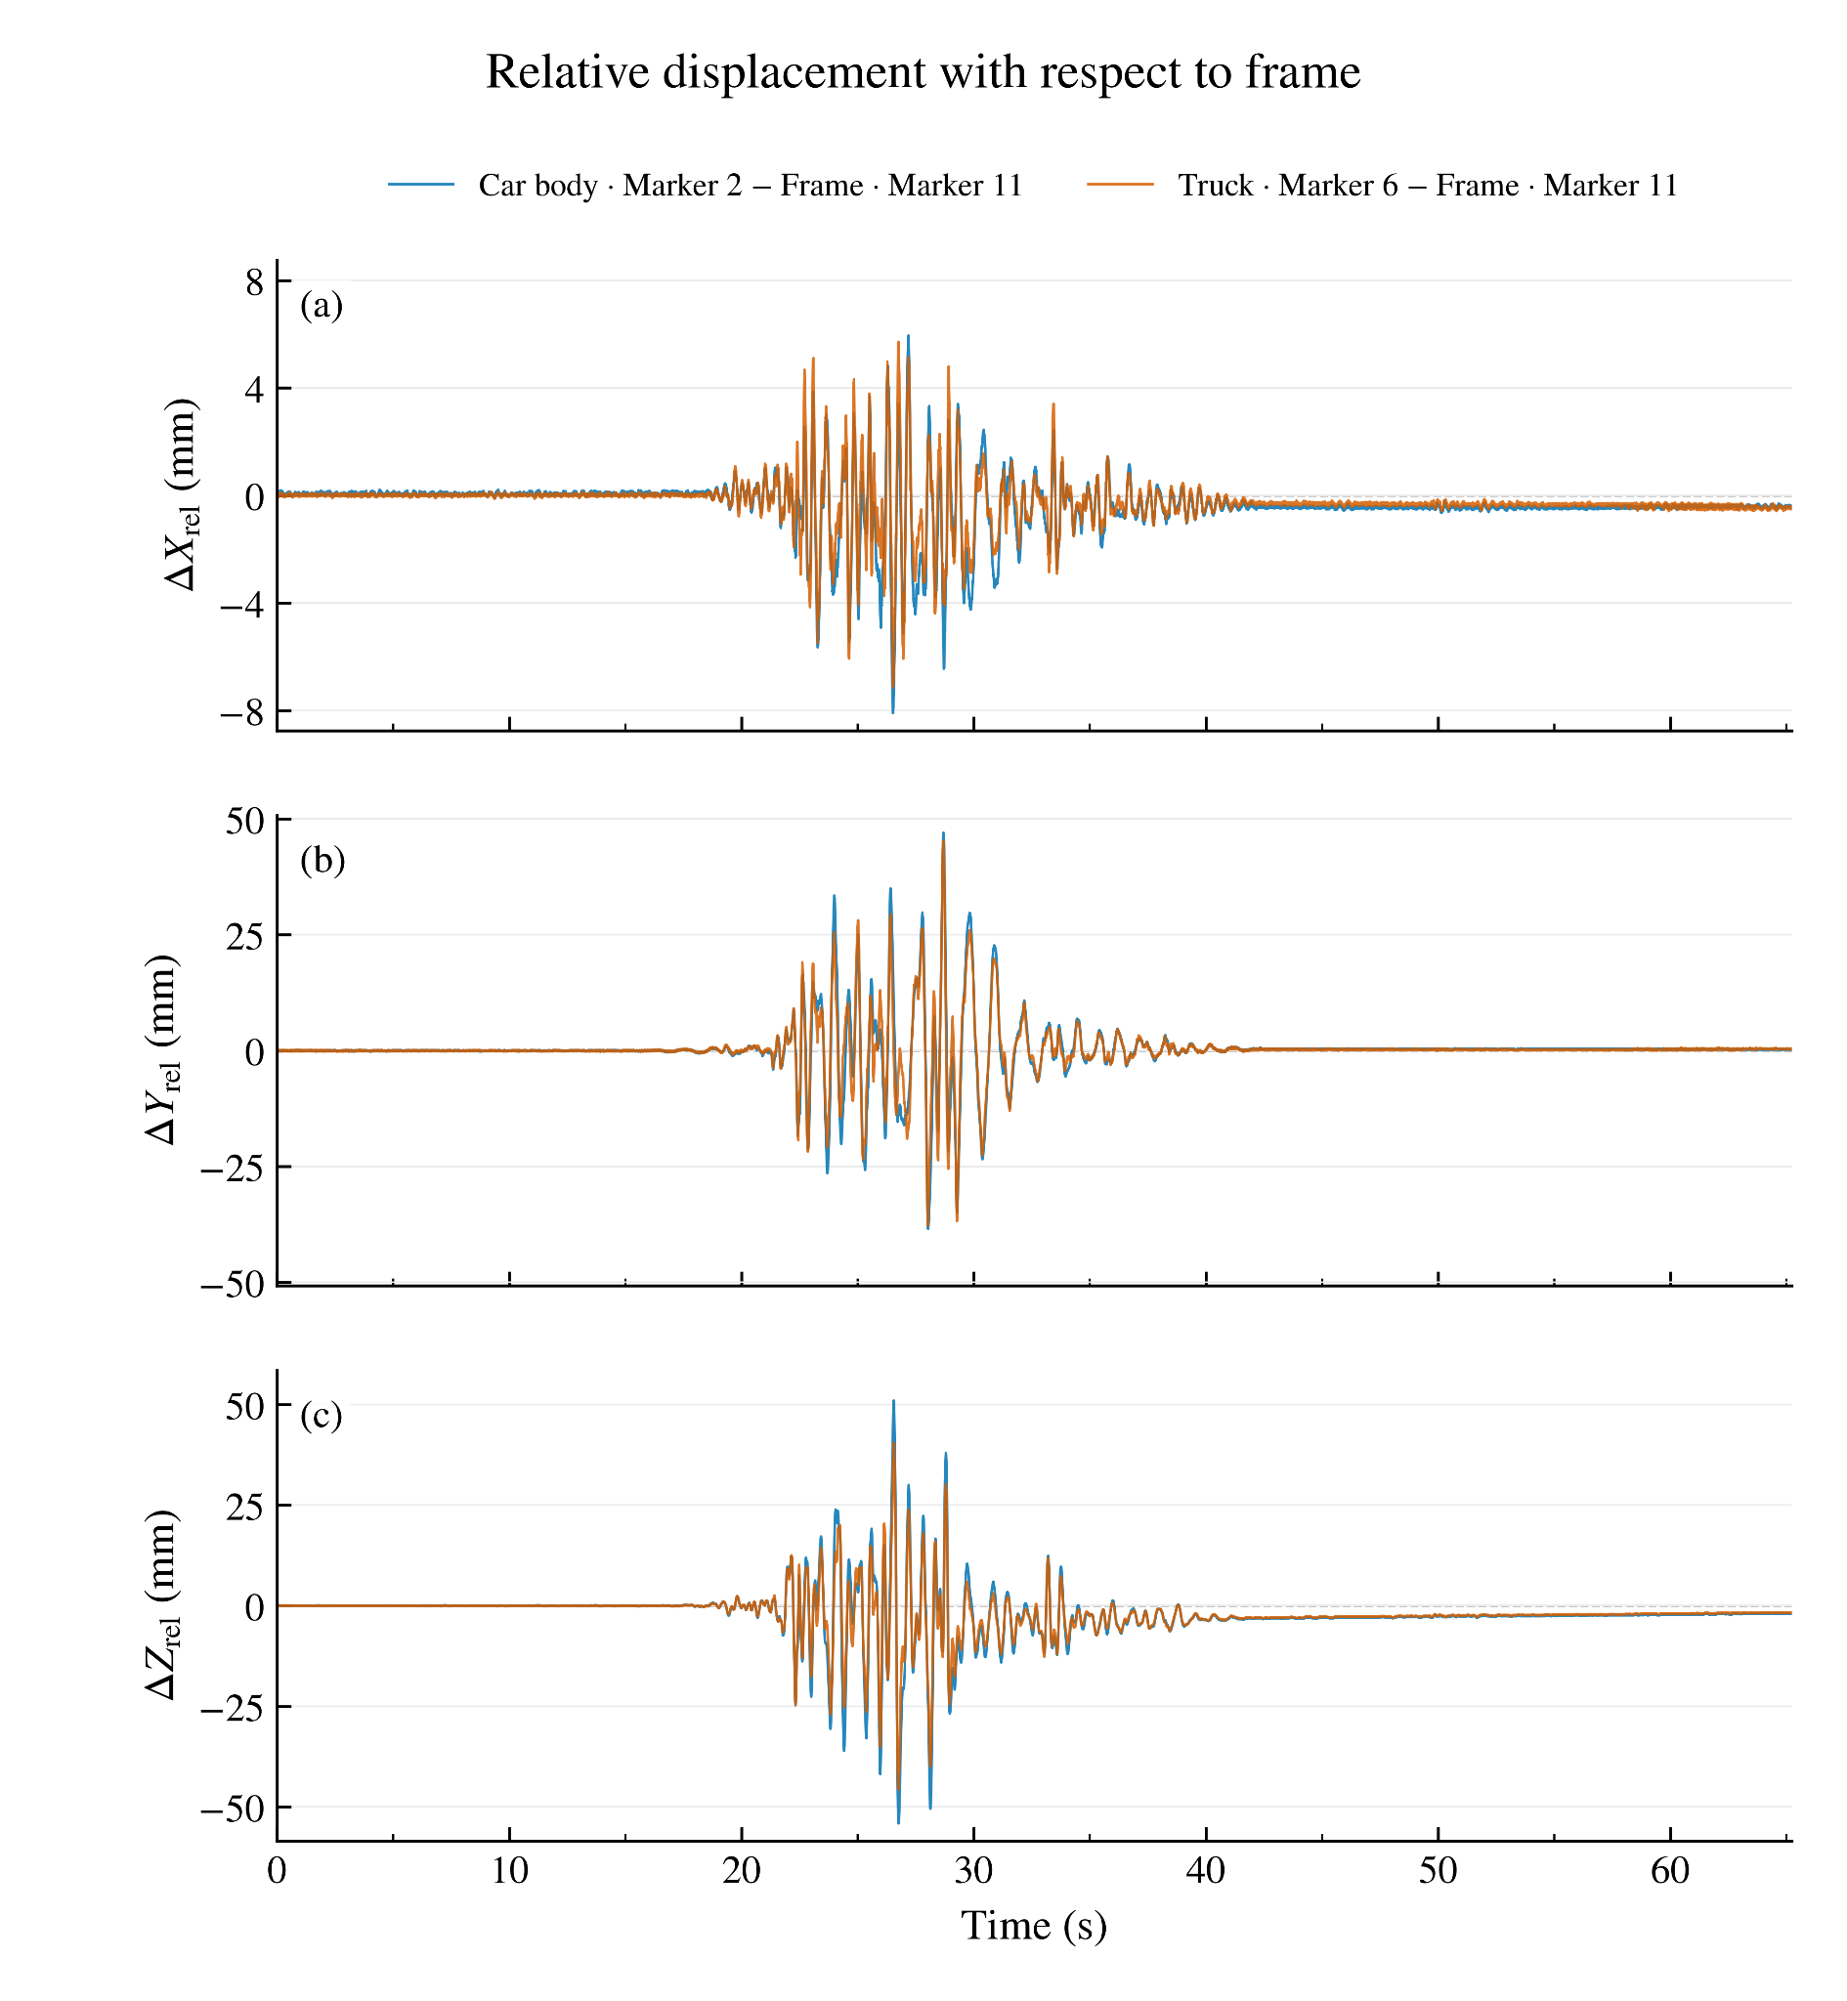
Relative Displacement of the Railcar and Trucks
Relative displacements quantify how railcar & trucks move with respect to supporting frame.
Measurements can help identify amplification & rocking.
14
Notes:
By comparing the motion of the railcar body and trucks relative to the supporting frame, we can investigate response amplification, rocking, and potential uplift.

Slide 14
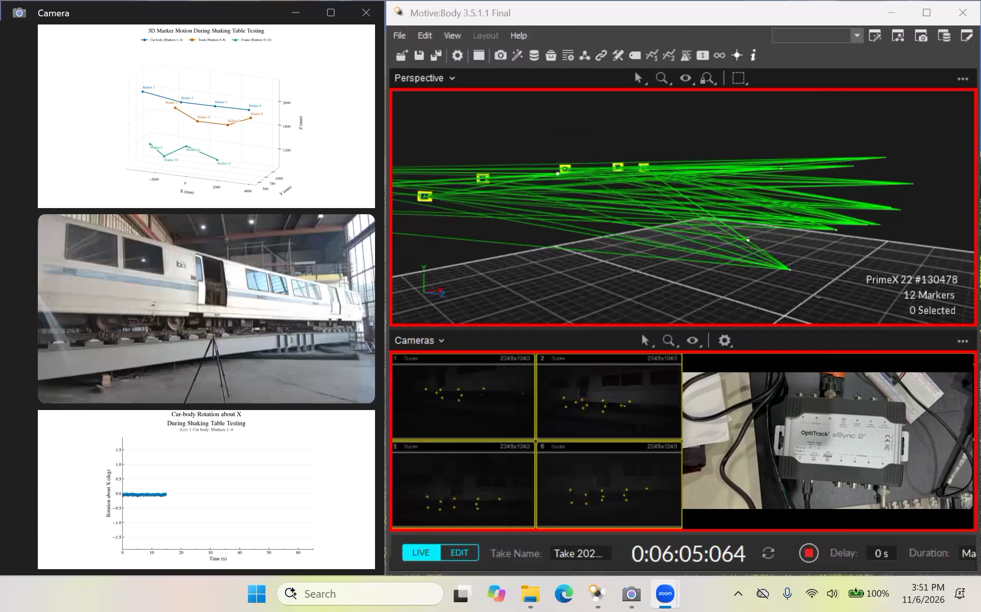
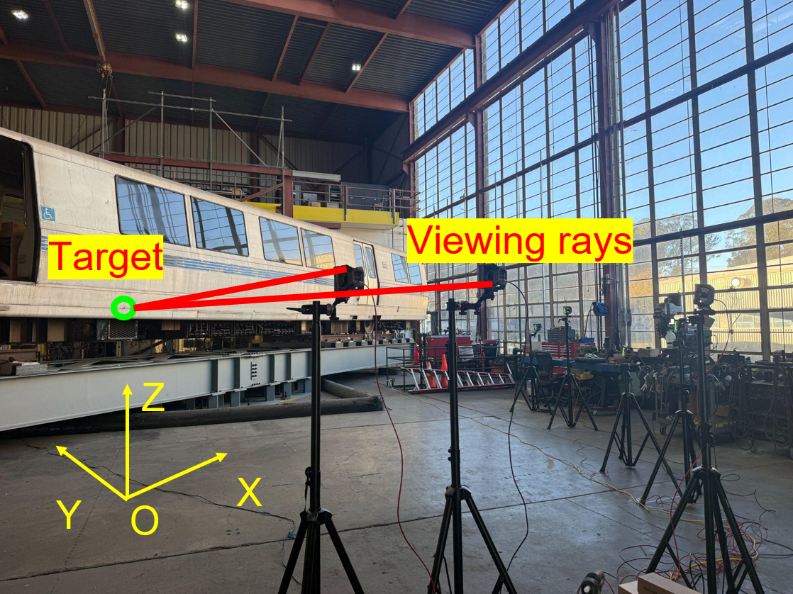
OptiTrack Demonstration Video
Camera viewing rays locate reflective markers in 3D.
3D marker motion during shaking:
Blue: Car-body markers 1–4
Orange: Truck markers 5–8
Green: Support-frame markers 9–12
X, Y, Z (mm): 3D marker coordinates showing relative positions & motions of measured components.
Car-body rotation about X, θₓ (degrees)
15
Notes:
This video illustrates how the optical system reconstructs three-dimensional marker trajectories and estimates railcar body rotation during shaking.

Slide 15
What the Test Results Will Help Us Understand
Research questions
01
Railcar motions, rocking, and potential uplift
02
Response relative to support and track
03
Sensitivity to different earthquake motions
Application for BART
Evidence supporting recommended BART earthquake operating thresholds
16
Notes:
Ultimately, we will use these measurements to better understand the response of the railcar under different earthquake motions and inform BART's operating thresholds.

Slide 16
After the Demonstration | A Proposed PEER–BART Program
PEER-Transit — concept for discussion
A sustained research partnership could help translate seismic research into practical operating decisions for BART.
A PROVEN FRAMEWORK
Adapt the PEER–Caltrans PEER-Bridge model: A master agreement, jointly defined priorities, and competitive task orders.
EXPERTISE AND FACILITIES
Leverage PEER’s earthquake engineering community, OpenSees, ground-motion resources, instrumentation, and testing facilities.
FLEXIBLE IMPLEMENTATION
Begin with a focused pilot and scale the program based on BART priorities, resources, and outcomes.
Discussion question: Which challenges would create the greatest near-term value for BART?
17
Notes:
Looking beyond the current project, we envision a sustained PEER–BART partnership modeled on our successful collaboration framework with Caltrans.

Slide 17
After the Demonstration | PEER-Transit Opportunities
Six initial topics of PEER-Transit concept
01
Aerial structures
02
Network resilience
Seismic assessment and fragility functions
Regional scenario-earthquake assessment using SGMD
03
Smart instrumentation
04
Post-earthquake assessment
Sensors on aerial structures and railcars for decisions
Field reconnaissance and AI-supported evidence
05
New railcars
06
Functional recovery
Fragility functions for next-generation vehicles
Design and operational strategies to restore service
Ideas to be refined jointly with BART; program scale and scope remain open.
18
Notes:
Potential collaborative topics include aerial-structure vulnerability, network resilience, smart sensing, post-earthquake assessment, new railcars, and functional recovery.

Slide 18


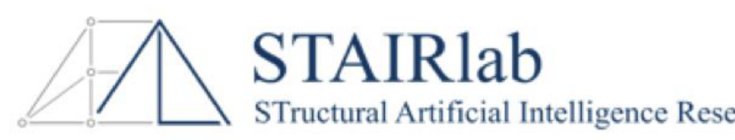
Acknowledgments
BART — Project Partners
UC Berkeley — PEER / STAIRlab
Selim Günay • Amarnath Kasalanati
Jiawei Chen • Naiqi Guo
Jiarui Cui • Nima Khodadadi
Chung-Soo Doo • Carlos Alberto Rosales
Alvin Tsui • Heryang Lee • Zhihui Huang
Special thanks to PEER laboratory and administrative staff
Llyr Griffith • Nate Knight • Robert Cerney (ret.) — experimental setups and testing
Zulema Beatriz Lara • Laman Sadaghiani — project financial reporting
Notes:
I would like to sincerely thank our colleagues at BART, the PEER and STAIRlab research teams, and especially our lab and administrative staff, whose extraordinary efforts made these experiments possible.

Slide 19
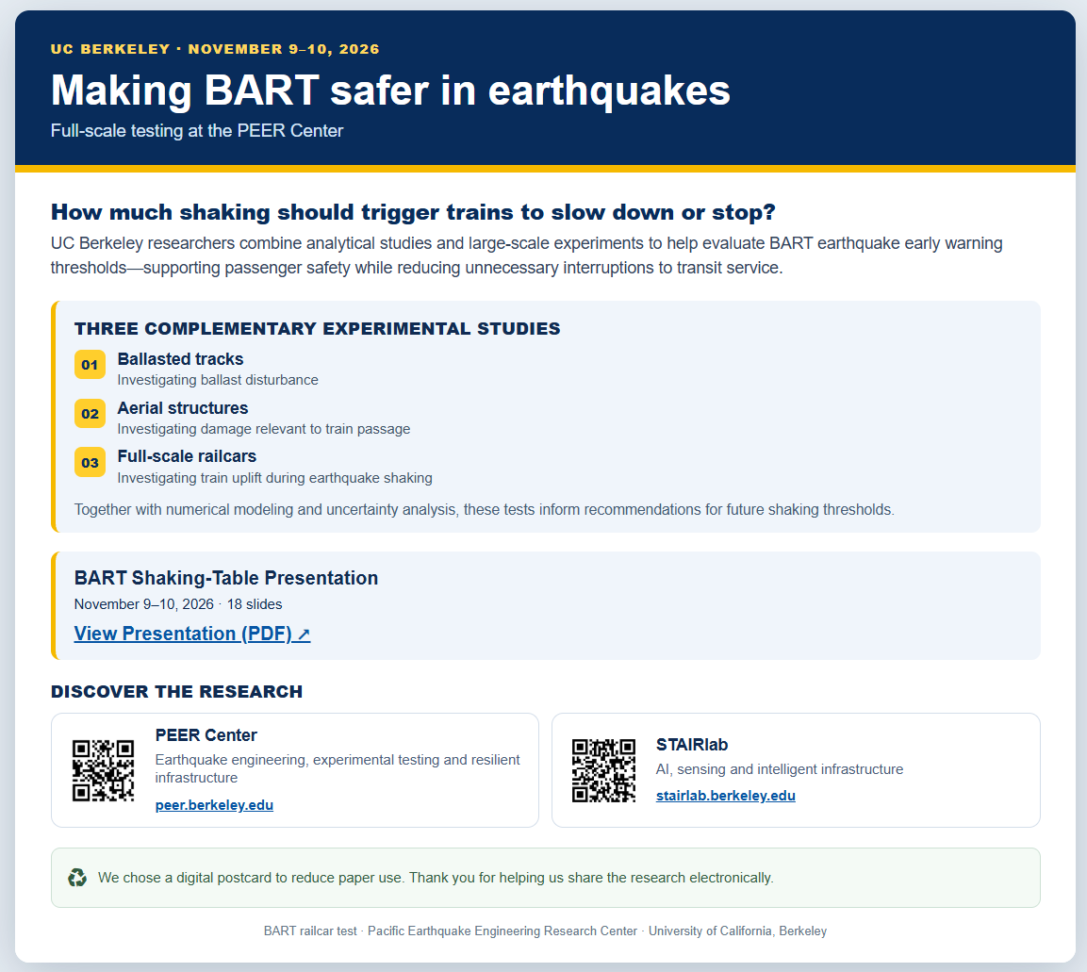

Explore the Interactive BART Digital Postcard
Scan for postcard, project overview & slides.
3
Notes:
Please scan the QR code to explore our interactive digital postcard, learn more about the research, and access additional project information and presentation materials.

