Slide 1
How human perceive an application error? Error potential study
Krzysztof Moskwa
Izabela Rejer

Slide 2
Objectives
Using created test environment, carry out the preliminary experiment
Finding patterns and dependencies between three combinations of averaged signals (correct, incorrect and system error responses)
Comparing characteristics of ErrP evoked by subject slips, to ErrP evoked by errors made by system itself

Slide 3
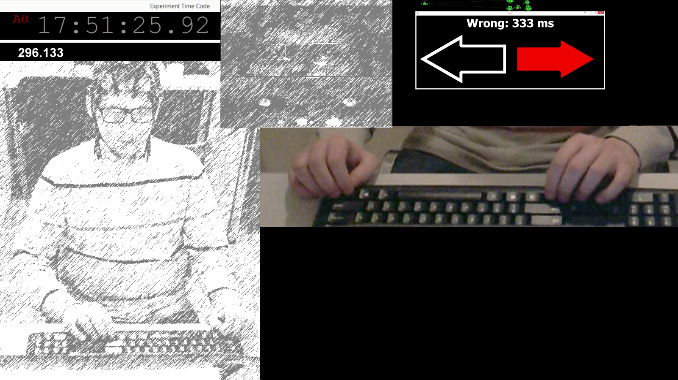
Scheme of the experiment
Eye Tracker
View
Screen with Eye Tracker Output
“Timecode”
Stimulation
EEG Time
Operator View
Interaction View
Timing of the experiment with one subject.

Slide 4
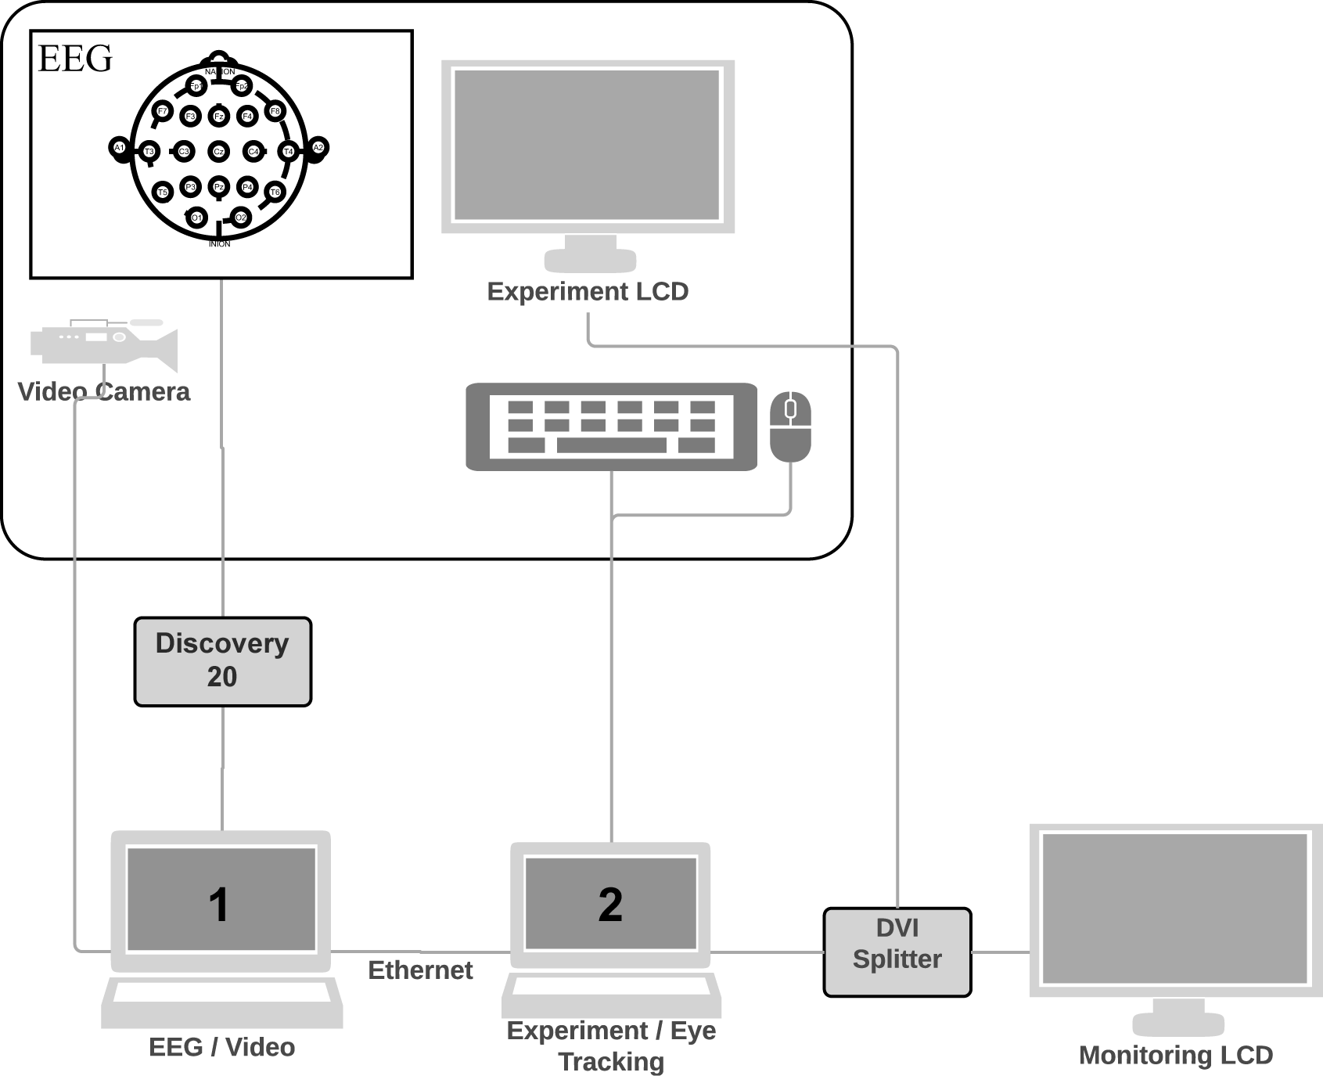
Scheme of the experiment
EEG data was recorded from 19 monopolar channels
Sampling frequency of 256 Hz
Passive electrodes connected according to the International 10-20 system
The reference electrode placed on the left mastoid
Ground electrode at Fz
The impedance of the electrodes controlled with BrainMaster Discovery
Impedance kept below 5 kΩ
The configuration of the test environment setup. EEG signal acquired with Discovery 20 device. EEG signal and audio-video recording stored on laptop number 1. Eye-tracking data with video screen capture stored on the number 2 laptop. The experiment performed on laptop 2 - second display. The second screen output splitted to two external monitors. One for subject’s operations, another for experimenter monitoring purposes

Slide 5
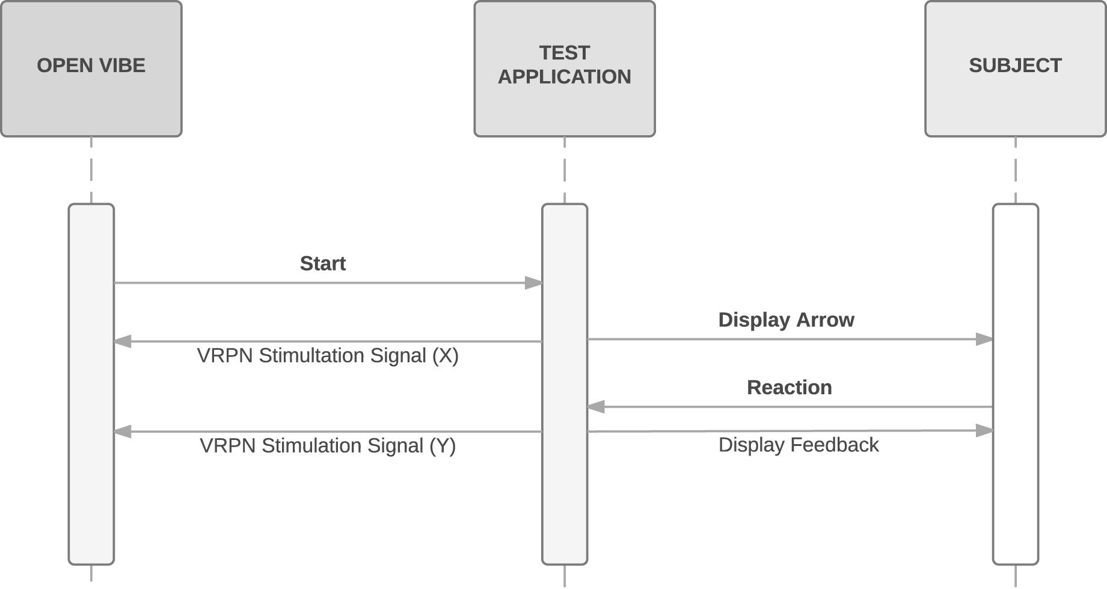
Scheme of the experiment
Workflow of stimulations signals transferred between OpenVibe and test application

Slide 6
Scheme of experiment
Session 1 - subjects were supposed to make slips on their own (due to the imposed time restriction)
Session 3 - the subjects were informed about the possible incorrect application behaviour
Session 2 - Subject and the system could make an error (the system error rate was equal to 20%). The subject was not informed about the intended machine errors
the methodology for detecting stimulation frequencies providing significant SSVEP response
simply compared the different approaches for SSVEP detection in order to find out which approach promise the highest recognition rate
we posed a question whether we could increase the number of SSVEPs found if we used individual approach for SSVEP detection for each subject

Slide 7
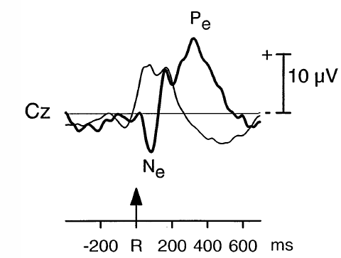
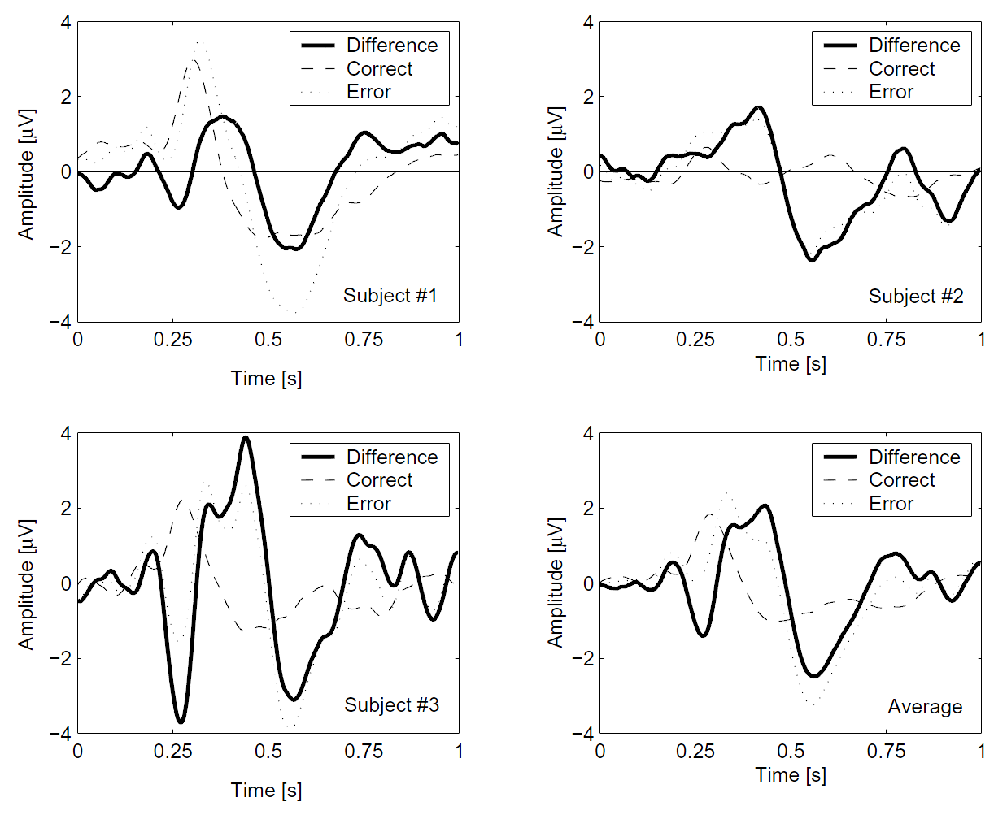
What we expected?
Falkenstein, M., Hoormann, J., Christ, S., and Hohnsbein, J. (2000) ERP components on reaction errors and their functional significance: a tutorial. Biological Psychology, 87-100
Ferrez, P.W., Millán, J.R. (2005) You Are Wrong! - Automatic Detection of Interaction Errors from Brain Waves. Proceedings of IJCAI'2005.1413-1418.
Notes:
Right
The characteristics of waveforms from the right chart are similar to the typical Error Potential described in [Escalante]
About 120ms after stimulus onset the averaged signal forms a negative peak (potential below -10.5μV), while 300ms after stimulus onset it goes up to +10μV and forms a positive peak
The negative peak depicts specific error negativity (Ne) while the following positive peak shows typical error positivity (Pe)
Left
Signal slope around 80ms with -1.38μV - weak Ne, peak at 260ms with +2.9 μV - Pe

Slide 8
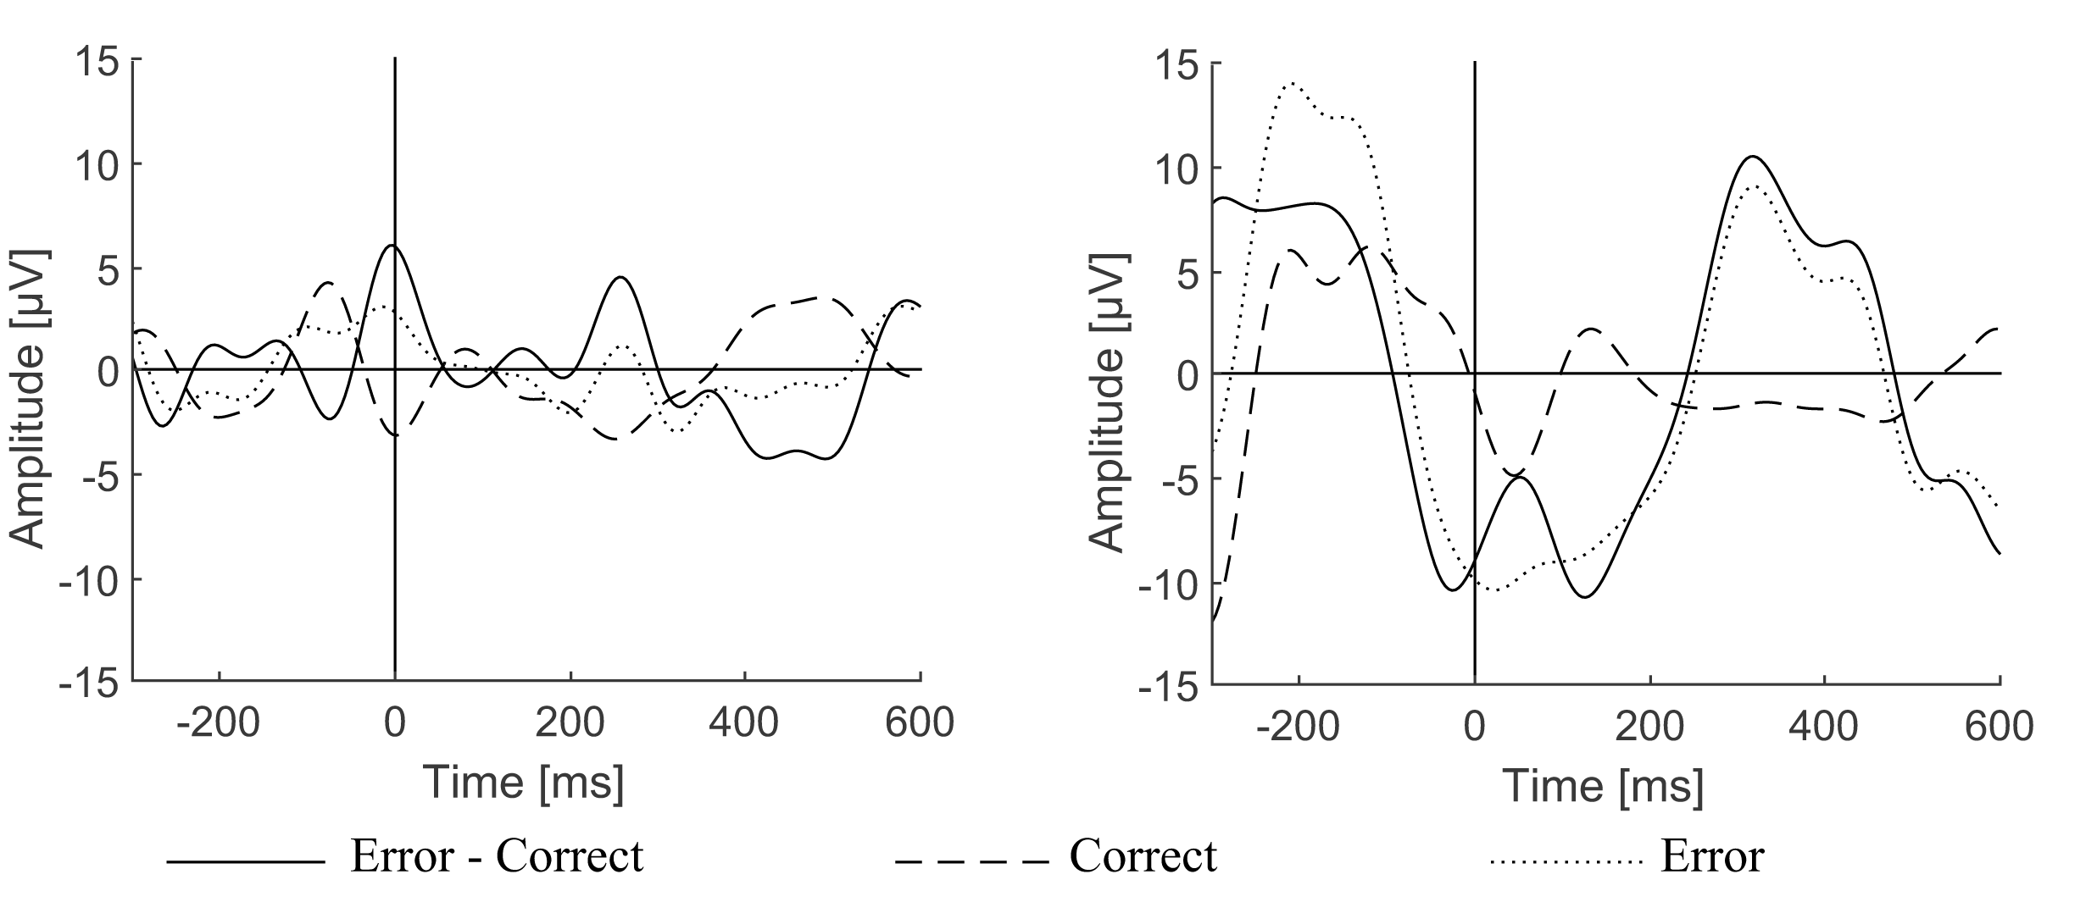
EEG Error Potential. Case Study.
The signal average of the correct responses (dashed line), wrong responses (dotted line) and their difference (solid line); subject S1 on the left, subject S2 on the right
Notes:
Right
The characteristics of waveforms from the right chart are similar to the typical Error Potential described in [Escalante]
About 120ms after stimulus onset the averaged signal forms a negative peak (potential below -10.5μV), while 300ms after stimulus onset it goes up to +10μV and forms a positive peak
The negative peak depicts specific error negativity (Ne) while the following positive peak shows typical error positivity (Pe)
Left
Signal slope around 80ms with -1.38μV - weak Ne, peak at 260ms with +2.9 μV - Pe

Slide 9
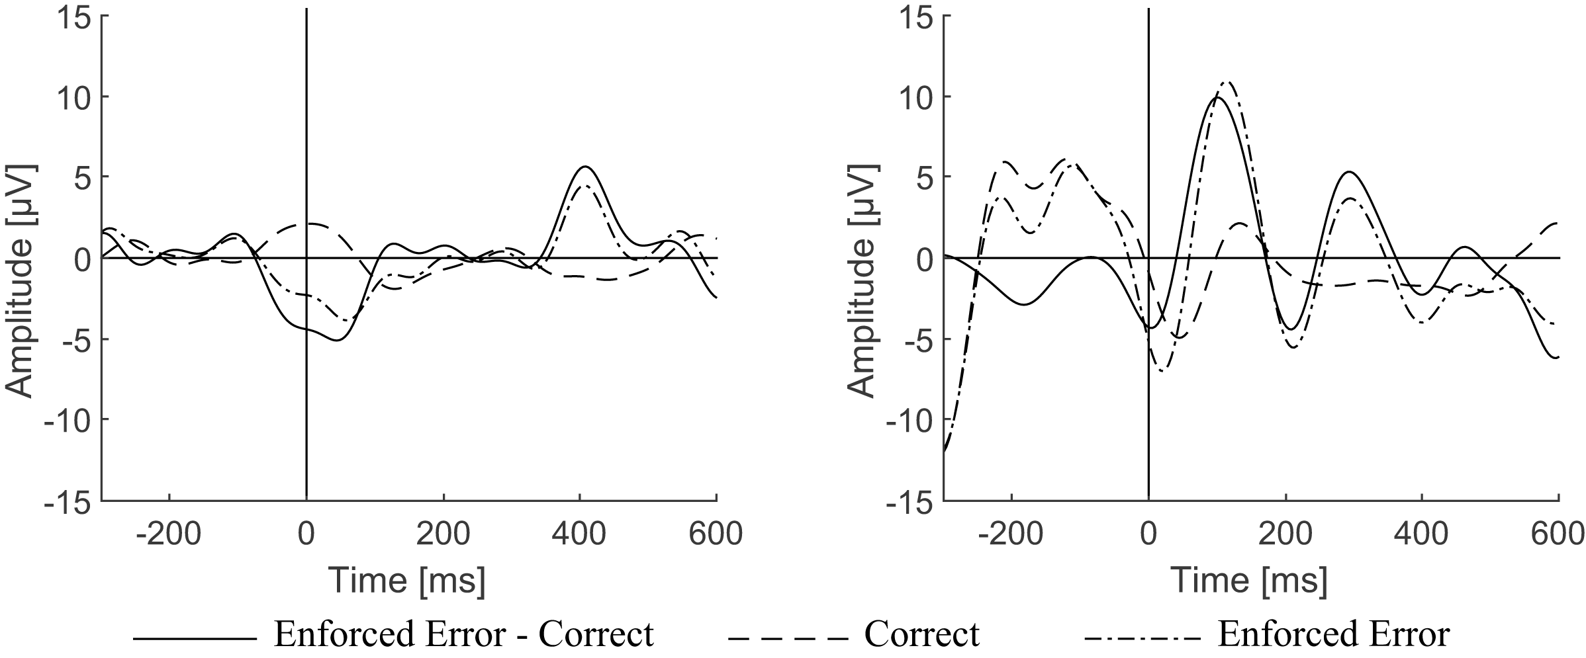
EEG Error Potential. Case Study.
The signal average of the correct subject responses with the correct application feedback (dashed line), correct subject responses with wrong application feedback (dashed-dot line) and the difference of both waveforms (solid line); data from the second session; subject S1 on the left, subject S2 on the right
Notes:
Both averaged signals are virtually similar before the stimulus onset.
The amplitude of the difference waveform for both subjects does not exceed 3μV
Difference waveform for subject S1 is similar to the correct wave
Difference waveform of subject S2 is very similar to the error potential from previous figure (Pe at 300 ms)
R
differences between signals exceed 9.9μV around the time of 100 ms after feedback

Slide 10
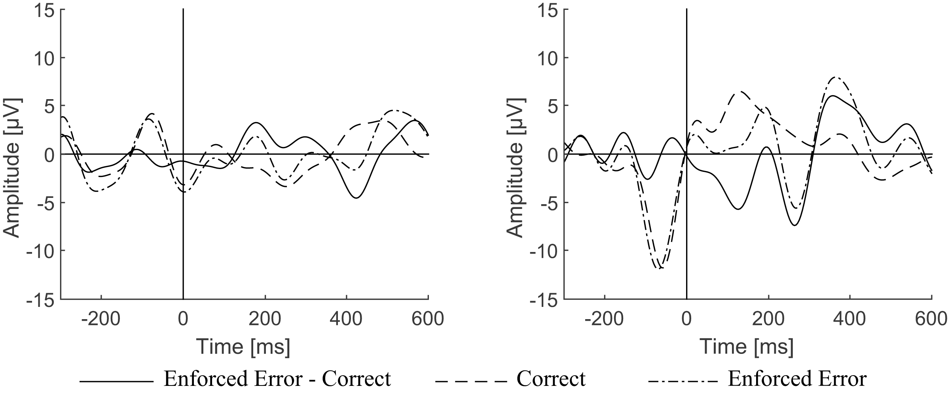
EEG Error Potential. Case Study.
The signal average of the correct subject responses with the correct application feedback (dashed line), correct subject responses with wrong application feedback (dashed-dot line) and the difference of both waveforms (solid line); data from the third session; subject S1 on the left, subject S2 on the right
Notes:
positive peak at 400 ms - very late Pe
no Ne visible in the right chart but the positive peak of the difference waveform can be found at about 380 ms (late Pe)

Slide 11
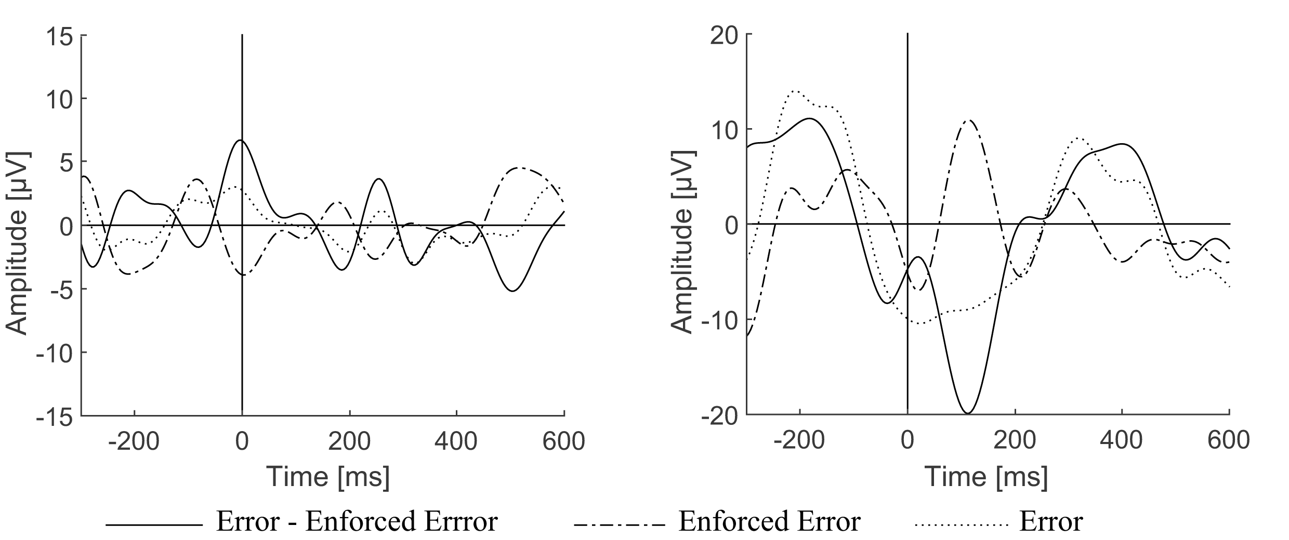
EEG Error Potential. Case Study.
The signal average of the correct subject responses with wrong application feedback (dashed-dot line), incorrect subject responses (dotted line) and the difference of both waveforms (solid line); subject S1 on the left, subject S2 on the right
Notes:
S1 did not perceive the application error as his own
small late Ne potential at about 190 ms after stimulus onset
For S2 - similar perception of application and own error

Slide 12
Conclusions
Patterns and dependences between all three combinations of average signals collected for:
the correct subject responses;
the incorrect subject responses;
and correct subject responses with incorrect application feedback;
Results obtained in the experiment are in general in agreement with other research in the field;
Signal features described in literature in terms of Pe and Ne have been reproduced;
The feedback for all three subjects (Ne was observed in two of them with a latency about 270 ms);
Brain potentials after perceiving an application error were significantly different for both subjects;
Sessions with more subjects are needed to confirm recurrence of the obtained results

Slide 13
Thank you for your attention

