Slide 1
Aspiring Developer?
-

Slide 2
Topics
How the car works
Evolution of an application
Why we need a mentor?
Dry Principle
Better Code
Takeaway

Slide 3
How the car works (ICE)
Purpose of a car?
All cars have same purpose?
Core of a car.
How the core works?
Is it same everywhere or is it special?

Slide 4
Evolution of an application
Server
Client - Server
Internet
Service based
Microservice
Serverless
Notes:
Hardware to Software

Slide 5
Why we need a mentor?
Why we need a mentor? (Knowledge vs Wisdom)
Why we need to become a mentor?
How to become a good mentor?
Be humble (Career Growth vs Personal Growth)
Ask the right question
Notes:
Out of box

Slide 6
Dry Principle
What is DRY principle
Why you shouldn’t repeat?
Why you should repeat?

Slide 7
Better Code
The intend
Naming
Ternary operator
If false
If function
Update query
API Response
State

Slide 8
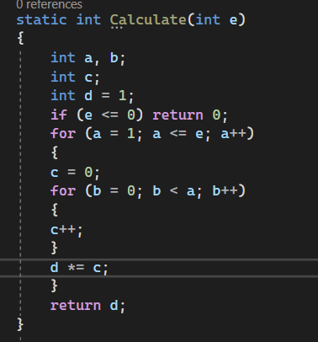
The intend

Slide 9
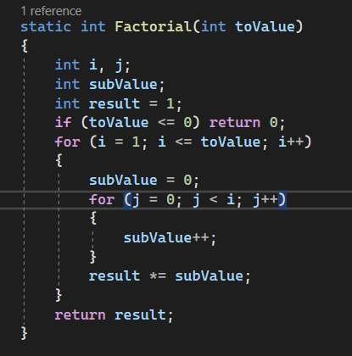
Naming

Slide 10
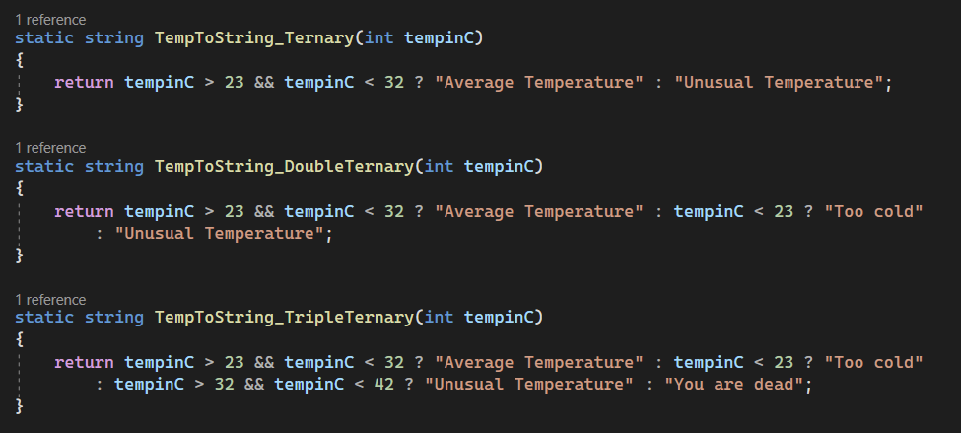
Ternary operator

Slide 11
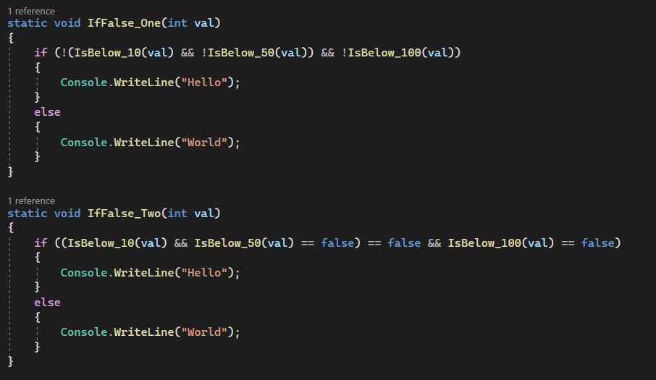
If false

Slide 12
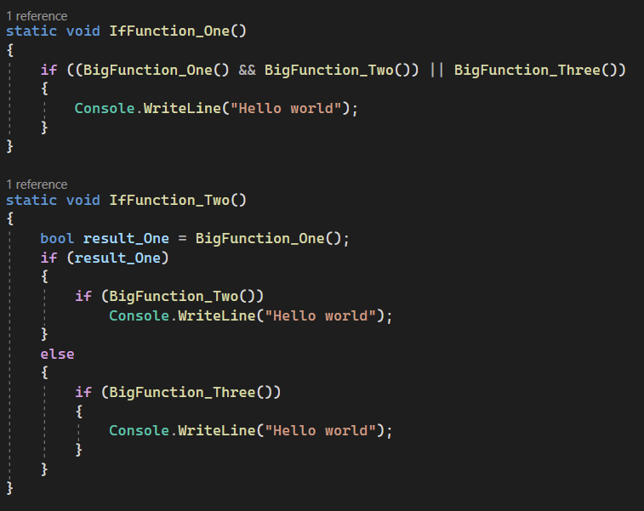
If function

Slide 13
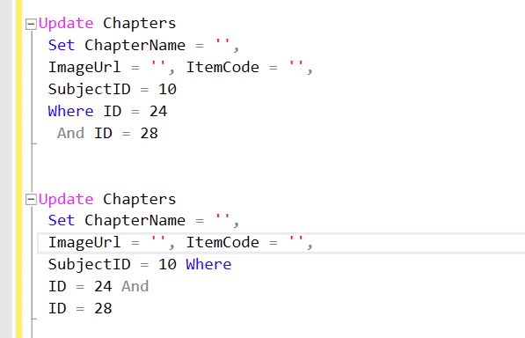
Update query

Slide 14
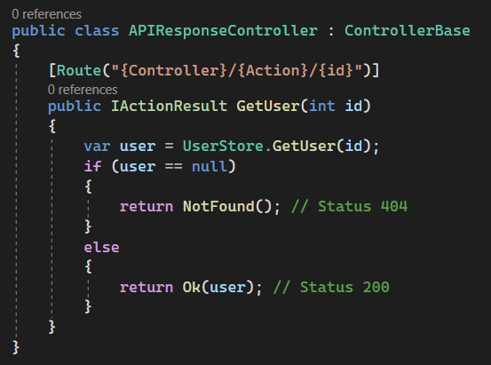
API Response

Slide 15
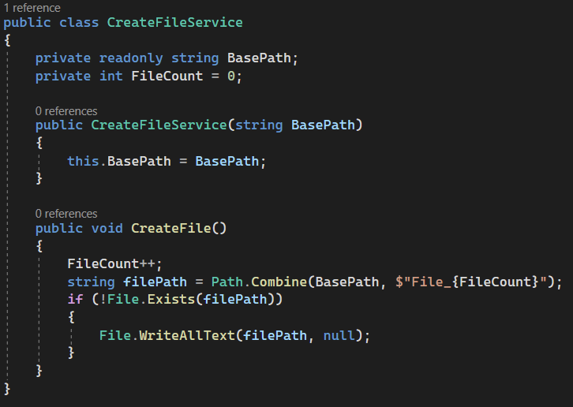
State

Slide 16
Takeaway
Understand basics.
Find and be a mentor.
Repeat to learn.
Maintainable code over optimized code.
Ask and you shall receive.

