Slide 1
Azure Cosmos DB
Ajai K M
Lead Engineer, Suyati Technologies Pvt Ltd
https://www.linkedin.com/in/ajai-km/

Slide 2
Agenda
Overview of Cosmos DB
Data Modelling
Consistency Models
Partitioning and Scalability
Indexing and Query
Global Distribution
Serverless
Security
Backup and Disaster Recovery
Migration
Monitoring and Troubleshooting
Hands-on lab/demo

Slide 3
Overview of Cosmos DB
Cosmos DB is a fully managed, globally distributed, multi-model database service that supports document, key-value, graph, and column-family data models.
It's designed to be highly available, with built-in replication and automatic failover, and it offers low-latency and high-throughput performance.
It also provides a variety of consistency models to choose from, so you can balance consistency and availability to meet the needs of your application.
Cosmos DB allows you to elastically scale throughput and storage across any number of Azure regions worldwide.

Slide 4
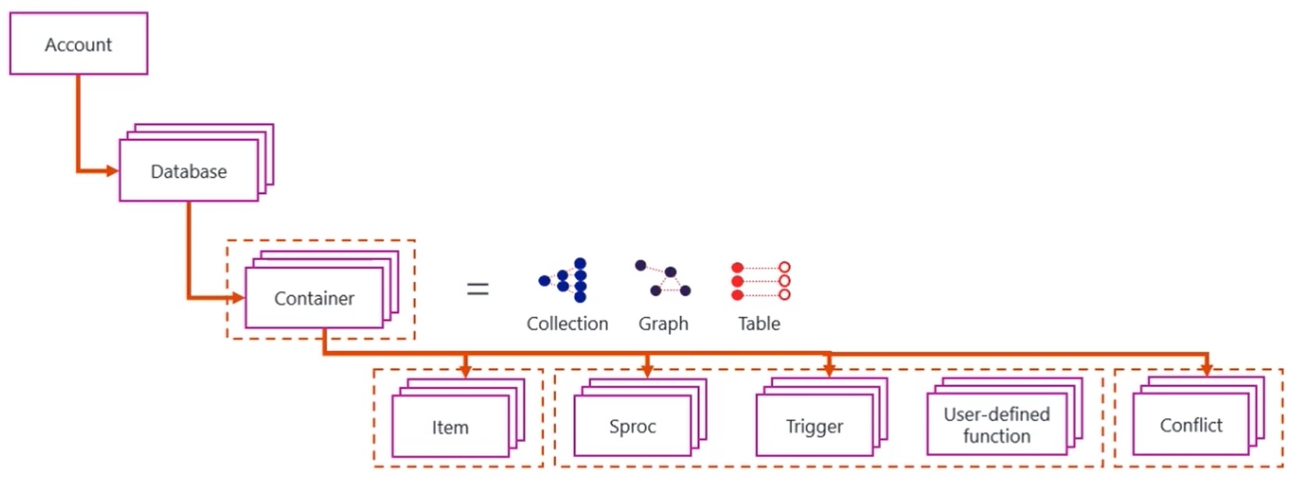

Slide 5
Data Modelling
Cosmos DB supports multiple data models, including document, key-value, graph, and column-family.
Document data model: Cosmos DB supports document data model via MongoDB, SQL and Cassandra API.
Key-value data model: Cosmos DB supports key-value data model via Table API.
Graph data model: Cosmos DB supports graph data model via Gremlin API.
Column-family data model: Cosmos DB supports column-family data model via Cassandra API.
It is important to design the schema based on the access patterns and the queries that the application will perform.
This will help you to optimize the performance of your application by avoiding hot partitions and reducing the number of request units (RUs) required to perform each operation.

Slide 6
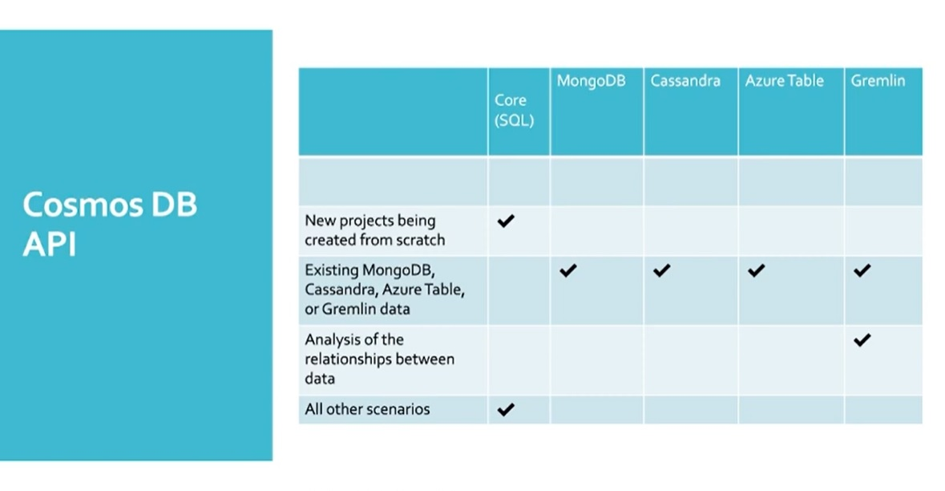

Slide 7
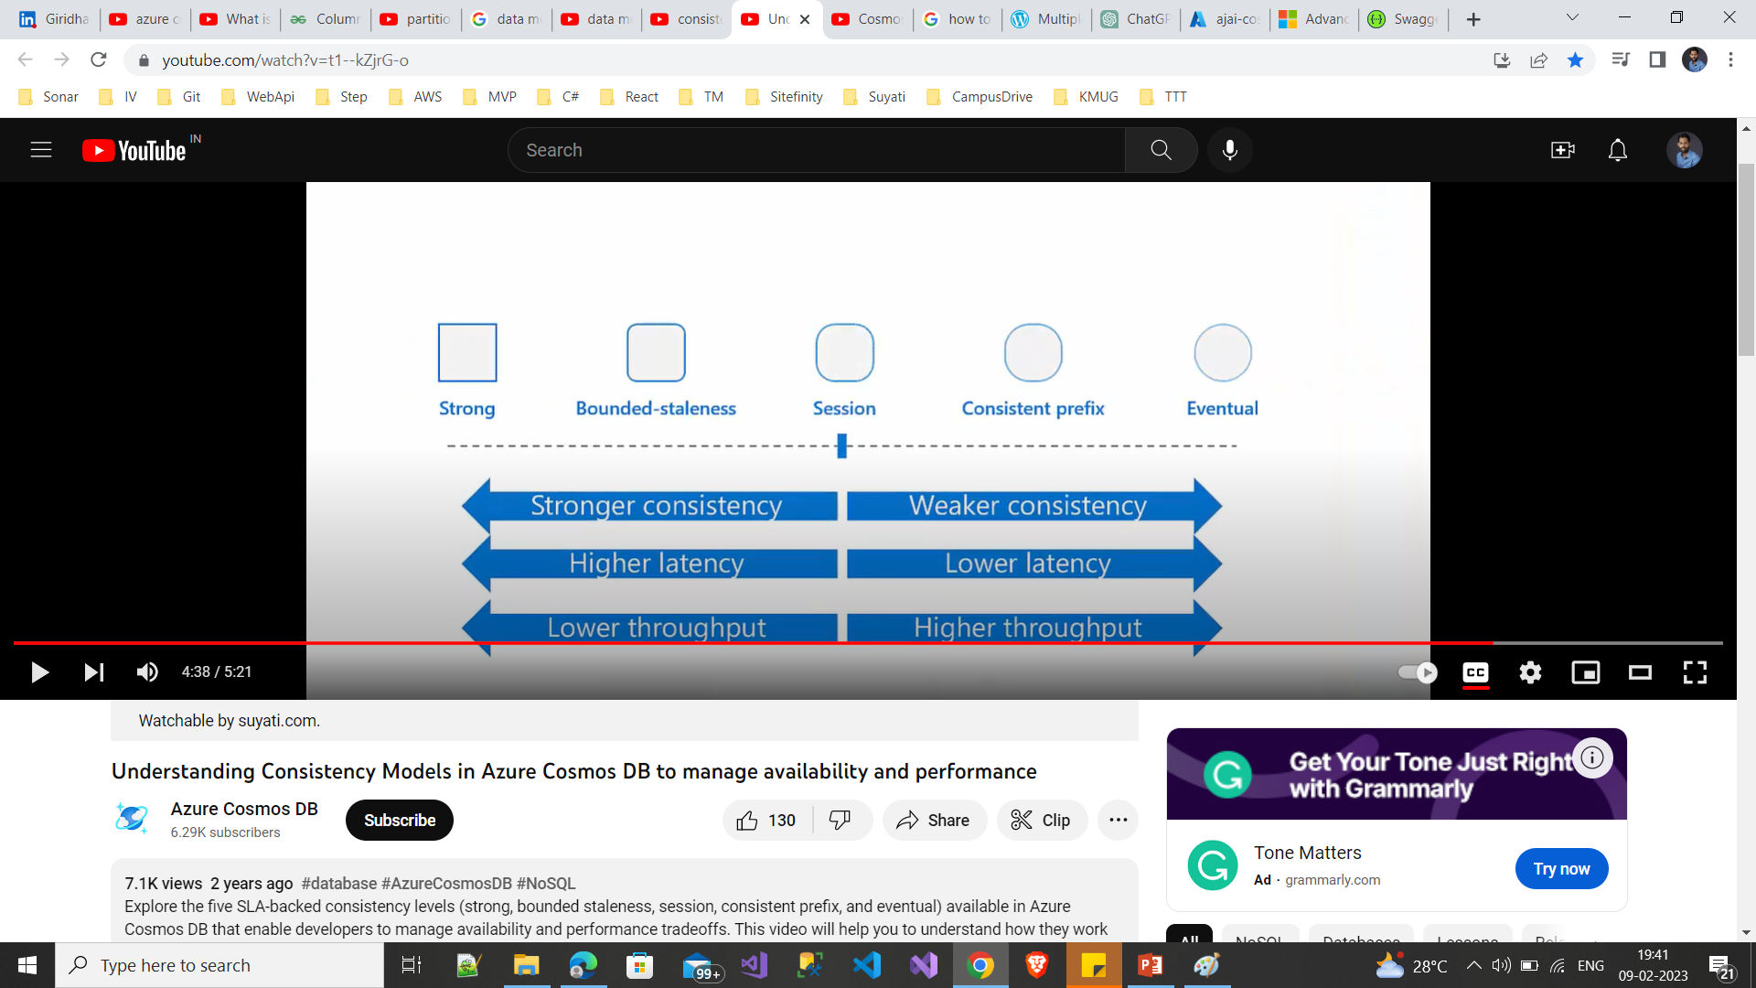
Consistency Models
Describes the uniformity of data in a distributed database. A contract that describes how and when data is replicated
Strong: This consistency level guarantees that read operations always return the most recent version of an item.
Bounded-staleness: This consistency level guarantees that read operations return a version of an item that's no more than a certain number of operations behind the current version.
Session: This consistency level guarantees that read operations return a version of an item that's no more than a certain number of operations behind the current version, and that all writes made by the same session are immediately visible to that session.
Consistent-prefix: This consistency level guarantees that read operations return a version of an item that's no more than a certain number of operations behind the current version, and that any writes made by a session are immediately visible to that session.
Eventual: This consistency level guarantees that read operations eventually return the most recent version of an item, but there's no guarantee about how long it will take for the item to be visible.

Slide 8
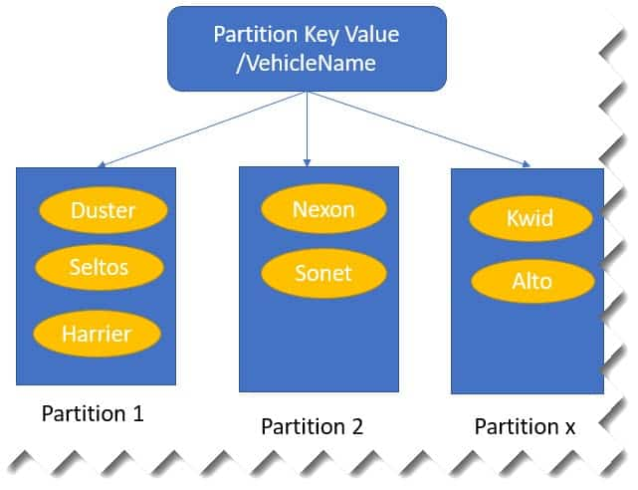
Partitioning and Scalability
Cosmos DB uses a partitioning model to distribute data across multiple partitions.
Each partition is a container for a subset of the data, and each partition can be replicated to multiple regions for high availability and low latency.
It is important to choose the right partition key for your data based on the access patterns and the queries that the application will perform.
This will help you to optimize the performance of your application by avoiding hot partitions and reducing the number of request units (RUs) required to perform each operation.

Slide 9
Indexing and Query
Cosmos DB automatically indexes all data and supports a variety of query options, including SQL, MongoDB, Cassandra, and Gremlin.
No need of schema and index management
Work across every data model
Multiple index types : hash, range, geospatial
It is important to understand how Cosmos DB indexes data and how to optimize queries for performance.
This will help you to reduce the number of request units (RUs) required to perform each operation and improve the performance of your application.

Slide 10
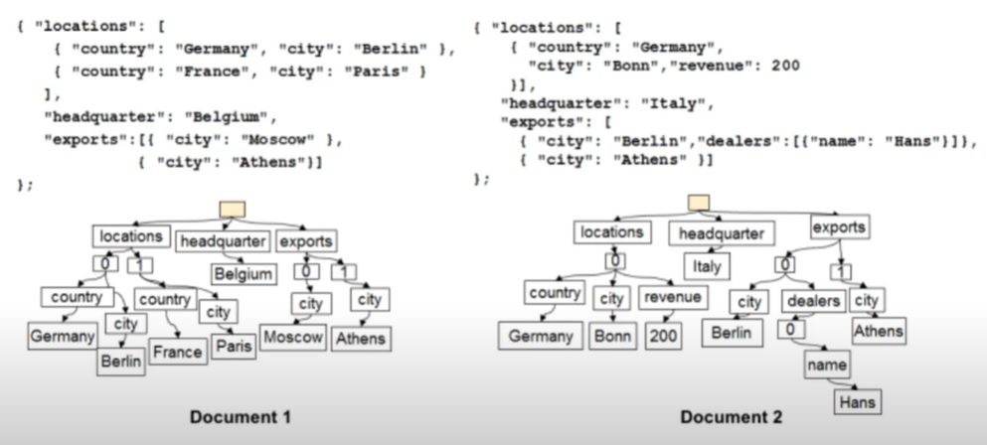
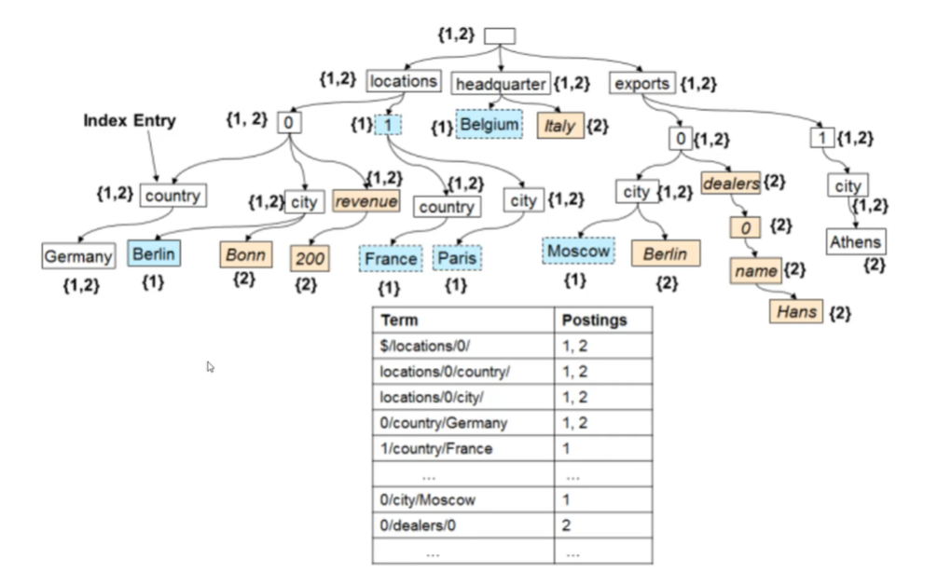
Indexing…

Slide 11
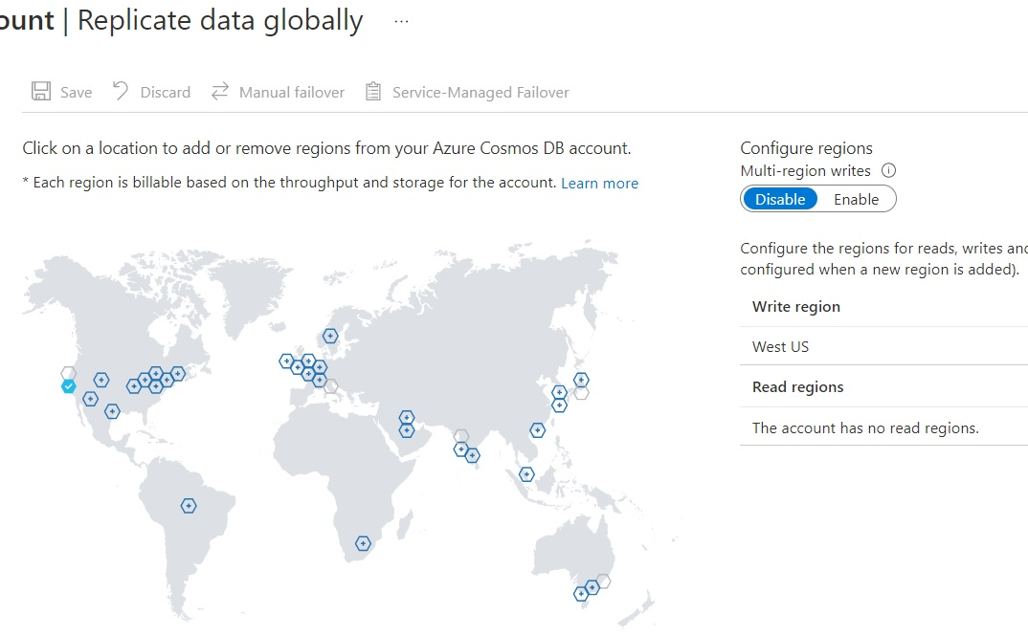
Global Distribution
Cosmos DB allows you to elastically scale throughput and storage across any number of Azure regions worldwide.
This allows you to build globally distributed applications that can provide low-latency access to data for users all over the world.
You can use the Azure Cosmos DB global distribution feature to replicate your data across multiple regions, and configure the consistency level and failover priorities to meet the needs of your application.

Slide 12
Serverless
Cosmos DB also provides a serverless option, which allows you to pay only for the storage and throughput that you actually use, with no need to provision any capacity.
Serverless containers can serve thousands of requests per second
It is a cost-effective option for applications that have variable or unpredictable workloads.
When to use : where you expect intermittent and unpredictable traffic with long idle times, application bandwidth is bursty/low, integrating with serverless compute services like Azure functions

Slide 13
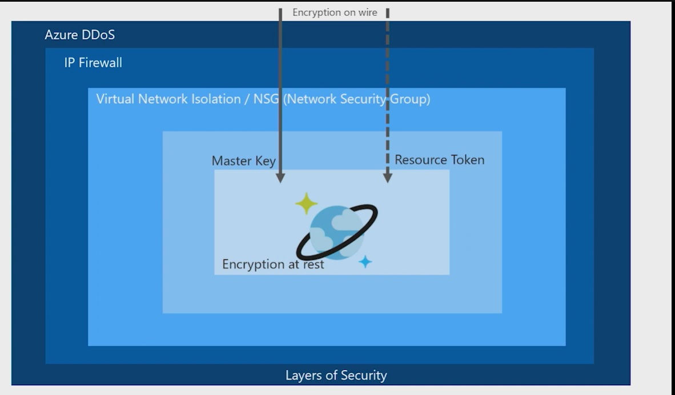
Security
Cosmos DB provides a variety of security features to help you protect your data and manage access.
You can use Azure Active Directory (AAD) authentication to secure access to your Cosmos DB resources.
You can also use network security groups (NSGs) and virtual networks (VNets) to control access to your Cosmos DB resources.
You can also use Azure Key Vault to encrypt your data at rest and in transit.

Slide 14
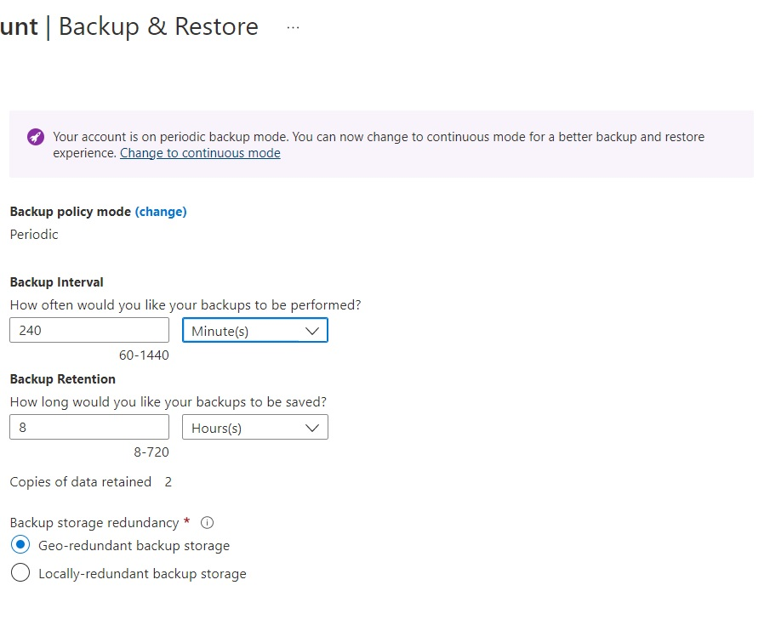
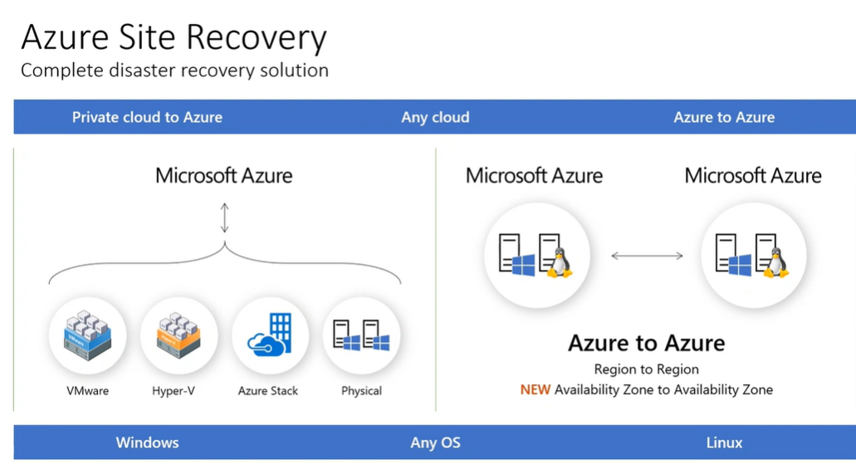
Backup and Disaster Recovery
Cosmos DB provides built-in automatic backups and point-in-time recovery, which allows you to restore your data to any point in time in the past 30 days.
You can also use Azure Backup service to create long-term backups of your Cosmos DB data, and use Azure Site Recovery to implement disaster recovery for your Cosmos DB data.

Slide 15
Migration
Cosmos DB also provides several options for migrating data from other databases or data sources, such as MongoDB, Cassandra, SQL Server, or Azure Table Storage.
You can use the Azure Cosmos DB Data Migration tool, Azure Data Factory, or third-party tools to perform the migration

Slide 16
Monitoring and Troubleshooting
Monitoring:
Azure portal, Azure Monitor, Azure Log Analytics...
we can use these tools to monitor the performance and health of your Cosmos DB database, including request rate and storage utilization.
set up alerts to notify you of any issues, such as high request latencies or low storage utilization.
Performance tuning:
To ensure that your Cosmos DB database is performing optimally, you can use several performance tuning techniques, such as:
Proper partitioning of data
Proper indexing and indexing strategy
Proper use of consistency levels and request unit (RU) utilization
Troubleshooting:
If you encounter any issues with your Cosmos DB, there are several resources you can use to help troubleshoot the problem:
The Azure portal, which provides detailed logs and metrics to help you understand the issue.
Azure Cosmos DB Support, which provides access to
The Azure Cosmos DB documentation
The Azure Cosmos DB forums, which provide a community of users and experts who can help you troubleshoot any issues.

Slide 17
Read More…
https://learn.microsoft.com/en-us/azure/cosmos-db/introduction
https://cosmos.azure.com/
Azure Cosmos DB Essentials Series
https://developer.azurecosmosdb.com/community

