Slide 1
Streamlining Kubernetes Development With Draft
Shibin M

Slide 2
Agenda
Draft Introduction
Kubernetes Basics
Draft History
Benefits of Draft
Demo

Slide 3
Draft
Draft is an open-source project that helps developers go from a noncontainerized application to running on Kubernetes with ease.
As a developer with Draft, you don't have to go through an extensive ramp of containers, container registries, Kubernetes, and deployment methods to get your app running as a container on Azure Kubernetes Services.

Slide 4
History of Draft
Microsoft acquired container platform Deis from Engine Yard in 2017. Deis is behind some of the most popular tools for building and managing applications on Kubernetes. Their projects include Helm, Brigade, and Containered Wasm Shims. They also built Draft.
Deis still exists but has been renamed to Deis Labs

Slide 5
Timeline
Apri 2017
Draft
Jan 2022
Draft 2
AKS Preview
VS Code extension
2023

Slide 6
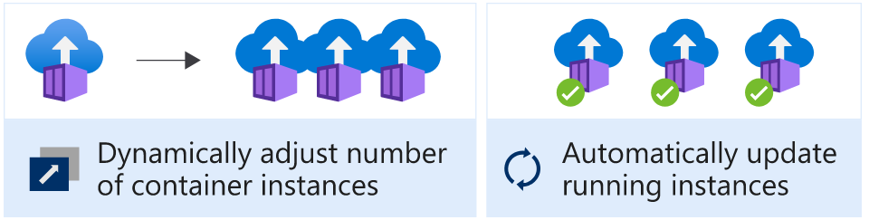
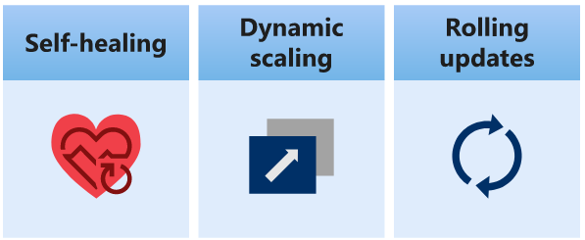
Kubernetes
Kubernetes is an open-source container orchestration engine that can help with the automated deployment, scaling, and management of our applications.
Benefits:
Notes:
https://azure.microsoft.com/en-us/resources/cloud-computing-dictionary/what-is-kubernetes/#overview
https://learn.microsoft.com/en-us/azure/aks/concepts-clusters-workloads
https://learn.microsoft.com/en-us/training/modules/intro-to-kubernetes/2-what-is-kubernetes?source=recommendations&ns-enrollment-type=learningpath&ns-enrollment-id=learn.intro-to-kubernetes-on-azure

Slide 7
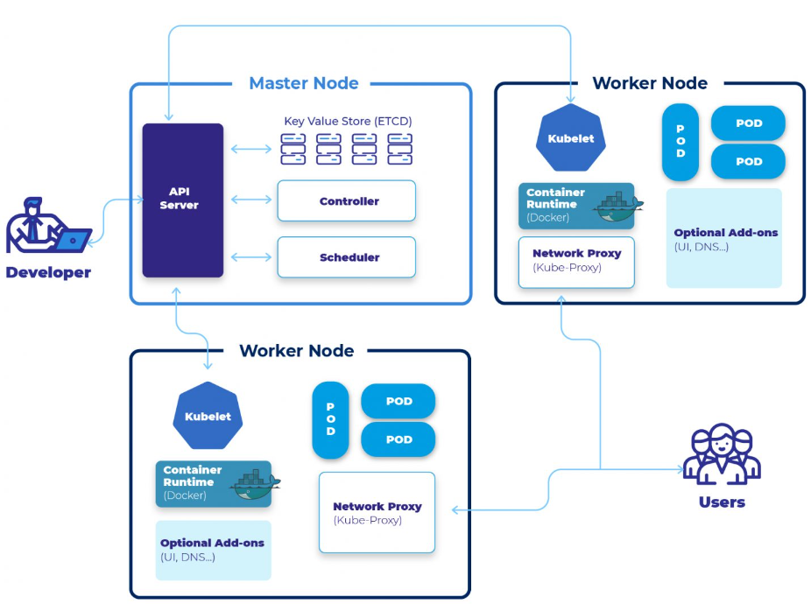
Kubernetes Architecture
Notes:
https://devopscube.com/kubernetes-architecture-explained/
https://www.clickittech.com/devops/kubernetes-architecture-diagram/

Slide 8
Why Draft
Kubernetes for all developers
When developers approach building applications that run on top of Kubernetes, they need to learn many infrastructure concepts, like containerization, Kubernetes manifests, and ingresses, which significantly increases their cognitive overload.
Draft simplifies creating the artifacts needed to run your app on Kubernetes so that you can stay more focused on building and maintaining the app itself.
Notes:
https://techcommunity.microsoft.com/t5/apps-on-azure-blog/azure-kubernetes-service-aks-updates-for-seamless-developer-and/ba-p/3407089

Slide 9
Draft 2
To address getting from code-to-container-to-cloud, version 2 of Draft is released
Integrating the Draft experience into AKS Preview. Developers will be able to use Draft with AKS using the Azure Command Line Interface (CLI) and Visual Studio Code
Draft 2 command start with az aks create

Slide 10
Draft – Commands
draft create: Creates the Docker file and the proper manifest files
draft setup-gh: Sets up your GitHub OIDC
draft generate-workflow: Generates the GitHub Action workflow file for deployment onto your cluster
draft up: Sets up your GitHub OIDC and generates a GitHub Action workflow file, combining the previous two commands
draft update: Update your application to be internet accessible
Notes:
Learn commands here
https://learn.microsoft.com/en-us/azure/aks/draft
https://azure.github.io/Cloud-Native/cnny-2023/building-with-draft/
https://www.youtube.com/watch?v=3RIulCcDet0
https://github.com/azure/draft

Slide 11
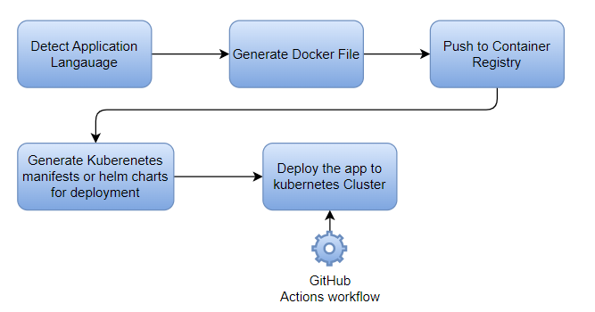
Process

Slide 12
Demo

Slide 13
Prerequisites
Azure subscription
Resource group to hold all components
Azure Container Registry
AKS cluster
Application code hosted in a GitHub repository
VS Code
Azure CLI installed and logged into a proper Azure subscription
GitHub CLI installed and logged into a GitHub.com account
AKS-preview Azure CLI extension
Ability to run all code from the VS Code Bash terminal

Slide 14
Steps
Create a Dockerfile
Create the Kubernetes manifest files for deployment and service
Connect our Azure to our GitHub repository
Create a GitHub Actions workflow
Run the GitHub Actions workflow to build our containerized app, push it to the Azure Container Registry, and deploy our app on Azure Kubernetes Service

Slide 15
Future
GUI-based extension in Visual Studio Code
Draft into the Azure portal
Notes:
https://learn.microsoft.com/en-us/azure/aks/draft-devx-extension-aks
https://learn.microsoft.com/en-us/azure/aks/draft
https://marketplace.visualstudio.com/items?itemName=ms-kubernetes-tools.aks-devx-tools

Slide 16
References
https://learn.microsoft.com/en-us/azure/aks/draft
https://learn.microsoft.com/en-us/azure/aks/
https://learn.microsoft.com/en-us/training/modules/intro-to-azure-kubernetes-service/4-when-to-use-azure-kubernetes-service?source=recommendations&ns-enrollment-type=learningpath&ns-enrollment-id=learn.intro-to-kubernetes-on-azure
https://learn.microsoft.com/en-us/training/paths/intro-to-kubernetes-on-azure/?source=recommendations
https://devopscube.com/kubernetes-architecture-explained/

Slide 17
Thank you
Shibin M​
Suyati Technologies
https://www.linkedin.com/in/shibinvas/
shibinvas@gmail.com

