Slide 1
Get started using ChatGPT (preview) and GPT-4 (preview) with Azure OpenAI Service
Jithin Sakthan
Full stack developer,Socxo solutions pvt ltd

Slide 2
Gpt-4
GPT-4 is OpenAI’s most advanced system, producing safer and more useful responses.
GPT-4 series models are now available in preview on Azure OpenAI. These models are currently available in the East US and South Central US regions.
ChatGPT (gpt-35-turbo) preview
Increased training limits for fine-tuning: The max training job size (tokens in training file) x (# of epochs*) is 2 Billion tokens for all models. We have also increased the max training job from 120 to 720 hours.
GPT-4 has a maximum token limit of 32,000 (equivalent to 25,000 words), which is a significant increase from GPT-3.5’s 4,000 tokens (equivalent to 3,125 words)
*if you have a training set of 10,000 images, an epoch would be 10,000 training iterations, where each iteration uses one image.

Slide 3
GPT-4 improvements
Linguistic Finesse
Information Synthesis
Creativity And Coherence
Complex Problem-Solving
Programming Power
Image And Graphics Understanding
Ref:https://www.searchenginejournal.com/gpt-4-vs-gpt-3-5/482463/#close

Slide 4
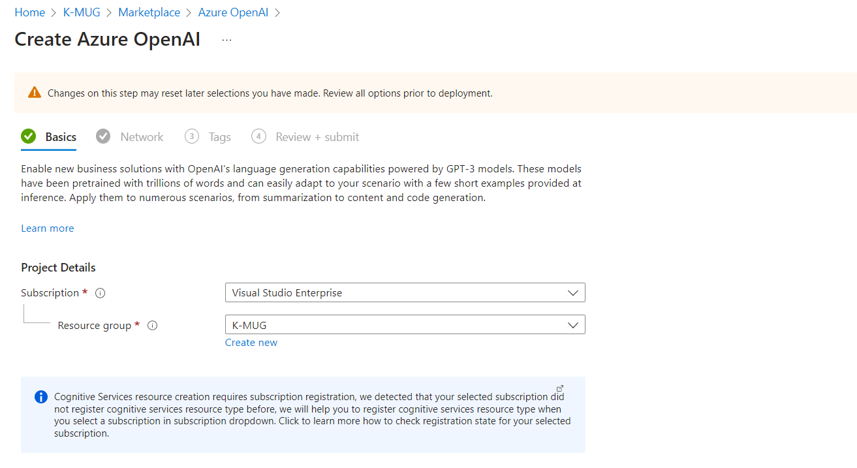
Create Azure OpenAI

Slide 5
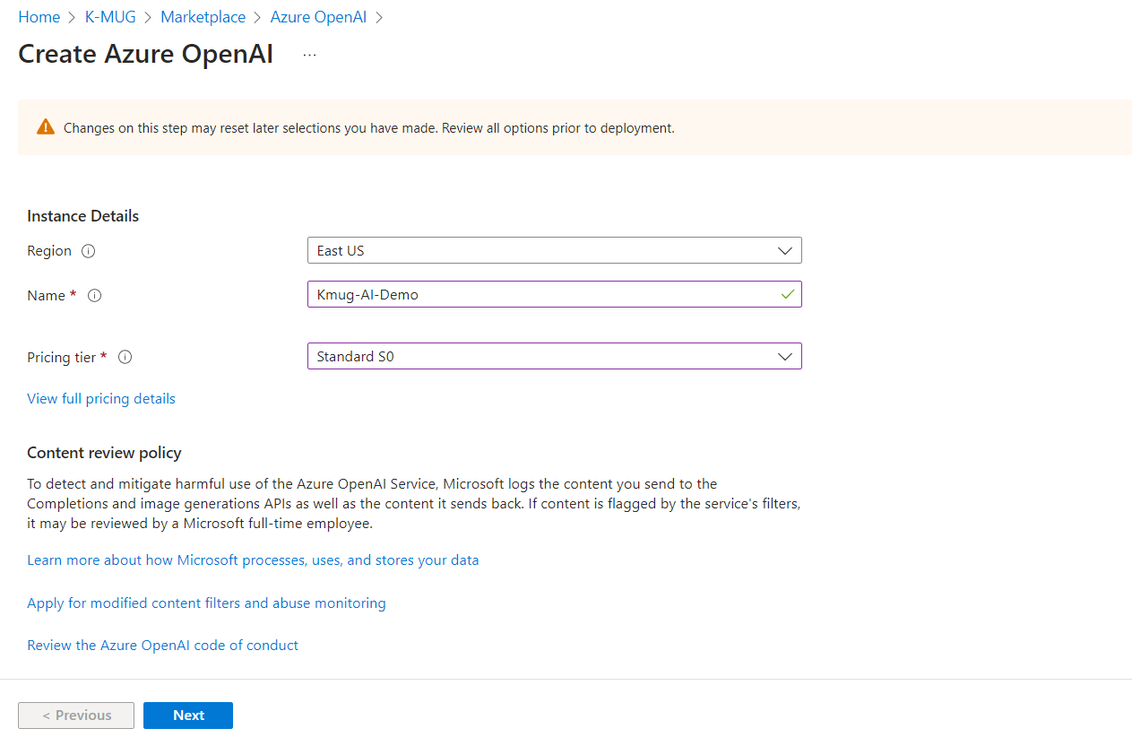

Slide 6
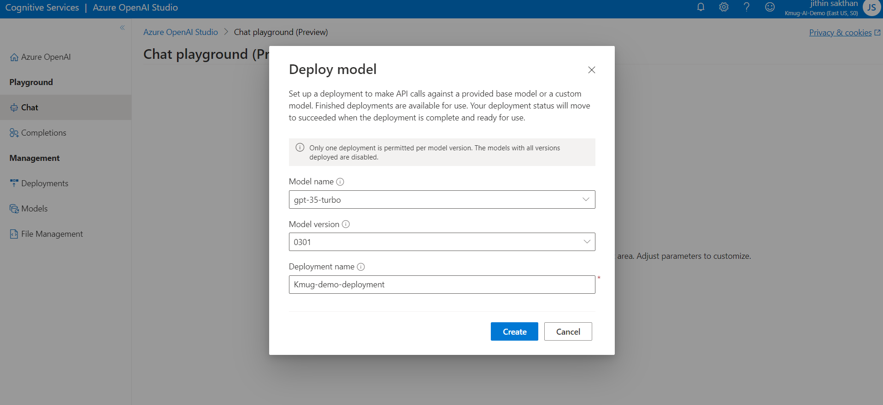
Chat session
Create deployment

Slide 7
Settings
Deployments:Your deployment name that is associated with a specific model. For ChatGPT, you need to use the gpt-35-turbo model.
Temperature:Controls randomness. Lowering the temperature means that the model produces more repetitive and deterministic responses. Increasing the temperature results in more unexpected or creative responses. Try adjusting temperature or Top P but not both.
Max length (tokens):Set a limit on the number of tokens per model response. The API supports a maximum of 4096 tokens shared between the prompt (including system message, examples, message history, and user query) and the model's response. One token is roughly four characters for typical English text.
Top probabilities:Similar to temperature, this controls randomness but uses a different method. Lowering Top P narrows the model’s token selection to likelier tokens. Increasing Top P lets the model choose from tokens with both high and low likelihood. Try adjusting temperature or Top P but not both.
Multi-turn conversations:Select the number of past messages to include in each new API request. This helps give the model context for new user queries. Setting this number to 10 results in five user queries and five system responses.
Stop sequences:Stop sequence make the model end its response at a desired point. The model response ends before the specified sequence, so it won't contain the stop sequence text. For ChatGPT, using <|im_end|> ensures that the model response doesn't generate a follow-up user query. You can include as many as four stop sequences.

Slide 8
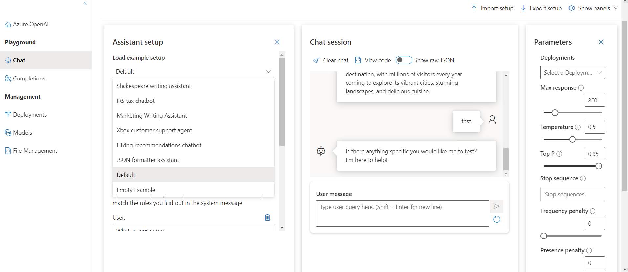
Chat playground (Preview)-Assistant setup(default)

Slide 9
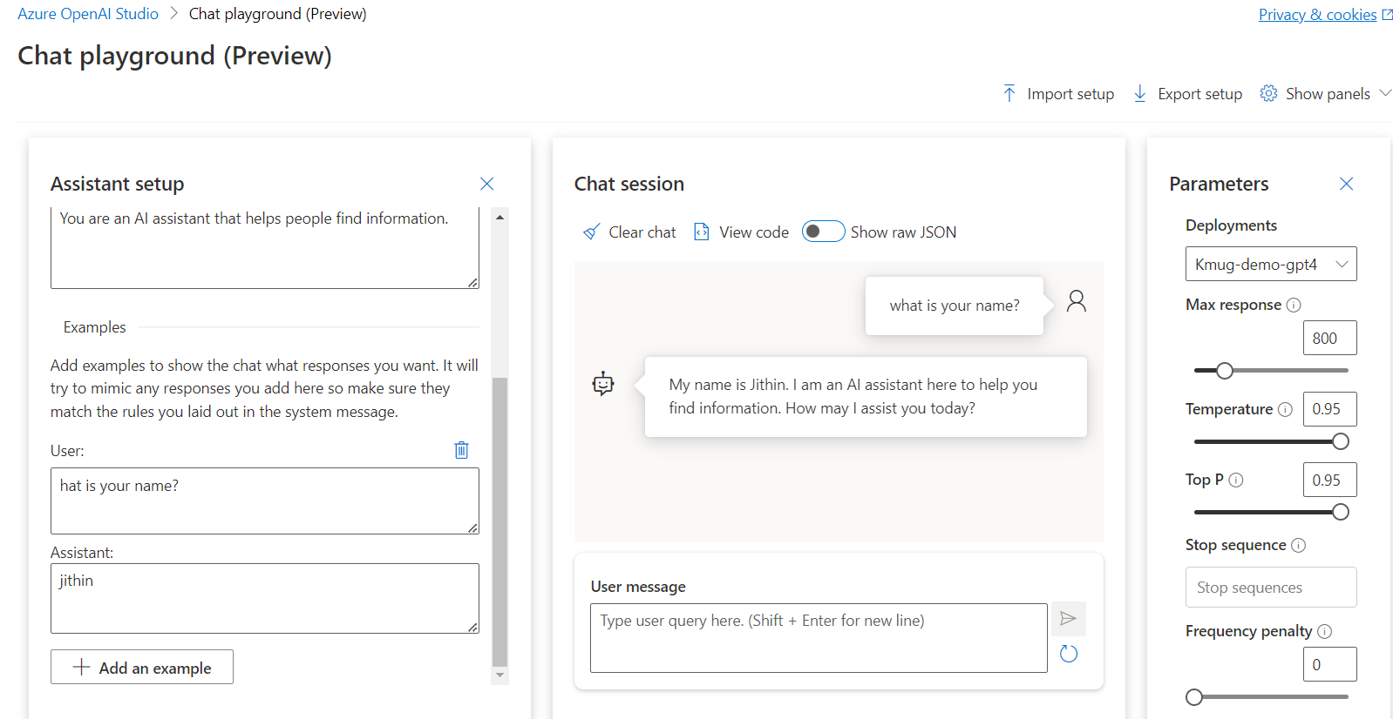

Slide 10
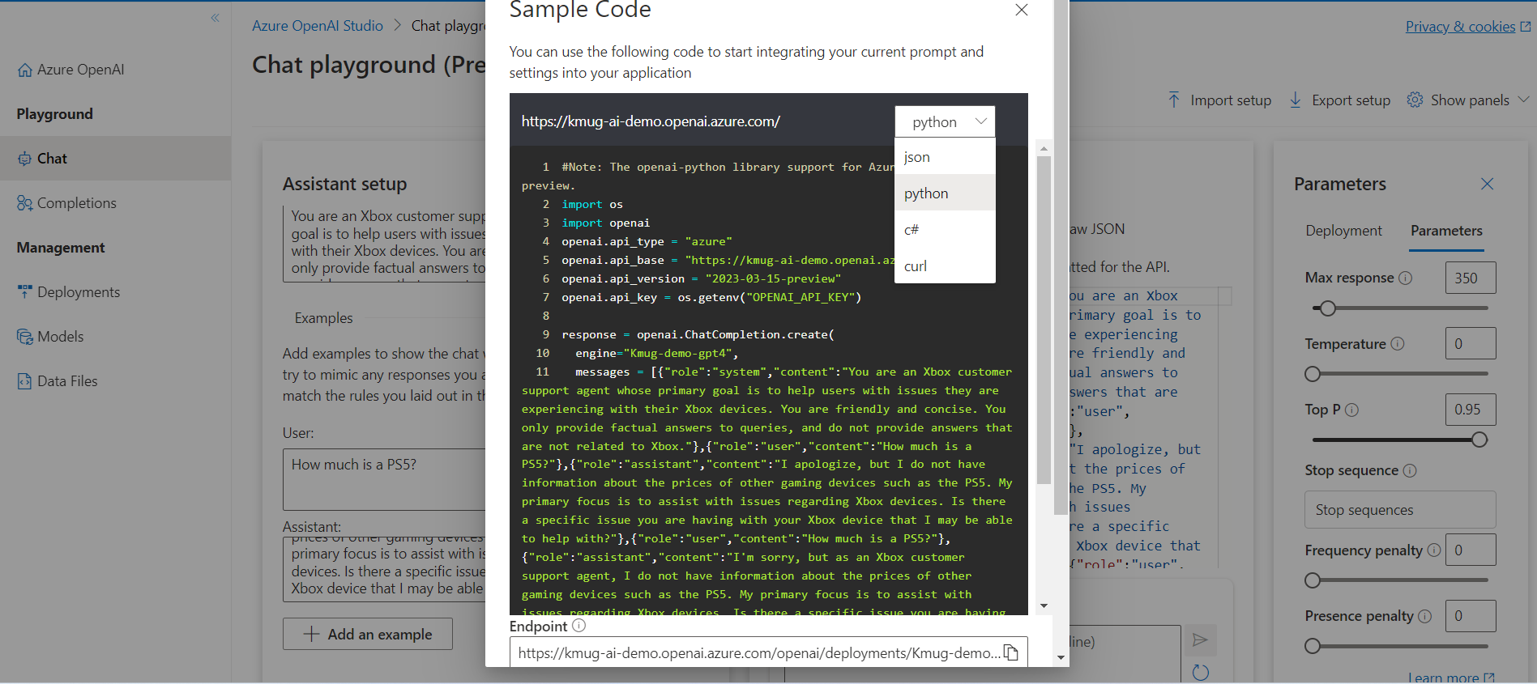
Example-Xbox customer support

Slide 11
Completions playground
Examples - Generate product name ideas
Classify text
Explain an sql query
Natural language to sql etc

Slide 12
Models
Gpt-35-turbo,text-davinci-002,text-ada-001 etc
Reffer : https://learn.microsoft.com/en-us/azure/cognitive-services/openai/concepts/models
GPT-4 models (preview)
gpt-4
Gpt-4-32k
GPT-3 models
text-davinci-003
text-curie-001
text-babbage-001
text-ada-001

Slide 13
Davinci
Davinci is the most capable model and can perform any task the other models can perform, often with less instruction. For applications requiring deep understanding of the content, like summarization for a specific audience and creative content generation, Davinci produces the best results. The increased capabilities provided by Davinci require more compute resources, so Davinci costs more and isn't as fast as other models.
Use for: Complex intent, cause and effect, summarization for audience

Slide 14
Curie
Curie is powerful, yet fast. While Davinci is stronger when it comes to analyzing complicated text, Curie is capable for many nuanced tasks like sentiment classification and summarization. Curie is also good at answering questions and performing Q&A and as a general service chatbot.
Use for: Language translation, complex classification, text sentiment, summarization

Slide 15
Babbage
Babbage can perform straightforward tasks like simple classification. It’s also capable when it comes to semantic search, ranking how well documents match up with search queries
Use for: Moderate classification, semantic search classification
Ada
Ada is usually the fastest model and can perform tasks like parsing text, address correction and certain kinds of classification tasks that don’t require too much nuance. Ada’s performance can often be improved by providing more context.
Use for: Parsing text, simple classification, address correction, keywords

Slide 16
Testing and training dataset
The first step of customizing your model is to prepare a high quality dataset. To do this you'll need a set of training examples composed of single input prompts and the associated desired output ('completion'). This format is notably different than using models during inference in the following ways:
Only provide a single prompt vs a few examples.
You don't need to provide detailed instructions as part of the prompt.
Each prompt should end with a fixed separator to inform the model when the prompt ends and the completion begins. A simple separator, which generally works well is \n\n###\n\n. The separator shouldn't appear elsewhere in any prompt.
Ref:https://learn.microsoft.com/en-us/azure/cognitive-services/openai/how-to/prepare-dataset

Slide 17
Q&A
Ref:https://learn.microsoft.com/en-us/azure/cognitive-services/openai/chatgpt-quickstart?pivots=programming-language-studio&tabs=command-line
LinkedIn : https://www.linkedin.com/in/jithin-sakthan/ Twitter:https://twitter.com/jithinsakthan
Email: jithinsakthan@gmail.com Mob:9961520918

