Slide 1
ASP .Net Core Blazor
Shamjith Haridasan

Slide 2
Topics to be covered
What is Blazor and what problem does it solve
Setup a development environment
Different hosting models
Blazor project structure
Routing
Blazor components
Retrieving data from a service
Working with forms
Handling event validations
Forms validation

Slide 3
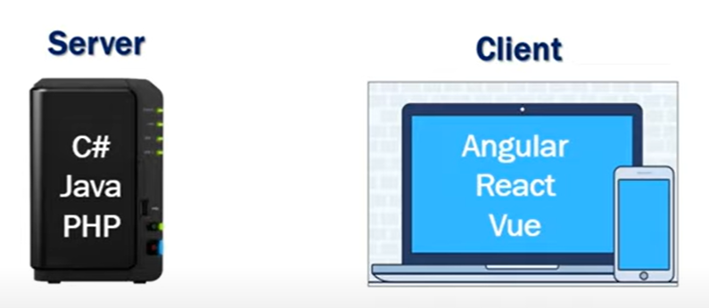
Todays web development

Slide 4
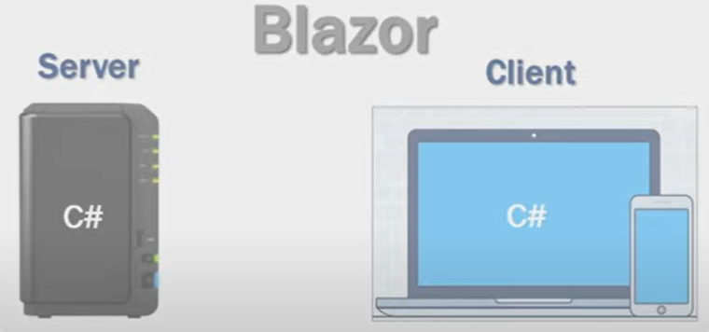
Blazor

Slide 5
What is Blazor?
Microsofts first ever single page application framework
Using Blazor, .NET developers can build a full-stack application using only .NET technologies
https://dotnet.microsoft.com/en-us/learn/aspnet/blazor-tutorial/create

Slide 6
Blazor History
Blazor framework was introduced in ASP .Net Core 3.0
In .Net 5.0 Blazor received significant updates to its component model, speed improvement and pre-rendering capabilities
In .Net 6.0, the blazor framework finds yet another path for developer success with .NET MAUI.
This new pattern is named Blazor Hybrid

Slide 7
Setup for Blazor development
Development environment
.Net core SDK 3.1 or later
Tools
Visual studio 2019 or later
VS Code
.Net core CLI
Pre-requisite - Basic knowledge about
C#
HTML
CSS

Slide 8
Blazor hosting models
Client-side hosting model
Blazor- Webassembly
Server hosting model
Blazor server

Slide 9
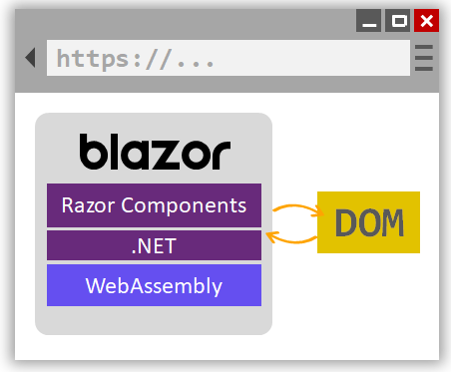
Client-side hosting model
Running .NET code inside web browsers is made possible by WebAssembly (abbreviated wasm)
Blazor WebAssembly is a single-page app (SPA) framework for building interactive client-side web apps with .NET
WebAssembly is an open web standard and supported in web browsers without plugins

Slide 10
Client side hosting models
Advantages
Active server connection not required
Client resources and capabilities are used
Full blown .Net hosting platform is not required. Can be served from CDN
Disadvantages
The very first request will take a lot of time
Browser with web assembly support is needed

Slide 11
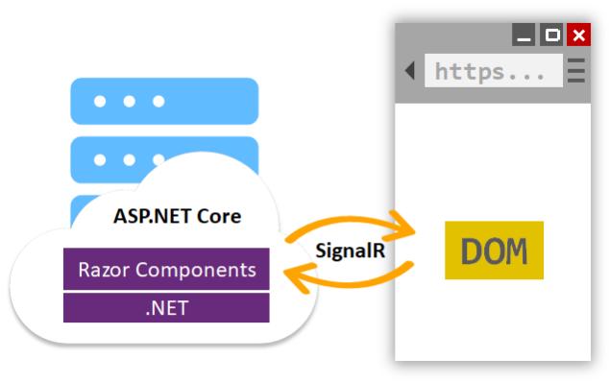
Server side hosting model
Blazor Server provides support for hosting Razor components on the server in an ASP.NET Core app
UI updates are handled over a SignalR connection

Slide 12
Server side hosting models
Advantages
App loads and runs faster
Can take full advantage of server capabilities
Only a browser is required on the client side
Disadvantages
A full blown ASP .Net core server is required
An active connection to the server is required

Slide 13
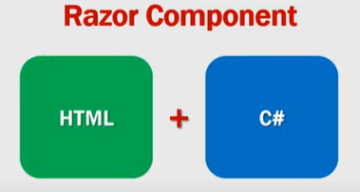
Components
Components are the basic building block of Blazor applications
Components files have the extension .razor
Component name must start with an uppercase character

Slide 14
Split component HTML and code
Partial files
Create a class file named <<componentname>>.razor.cs
Change class to partial class
Base class
Create a class named <<componentname>>Base.cs
Inherit from ComponentBase class
Add the class to the component using @inherits
All properties and events should be protected or public

Slide 15
Thank you

