Slide 1
Windows 10 for developer
Ian
2015.8.15

Slide 2


Who am I ?
Microsoft MVP (ASP.NET)
TechDays 2014 講師
MVP 2015 微軟實戰課程日 講師
遠綠資訊資深開發工程師
html5 & javascript程式開發實戰書籍共同作者
K.NET 社群共同人
Study4.TW 社群成員
www.dotblogs.com.tw/ian
Ian.msmvp@outlook.com

Slide 3
Agenda
Universal Windows Platform (UWP)
自適應UI(Adaptive UI)
適應式程式碼(Adaptive Code)
Windows 8.1 UAP移植到Windows 10 UWP

Slide 4
Universal Windows Platform

Slide 5
One Windows
Desktop SKU
Mobile SKU
Xbox SKU
IoT SKU
IoT headless SKU
Surface Hub SKU
Holographic SKU
PC
Tablet
Xbox
Band
Raspberry Pi
Surface Hub
HoloLens
2 in 1
Phablet
Home Automation
Phone

Slide 6
開發環境
Windows 10
Windows 8.1
Windows Server 2012 R2
Windows 7
Best developer experience for building Universal Windows apps
Deploy/Debug/Profile
Simulator
Local Machine
Mobile Emulators
Remote Machine
Device
XAML Designer/Intellisense
All other features work at parity with Windows 10, except:
Deploy/Debug/Profile
Mobile Emulators
Remote Machine
Device
XAML Intellisense
No WACK (Server R2)
All other features work at parity with Windows 10, except:
Deploy/Debug/Profile
Remote Machine
Device
XAML Intellisense

Slide 7
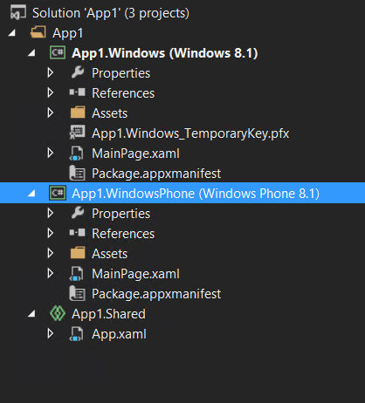
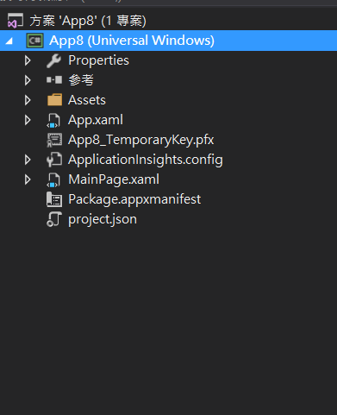
Windows 8 UWA | Windows 10 UWP

Slide 8







One store, one dev center
ONE APP PLATFORM
ONE STORE
ONE CORE OS
IoT
HoloLens
Surface Hub

Slide 9
Dev
create a single app package
Unified Developer Platform - 統一開發平台
provides a guaranteed core API layer across devices
Adaptive Code
across all device types
Universal Windows Platform
Windows Core
Desktop
Device
Phone
Device
Xbox
Device

Slide 10
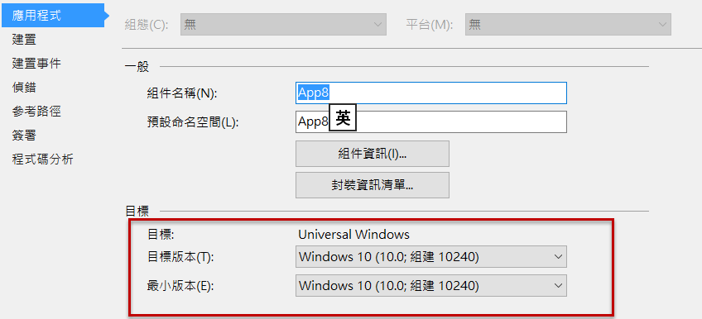
Apps don't target Windows 10, apps target the platform

Slide 11

良好的使用者體驗
Multi Windows Devices
設備特殊功能

Slide 12
Adaptive UI
UWP在one app one store的目標前題下，如何做出在各種類型的裝置上良好的使用者UI體驗是一個相對重要的課題，開發人員必須開發自適應式（adaptive UI）操作介面來適用於各種類型的裝置。

Slide 13
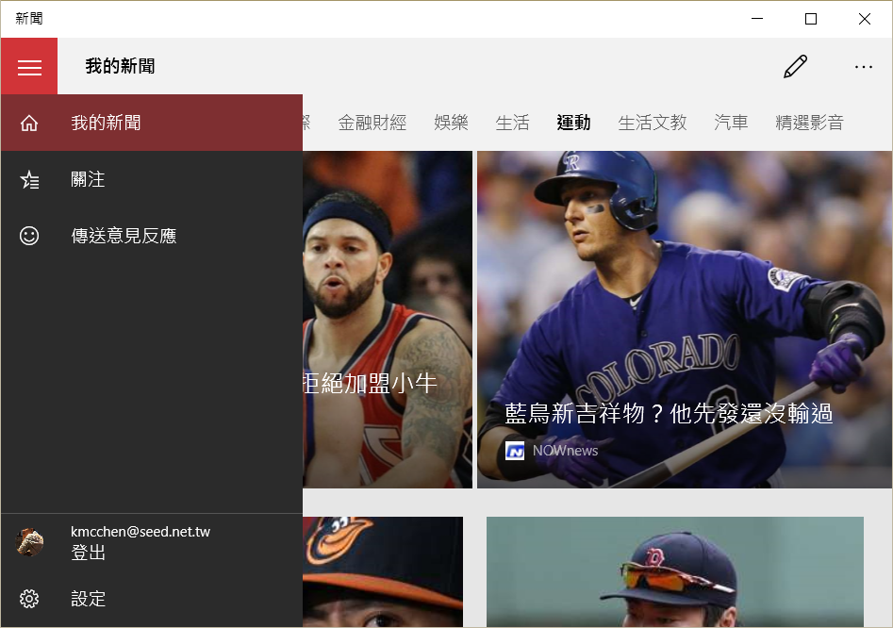
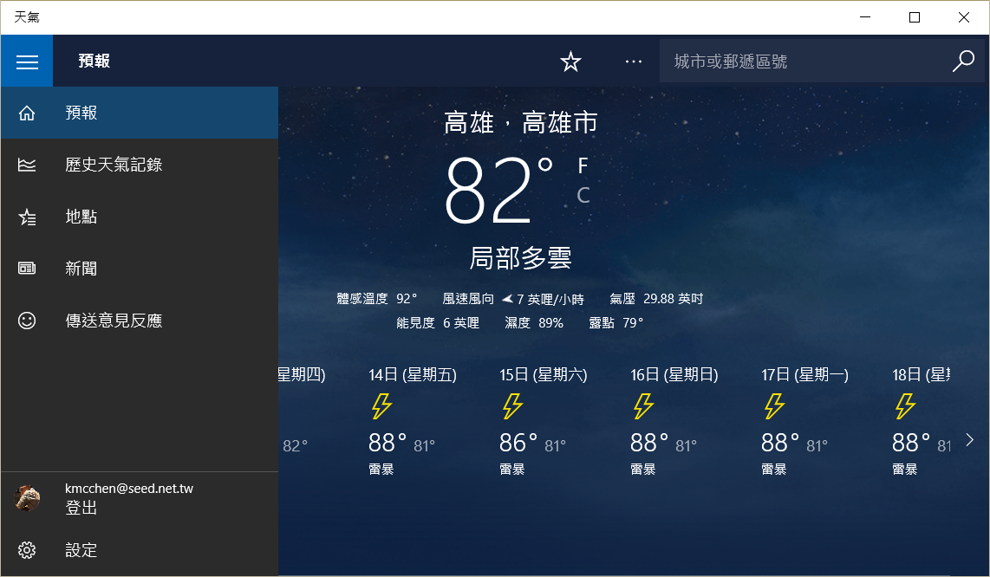
SplitView -漢堡選單

Slide 14
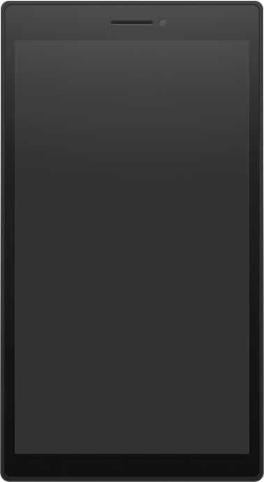
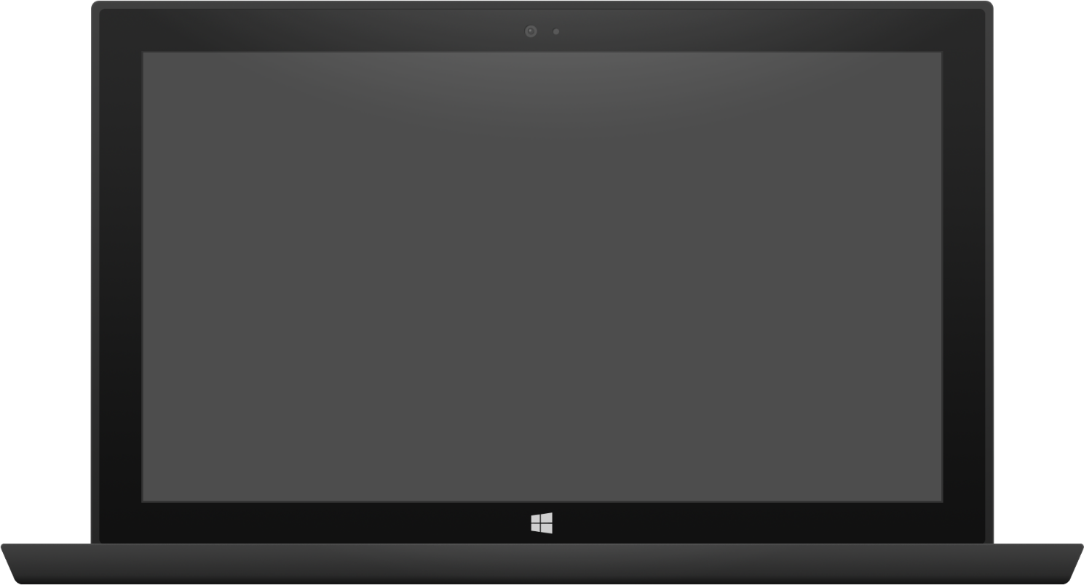
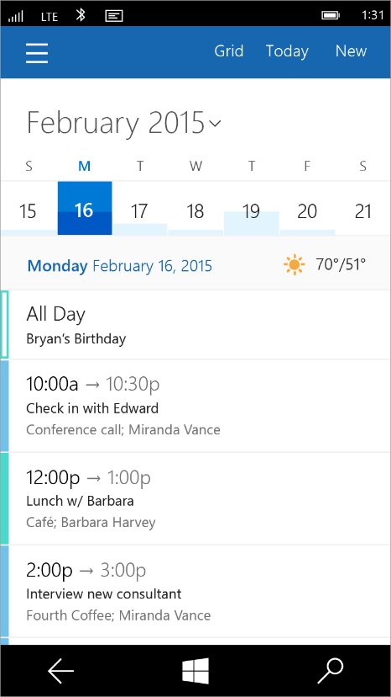
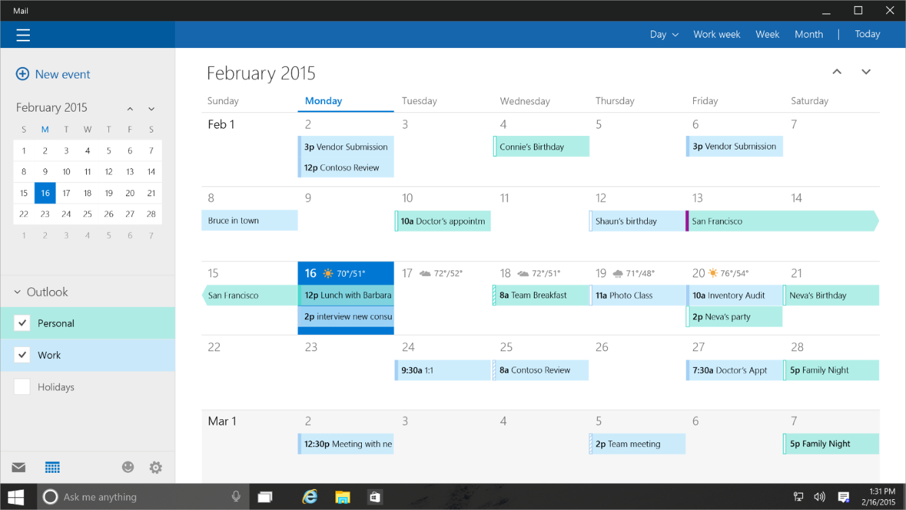
Tailored Design
http://www.microsoftvirtualacademy.com/training-courses/a-developers-guide-to-windows-10

Slide 15
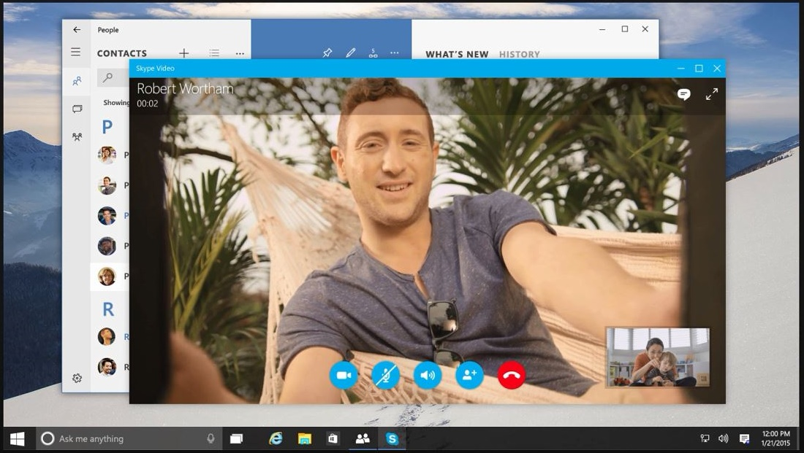
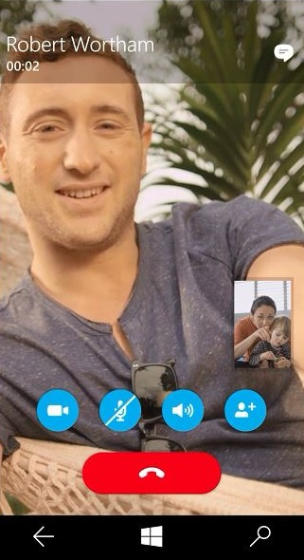
Adaptive design
http://www.microsoftvirtualacademy.com/training-courses/a-developers-guide-to-windows-10

Slide 16

SplitView - 新UI控制項 "漢堡選單“
TailoredDesign - Devices 專屬頁面
AdaptiveUI + AdaptiveCode - Back Button
VisualStateManager - 依設備尺吋響應式UI
RelativePanel - 新UI控制項 "UI相對位置排版"

Slide 17
Adaptive Code
UWP架構下提供85%通用API集合，可以在不同裝置間共用多數的程式碼，而面對特定設備獨有的特性，則可以採用Extension SDK的方式，呼叫指定平台的APIs 來撰寫自適應式程式碼

Slide 18
Windows 8.1 Universal
Shared code project
two binaries project

Slide 19
Compilation directives
#if WINDOWS_PHONE_APP Windows.Phone.UI.Input.HardwareButtons
.BackPressed += this.HardwareButtons_BackPressed; #endif

Slide 20
Extension SDK
Extension SDK
Extension SDK
Extension SDK
UAP （通用型APIs集合，做為通用型應用程式開發的基礎）
Windows Core（核心基礎服務）
Desktop
Mobile
Xbox
More…

Slide 21
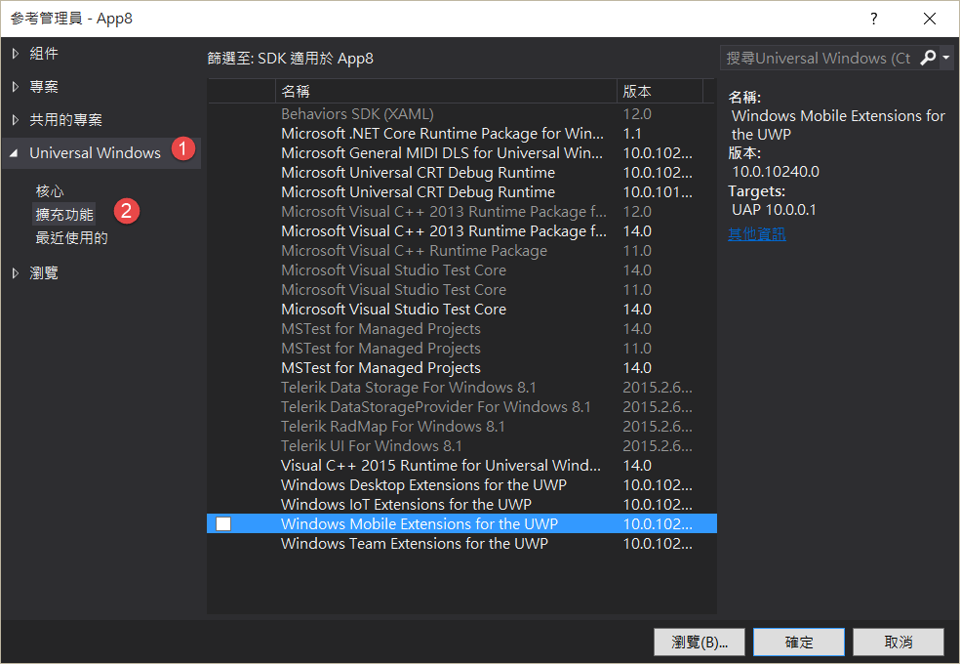
Extensions SDK
Windows App
Desktop
extension
Phone
extension
Xbox
extension
Universal Windows Platform
Windows Core
Desktop
Device
Phone
Device
Xbox
Device

Slide 22
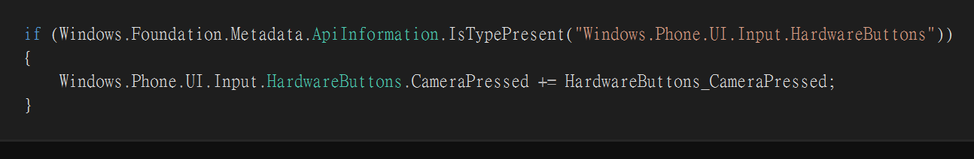
Test capabilities at runtime
Windows.Foundation.Metadata.ApiInformation
IsApiContractPresent
IsEnumNamedValuePresent
IsEventPresent
IsMethodPresent
IsPropertyPresent
IsReadOnlyPropertyPresent
IsTypePresent
IsWriteablePropertyPresent

Slide 23
AdaptiveCode – Hide StatusBar
AdaptiveCode – HardwareButtons

Slide 24
Ref
https://docs.com/user993013/2805/windows-10-uwp

