Slide 1

Face Detection
Juan Ning
09/27/2019

Slide 2
Outline
Face Detection
Haar-like Feature
AdaBoost Algorithm
Q & A
Integral Image

Slide 3
Face Detection
Face Information
Personal information, including gender and identity.
Face Detection
Detect face in dynamic scene or complicated background image.
Prerequisite and foundation of face recognition.
Apply AdaBoost Algorithm in face detection.

Slide 4
Outline
Face Detection
Haar-like Feature
AdaBoost Algorithm
Q & A
Integral Image

Slide 5

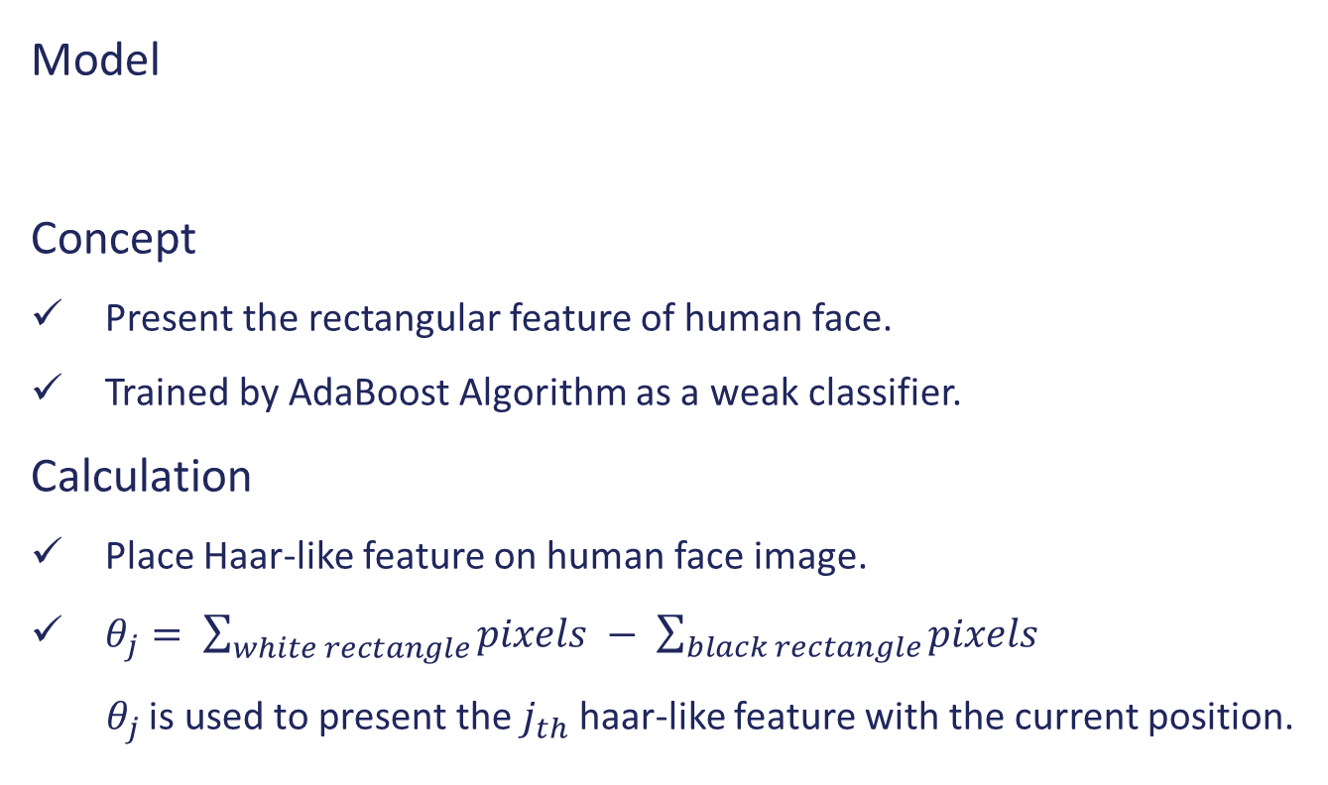
Haar-like Feature
Model
Concept
Present the rectangular feature of human face.
Trained by AdaBoost Algorithm as a weak classifier.
Calculation
Place Haar-like feature on human face image.
$θ_{j}= \sum_{white rectangle}{pixels} − \sum_{black rectangle}{pixels}$
$θ_{j}$ is used to present the $j_{th}$ haar-like feature with the current position.

Slide 6
Outline
Face Detection
Haar-like Feature
AdaBoost Algorithm
Q & A
Integral Image

Slide 7
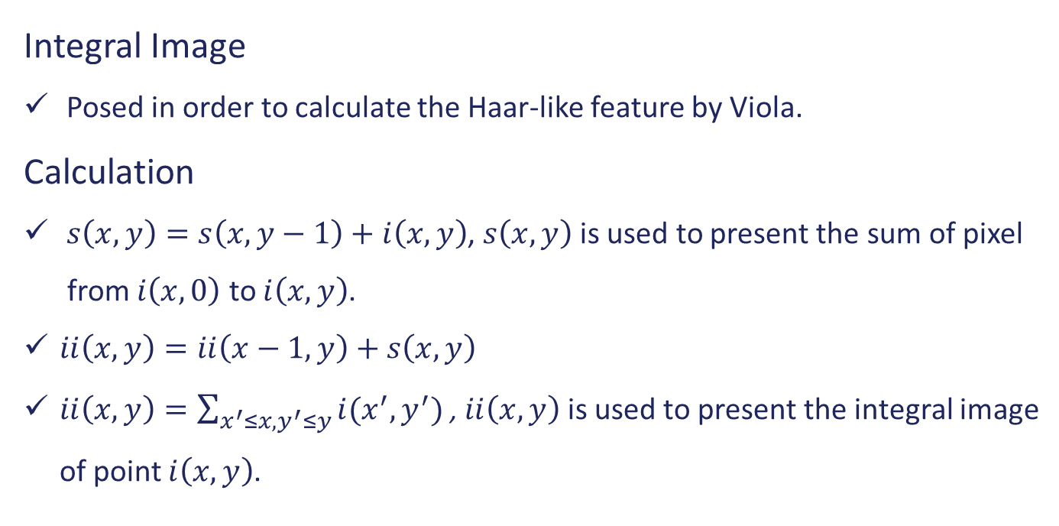
Integral Image
Integral Image
Posed in order to calculate the Haar-like feature by Viola.
Calculation
$s\left(x,y\right)=s\left(x,y−1\right)+i\left(x,y\right)$, $s\left(x,y\right)$is used to present the sum of pixel
from $i\left(x, 0\right)$ to $i\left(x,y\right)$.
$ii\left(x,y\right)=ii\left(x−1,y\right)+s\left(x,y\right)$
$ii\left(x,y\right)=\sum_{x^{′}≤x,y^{′}≤y}{i(x^{′},y^{′})}$ , $ii\left(x,y\right)$is used to present the integral image
of point $i\left(x,y\right)$.

Slide 8
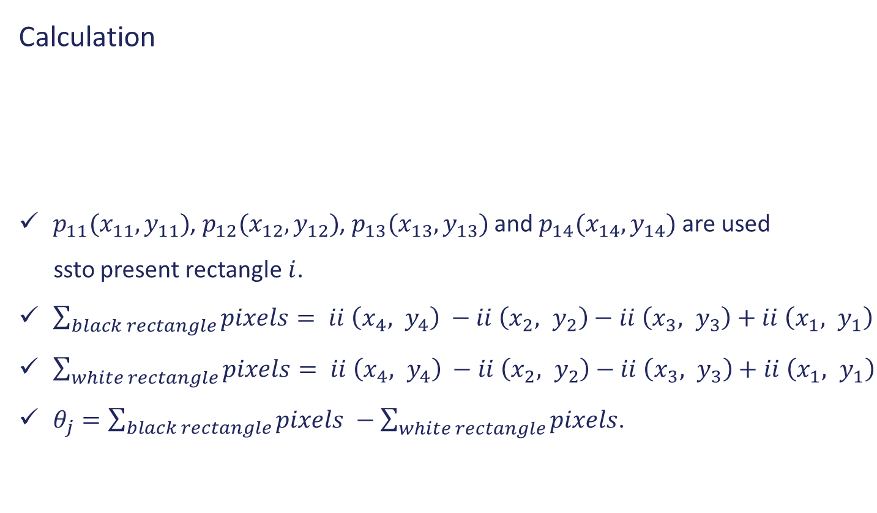
Integral Image
Calculation
$p_{11}(x_{11}, y_{11})$, $p_{12}(x_{12},y_{12})$, $p_{13}(x_{13},y_{13})$ and $p_{14}(x_{14}, y_{14})$ are used
ssto present rectangle $i$.
$\sum_{black rectangle}{pixels}= ii \left(x_{4}, y_{4}\right) −ii \left(x_{2}, y_{2}\right)−ii \left(x_{3}, y_{3}\right)+ii \left(x_{1}, y_{1}\right)$
$\sum_{white rectangle}{pixels}= ii \left(x_{4}, y_{4}\right) −ii \left(x_{2}, y_{2}\right)−ii \left(x_{3}, y_{3}\right)+ii \left(x_{1}, y_{1}\right)$
$θ_{j}=\sum_{black rectangle}{pixels} −\sum_{white rectangle}{pixels}$.
Rectangle 1 Rectangle 2
(Black) (White)

Slide 9
Outline
Face Detection
Haar-like Feature
AdaBoost Algorithm
Q & A
Integral Image

Slide 10
AdaBoost Algorithm
Background:
In 1995, Freend and Schapire posed the AdaBoost algorithm.
In order to speed up the calculation of Haar-like feature, Viola.P and Jones.M posed Haar-like feature with the conception of integral image.

Slide 11
AdaBoost Algorithm
Procedure
Initialize the weights of all samples.
Calculate the Haar-like features to represent human face.
Train all Haar-like features using AdaBoost Algorithm.
Each cycle:
Uniformization the weights of all samples.
Train the weak classifiers by AdaBoost Algorithm.
Choose the weak classifier with the minimum error rate.
Update the weights of all samples.
Compute the weight of weak classifiers to get the strong classifier.

Slide 12

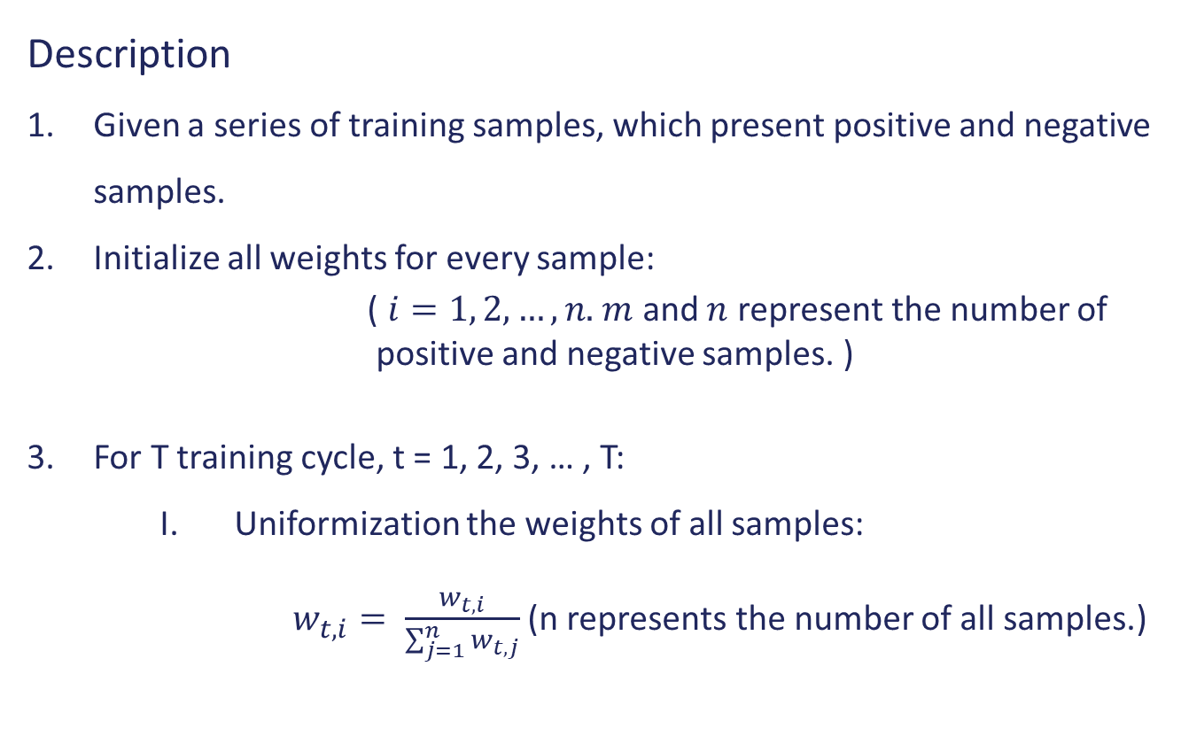
AdaBoost Algorithm
Description
Given a series of training samples, which present positive and negative samples.
Initialize all weights for every sample:
( $i=1, 2, …, n.$ $m$ and $n$ represent the number of positive and negative samples. )
For T training cycle, t = 1, 2, 3, … , T:
Uniformization the weights of all samples:
$w_{t, i}= \frac{w_{t, i}}{\sum_{j=1}^{n}{w_{t, j}}}$ (n represents the number of all samples.)

Slide 13
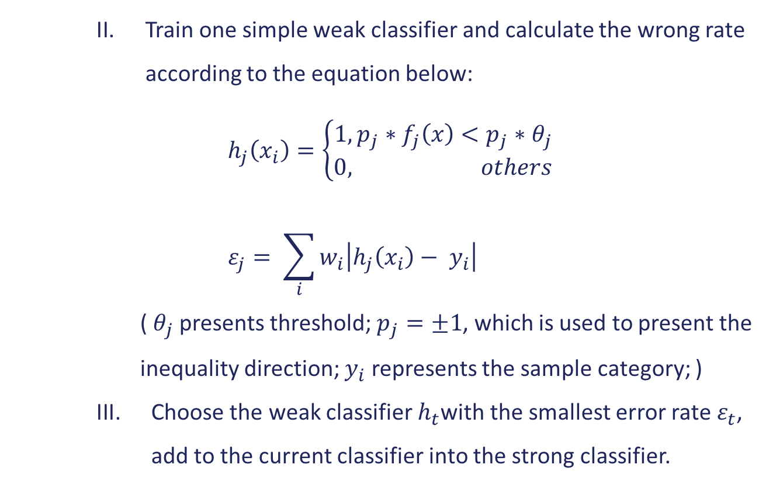
AdaBoost Algorithm
Train one simple weak classifier and calculate the wrong rate according to the equation below:
$$h_{j}\left(x_{i}\right)=\left\{\begin{aligned}1,p_{j}∗f_{j}\left(x\right)<p_{j}∗θ_{j} \\ 0, others\end{aligned}\right.$$
$$ε_{j}= \sum_{i}{w_{i}\left|h_{j}\left(x_{i}\right)− y_{i}\right|}$$
( $θ_{j}$ presents threshold; $p_{j}=±1$, which is used to present the inequality direction; $y_{i}$ represents the sample category; )
Choose the weak classifier $h_{t}$with the smallest error rate $ε_{t}$, add to the current classifier into the strong classifier.

Slide 14
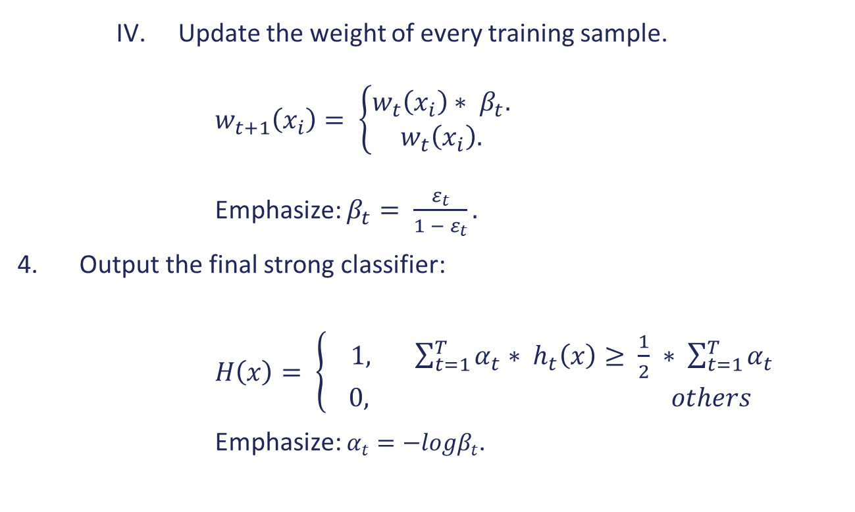
AdaBoost Algorithm
Update the weight of every training sample.
$w_{t+1}\left(x_{i}\right)= \left\{\begin{aligned}w_{t}\left(x_{i}\right)∗ β_{t}. \\ w_{t}\left(x_{i}\right).\end{aligned}\right.$
Emphasize: $β_{t}= \frac{ε_{t}}{1 − ε_{t}}.$
Output the final strong classifier:
$H\left(x\right)= \left\{\begin{aligned} 1, \sum_{t=1}^{T}{α_{t}}∗ h_{t}\left(x\right)≥ \frac{1}{2} ∗ \sum_{t=1}^{T}{α_{t}} \\ 0, others\end{aligned}\right.$
Emphasize: $α_{t}=−logβ_{t}$.

Slide 15
Outline
Face Detection
Haar-like Feature
AdaBoost Algorithm
Q & A
Integral Image

Slide 16
Q & A

