Slide 1
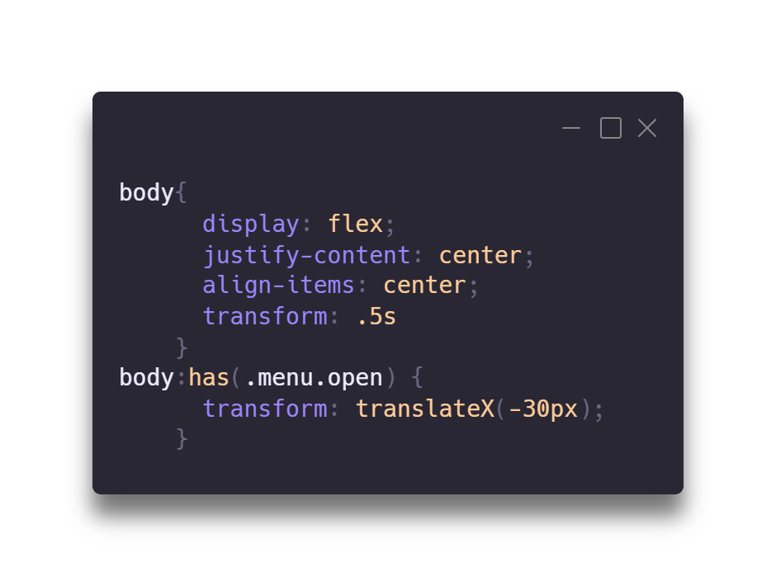
:has
TIPS & TRICKS

Slide 2
:has

Slide 3
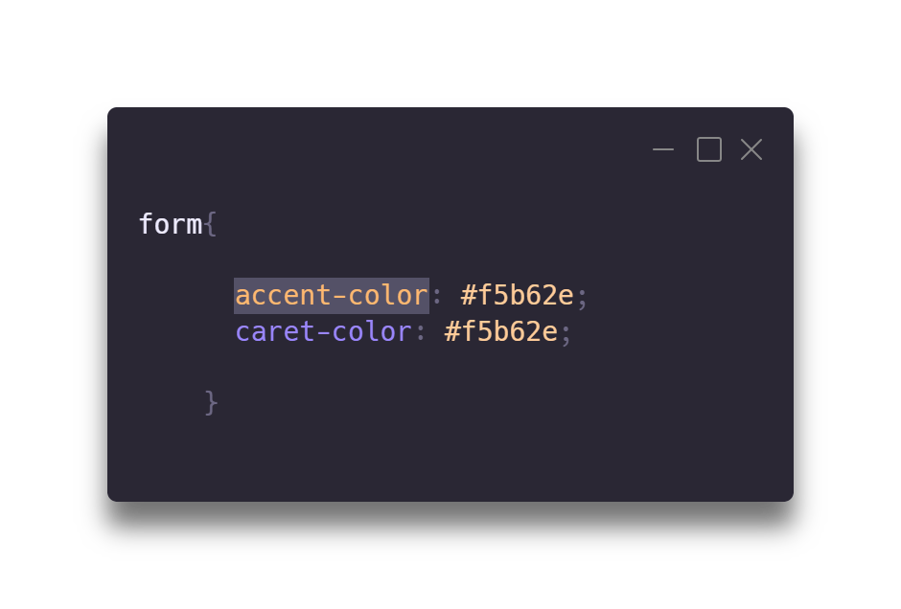
Accent Color caret-color

Slide 4
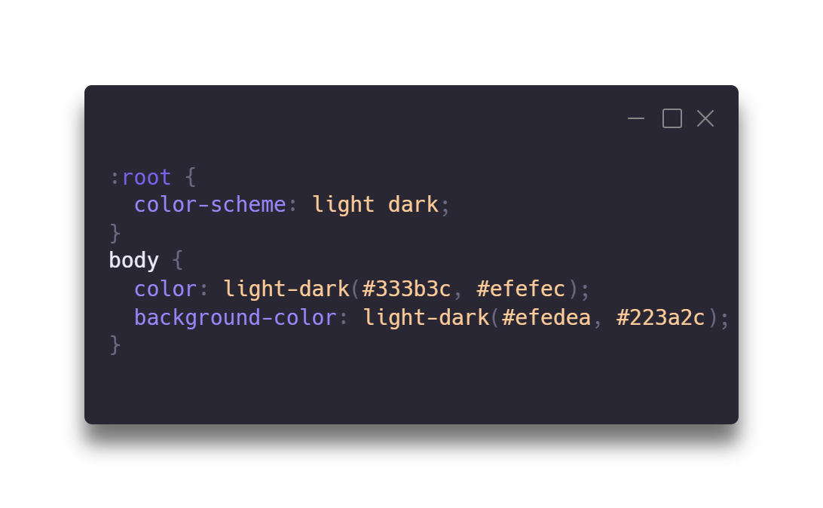
Color Scheme light-dark()

Slide 5
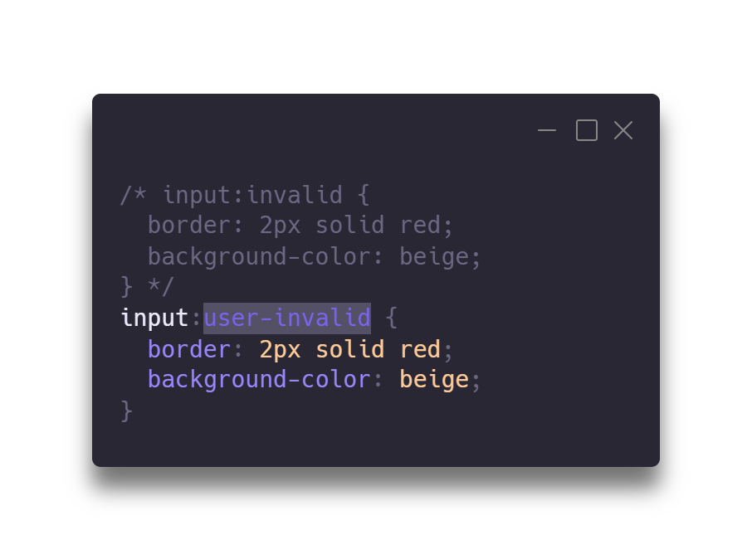
:invalid VS :user-invalid

Slide 6
:invalid VS :user-invalid
TIPS & TRICKS

