Slide 1
Sleep
Tracking
Analysis
Data 211 Final Project
21 consecutive nights of sleep data tracked from April 5 to April 25, 2026 — visualized, analyzed, and tested for statistical significance.
Kofi Owusu
DATA 211 · Spring 2026
April 5 – April 25, 2026 | n = 21

Slide 2
Research Question & Hypotheses
Is my average nightly sleep significantly different from the recommended 8 hours?
H₀ Null Hypothesis
H₁ Alternative Hypothesis
My average nightly sleep equals 8 hours.
(μ = 8)
My average nightly sleep does not equal 8 hours.
(μ ≠ 8)
One-Sample T-Test · Two-tailed · α = 0.05

Slide 3
Data Collection & Summary Statistics
6.88
7.0
1.77
3.5
10.5
hrs
hrs
hrs
hrs
hrs
Mean
Median
Std Dev
Min
Max
📋 Method
📅 Period
Google Sheets — logged every morning
April 5 – April 25, 2026
📏 Variables
⚠️ Challenges
Day (1–21) + sleep_hours
Estimating exact hours; missed logs

Slide 4
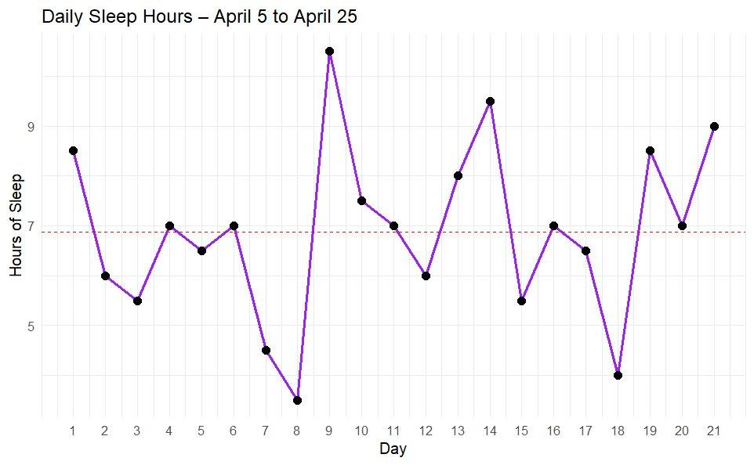
Daily Sleep Hours — Line Graph
Key Points
High
10.5 hrs
(Day 9)
Low
3.5 hrs
(Day 8)
Avg
6.88 hrs

Slide 5
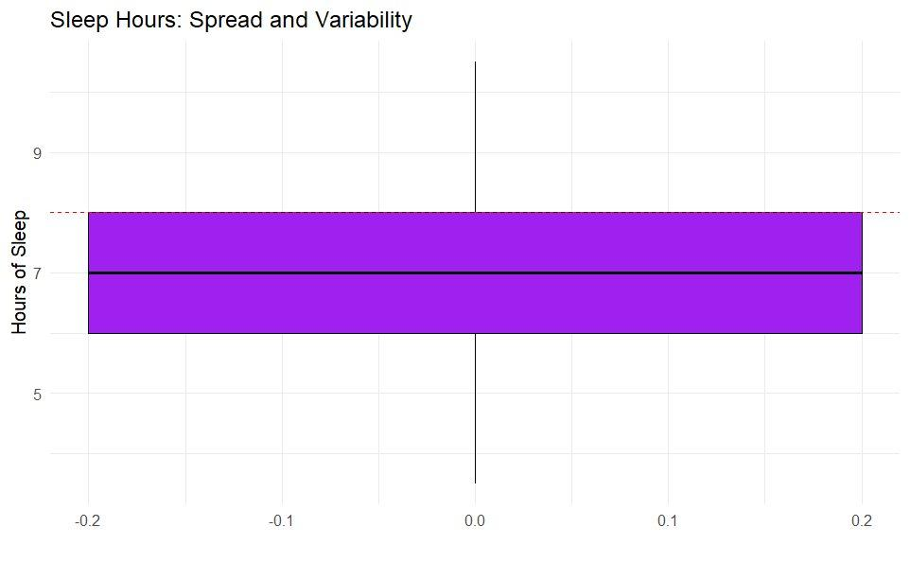
Sleep Distribution — Box Plot
Key Points
Q1
6.0 hrs
Median
7.0 hrs
Q3
8.0 hrs

Slide 6
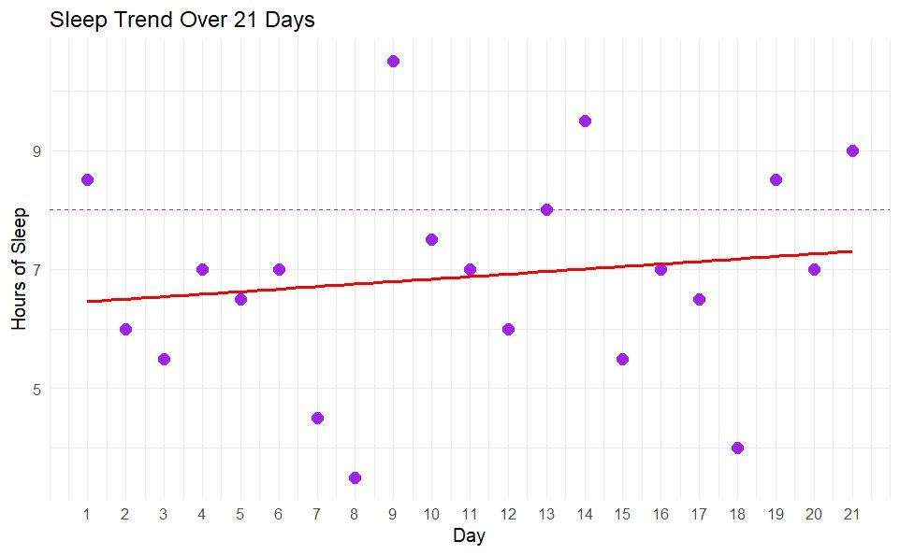
Sleep Trend — Scatter Plot
Finding
Slight upward trend (red line) over 21 days suggesting marginal improvement, but high scatter makes this inconclusive.

Slide 7
Statistical Test Results
One-Sample T-Test · H₀: μ = 8 · H₁: μ ≠ 8 · α = 0.05
t-statistic
p-value
Sample Mean
95% CI
Decision
−2.902
0.0088
6.88 hrs
[6.08, 7.69]
Reject H₀
p-value (0.0088) < α (0.05) — Reject the null hypothesis. Strong statistical evidence that average sleep of 6.88 hrs significantly differs from the recommended 8 hours.

Slide 8
Conclusion, Limitations & Learnings
Conclusion
Average sleep of 6.88 hrs is statistically significantly below the recommended 8 hours (t = −2.902, p = 0.0088). The 95% confidence interval [6.08, 7.69] confirms the deficit. I consistently undersleep across the 21-day period.
Limitations
What I Learned
· Small sample size (n = 21) limits generalizability
· Applied full data science pipeline to real personal data
· Self-reported data may have measurement error
· Practiced one-sample t-test and RMarkdown
· Only sleep duration tracked — not quality, stress, or other factors
· Built meaningful visualizations with ggplot2
· 3-week window may not reflect typical long-term patterns
· Discovered consistent undersleeping with health implications

Slide 9
Thank You
Questions?
Kofi Owusu · DATA 211 · Spring 2026 · Metropolitan State University

