Slide 1
Recommendation Engine for Books

Slide 2
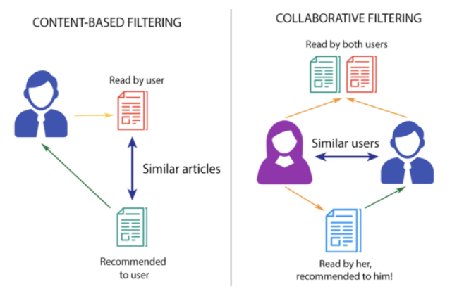
Two types of recommendation systems

Slide 3
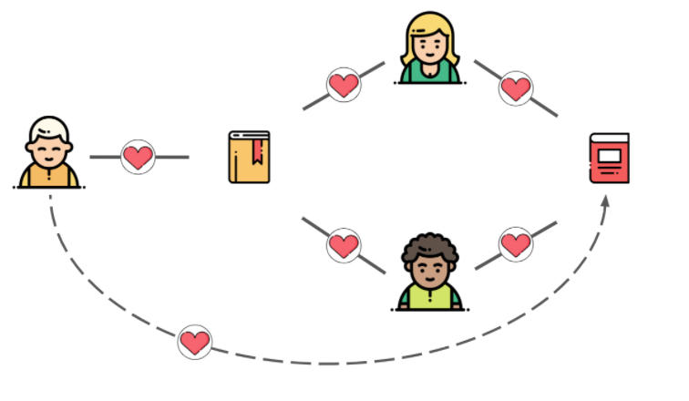
Collaborative filtering
You like Harry potter
He likes Harry potter
He also likes Game of thrones
Hence, You will also like Game of thrones

Slide 4
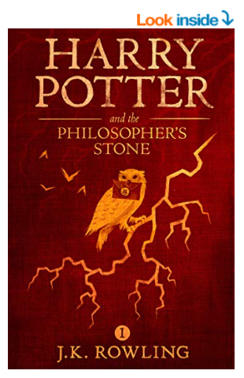
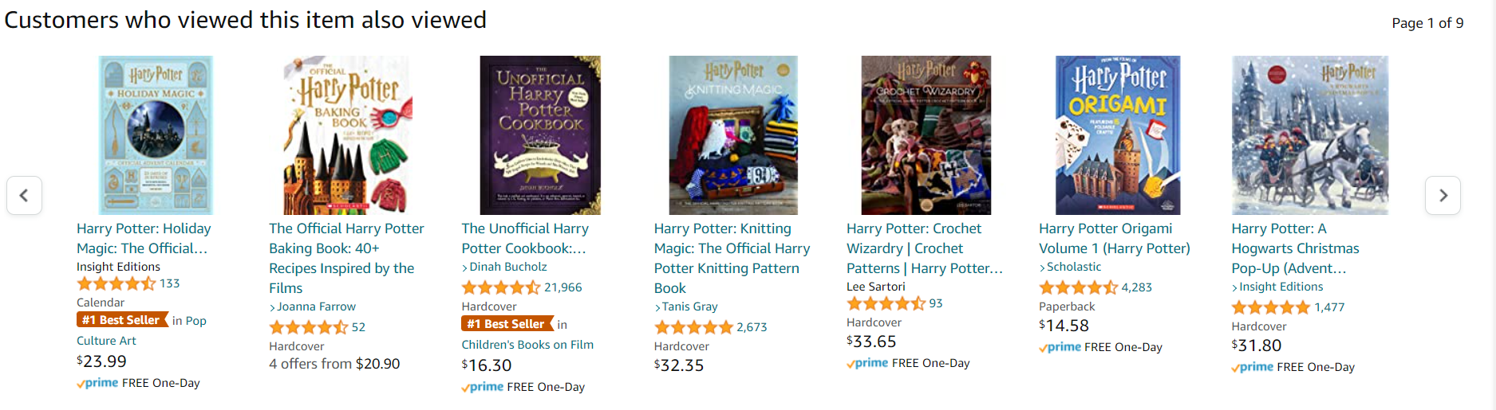

Slide 5
Different Approaches in CF
Collaborative filtering makes use of user and product interactions
We can compare user interactions with items and find similar users. This is called user-user based CF
Similarly, we can understand how different users respond to a product, and use it to find similar items. This is called item-item based CF.

Slide 6

Why not user-user based CF
New users have next to zero data, which makes recommendations difficult

Slide 7
Why not user-user based CF
User behaviors change drastically, making historically collected data biased

Slide 8
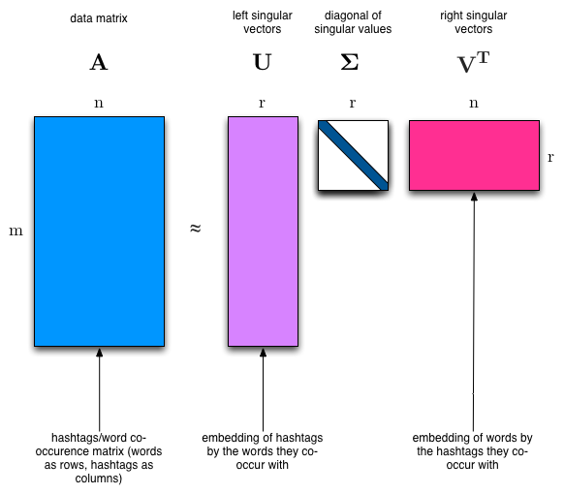
Singular Value Decomposition
Why ?
Big matrices are difficult to work with .. more storage more compute
SVD solves this problem by helping reduce a large 2D matrix to smaller dimensions

Slide 9
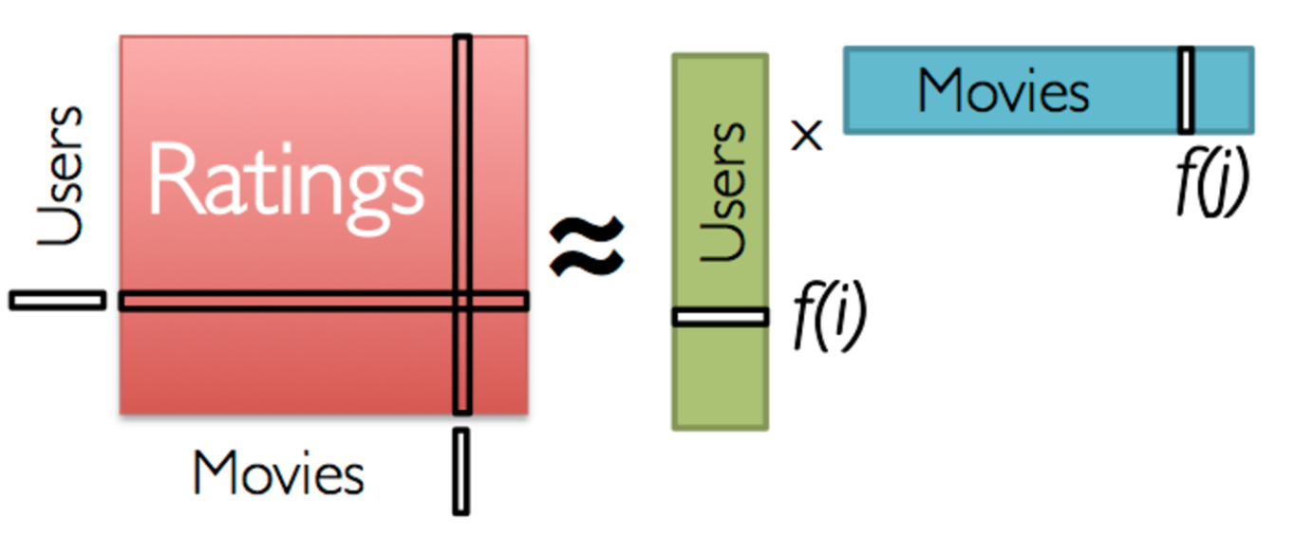
Using SVD for recommendation systems
The idea of embeddings
U = User Matrix #users (x) #latent_features
M = Movie Matrix #movies (x) #latent_features

Slide 10

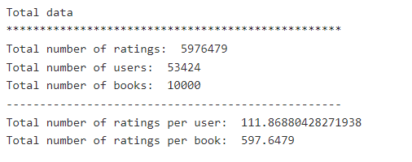
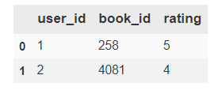
Dataset
Goodreads book ratings
There are total of nearly 6 million ratings in this dataset. So, in order to be realistic, we had to sample the dataset to small enough size for processing

Slide 11
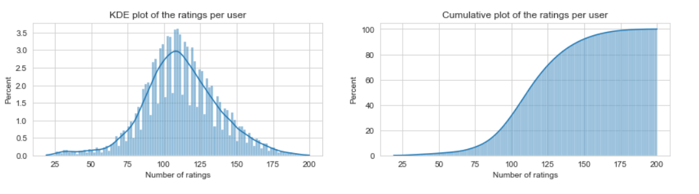
Distribution of book ratings
The number of ratings given by each user follows a nearly normal distribution, with the average user rating around 112 books in total.

Slide 12
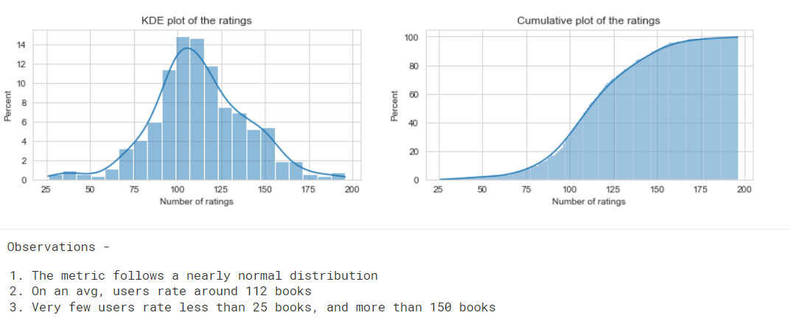
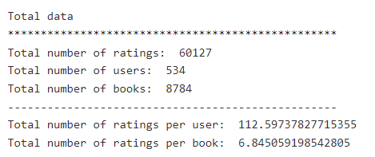
Sampling data to preserve the distribution
We made use of stratified sampling to sample down the data from 6 million ratings to 60k.

Slide 13
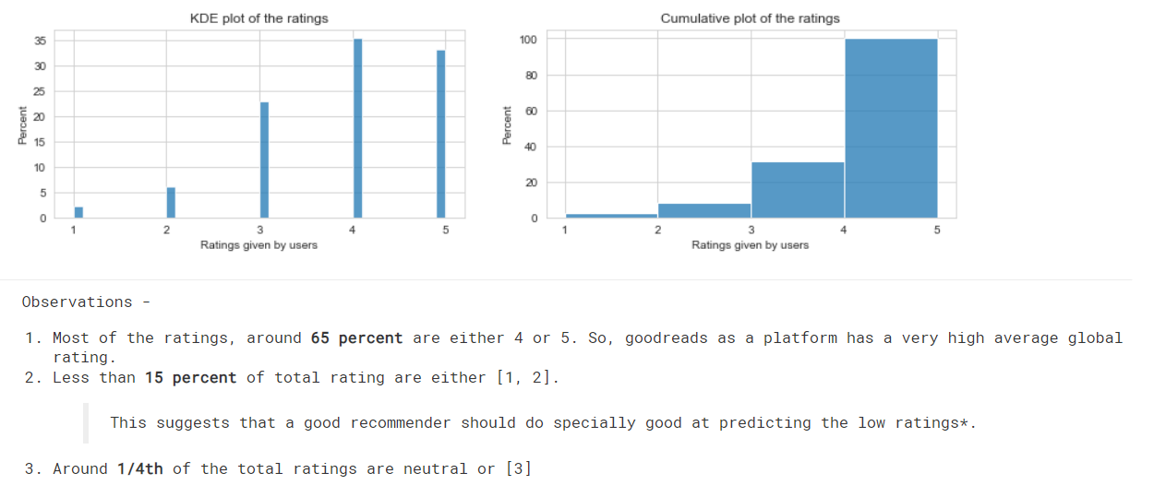
Ratings given by user (proportions)

Slide 14
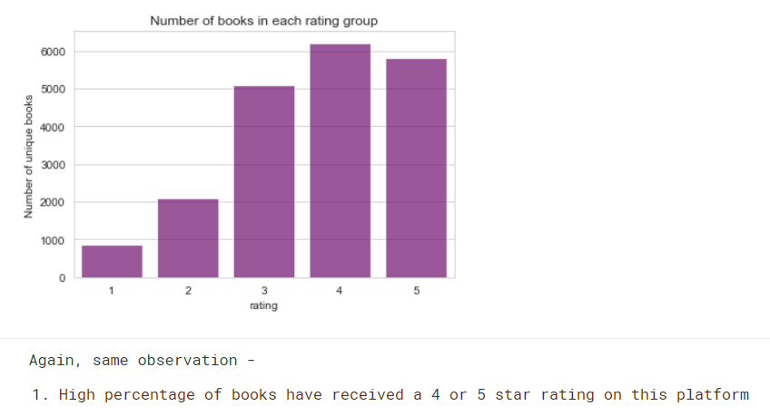
Number of books for each rating category

Slide 15

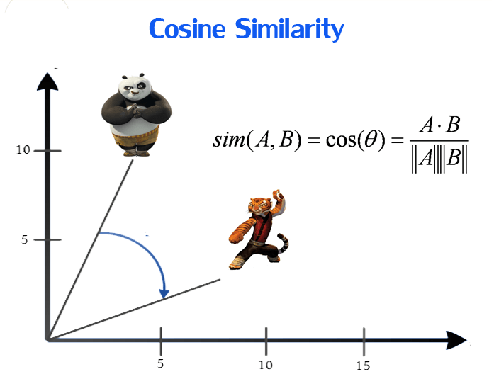
Flow of program
EDA
Better data understanding
sampling
Apply SVD
Extract reduced item matrix
Make use of cosine similarity to find nearby items in the latent space

Slide 16
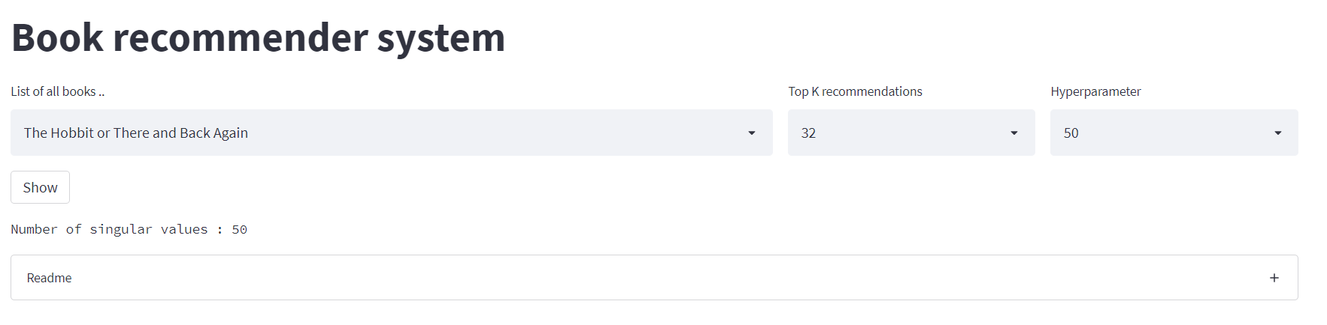
Demo
We search for books of choice from a database around 8k books

Slide 17

The recommendation system retrieves the list of best matching books based on similarity score calculated for item vectors in latent space

Slide 18
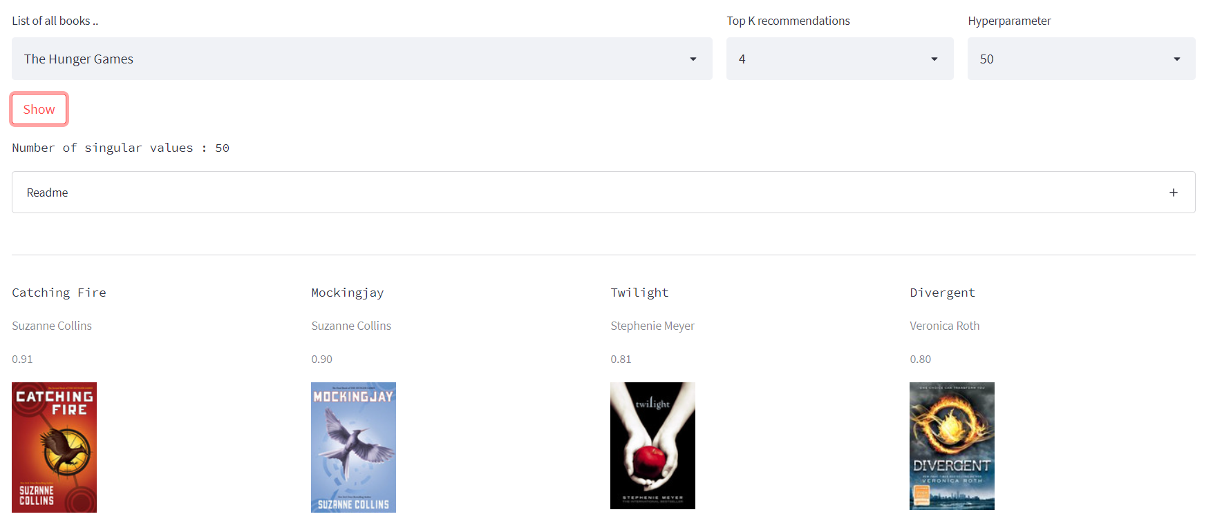

Slide 19
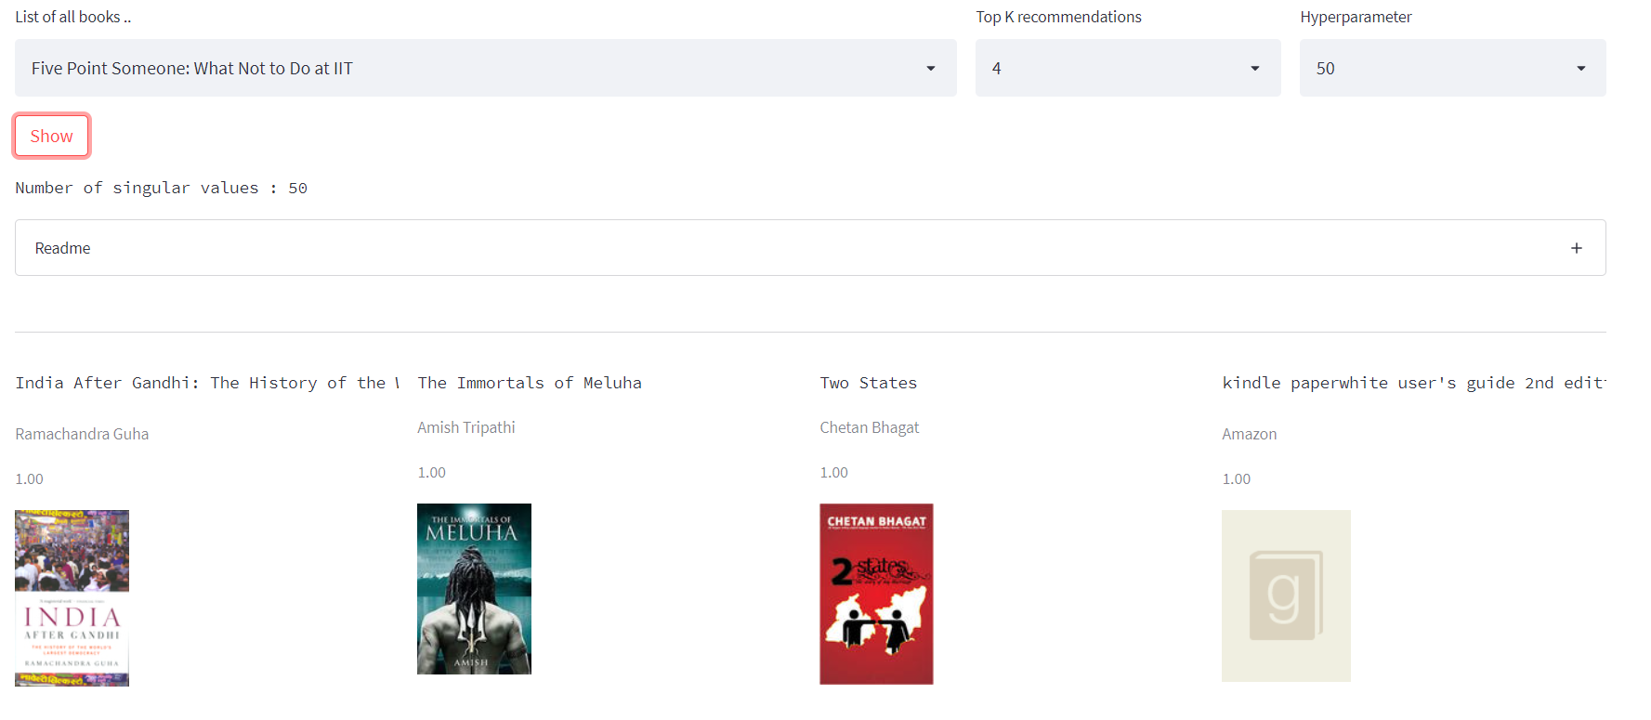

Slide 20
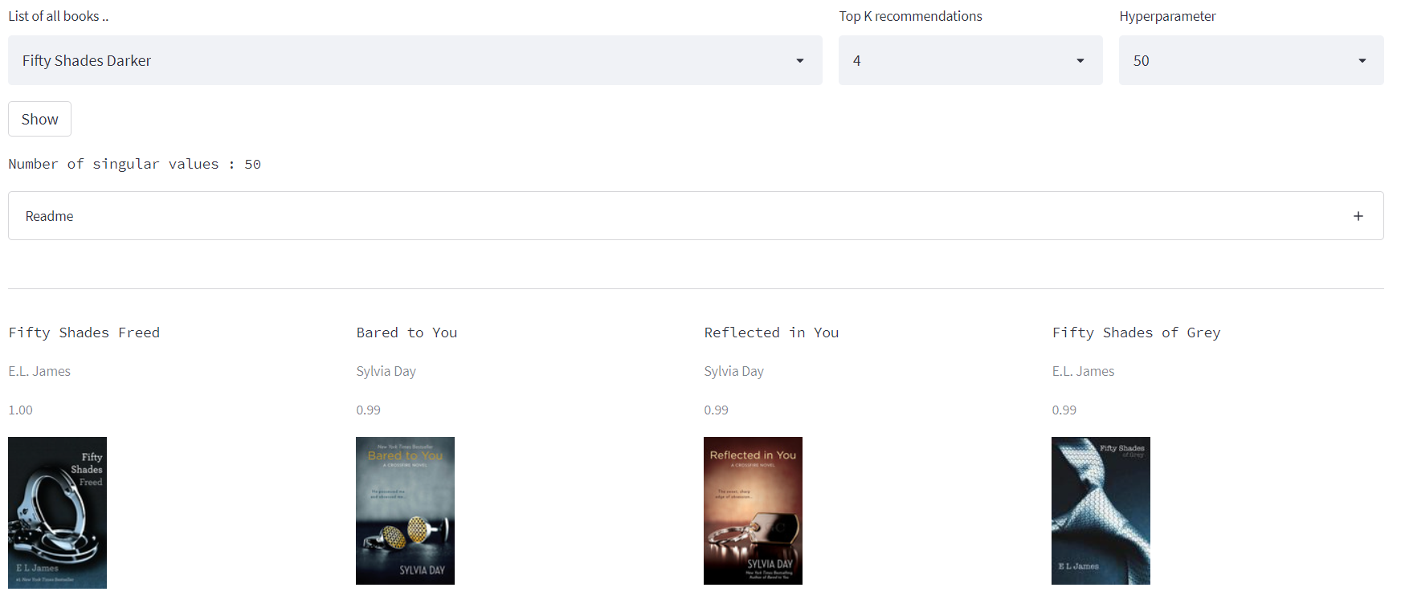

Slide 21
QUESTIONS

