Slide 1
Recommendation Engine for Book selection

Slide 2

Different types of recommendations systems

Slide 3
Non Personal results
Examples
Most watched
Highest Rating

Slide 4
Personal results
Examples
Similar items
Similar taste

Slide 5

Technically speaking

Slide 6
Content based filtering
Item A is also a book
1
Item A is also science fiction
2
Item A is written by the same author in same decade
3

Slide 7
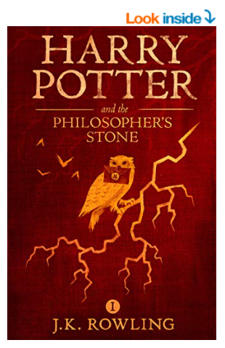
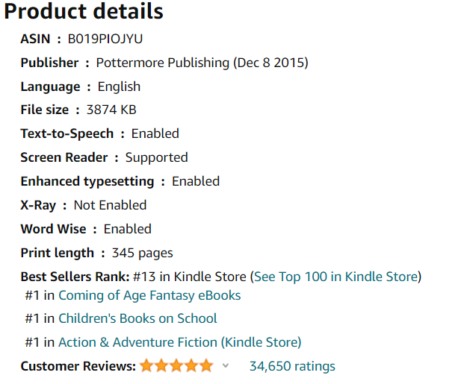
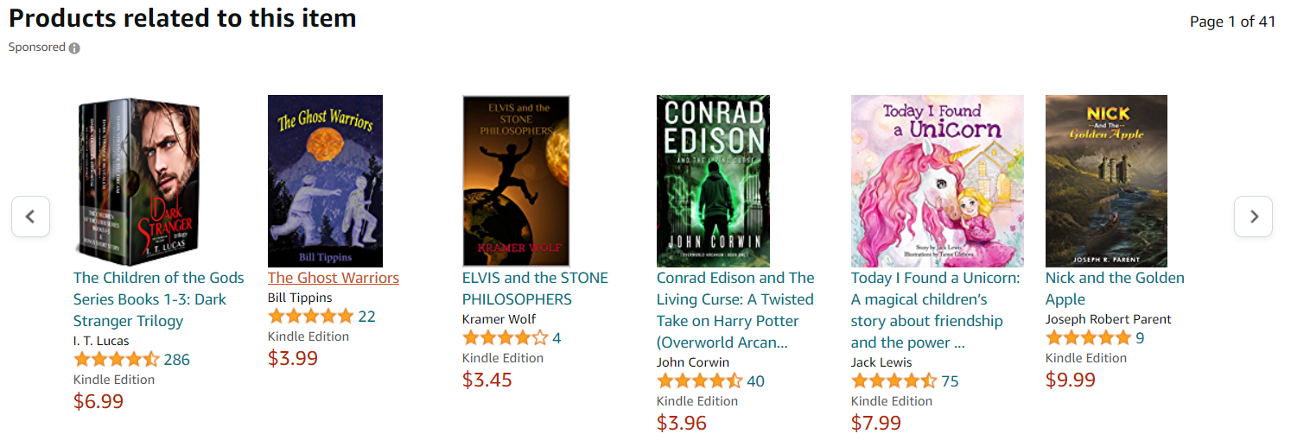

Slide 8
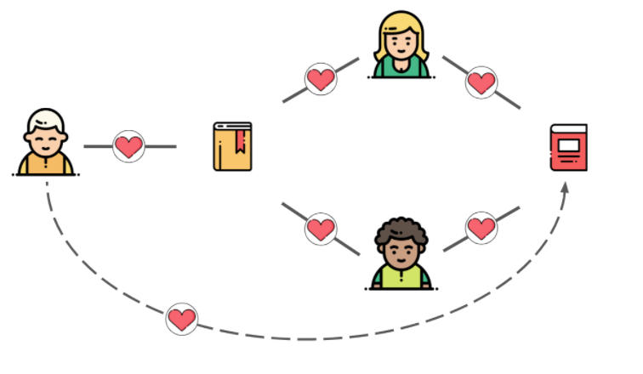
Collaborative filtering
You like Harry potter
He likes Harry potter
He also likes Game of thrones
Hence, You will also like Game of thrones

Slide 9
