Slide 1
An Introduction to NS-2*

Slide 2
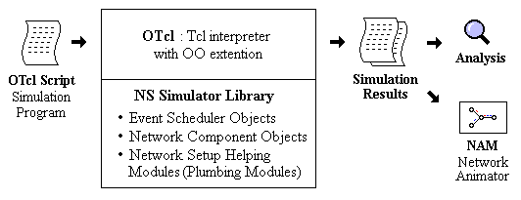
What is ns?
Object-oriented, discrete event-driven network simulator
Written in C++ and OTcl
By VINT: Virtual InterNet Testbed

Slide 3
What is ns?
Object-oriented, discrete event-driven network simulator
Written in C++ and OTcl
By VINT: Virtual InterNet Testbed

Slide 4
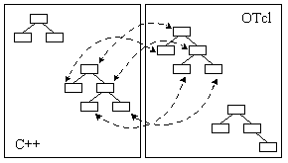
ns Architecture
Separate data path and control path implementations.

Slide 5
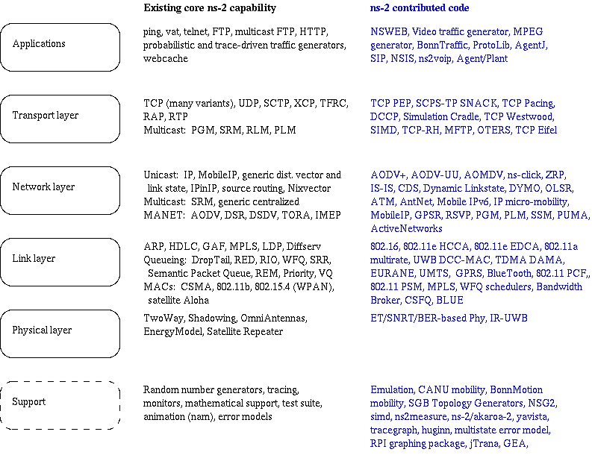
Functionalities of NS-2

Slide 6
Hello World – Batch mode
simple.tcl
  set ns [new Simulator]
  $ns at 1 “puts \“Hello World!\””
  $ns at 1.5 “exit”
  $ns run
bash-shell$ ns simple.tcl
Hello World!
bash-shell$

Slide 7
Hello World
Interactive mode
Batch mode
bash-shell$ ns
% set ns [new Simulator]
_o3
% $ns at 1 “puts \“Hello world!\””
1
% $ns at 1.5 “exit”
2
% $ns run
Hello World!
bash-shell$
simple.tcl
set ns [new Simulator]
$ns at 1 “puts \“Hello World!\””
$ns at 1.5 “exit”
$ns run
bash-shell$ ns simple.tcl
Hello World!
bash-shell$

Slide 8
NS-2 Generic Script Structure
Create Simulator object
[Turn on tracing]
Create topology
[Setup packet loss, link dynamics]
Create routing agents
Create application and/or traffic sources
Post-processing procedures (i.e. nam)
Start simulation

Slide 9
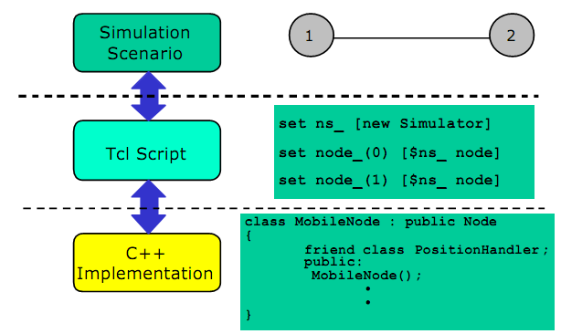
$

Slide 10
Step1: Create Simulator Object
Create event scheduler
  set ns [new Simulator]

Slide 11
Step2: Tracing
Insert immediately after scheduler!
Trace packets on all links
  set nf [open out.nam w]
  $ns namtrace-all $nf
  set nt [open out.tr w]
  $ns trace-all $nt

Slide 12
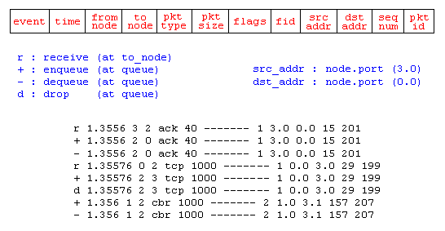
Step2: Tracing

Slide 13
NS-2 Generic Script Structure
Create Simulator object
[Turn on tracing]
Create topology
[Setup packet loss, link dynamics]
Create routing agents
Create application and/or traffic sources
Post-processing procedures (i.e. nam)
Start simulation

Slide 14
Step 3: Create network
Two nodes, One link
n0
n1

Slide 15
Step 3: Create Network
n0
Nodes
  set n0 [$ns node]
  set n1 [$ns node]
Links and queuing
  $ns duplex-link $n0 $n1 1Mb 10ms RED
  $ns duplex-link $n0 $n1 <bandwidth> <delay> <queue_type>
  <queue_type>: DropTail, RED, etc.
n1

Slide 16
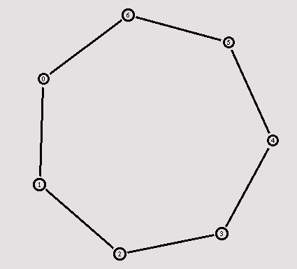
Creating a larger topology
  for {set i 0} {$i < 7} {incr i} {
    set n($i) [$ns node]
    }
    for {set i 0} {$i < 7} {incr i} {
    $ns duplex-link $n($i) $n([expr ($i+1)%7]) 1Mb 10ms RED
    }

Slide 17
NS-2 Generic Script Structure
Create Simulator object
[Turn on tracing]
Create topology
[Setup packet loss, link dynamics]
Create routing agents
Create application and/or traffic sources
Post-processing procedures (i.e. nam)
Start simulation

Slide 18
Step 4: Network Dynamics
Link failures
  Hooks in routing module to reflect routing changes
$ns rtmodel-at <time> up|down $n0 $n1
For example:
$ns rtmodel-at 1.0 down $n0 $n1
$ns rtmodel-at 2.0 up $n0 $n1

Slide 19
Step 5: Creating UDP connection
  set udp [new Agent/UDP]
  set null [new Agent/Null]
  $ns attach-agent $n0 $udp
  $ns attach-agent $n1 $null
  $ns connect $udp $null
udp
n0
n1
null

Slide 20
Step 6: Creating Traffic
(On Top of UDP)
cbr
CBR
  set cbr [new Application/Traffic/CBR]
  $cbr set packetSize_ 500
  $cbr set interval_ 0.005
  $cbr attach-agent $udp
udp
n0
n1
null

Slide 21
Creating TCP connection
  set tcp [new Agent/TCP]
  set tcpsink [new Agent/TCPSink]
  $ns attach-agent $n0 $tcp
  $ns attach-agent $n1 $tcpsink
  $ns connect $tcp $tcpsink
tcp
n0
n1
sink

Slide 22
Step 6: Creating Traffic
(On Top of TCP)
ftp
FTP
  set ftp [new Application/FTP]
  $ftp attach-agent $tcp
Telnet
  set telnet [new Application/Telnet]
  $telnet attach-agent $tcp
tcp
n0
n1
sink

Slide 23
Recall: Generic Script Structure
set ns [new Simulator]
[Turn on tracing]
Create topology
[Setup packet loss, link dynamics]
Create agents
Create application and/or traffic sources
Post-processing procedures (i.e. nam)
Start simulation
Examples

Slide 24
Post-Processing Procedures
Add a 'finish' procedure that closes the trace file and starts nam.
proc finish {} {
global ns nf
$ns flush-trace
close $nf
exec nam out.nam &
exit 0
}

Slide 25
Run Simulation
Schedule Events
$ns at <time> <event>
  <event>: any legitimate ns/tcl commands
$ns at 0.5 "$cbr start"
$ns at 4.5 "$cbr stop“
Call ‘finish’
$ns at 5.0 "finish"
Run the simulation
$ns run

Slide 26
Recall: Generic Script Structure
set ns [new Simulator]
[Turn on tracing]
Create topology
[Setup packet loss, link dynamics]
Create routing agents
Create application and/or traffic sources
Post-processing procedures (i.e. nam)
Start simulation
Examples

Slide 27
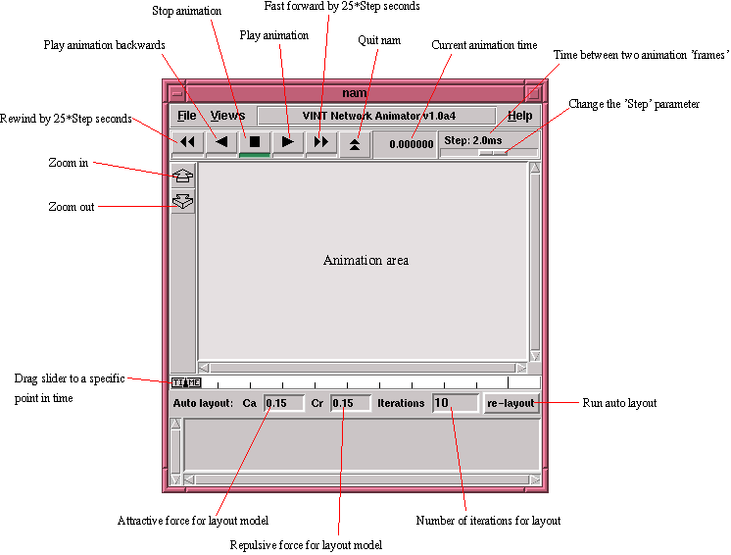

Slide 28
nam Interface: Nodes
Color
  $node color red
Shape (can’t be changed after sim starts)
  $node shape box (circle, box, hexagon)
Label (single string)
  $ns at 1.1 “$n0 label \”web cache 0\””

Slide 29
nam Interfaces: Links
Color
  $ns duplex-link-op $n0 $n1 color "green"
Label
  $ns duplex-link-op $n0 $n1 label “backbone"

Slide 30
nam Interface: Topology Layout
“Manual” layout: specify everything
  $ns duplex-link-op $n(0) $n(1) orient right
  $ns duplex-link-op $n(1) $n(2) orient right
  $ns duplex-link-op $n(2) $n(3) orient right
  $ns duplex-link-op $n(3) $n(4) orient 60deg
If anything missing → automatic layout

Slide 31
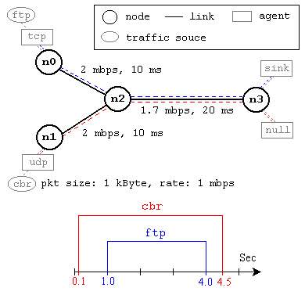
Simulation Example

