Slide 1
Overview of Compilation
Programming Languages
Adeesha Wijayasiri

Slide 2
Overview of translation
Definition: A translator is an algorithm that converts source programs into equivalent target programs.
Definition: A compiler is a translator whose target language is at a “lower” level than its source language.
When is one language’s level “lower” than another’s?
Source
Target
Translator

Slide 3
Overview of translation
Definition: An interpreter is an algorithm that simulates the execution of programs written in a given source language.
input
Source
Interpreter
output

Slide 4
Overview of translation
Definition: An implementation of a programming language consists of
a translator (or compiler) for that language, and
an interpreter for the corresponding target language.
input
Source
Target
Compiler
Interpreter
output

Slide 5
Overview of translation
A source program may be translated an arbitrary number of times before the target program is generated.
Source
Translator₁
Translator₂
. . .
Translator_{N}
Target

Slide 6
Overview of translation
Each translation is a phase.
Divide a compiler into phases:
Use a formal model of computation,
Do it efficiently.

Slide 7
Overview of translation
Usual division into phases:
Two major phases, many possibilities for subdivision.
Phase 1: Analysis (determine correctness)
Phase 2: Synthesis (produce target code)
Another criterion:
Phase 1: Syntax (form).
Phase 2: Semantics (meaning).

Slide 8
PHASE 1: Scanning (Lexical analysis).
Group character sequences in the source.
Form logical atomic units called tokens.
Examples of tokens: Identifiers, keywords, integers, strings, punctuation marks, “white spaces”, end-of-line characters, comments, etc.
Source
Scanner (Lexical analysis)
Sequence of Tokens

Slide 9
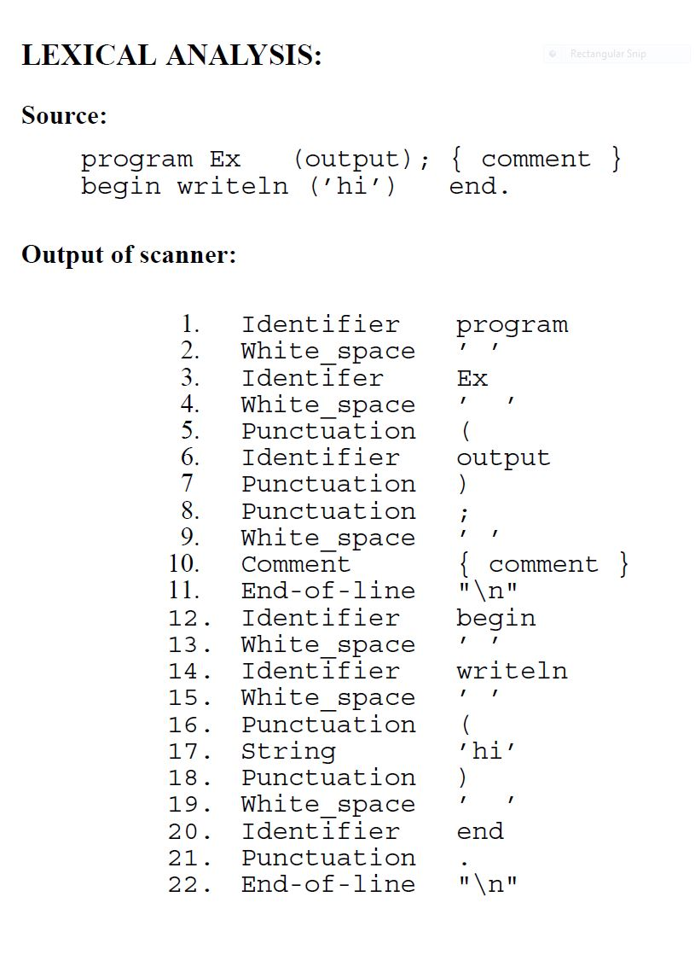

Slide 10
PHASE 1: Scanning (Lexical analysis).
Proceeds sequentially.
First character usually determines the token.
A preliminary classification of tokens is made.
Example: ‘program’ and ‘Ex’ are classified as Identifier.
Lexical rules must be provided.
“_” allowed in identifiers ?
Comments cross line boundaries ?
Must deal with end-of-line and end-of-file characters.

Slide 11
PHASE 1: Screening (post-process)
Remove unwanted tokens (spaces, comments).
Recognize keywords.
Merge/simplify tokens.
Prepare token list for next phase (parser).
Sequence of Tokens
Screener
Sequence of Tokens

Slide 12
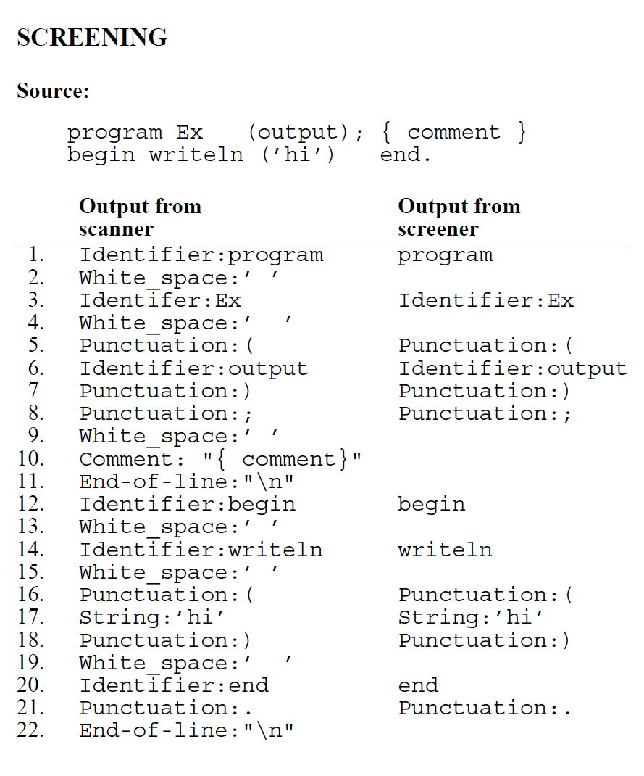

Slide 13
PHASE 2: Parsing (Syntax Analysis)
Is the token sequence syntactically correct ?
Group the tokens into the correct syntactic structures.
Expressions, statements, procedures, functions, modules.
Use “re-write” rules (a.k.a. BNF).
Build a “syntax tree”, bottom-up, as the rules are used.
Use a stack of trees.

Slide 14
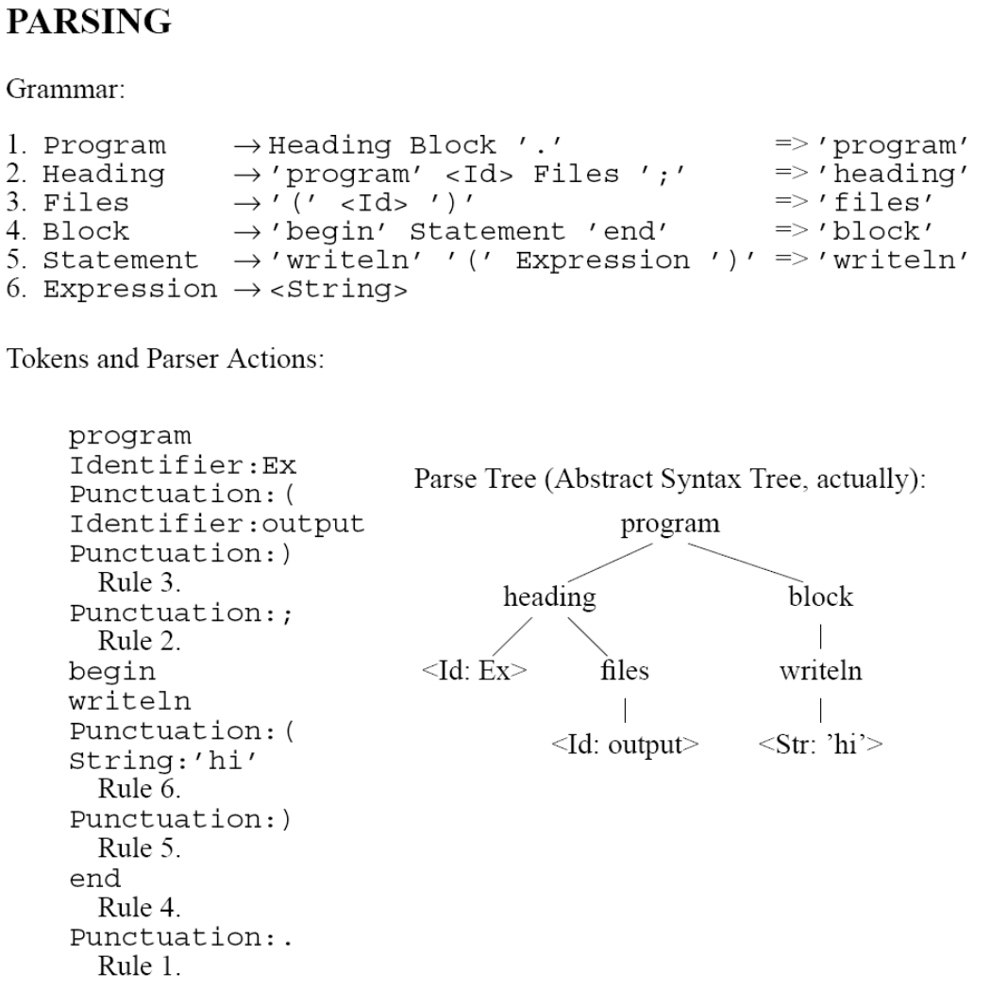

Slide 15
PHASE 3: Contextual Constraint Analysis
Analyze static semantics:
Variables declared before they are used ?
Assignment compatibility? e.g., a:=3
Operator type compatibility ? e.g., a+3
Do actual and formal parameter types match? e.g.
int f(int n, char c) {…}
...
f('x', 3);
Enforcement of scope rules.

Slide 16
Contextual Constraint Analysis
Traverse the tree recursively
Deduce type information at the bottom,
Pass type information up the tree.
Each node verifies the types below.
Make use of a DECLARATION TABLE,
to keep track of names and their meaning.

Slide 17
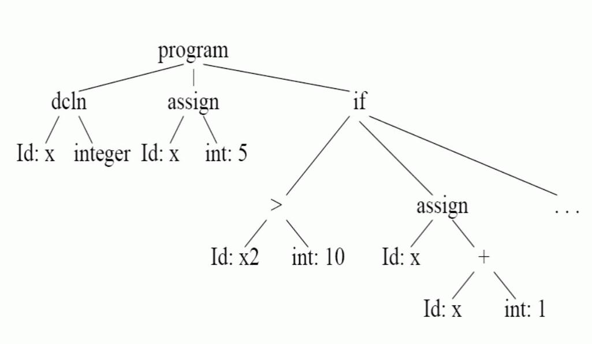
Contextual Constraint Analysis
Enter x into the DCLN table, with its type.
Check type compatibility for x=5.
x2 not declared!
Verify type of ’>’ is boolean.
Check type compatibility for ‘+’.
Check type compatibility between x and int, for assignment.

Slide 18
PHASE 4: code generation
Goal: Convert syntax tree to target code.
Target code could be:
Machine language.
Assembly language.
Quadruples for a fictional machine:
Label, opcode, operands (1 or 2)

Slide 19
Code generation (stack machine)
LOAD 5
STORE X
LOAD X
LOAD 10
BGT
COND L1 L2
L1 LOAD X
LOAD 1
BADD
STORE X
GOTO L3
L2
...
L3
Text Level 1
Text Level 2
Text Level 3

Slide 20
Code Optimization
Reduce the size of the target program.
Decrease the running time of the target.
Two types of optimization:
Peephole optimization (local).
Global optimization (improve loops, etc.).

Slide 21
Code Optimization
LOAD 5
STORE X
LOAD X
LOAD 10
BGT
COND L1 L2
L1 LOAD X
LOAD 1
BADD
STORE X
GOTO L3
L2
...
L3
LOAD 5
STORE X
LOAD X
is replaced with
LOAD 5
STND X
STND: Store non-destructive

Slide 22
Summary
Source
Scanner
Tokens
Screener
Tokens
Error Routines
Table Routines
Parser
Tree
Constrainer
Tree
Code Generator
Code
Interpreter
Input
Output

Slide 23
Acknowledgements
Programming Language Pragmatics by Michael L. Scott. 3rd edition. Morgan Kaufmann Publishers. (April 2009).
Lecture Slides of Dr.Malaka Walpola and Dr.Bermudez

