Slide 1
The RPAL Functional Language
Programming Languages
Lecture 4
Adeesha Wijayasiri

Slide 2
Introduction to RPAL
RPAL is a subset of PAL
PAL: Pedagogic Algorithmic Language.
Developed by J. Wozencraft and A. Evans at MIT, early 70's.

Slide 3
Why study RPAL?
Not familiar
Easy to study the (operational) specs.
Good example of the operational approach for describing semantics.

Slide 4
Three Versions of PAL: RPAL, LPAL, and JPAL
We will only cover RPAL.
R in RPAL stands for right-reference (as in C).
An RPAL program is simply an expression.
No notion of assignment, or even memory.
No loops, only recursion.

Slide 5
Two Notions: Function Definition and Function Application
RPAL is a functional language.
Every RPAL program is an expression.
Running an RPAL program consists of evaluating the expression.
The most important construct in RPAL is the function.

Slide 6
Two Notions: Function Definition and Function Application (cont’d)
Functions in RPAL are first-class objects. Programmer can do anything with a function:
Send a function as a parameter to a function
Return a function from a function.

Slide 7
Sample RPAL Programs:
let X=3
in
Print(X,X**2)
// Prints (3,9)

Slide 8
Sample RPAL Programs:
let Abs N =
N ls 0 -> -N | N
in
Print(Abs -3)
// Prints 3

Slide 9
Preview of Lambda Calculus
Program 1 is equivalent to:
(fn X. Print(X,X**2)) 3
Program 2 is equivalent to:
let Abs = fn N. N ls 0 -> -N | N
in Print(Abs -3)
which is equivalent to:
(fn Abs. Print(Abs -3))
(fn N. N ls 0 -> -N | N)

Slide 10
RPAL constructs
Operators
Function definitions
Constant definitions
Conditional expressions
Function application
Recursion

Slide 11
RPAL Is Dynamically Typed
The type of an expression is determined at run - time.
Example:
let Funny = (B -> 1 | 'January')

Slide 12
RPAL Has Six Data Types:
Integer
Truthvalue (boolean)
String
Tuple
Function
Dummy

Slide 13
Type Identification Functions
All are intrinsic functions.
Applied to a value, return true or false:
Isinteger x
Istruthvalue x
Isstring x
Istuple x
Isfunction x
Isdummy x

Slide 14
Other Operations
Truthvalue operations:
or, &, not, eq, ne
Integer operations:
+, -, *, /, **, eq, ne, ls, <, gr, >, le, <=, ge, >=
String operations:
eq, ne, Stem S, Stern S, Conc S T

Slide 15
Examples
let Name = 'Dolly'
in Print ('Hello', Name)
let Inc x = x + 1 in Print (Inc x)
let Inc = fn x. x + 1
in Print (Inc x)
Print (Inc 7) where Inc x = x + 1

Slide 16
Nesting Definitions
Nested scopes are as expected.
let X = 3
in
let Sqr X = X**2
in
Print (X, Sqr X,
X * Sqr X,
Sqr X ** 2)

Slide 17
Nesting Definitions (cont’d)
( Print (X, Sqr X,
X * Sqr X, Sqr X ** 2) where Sqr X = X**2
)
where
X = 3
Parentheses required ! Otherwise
Sqr X = X**2 where X=3

Slide 18
Simultaneous Definitions
let X=3 and Y=5 in Print(X+Y)
Note the and keyword: not a boolean operator (for that we have &).
Both definitions come into scope in the Expression Print(X+Y).
Different from
let X=3 in let Y=5 in Print(X+Y)

Slide 19
Function Definitions Within One Another
The scope of a 'within' definition is another definition, not an expression.
Example:
let c=3 within f x = x + c
in Print(f 3)

Slide 20
Functions
In RPAL, functions are first-class objects.
Functions can be named, passed as parameters, returned from functions, selected using conditional, stored in tuples, etc.
Treated like 'values’

Slide 21
Every function in RPAL has:
A bound variable (its parameter)
A body (an expression)
An environment (later)
For example:
fn X. X < 0 -> -X | X

Slide 22
Functions (cont’d)
Naming a Function
let Abs = fn X. X ls 0 -> -X | X in Print (Abs(3))
Passing a function as a parameter:
let f g = g 3 in let h x = x + 1 in Print(f h)
Returning a function from a function:
let f x = fn y. x+y
in Print (f 3 2)

Slide 23
Functions (cont’d)
Selecting a function using conditional:
let B=true in
let f = B -> (fn y.y+1) | (fn y.y+2)
in Print (f 3)
Storing a function in a tuple:
let T=((fn x.x+1),(fn x.x+2))
in Print (T 1 3, T 2 3)

Slide 24
Functions (cont’d)
N-ary functions are legal, using tuples:
let Add (x,y) = x+y
in Print (Add (3,4) )

Slide 25
Function Application
(fn x.B) A.
Two orders of evaluation:
PL order: evaluate A first, then B with x replaced with the value of A.
Normal order, postpone evaluating A. Evaluate B with x literally replaced with A.
RPAL uses PL order.

Slide 26
Example: Normal order vs. PL order
let f x y = x
in Print(f 3 (1/0))
Normal Order: output is 3.
PL Order: division by zero error.

Slide 27
Recursion
Only way to achieve repetition.
No loops in RPAL.
Use the rec keyword.
Without rec, the function is not recursive.

Slide 28
Factorial
let rec Fact n =
n eq 1 -> 1
| n * Fact (n-1)
in
Print (Fact 3)
Without rec, the scope of Fact would be the last line ONLY.

Slide 29
Example:
let rec length S =
S eq '' -> 0
| 1 + length (Stern S)
in Print ( length('1,2,3'),
length (''),
length('abc')
)
Typical layout: define functions, and
print test cases.

Slide 30
Example:
let Is_perfect_Square N =
Has_sqrt_ge (N,1)
where
rec Has_sqrt_ge (N,R) =
R**2 gr N -> false
| R**2 eq N -> true
| Has_sqrt_ge (N,R+1)
in Print (Is_perfect_Square 4,
Is_perfect_Square 64,
Is_perfect_Square 3)

Slide 31
Tuples
The only data structure in RPAL.
Any length, any nesting depth.
Empty tuple (length zero) is nil.
Example:
let Bdate = (‘Jan’, 01, ‘2000')
in let Student =
(‘John’,’Doe', Bdate, 19)
in Print (Student)

Slide 32
Arrays
Tuples in general are heterogeneous.
Array is special case of tuple: a homogeneous tuple (all elements of the same type).
Example:
let I=2
in let A=(1,I,I**2,I**3,I**4,I**5)
in Print (A)

Slide 33
Multi-Dimensional Arrays: Tuples of Tuples
let A=(1,2) and B=(3,4) and C=(5,6)
in let T=(A,B,C)
in Print(T)
Triangular Array:
let A = nil aug 1
and B=(2,3) and C=(4,5,6)
in let T=(A,B,C)
in Print(T)

Slide 34
Notes on Tuples
() is NOT the empty tuple.
(3) is NOT a singleton tuple.
nil is the empty tuple.
The singleton tuple is built using aug:
nil aug 3.
Build tuples using the comma, e.g. (1,2,3)

Slide 35
Selecting an Element From a Tuple
Apply the tuple to an integer, as if it were a function.
Example:
let T = ( 1, (2,3), ('a', 4))
in Print (T 2)
Output: (2,3)
Example:
let T=('a','b',true,3)
in Print(T 3,T 2)
Output: (true, b)

Slide 36
Extending Tuples
Use aug (augment) operation.
Additional element added to RIGHT side of tuple.
NEW tuple is built.
NOT an assignment to a tuple.
In general, ALL objects in RPAL are IMMUTABLE.
Example:
let T = (2,3) in let A = T aug 4 in Print (A) // Output: (2,3,4)

Slide 37
Summary of Tuple Operations
E1,E2,...,En tuple construction (tau)
T aug E tuple extension (augmentation)
Order T number of elements in T
Null T true if T is nil, false otherwise

Slide 38
The @ Operator
Allows infix use of a function.
Example:
let Add x y = x + y
in Print (2 @Add 3 @Add 4)
Equivalent to:
let Add x y = x + y
in Print (Add (Add 2 3) 4)

Slide 39
Operator Precedence in RPAL, from lowest to highest
not
gr ge le ls eq ne
+ -
* /
**
@ <IDENTIFIER>
function application
()
let fn
where
tau
aug
->
or
&

Slide 40
Sample RPAL Programs
Example 1:
let Sum_list L =
Partial_sum (L, Order L)
where rec Partial_sum (L,N) =
N eq 0 -> 0
| L N + Partial_sum(L,N-1)
in Print ( Sum_list (2,3,4,5) )

Slide 41
Sample RPAL Programs (cont’d)
Example 2:
let Vector_sum(A,B) =
Partial_sum (A,B,Order A)
where rec Partial_sum (A,B,N) =
N eq 0 -> nil
| ( Partial_sum(A,B,N-1)
aug (A N + B N)
) // parentheses required
in Print (Vector_sum((1,2,3),(4,5,6)))

Slide 42
Error Conditions
Error Location of error
A is not a tuple Evaluation of Order A
B is not a tuple Indexing of B N
A shorter than B Last part of B is ignored
B shorter than A Indexing B N
Elements not integers Addition

Slide 43
Data Verification
let Vector_sum(A,B) =
not (Istuple A) -> 'Error'
| not (Istuple B) -> 'Error'
| Order A ne Order B -> 'Error'
| Partial_sum (A,B,Order A)
where ...
in Print(Vector_sum((1,2),(4,5,6)))

Slide 44
RPAL’s SYNTAX
RPAL’s lexical grammar.
RPAL’s phrase-structure grammar.

Slide 47
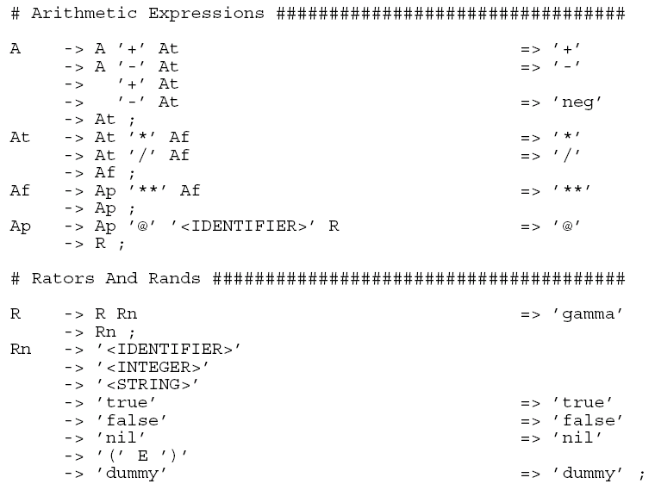

Slide 49
Thank You!

Slide 50
REFERENCES
Programming Language Pragmatics by Michael L. Scott. 3rd edition. Morgan Kaufmann Publishers. (April 2009).
Slides are adopted from Lecture Slides of Dr.Malaka Walpola and Dr.Bermudez

