Slide 1

Kavya's homepage
Kavya Kusuma Reddy Korem
Project 1: CS5610 Web Development
Northeastern University
Notes:
Kavya Kusuma Reddy Korem is an MS Computer Science student at Northeastern University. This personal homepage includes Home, About, and Bookshelf. Course presentation format supplied in Example Project presentation slides.pptx.

Slide 2
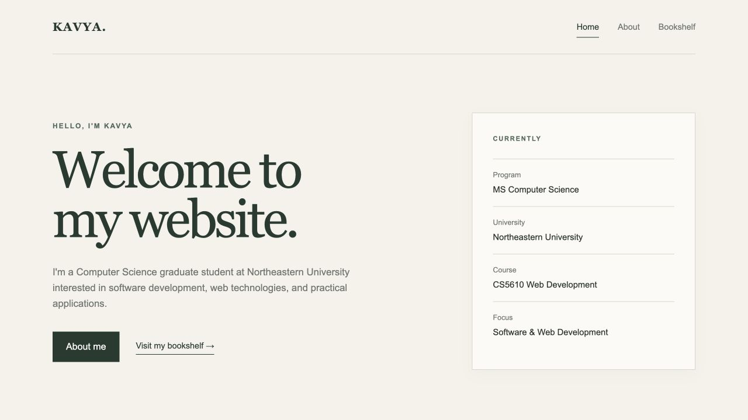
Objective
Introduce my background, skills, and selected work.
Share my reading interests through an interactive book finder.
Notes:
Home introduces Kavya as a graduate student at Northeastern University and presents skills and three project summaries. About expands the academic background. Bookshelf shares reading interests and provides genre and mood recommendations. Source: index.html, about.html, and ai-page.html in the supplied project.

Slide 3
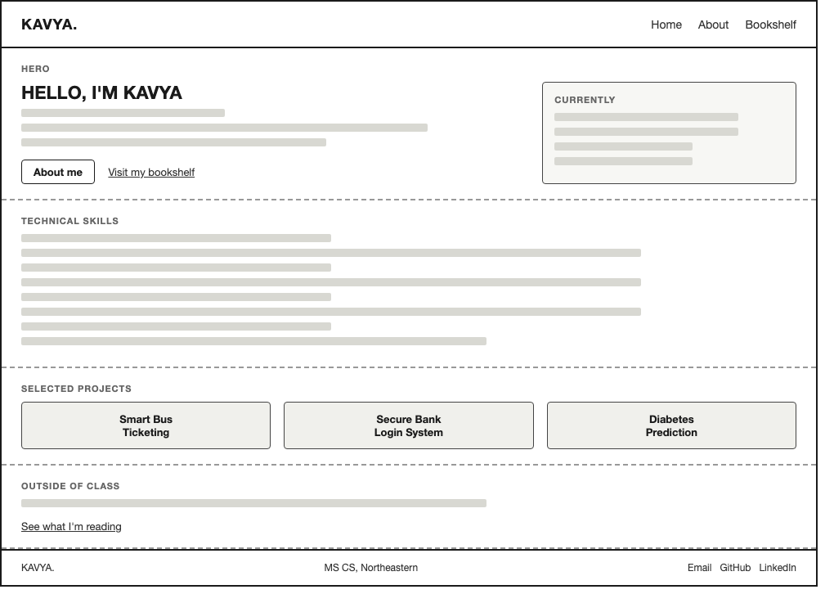
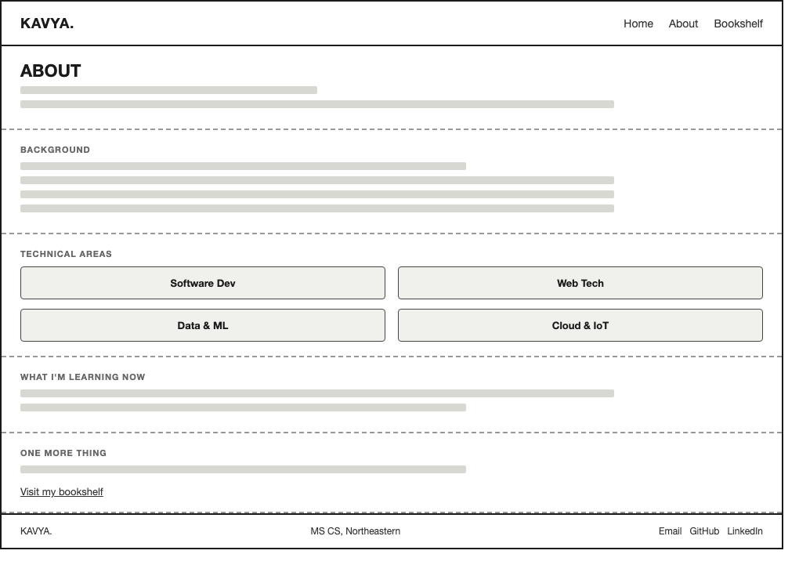
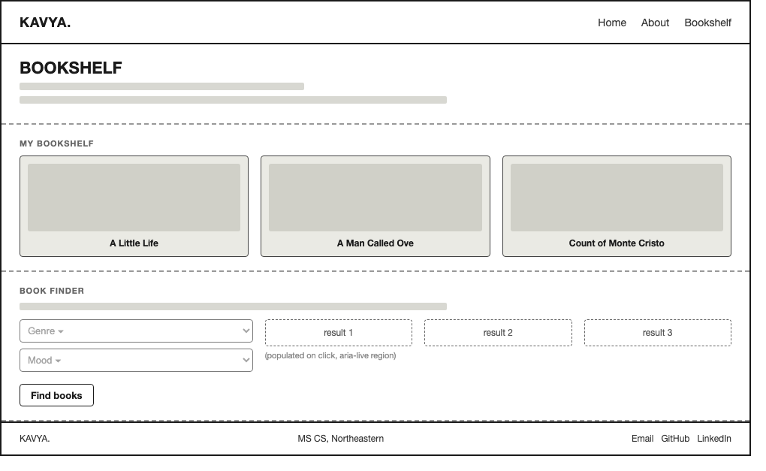
Design and Mockups
Home
About
Bookshelf
Cream and sage colors, serif headings, and consistent navigation
Notes:
The supplied wireframes organize Home around introduction, skills, and projects, About around background and technical areas, and Bookshelf around favorite books and the finder. The implemented Home page uses larger project cards with descriptions. CSS defines a cream and sage palette with Georgia headings and Arial body text. Sources: supplied wireframes and css/style.css.

Slide 4
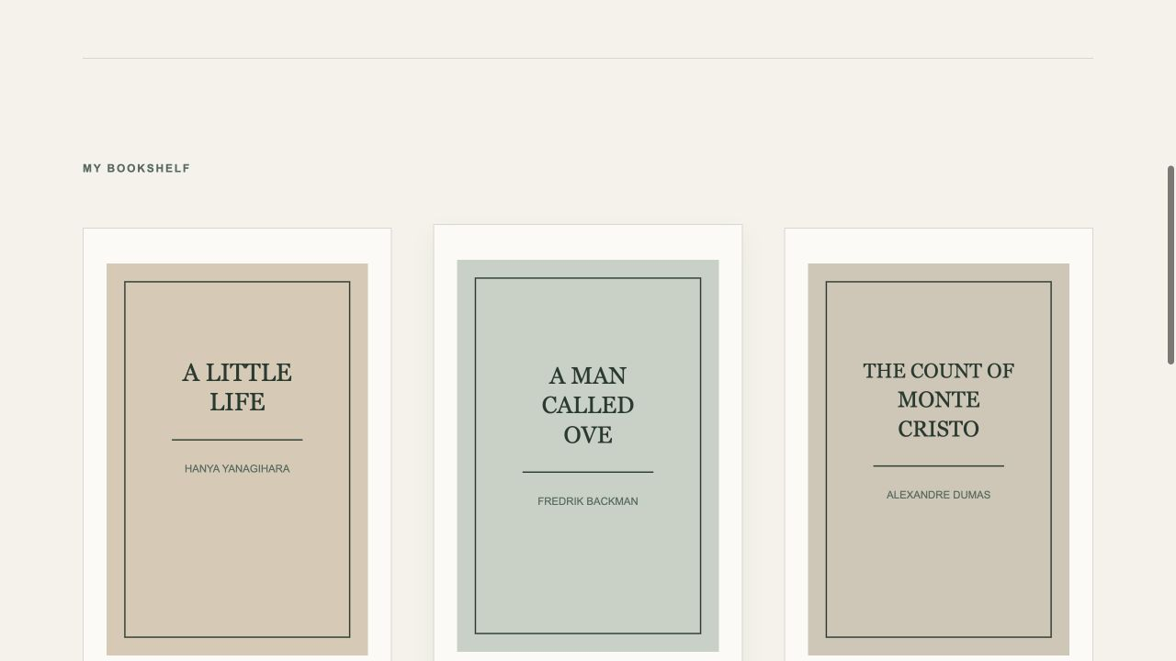
Technologies used
HTML5 and CSS Grid / Flexbox
Native JavaScript modules
Local recommendation data
ESLint and Prettier
Static site with no framework or build step
Notes:
All pages use HTML and css/style.css. js/main.js is a native JavaScript module. The finder uses a local nested object and creates results with browser DOM APIs. The tools in package.json handle formatting, linting, and local HTTP preview. Sources: package.json, ai-page.html, and js/main.js.

Slide 5
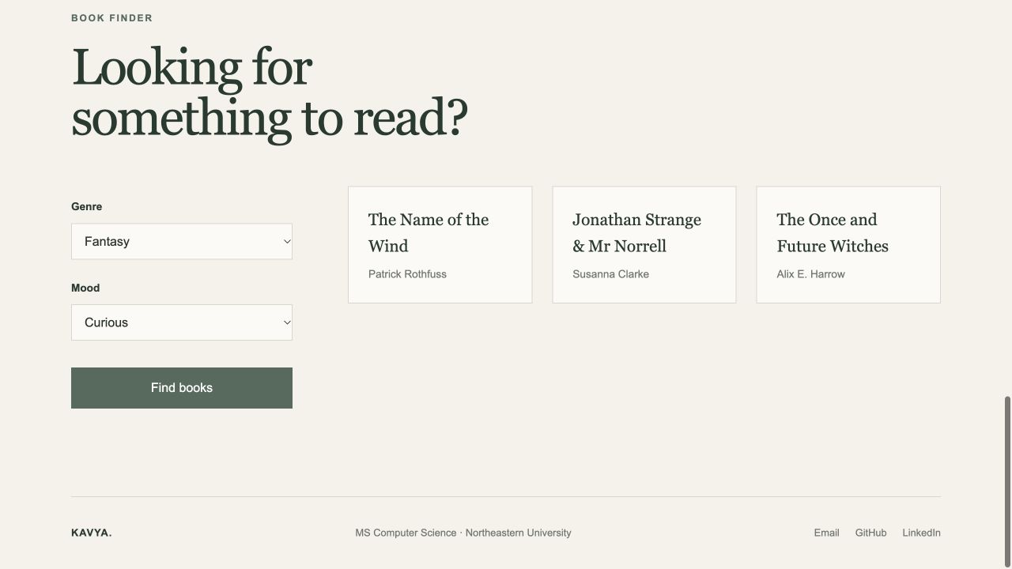
What I'm proud of
12 genre and mood combinations, three recommendations each
Notes:
The finder supports three genres and four moods. All 12 combinations returned three title and author pairs during local browser checks. The screenshot shows Fantasy with Curious: The Name of the Wind by Patrick Rothfuss, Jonathan Strange & Mr Norrell by Susanna Clarke, and The Once and Future Witches by Alix E. Harrow. Results update without reloading the page. Sources: js/main.js and the captured local Bookshelf page.

Slide 6
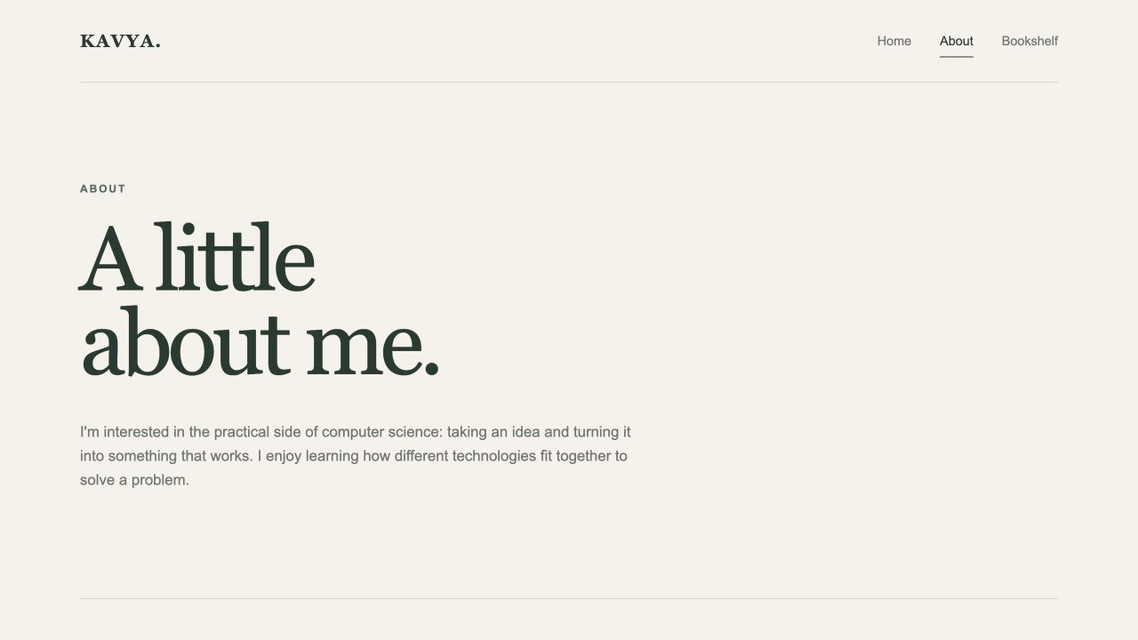
Implementation challenges
Large headings and project cards need room on narrow screens.
Long book titles need to wrap within recommendation cards.
Responsive layouts change at 800px and 500px
Notes:
The responsive stylesheet changes grids to one column at 800px and adjusts spacing and card padding at 500px. These rules accommodate the large headings and long recommendation titles. Checks at a 390px viewport width found no horizontal overflow on Home, About, or Bookshelf. This slide describes implementation challenges visible in the supplied source. It does not assert a personal development history. Source: css/style.css and local viewport checks.

Slide 7
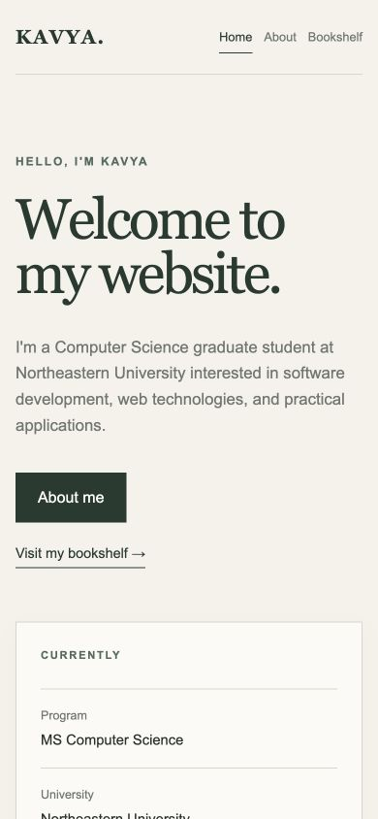
Demo
Home, About, and the book finder
Live website
Project repository
Video demonstration
korem.k@northeastern.edu
Notes:
The live-site, repository, and video URLs come from the original project README. The screenshot shows the local Home page at a 390px viewport width. Contact: korem.k@northeastern.edu. The primary interactive demonstration is selecting a genre and mood on Bookshelf and clicking Find books.

