Slide 1
Hierarchical Multi-Objective Task Scheduling approach for Big Data Processing
Under Guidance of Dr Srinivas Naik
Date: Apr 26th, 2023
International Institute of Information Technology, Naya Raipur

Slide 2
Introduction & Motivation
Cloud computing has revolutionised the way we store and process the large amounts of data.
Requirement of efficient task scheduling to optimize resource utilization and reduce the processing time.
Multi-Objective optimization techniques can be used to simultaneously optimize multiple criteria such as resource utilization and makespan.
Parallel processing can be achieved by dividing an application program into small parts called tasks and sending tasks to different computing nodes for execution.
International Institute of Information Technology, Naya Raipur

Slide 3
Why Task Scheduling
Parallel execution of independent tasks reduces data processing time.
Task scheduling means mapping several tasks to different computing nodes
The relationship between application tasks is represented by a directed acyclic graph (DAG)
Task scheduling is an NP hard problem and a polynomial time algorithm is impossible to be formulated.
It optimizes the makespan and improves resource utilization rate.
Improves the load balancing of data centres.
International Institute of Information Technology, Naya Raipur

Slide 4
Literature review
Remove the use of sequential algorithm due to availability of multiple data-centers to process data and achieve parallelism. [1]
The reinforcement learning model with evolutionary strategies are good for optimizing long-term latency which had a 16.1% higher reward than the greedy method but the method was slower than traditional methods. [2]
International Institute of Information Technology, Naya Raipur

Slide 5
Contributions
Introducing a new task scheduling scheme that concentrates on fast big data processing by optimizing the clusters of tasks, to reduce makespan.
Load balancing strategy is used to balance the workloads on clusters.
Uses DE algorithm, the proposed scheme tries to optimize the total execution time.
Decision making for task assignment is made based on available resources and states of the computing nodes.
Simulation of the proposed task scheduling scheme in Cloudsim presenting better efficiency in comparison with related schedulers
International Institute of Information Technology, Naya Raipur

Slide 6
Methodology
Assumptions:
Tasks have different sizes and contain information on taskId, task size and related taskId information.
Considered only non-interrelated tasks.
Tasks have no priority over each other.
The tasks size is one of the most important factors in scheduling.
The CPU MIPS and the size of other tasks in the computational nodes affect the scheduling.
Data are already stored in datacenters and do not enter the system at runtime.
International Institute of Information Technology, Naya Raipur

Slide 7
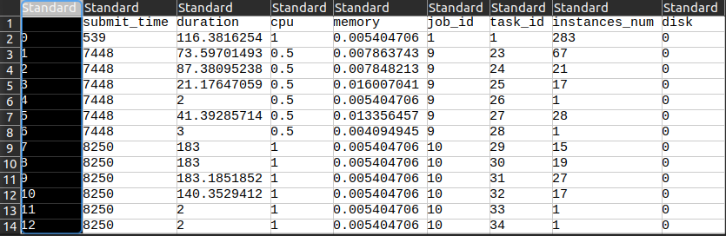
Methodology
Dataset Attributes:
Size: 31700 Rows
Submit time, Duration, Memory, jobID, taskID, instanceNumber, CPU
Figure-1: Snapshot of the dataset
International Institute of Information Technology, Naya Raipur

Slide 8
Methodology
Implementation:
Implemented using the CloudSim framework, SimJava toolkit, Java SIMSystem and multi cloudsim libraries.
Input tasks are taken as datasets from a Docker container and given as input cloudlets.
Tasks are assigned to VMs based on their resource requirements, and VMs are assigned to hosts based on their computing power.
Clustering is performed at cloud level based on task and host information.
International Institute of Information Technology, Naya Raipur

Slide 9
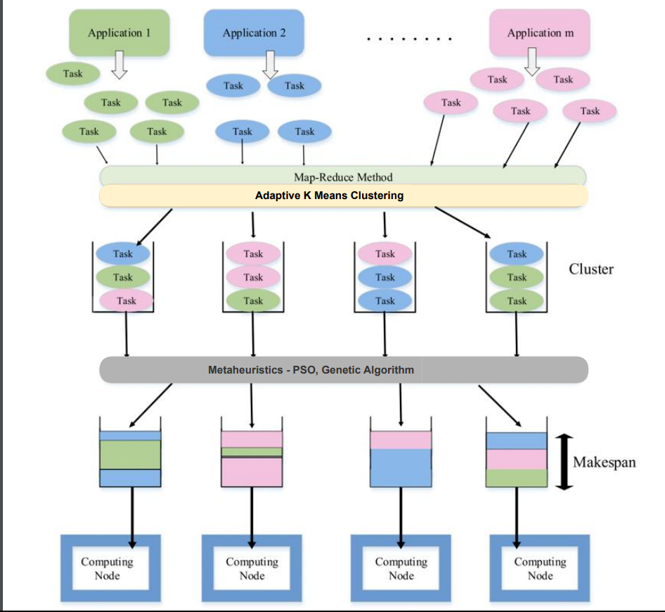
Methodology
K-Means clustering:
To group similar jobs into a certain number of clusters.
It is fast, robust, and computationally low cost.
To generate the initial population, the K-means algorithm is used such that the members of the population are evenly distributed in clusters.
The main goal of their scheme has been to improve schedulability and reduce waiting time.
Figure-1: Map-reduce architecture
International Institute of Information Technology, Naya Raipur

Slide 10


Methodology
Applying Metaheuristic Algorithms (Genetic Algorithm):
DE algorithm globally searches for optimal results.
Proposed scheme optimizes total execution time of clusters to reduce makespan.
DE algorithm's basic operations include mutation, crossover, and selection.
Combination of mutation and crossover operators balances local and global search space, leading to optimal solution.
International Institute of Information Technology, Naya Raipur

Slide 11
Methodology
Distribution of tasks and calculation of makespan
After the tasks have been clustered, map-reduce will send it to the data-center for processing.
The heavier tasks as sent to CPUs with higher MIPS value.
The makespan (total completion time) is calculated after the tasks have been executed.
International Institute of Information Technology, Naya Raipur

Slide 12
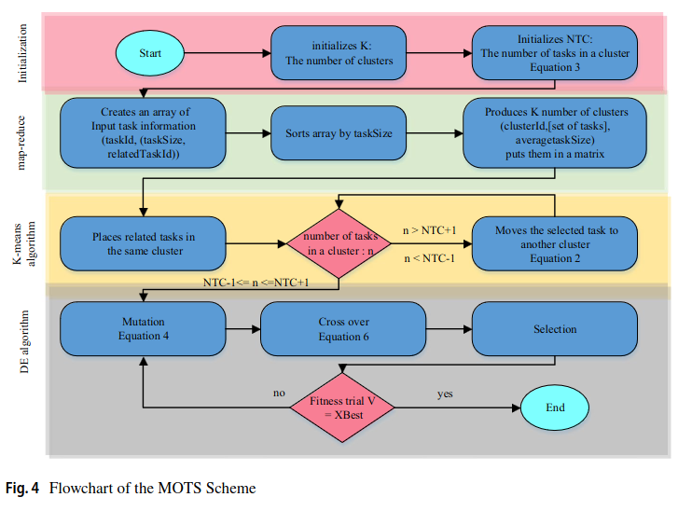
Architecture
International Institute of Information Technology, Naya Raipur

Slide 13
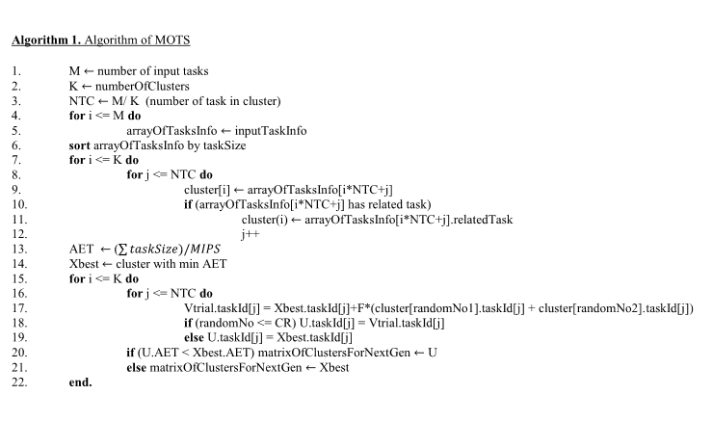
Algorithm
International Institute of Information Technology, Naya Raipur

Slide 14
Improvement over existing approach
The existing approach uses K-means clustering with a fixed value of K.
We used Adaptive K-means clustering to avoid that and decrease the makespan value.
Performed comparison for various meta-heuristic algorithms.
International Institute of Information Technology, Naya Raipur

Slide 15
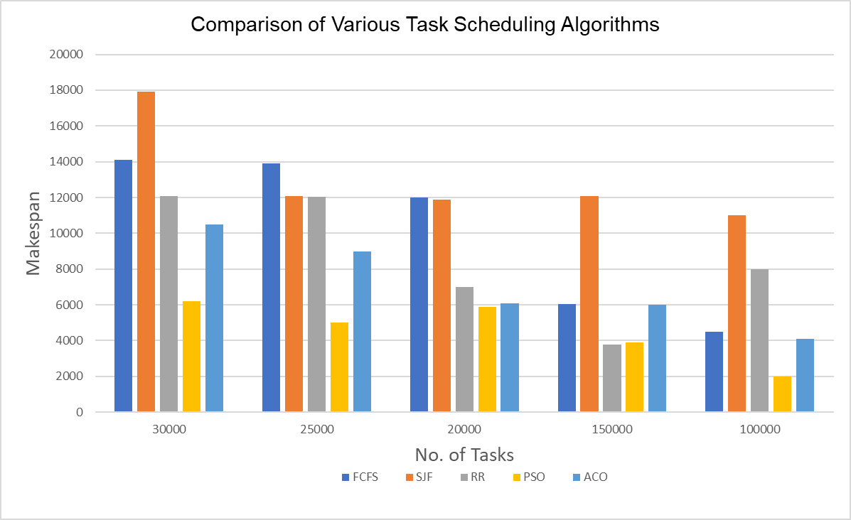
Results
International Institute of Information Technology, Naya Raipur

Slide 16
Conclusions
The K-means algorithm was used to cluster similar tasks for assigning to appropriate computing nodes.
The DE algorithm was inspired to optimize the cluster to shorten the total waiting and execution time (makespan).
To maintain the load balance between similar computing nodes, the number of tasks in all similar computing nodes was considered to be almost the same.
International Institute of Information Technology, Naya Raipur

Slide 17
Future Improvements
Use of K-means clustering hinders the diversification of clusters - there might be more or possibly less group of tasks with similar attributes.
The solution discussed assumes that all the tasks are known in advance, and hence not incorporate dynamic task scheduling.
The authors of paper did not compare the reliability of various other metaheuristic algorithms and concluded their study by directly using DE Algorithm.
International Institute of Information Technology, Naya Raipur

Slide 18
References
[1] Bugerya AB, Kim ES, Solovev MA (2019) Parallelization of ımplementations of purely sequential algorithms. J Program Comput Softw 7:381–389
[2] L. Mai, N. Dao, M. Park (2018) Real-time task assignment approach leveraging reinforcement learning with evolutionary strategies for long-term latency minimization in fog computing. J Sensors. pp. 1–19
[3] Jalalian, Z., Sharifi, M. A hierarchical multi-objective task scheduling approach for fast big data processing. J Supercomput 78, 2307–2336 (2022). https://doi.org/10.1007/s11227-021-03960-9
International Institute of Information Technology, Naya Raipur

Slide 19
THANK YOU
By:
Bhavesh Ajwani | 201020409 | DSAI
Kondury Rishabh | 201020425 | DSAI
Pranav Jaiswal | 20100000 | CSE
International Institute of Information Technology, Naya Raipur

