Slide 1
IXIGO TRAINS · PRODUCT CAPSTONE
Best Way to Reach
Turning a waitlisted ticket into a travel plan people trust
Own berth 35% · RAC 25% · Stays WL 40%
Rohit Kumar
Airtribe PM Launchpad · November 2026
Notes:
Hi, I’m Rohit. This is my capstone on ixigo Trains. The problem: when a user’s train is waitlisted, only 26 out of 100 end up with a resolved booking within 24 hours. In the next 15 minutes I’ll walk you through why that happens, what users told me, the two solutions I’m proposing, a clickable prototype, how we launch and measure it, and an AI extension I built.

Slide 2
Only 1 in 4 waitlisted users leaves with a plan
26%
42%
→
resolve a booking within 24 hours today
target in 6 months
Resolved booking = a confirmed train, bus or flight for the trip, or a waitlisted ticket with a backup or protection the user chose knowingly.
Notes:
This is the number the whole project is about. Today, of every 100 users whose preferred train shows waitlisted or no seats, only 26 complete a resolved booking within 24 hours. The goal is 42 in six months. Resolved means a confirmed train, bus or flight, or a waitlisted ticket where the user deliberately chose a backup or protection. A plain WL ticket with no plan does not count.

Slide 3
Trains are ixigo’s core, so this moment matters
84.8M
104M
₹511 cr
85.6%
monthly active users, Q4 FY26
train passenger segments booked, FY26
train revenue, about 42% of the total
repeat transaction rate
ixigo, ConfirmTkt and AbhiBus already hold trains, predictions and buses. The gap is not inventory: it is helping users choose between options with confidence.
Source: ixigo FY26 figures from the capstone brief
Notes:
Some context. ixigo has about 85 million monthly users and booked over 100 million train passenger segments last year. Trains bring in about 511 crore, the biggest slice of revenue, and 85% of transactions are repeat. Through ConfirmTkt and AbhiBus, ixigo already has predictions, alternate trains and buses. So the opportunity isn’t building inventory; it’s helping users decide.

Slide 4
How I researched it
20
7
5
7
User interviews
Survey responses
Competitors
Hypotheses
20 recorded calls + 1 WhatsApp chat, English and Hindi
Bilingual 18-question Google Form; 6 had a recent waitlist
ixigo, ConfirmTkt, IRCTC VIKALP, MakeMyTrip, redRail
From “can’t compare” to “a 90% chance ends in RAC”
Mix: 10 active ixigo users, 3 who check ixigo but book on IRCTC, 2 who use it less now, 4 IRCTC or MakeMyTrip users, 2 unclear.
Notes:
I recorded 20 calls and one WhatsApp chat, in English and Hindi. That’s 21 records, about 20 unique people, since two may be the same person. The mix: 10 active ixigo users, 3 who check ixigo but book on IRCTC, 2 who now use it less, 4 who use IRCTC or MakeMyTrip, and 2 where the audio was too unclear to tell. I also ran an 18-question bilingual survey, compared five competitors, and tested seven hypotheses.

Slide 5
What 20 travellers told me
8 of 20
3 of 20
6 of 20
have a personal cut-off
were let down by high odds
named a different top priority
They book a waitlisted ticket only above 80–95% chance. The number is their decision rule.
Often got RAC, or a high-chance ticket did not confirm. Same as my own 90% that ended in RAC.
Comfort, punctuality, speed, safety, timing. One sort order cannot serve them all.
Also heard: 8 named a fallback (flight, bus, Tatkal); 7 book mainly on IRCTC or MakeMyTrip; 2 found login or the flow harder than IRCTC; 3X Refund terms were unclear to several.
21 records: 20 calls + 1 WhatsApp chat; two may be the same person. Counts are qualitative signals, not market share.
Notes:
I spoke to 20 travellers, 20 calls and one WhatsApp chat. Three patterns stood out. First, 8 of them have a personal cut-off: they book a waitlisted ticket only above 80 to 95 percent. The number is their decision rule, so it has to be honest. Second, 3 were let down by high odds: they often got RAC, or a high-chance ticket didn’t confirm, just like my own 90 percent ticket that ended in RAC. Third, priorities differ: comfort, punctuality, speed, safety, timing. One sort order can’t serve all of them. I also heard that 8 already think about flights, buses or Tatkal as a fallback, 7 book mainly on IRCTC or MakeMyTrip, and 3X Refund terms were unclear to several people. These are qualitative signals, not market numbers.

Slide 6
Survey: lots of searching, little trust
6 of 6
1.7 / 5
searched 3+ times before deciding; 2 searched 10+
average trust in an app’s “% chance”
4 of 6
2 of 4
said the hardest part was too many options or too many apps
who recall a 70%+ ticket saw it end as RAC or stay WL
Bilingual Google Form · 7 responses, 6 hit a WL in the last 6 months · small sample, directional only
Notes:
The survey is small, six qualified responses, so it’s directional, but it says the same thing. Every respondent searched at least three times before deciding, two searched more than ten times. Average trust in an app’s percentage is just 1.7 out of 5. Four of six said the hardest part was too many options or too many apps. And price came sixth out of seven: journey time, confirmation and arrival time matter more. Interesting tension with the interviews: people use the percentage as a rule, but they don’t really trust it. That’s exactly why it needs to be honest and explained.

Slide 7
Everyone sells protection; nobody helps you choose
Player | When the train is waitlisted | Gap for the user
ixigo Trains | Prediction; Alternate Travel Plan (3X / 2X value) | Refund mostly a coupon; user still finds the alternative
ConfirmTkt | Alternates: other quotas, split and train + bus | Many raw options, no ranking
IRCTC VIKALP | Free auto-shift to another train | No choice, outcome known only at chart
MakeMyTrip | Trip Guarantee 3X; route and station hacks | Trade-offs not explained
redRail | Probability; Alternate Trip add-on | Protects money, not the journey
Agents | Tatkal, quota know-how, one answer | Extra cost, no transparency
Opportunity: own the decision moment with a ranked, honest comparison.
Notes:
Every major player now pairs a prediction with a paid 3X-refund product, so protection alone is no longer a differentiator. What nobody does is help the user compare alternatives side by side and choose. Agents win because they give one clear answer. That’s the gap ixigo can own.

Slide 8
Most users drop between exploring and choosing
38 of 100 are lost between exploring and choosing: that is where both solutions act.
Per 100 users. 26% from the brief; middle stages estimated from interviews and the survey.
Notes:
Here’s the funnel per 100 users. 100 hit a waitlist, 72 explore alternatives, 48 actually compare two or more options, 34 choose, and 26 complete a resolved booking. The 26 comes from the brief; the middle stages are my estimates from interviews. The biggest loss, 38 users, is between exploring and choosing: people can’t compare and don’t trust the odds.

Slide 9
PRIMARY BARRIER
Users don’t lack options. They lack a way to choose with confidence.
They can’t compare trains, dates, buses and flights in one view, and a single “% confirm” hides whether they’ll get a berth, RAC or nothing.
Notes:
So the primary barrier is low decision confidence. Not inventory, which is out of scope and usually exists. Not mainly price. It’s two things together: users can’t compare alternatives on what matters to them, and they don’t trust the certainty they’re shown. Both are fixable inside the app.

Slide 10
+16 points is worth about ₹120 crore a year
Mode | Extra / month | Net ₹ / booking | ₹ cr / month
Train | 5,76,000 | 60 | 3.5
Bus | 2,88,000 | 110 | 3.2
Flight | 96,000 | 350 | 3.4
Total | 9,60,000 |  | 10.0
9.6 lakh
extra resolved bookings a month
₹10 cr
net revenue a month at full rollout
Plus fewer users lost to IRCTC and agents, more cross-mode users, and higher repeat use.
Assumptions: 60 lakh waitlisted users a month; mix 60% train, 30% bus, 10% flight. Estimates, not ixigo data.
Notes:
What’s it worth? Assuming about 60 lakh users hit a waitlist each month, moving from 26 to 42 percent adds 9.6 lakh resolved bookings a month. With a 60-30-10 split across train, bus and flight, that’s roughly 10 crore of net revenue a month, around 120 crore a year at full rollout. These are my assumptions, clearly stated, and easy to tune with real ixigo data.

Slide 11
The top three of 14 ideas fix the barrier
Idea | Reach | Impact | Conf. | Effort | RICE
Honest outcome meter (CNF / RAC / WL) | 60 | 2 | 80% | 2 | 48.0
Priority chips | 60 | 1 | 70% | 1 | 42.0
Smart compare view | 60 | 3 | 80% | 4 | 36.0
Chart-time decision nudge | 40 | 1 | 60% | 1 | 24.0
Explainable prediction | 60 | 1 | 70% | 2 | 21.0
AI trip resolver | 60 | 2 | 50% | 4 | 15.0
Group-fit filter | 20 | 2 | 70% | 2 | 14.0
Why these three: they hit the primary barrier head-on. The meter fixes trust; chips and the compare view fix comparison.
Reach = lakh users a month · Effort = person-months · 7 more ideas in the PRD doc
Notes:
I generated 14 ideas and scored them with RICE. The three highest all attack the primary barrier: the honest outcome meter, priority chips, and a smart compare view that puts every alternative in one ranked list. The AI resolver scored lower on confidence, so I kept it as a later extension, which I’ll show at the end.

Slide 12
Two solutions, one plan the user believes
A · FIXES COMPARISON
B · FIXES TRUST
Best Way to Reach
Honest Outcome Meter
One ranked list: trains, classes, dates, nearby stations, bus, flight
Chips plus a “my cut-off” filter, 80% by default
Top pick with a reason, plus a confirmed backup
Own berth / RAC / stays WL instead of one “% confirm”
“Last 10 similar Saturdays” shows why
Never says guaranteed; ranges when data is thin
Balanced
Arrive by 10 AM
Cheapest
Priority chips re-rank the list
Own berth 55% · RAC 30% · Stays WL 15%
Notes:
From those ideas I shortlisted two solutions that work together. Best Way to Reach fixes comparison: one ranked list across every alternative, priority chips, and a top pick with a reason plus a confirmed backup. The Honest Outcome Meter fixes trust: it splits the prediction into own berth, RAC and stays waitlisted, explains it with past outcomes, and never says guaranteed. Trade-off: honest odds may look less positive short term, but they build the trust that drives repeat use.

Slide 13
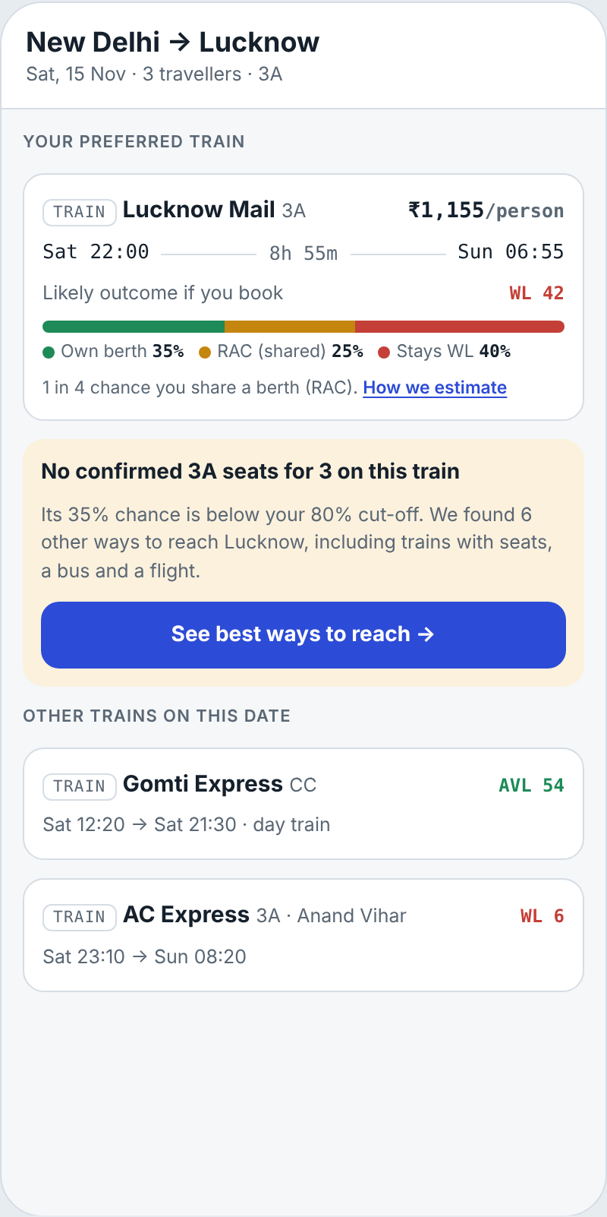
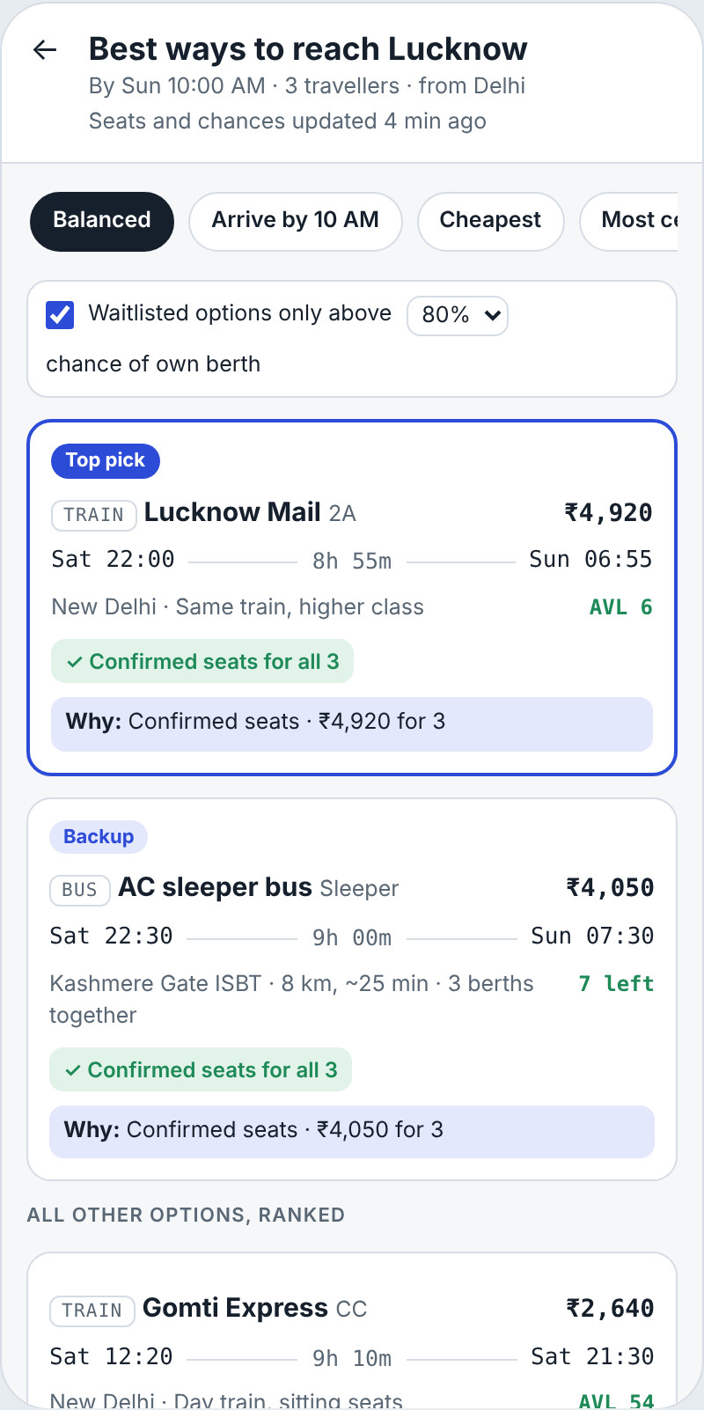
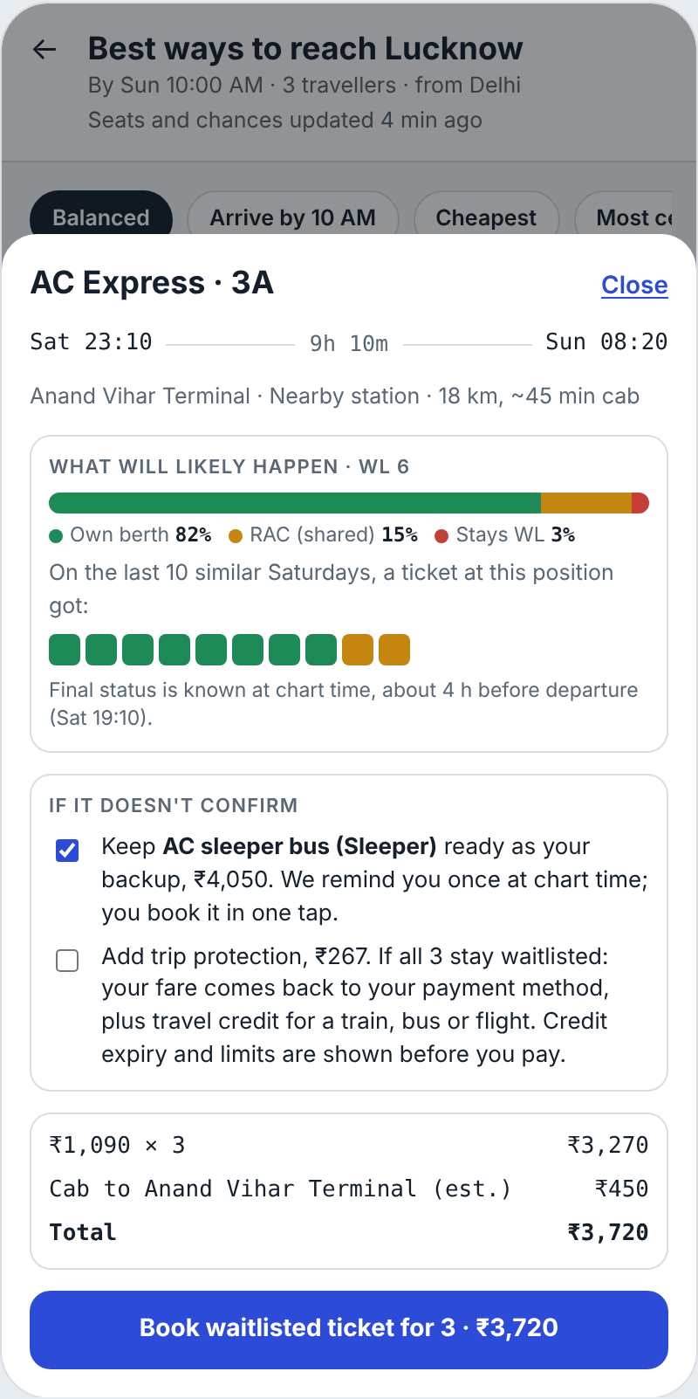
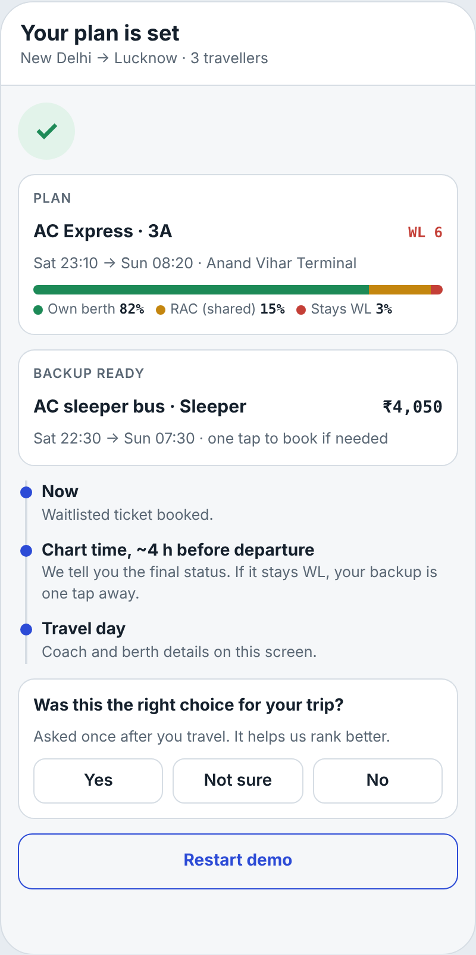
The prototype in four screens
Live: prototype-rohit-ixigo.lovable.app
1 · Honest odds
2 · Ranked list
3 · Odds + backup
4 · Plan set
Notes:
Here’s the prototype, live on Lovable. Screen one: the search result shows the outcome meter on a WL 42 train and says it’s below the user’s 80% cut-off, then offers “See best ways to reach.” Screen two: one ranked list with priority chips, the cut-off filter, a top pick with its reason and a confirmed backup. Long shots, including the user’s own train, move to one line at the bottom, so nothing is hidden. Screen three: the detail sheet explains the odds with the last ten similar Saturdays, keeps a backup ready, and states protection terms in plain words. Screen four: the plan is set, and after the trip we ask one question, “Was this the right choice?”, which feeds the ranking. [Switch to prototype-rohit-ixigo.lovable.app and click through.]

Slide 14
Where the journey changes
Stage | Today | With Best Way to Reach
Sees WL | “40% chance”, is that good? | Own berth 25% · RAC 15% · WL 60%
Explores | Re-searches trains, dates, other apps | One button opens one ranked list
Compares | Notes prices and times in memory | Chips and cut-off re-rank; top pick + backup
Decides | Calls family or agent, or gives up | Books in 2 taps, backup ready
Waits | Checks PNR many times | One chart-time alert
After trip | “The app was wrong” if RAC | “Was this the right choice?”
Notes:
This is the journey map. Today, the user sees an unclear percentage, re-searches across tabs and apps, keeps prices in their head, and often ends up calling an agent or giving up. With Best Way to Reach, they see honest odds, open one ranked list, re-rank with a chip, book in two taps with a backup, get one alert at chart time, and tell us afterwards if it was the right choice.

Slide 15
Launch in the waitlist moment, cohort by cohort
Months 1–2
Month 3
Months 4–6
Then
Pilot
Families
All WL users
PNR page
5% of WL users, top 20 routes, A/B test
Bookings with 3+ passengers
50% then 100%
Rescue users already holding WL
Next if +4 pts, regret ≤ control
Next if group-fit used by 30%
Guardrails stable 4 weeks
10% book a backup
GROWTH LOOP
Hit WL → top pick + backup → trip outcome and regret logged → odds and ranking get sharper → user trusts ixigo first next time and shares the plan on WhatsApp
Notes:
Go-to-market is in-product: the entry point appears only when someone hits a waitlist, so there’s no extra marketing cost and no discounts. We pilot with 5% of waitlisted users on the 20 busiest routes as an A/B test, then families, then everyone, then the PNR page for people already holding a waitlisted ticket. Each step has a clear exit criterion. The growth loop: every trip outcome makes the odds and ranking sharper, which builds trust and brings users back first.

Slide 16
One North Star, held in check by guardrails
26% → 42%
24-hour resolved booking rate for users who hit WL or no seats
Supporting
Guardrails
60% of WL users open Best Way to Reach
Searches before booking: 3–5 → 1–2
Time to booking: −40%
Trust in the shown chance: 1.7 → 3.5
Regret (“wrong choice”) ≤ 8%
Predicted vs actual CNF / RAC / WL within 5 pts
No rise in cancellations of picks
“Prediction wrong” complaints −30%
Notes:
The North Star is the 24-hour resolved booking rate, from 26 to 42 percent. Leading indicators: how many waitlisted users open Best Way to Reach, fewer searches before booking, faster time to booking, and more cross-mode bookings. And guardrails, because a recommendation can be wrong: post-trip regret, calibration of predicted versus actual CNF, RAC and WL, cancellations, and complaints about wrong predictions. Every event is in the tracking spec in the PRD.

Slide 17
Risks we plan for
Risk | Level | Mitigation
Wrong top pick | Medium | Always show a backup; regret tracking
Odds overconfident | Medium | Split + ranges; calibration guardrail
Honest odds cut WL bookings | Medium | Offer protected WL and backup together
Bus or flight data slow | Medium | Show trains first, stream others in
Seen as upselling flights | Low | “Balanced” default; cheapest always visible
Trade-offs we accept: honesty over short-term conversion, a clear recommendation over a neutral list, and speed over full automation in v1.
Notes:
The main risks: a wrong top pick, overconfident odds, honest odds lowering waitlisted bookings, slow bus and flight data, and looking like we upsell flights. Each has a mitigation. And three trade-offs we accept on purpose: honesty over short-term conversion, recommending over staying neutral, and shipping fast over automating everything in version one.

Slide 18
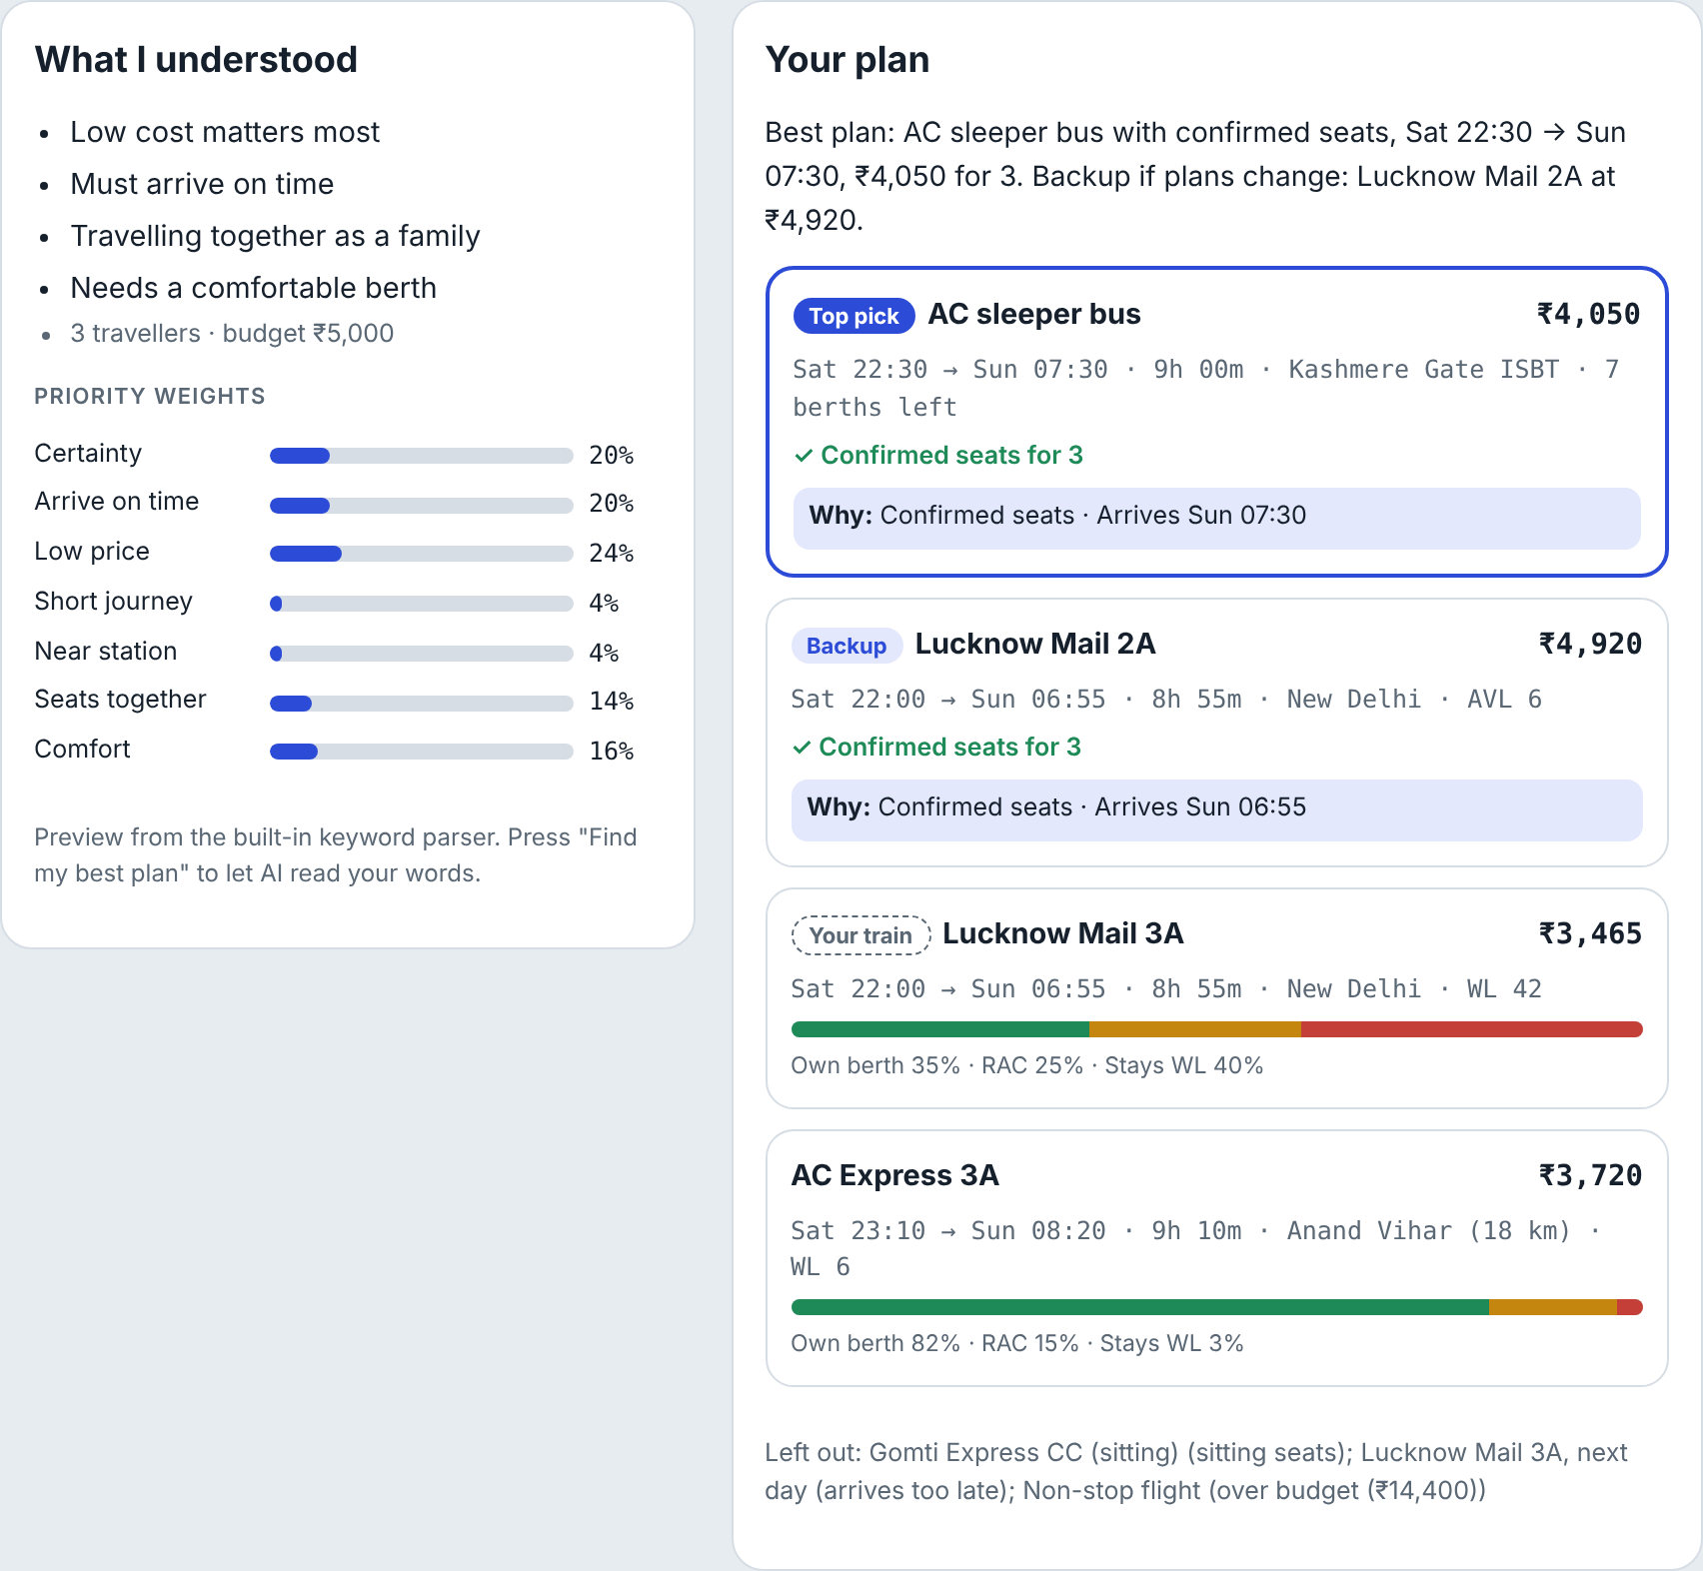
STEP 8 · AI EXTENSION
Trip Resolver: say it in your own words
Claude turns “3 of us, mother is 65, reach by Sunday, ₹5,000” into weights and limits
Transparent code ranks real options; AI never invents trains or prices
Same honest odds; “guaranteed” is blocked
Works in Hinglish; keyword fallback if AI is down
Notes:
As an extension, I vibe-coded a Trip Resolver. The user types their situation in their own words, even in Hinglish. Claude turns it into priorities and hard limits, like budget or no buses. Then transparent code ranks the real options, so the AI never invents a train or a price. The answer uses the same honest odds and blocks words like guaranteed. In ixigo this would sit inside TARA. [Switch to the live demo and try one example.]

Slide 19
From “Is 40% good?” to “I know how I’m getting there.”
Next 2 weeks
Next 2 months
Next 6 months
Validate RAC-split data with ConfirmTkt; usability test with 5 users
Pilot on 20 routes, A/B against today’s flow
All WL users; 42% resolved bookings
Prototype, AI demo, research and PRD: links in the submission · Rohit Kumar
Notes:
To close: we move users from “Is 40% good?” to “I know how I’m getting there.” Next two weeks: validate that ConfirmTkt can split RAC from confirmed, and run a usability test with five users. Next two months: pilot on 20 routes as an A/B test. In six months: all waitlisted users and 42% resolved bookings. All links, the prototype, the AI demo, the research and the PRD are in my submission. Thank you.

