Slide 1




Foundations of Artificial Intelligence
AI-Based Exam Duty and Laboratory Allocation System
Using constraint satisfaction and search algorithms
Presented by
Karthikeyan A
Kaarthika S

Slide 2


Foundations of Artificial Intelligence
Abstract
CSP + backtracking (MRV, LCV, forward checking)
Allocate once, repair on demand
Min-conflicts repair with minimal disruption
Exam cells assign venues and invigilators for hundreds of sessions by hand, and every lab failure, postponement or faculty leave forces a manual redo that disturbs assignments unrelated to the change.
We model the task as a Constraint Satisfaction Problem and generate the allocation with AC-3 propagation and heuristic backtracking search. Incidents are repaired with min-conflicts local search under a change penalty, so only the affected slots move. Infeasible cases are explained in terms of the blocking constraint.
Validator and infeasibility explanation

Slide 3

Foundations of Artificial Intelligence
Problem Statement
How exam allocation is done today, and where it breaks
Manual allocation
Venues and invigilators are assigned in spreadsheets. Clashes with lectures, over-capacity rooms and labs with too few working systems are caught late or not at all.
Fragile to change
One broken lab or postponed exam means re-checking the entire sheet, and faculty learn of changes hours before duty.
Given the exam timetable, rooms and faculty schedules, assign every exam a venue and invigilators so that all institutional rules hold, and when an incident occurs, repair the allocation with the fewest possible changes, or explain why no repair exists.

Slide 4

Foundations of Artificial Intelligence
Literature survey
What has been done
Examination timetabling is a standard CSP benchmark. Surveys by Qu et al. (2009) and Siew et al. (2024) cover graph colouring, constraint methods and metaheuristics; all target generation from scratch.
Constraint foundations
Exam timetabling surveys
Repair methods
Mackworth (1977) introduced AC-3; Russell & Norvig define MRV, LCV, forward checking and min-conflicts.
Qu et al. (2009), Siew et al. (2024): assign exams to periods and rooms; invigilators treated as post-processing.
Minton et al. (1992) showed min-conflicts repairs near-correct schedules in few steps; rarely applied to invigilator duties.

Slide 5

Foundations of Artificial Intelligence
Research Gap
Where existing systems stop
Existing 1
Ours 1
Any change triggers a full re-solve, so exams and staff unrelated to the incident are moved too. Faculty get a new duty chart for the week because one lab failed.
Only affected assignments are released and repaired with min-conflicts under a change penalty λ. A broken lab moves one exam; only faculty whose duties changed are notified.
Timetabling research has solved the generation problem well: given exams, periods and rooms, surveys. Yet three needs of a working examination cell remain unaddressed.
Existing 2
Ours 2
Rooms and periods are modelled, but faculty timetables, leave and duty limits are not, so invigilator allocation remains a manual step afterwards.
Venue and invigilators are assigned together as one CSP under H1–H7, so no faculty member is placed in a hall during their own lecture or beyond the daily duty limit.
The schedule is treated as disposable and regenerated after every change, invigilator duties are left outside the model, and infeasible cases are reported as plain failure. This project targets all three with a single CSP model solved by two complementary search algorithms.

Slide 6

Foundations of Artificial Intelligence
Research Objectives
Objectives
Formulate
Generate
Model allocation as a CSP with hard constraints H1–H7 and weighted soft constraints S1–S5
Implement AC-3 and backtracking with MRV, degree, LCV and forward checking
Repair
Validate and deliver
Implement min-conflicts with a change penalty λ for incident-driven rescheduling
Independent validator, infeasibility explainer, role-based web app with college login

Slide 7
Foundations of Artificial Intelligence
Proposed work
Generate, repair, explain
The published schedule is treated as a commitment. A complete search algorithm builds it from nothing; a fast local search protects it when something breaks.
01
02
03
Generate
Repair
Explain
AC-3 prunes domains, backtracking assigns venue and invigilators per exam, hill climbing balances duty load
Incident releases only affected slots; min-conflicts reassigns with penalty λ per change; validator re-checks
If no repair exists, name the blocking constraint and suggest a relaxation: new date, larger room, one extra duty

Slide 8
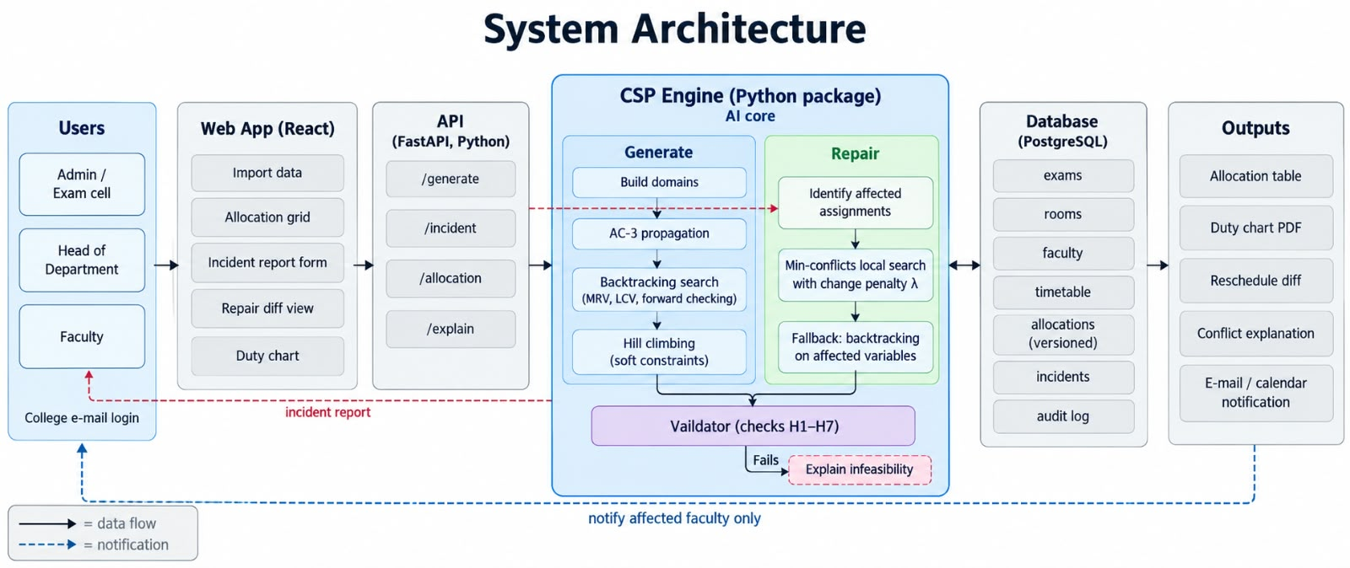
Foundations of Artificial Intelligence
Architecture
Architecture
Administrator imports exams, rooms, faculty and timetable; the CSP engine builds domains, runs AC-3, backtracking and hill climbing; results are validated and stored as versions.
Incident reports enter the rescheduling module, which repairs with min-conflicts and publishes a diff to affected faculty only.

Slide 9
Foundations of Artificial Intelligence
Algorithm
Four algorithms, implemented from scratch
AC-3
Removes room/staff values with no support in neighbouring exams; detects infeasibility before search
Backtracking + heuristics
MRV picks the most constrained exam, degree breaks ties, LCV orders rooms, forward checking prunes after each assignment
Four textbook algorithms, each written in Python without a solver library. Backtracking is complete and builds the schedule from nothing; min-conflicts starts from the published schedule and converges in a few steps, which is exactly the repair case
Min-conflicts repair
Starts from the published schedule; change penalty λ keeps unaffected assignments fixed; falls back to backtracking on affected variables
Pseudo Code:
Hill climbing
Swaps assignments to lower soft cost (fairness, proximity) while keeping hard feasibility.
BACKTRACK(A): X ← MRV variable; for v in LCV order:
if consistent(H1..H7): assign, forward-check, recurse; undo
MIN-CONFLICTS(published, incident): release affected vars;
repeat: X ← conflicted var; X ← argmin conflicts + λ·[changed]

Slide 10
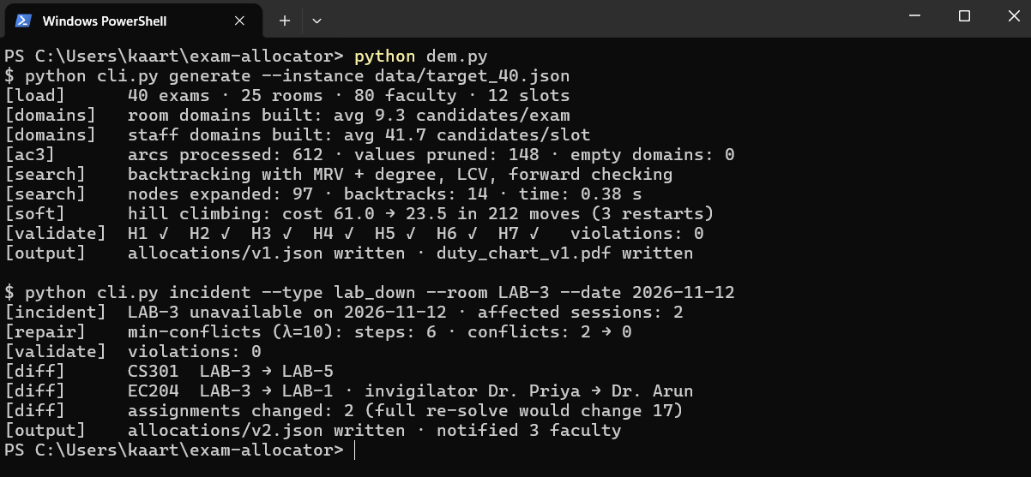
Foundations of Artificial Intelligence
Implementation
Stack and status
Backend
The CSP engine is a standalone Python package (ac3, backtracking, local_search, cost, validator, explain) exercised from the command line before any UI exists.
Python 3.12, FastAPI, PostgreSQL with versioned allocations
Frontend and auth
React, college-domain login (roster now, Google OAuth later), e-mail and ICS notifications
Data and tests
Synthetic generator (40 exams, 25 rooms, 80 faculty, 12 slots); pytest, scenario tests, validator property tests

Slide 11
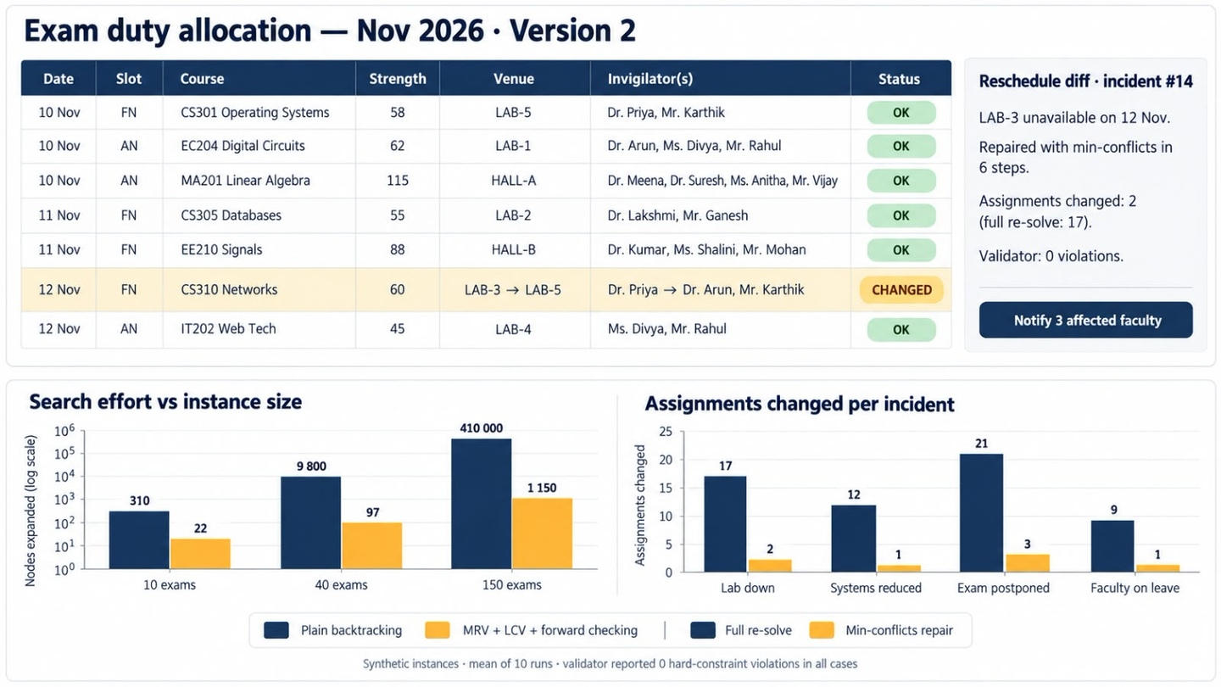




Foundations of Artificial Intelligence
Output and result
Outputs and evaluation
Allocation grid, duty chart PDF, reschedule diff ("CS301: Lab-2 → Lab-5; Dr A → Dr B") and conflict explanation. Evaluation on synthetic instances with planned experiments: heuristic ablation, repair vs full re-solve, fairness.
0 hard-constraint violations on every published allocation
≤ 5 assignments changed per incident (vs full re-solve)
< 2 s repair, < 5 s generation on the target instance

