Slide 1

HospitalIQ
End-to-End Healthcare Analytics & ML Platform
SQL Server · Power BI · Python/XGBoost · SHAP
27,891 encounters, 974 patients, $101.5M in claims, AUC 0.907
SAHAJ K · DATA ANALYST · JULY 2026

Slide 2

Executive Summary
An end-to-end hospital analytics project on synthetic EHR data (Synthea) — mirroring real production methodology: schema design, BULK INSERT loading, rigorous data quality auditing, multi-layered analysis, and explainable ML.
27,891
974
$101.5M
0.907
Encounters
Patients
Total Claims
Model AUC

Slide 3
Headline Findings
Encounter Volume
Payer Coverage Gap
Cost Concentration
Peaked in 2014 (3,885) and 2021 (3,530). Outpatient surged to 40.2% in 2021 — likely a COVID-era coding shift.
48.7% of encounters had zero payer coverage. 4,779 were insured patients (deductibles or denied claims) — a nuance most reporting misses.
Electrical cardioversion drives ~$35.8M (1,383 procedures × ~$25,903). ICU admissions rare (n=5) but cost $206K each on average.
Payer Disparities
Readmission Model
Average claim cost varies 3.7× across payers. Medicaid ($6,205) and uninsured ($5,593) carry the highest costs — consistent with delayed-care patterns.
XGBoost achieves AUC 0.907 predicting 30-day readmission, driven by clinical features (prior encounter count, recency, claim cost, age) — not demographics.

Slide 4




Project Phases
Data Engineering
SQL Analytics
Schema, BULK INSERT, data quality
10 business-question queries
Power BI Dashboard
Python ML Model
3 pages: Operations, Financial, Patient Risk
30-day readmission, XGBoost + SHAP
All four phases completed on a Synthea synthetic EHR dataset (974 patients, 27,891 encounters, 47,701 procedures, spanning 2011–2022).

Slide 5
Data Engineering & Quality
Loading Issues Resolved
Findings Documented, Not "Fixed"
1
Missing Patient Row
70% NULL reason codes
53 post-death encounters
BULK INSERT silently skipped one record (19 dependent encounters) due to special characters. Detected via LEFT JOIN orphan check; resolved with SSMS Import Flat File Wizard.
Routine visits have no diagnosis — left as NULL.
Admin/billing entries — kept for cost analysis; excluded from patient behavior.
1 patient, 1,381 encounters
4,779 zero-coverage encounters
2
Empty Strings vs NULLs
Optional fields loaded as "" instead of NULL, making every patient appear alive. Fixed with NULLIF() — 154 patients with valid death dates, exactly matching source CSV.
Chronic-care profile (likely dialysis) — flagged to prevent readmission model misinterpretation.
Insured patients with deductibles or denied claims — both interpretations reported explicitly.

Slide 6
SQL Analytics: Key Findings
Encounter Volume
Zero Coverage
Range: 220 (2022, partial) to 3,885 (2014). Ambulatory 37–60% every year. 95.87% of encounters under 24 hours.
13,586 encounters (48.71%). The gap of 4,779 insured patients with $0 coverage reflects deductibles or denied claims — both numbers reported.
Top Costs
Readmissions
ICU admit ($206K, n=5), CABG ($47K, n=9), Hemodialysis ($29K, n=27). Medicaid $6,205 avg vs Medicare $2,167 — a 3.7× range.
299 patients (79.3%) readmitted within 30 days (broad definition); 29 under CMS-aligned inpatient-only definition. Top readmitter: Kimberly Collier, 1,375 readmissions.

Slide 7
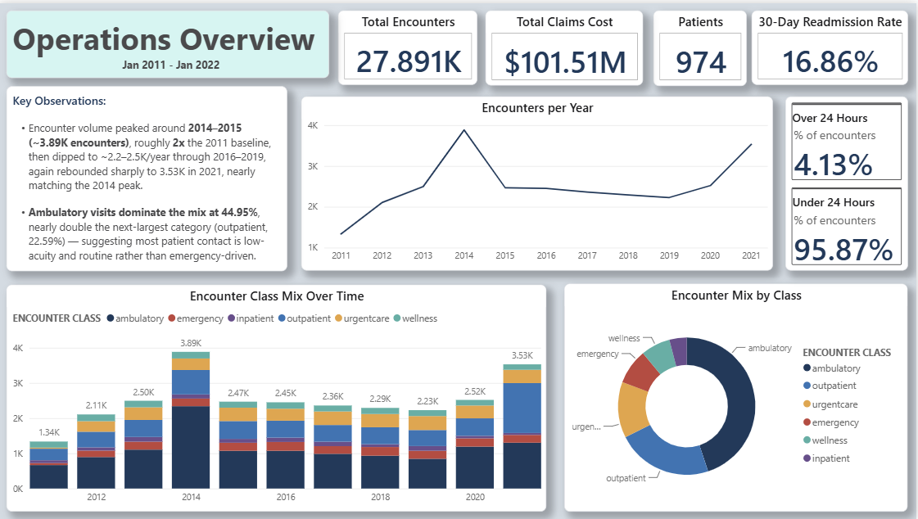
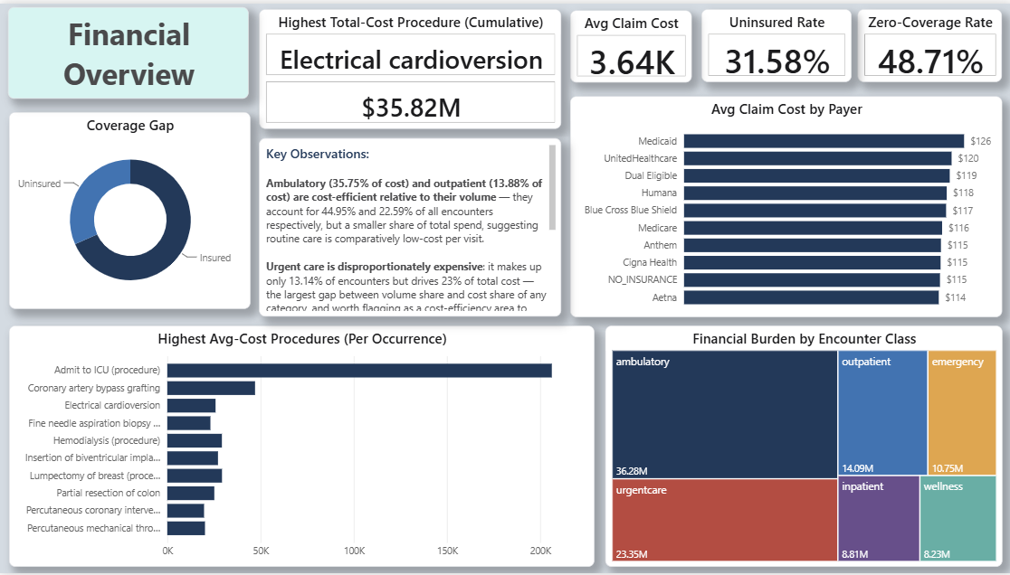
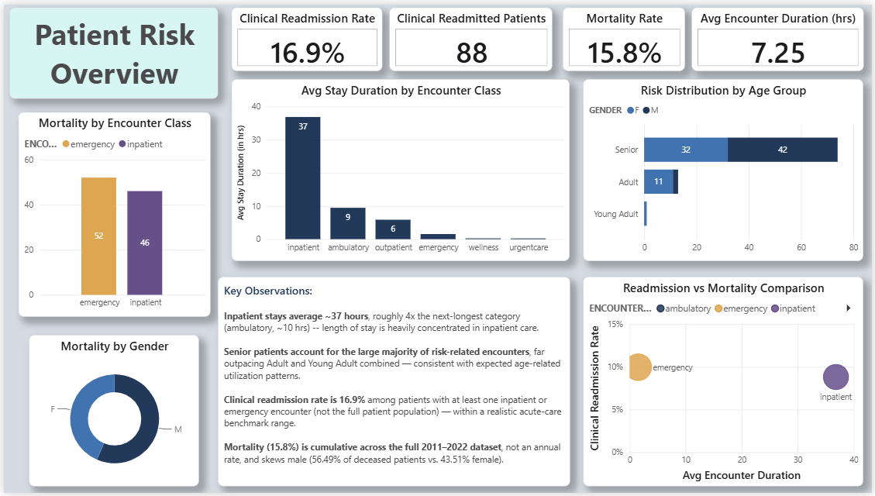
Power BI Dashboard
Three-page dashboard in Import mode on a star schema with encounters as fact table and four dimensions (patients, payers, organizations, procedures). All measures DAX-defined. Embedded with cached data — no live SQL Server connection needed
1
2
3
Operations Overview
Financial Overview
Patient Risk & Readmission
KPI cards, year-over-year trend, encounter-class donut, and class-mix stacked bar. 2014 and 2021 volume peaks visible at a glance.
Average claim cost by payer, coverage-type donut, top-10 procedures by cost, and financial burden treemap by encounter class.
Clinical readmission rate (strict definition), mortality rate, average stay duration, and risk distribution by age and gender.

Slide 8
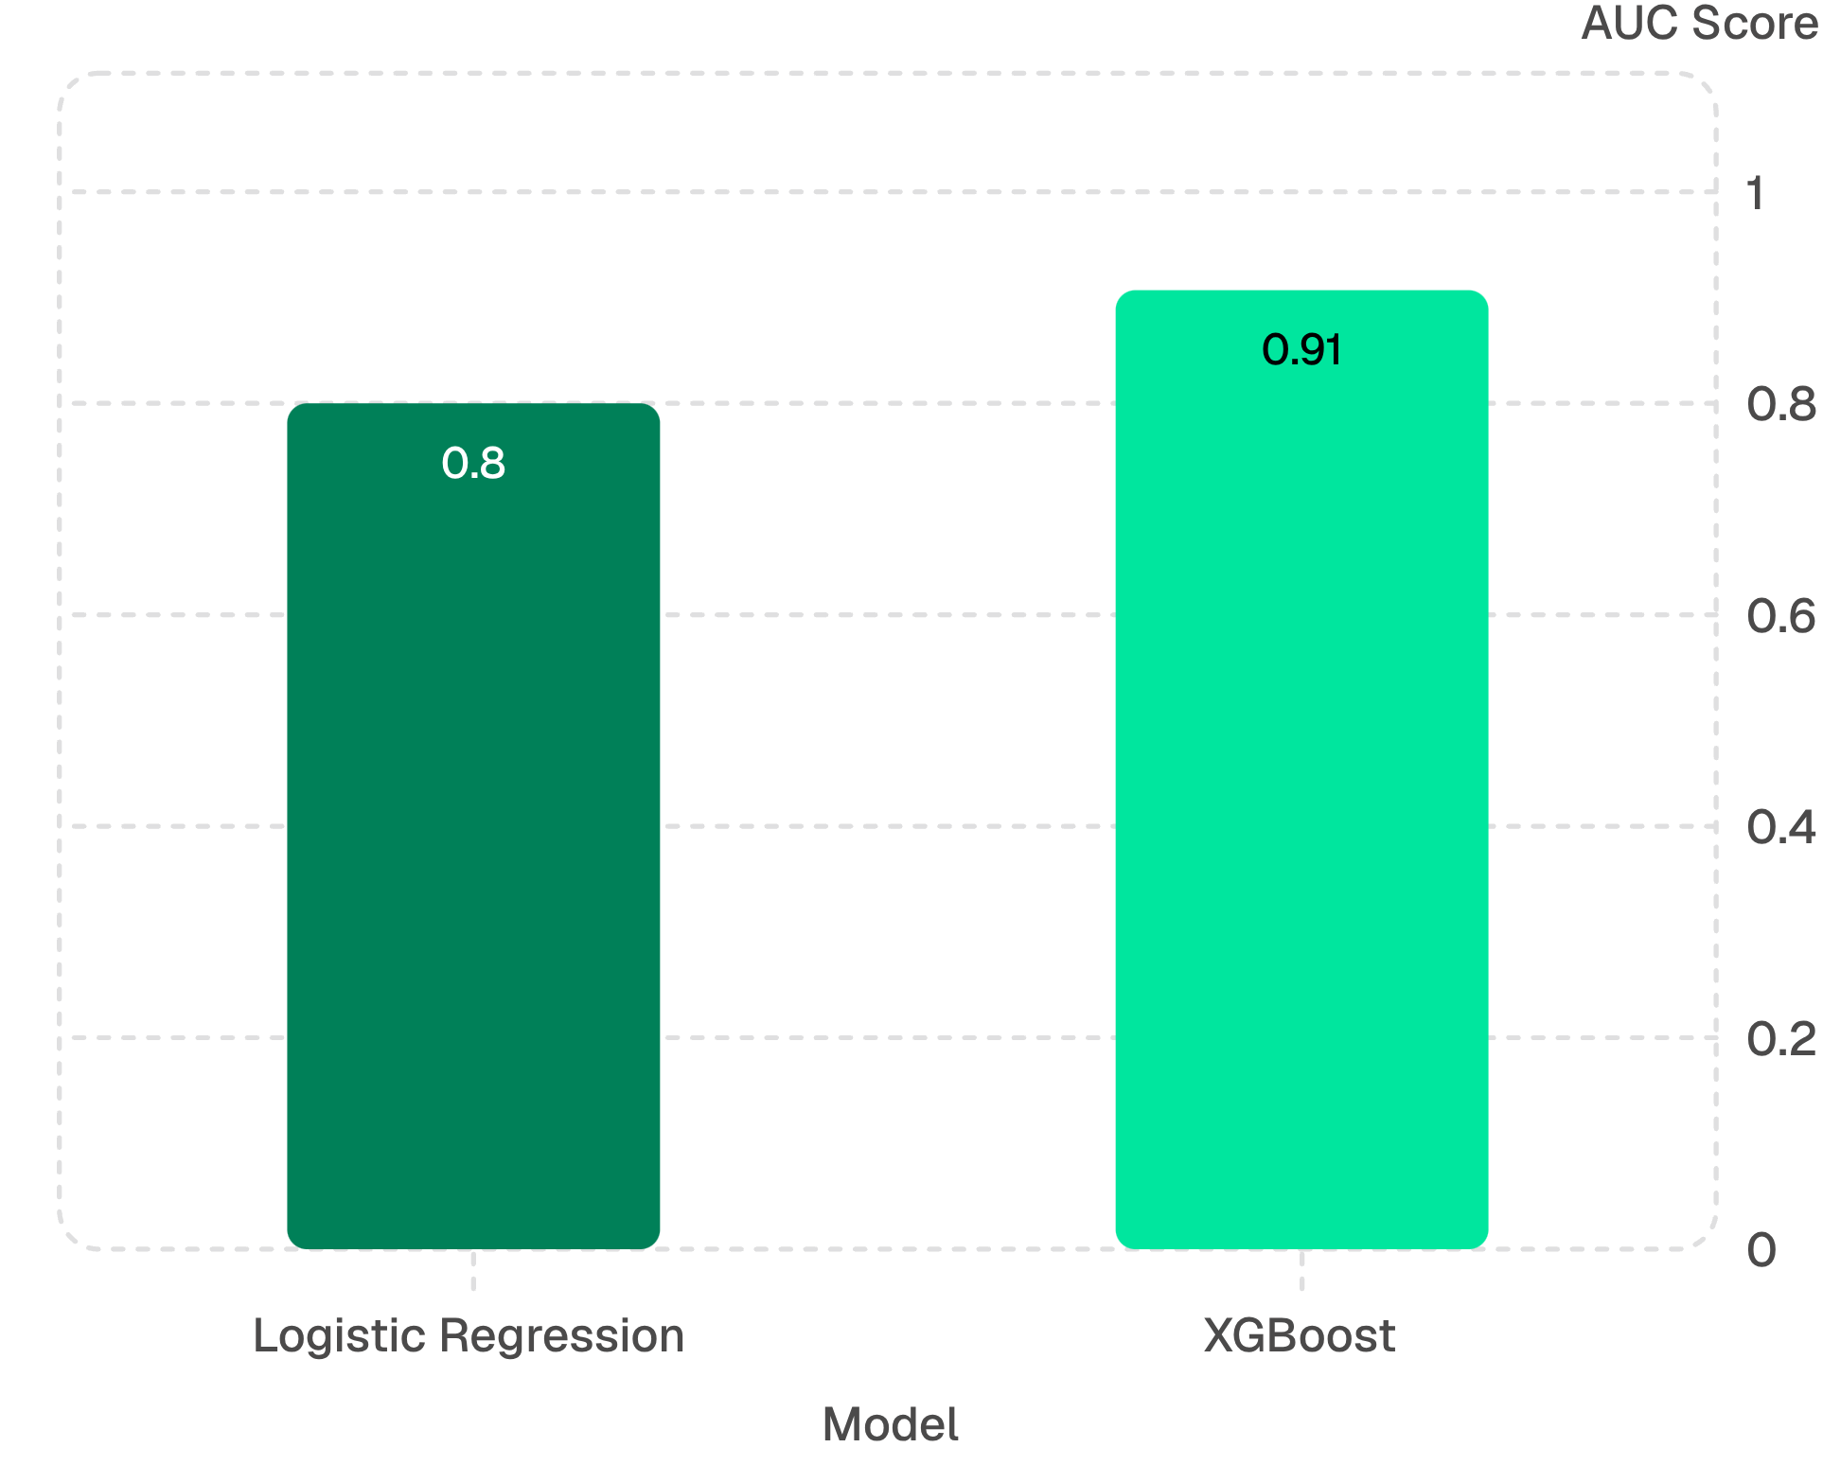

Readmission Prediction Model
Approach
Feature engineering in SQL - LAG, LEAD, COUNT OVER window functions compute prior encounter count and days since previous visit
Two models compared - Logistic Regression baseline vs XGBoost
80/20 stratified split - 22,312 train / 5,579 test, identical 61.6% target distribution
SHAP explainability - summary and beeswarm plots on 500 test predictions
Real-world EHR readmission models typically achieve AUC 0.65–0.75. The higher score here reflects Synthea's cleaner patterns - methodology transfers directly.
The 10.7-point AUC gap justifies XGBoost's additional complexity over the interpretable baseline.

Slide 9
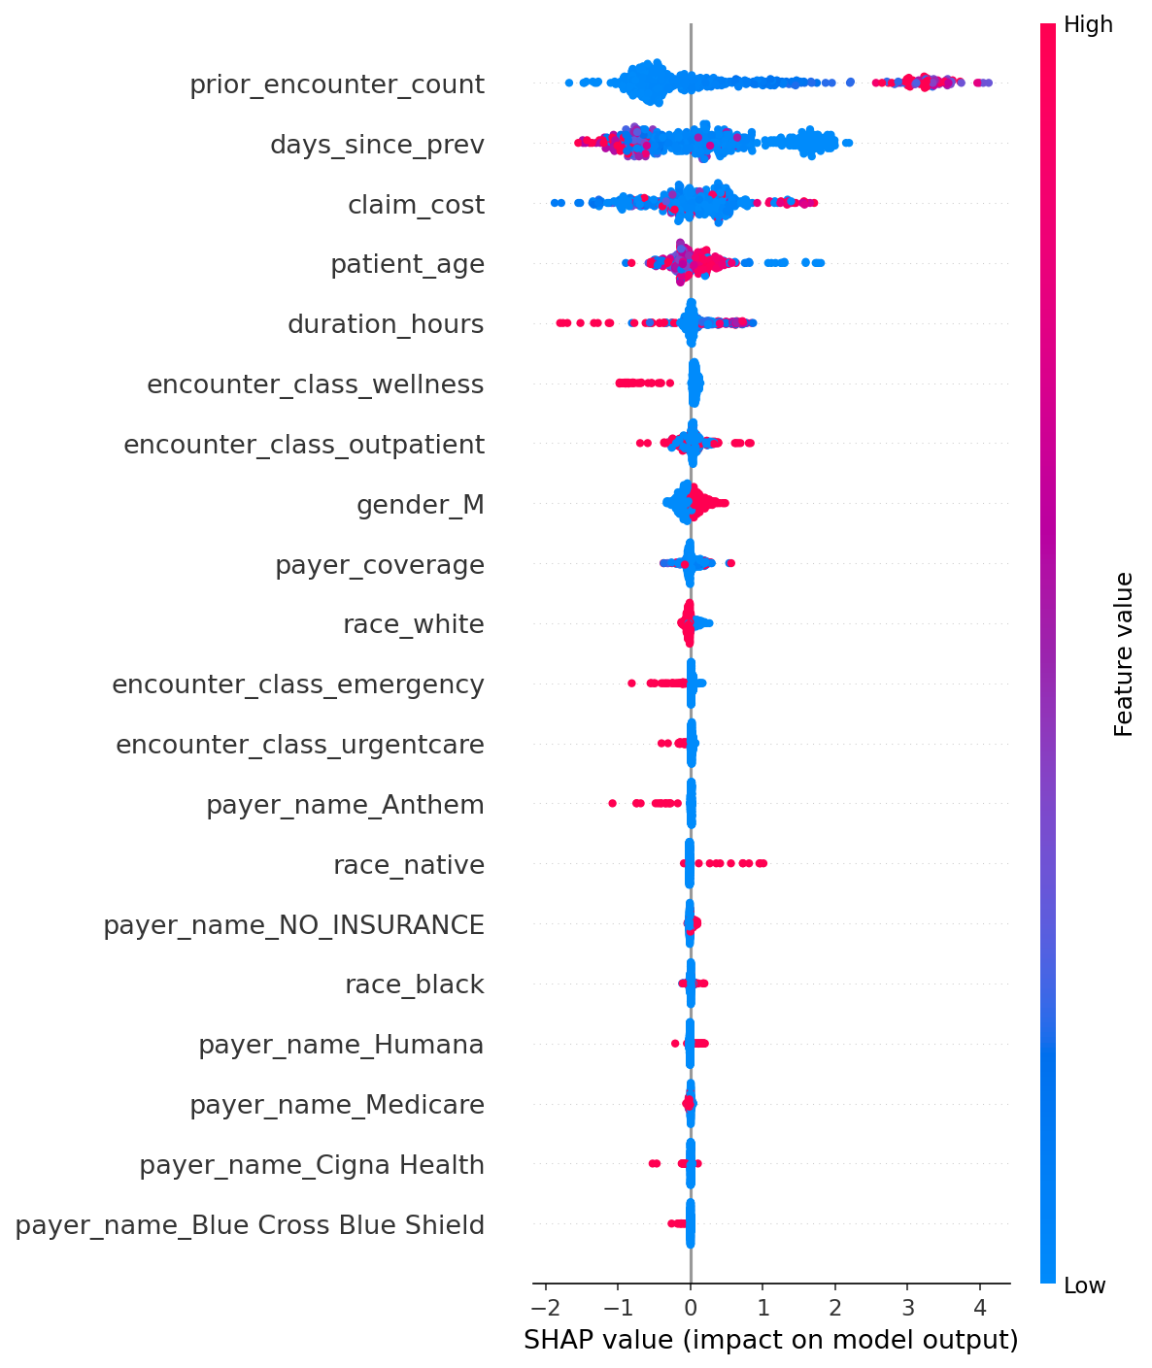
Feature Importance (SHAP)
prior_encounter_count
days_since_prev
claim_cost
More prior encounters → higher readmission probability
Recent prior visit → higher readmission probability
Higher cost (sicker patient) → higher readmission probability
patient_age
duration_hours
encounter_class_wellness
Older patient → modestly higher readmission probability
Longer encounter → higher readmission probability
Wellness check → pushes away from readmission
Clinical & Behavioral Features Dominate
The model's top predictors are clinically meaningful — exactly what a credible healthcare model should look like. Race and gender appear near the bottom of the importance ranking.

Slide 10
Conclusions & Next Steps
Coverage Gap
Cost Concentration
35% of zero-coverage encounters belonged to insured patients. Track both metrics — "uninsured rate" alone under-counts those exposed to large out-of-pocket costs.
One procedure (electrical cardioversion) drives ~$35M. Prioritize cost management on high-impact procedures rather than spreading thinly across all encounter types.
Preventative Outreach
Next Steps
Medicaid and uninsured patients carry the highest average costs - consistent with delayed-care patterns. Targeted outreach could reduce long-term costs more effectively than acute-care interventions alone.
Add chronic-care stratification; calibrate probabilities (Platt scaling); replicate on real EHR data via NHS or US health system partnership; wrap model in REST API for discharge-planning UI.
Data source: Walonoski J, Kramer M, Nichols J, et al. Synthea: An approach, method, and software mechanism for generating synthetic patients and the synthetic electronic health care record. JAMIA, March 2018.

