Slide 1


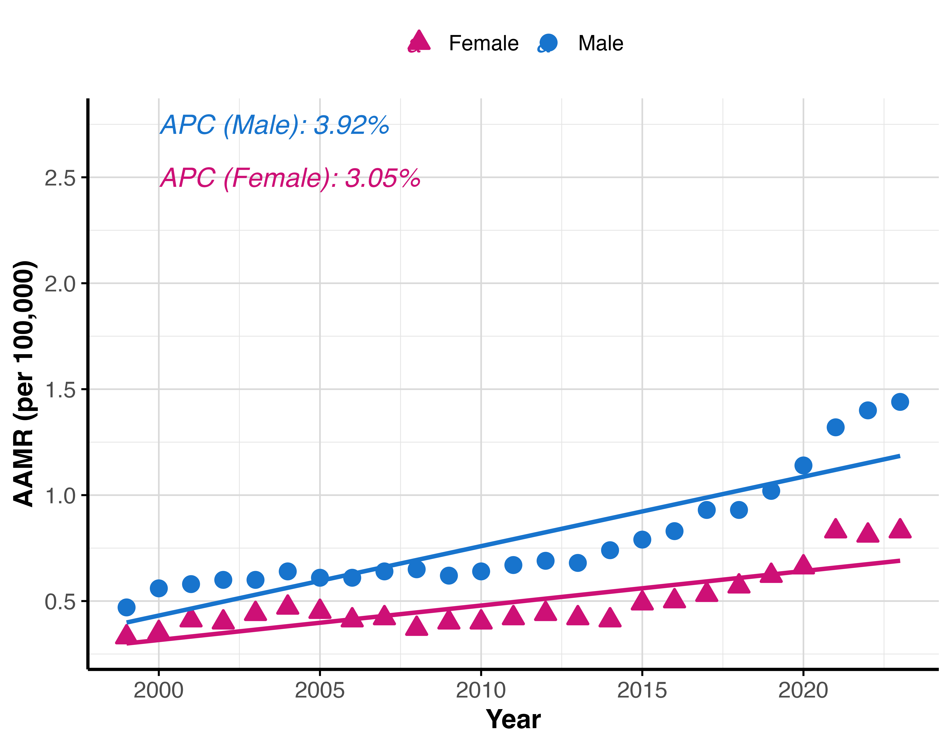
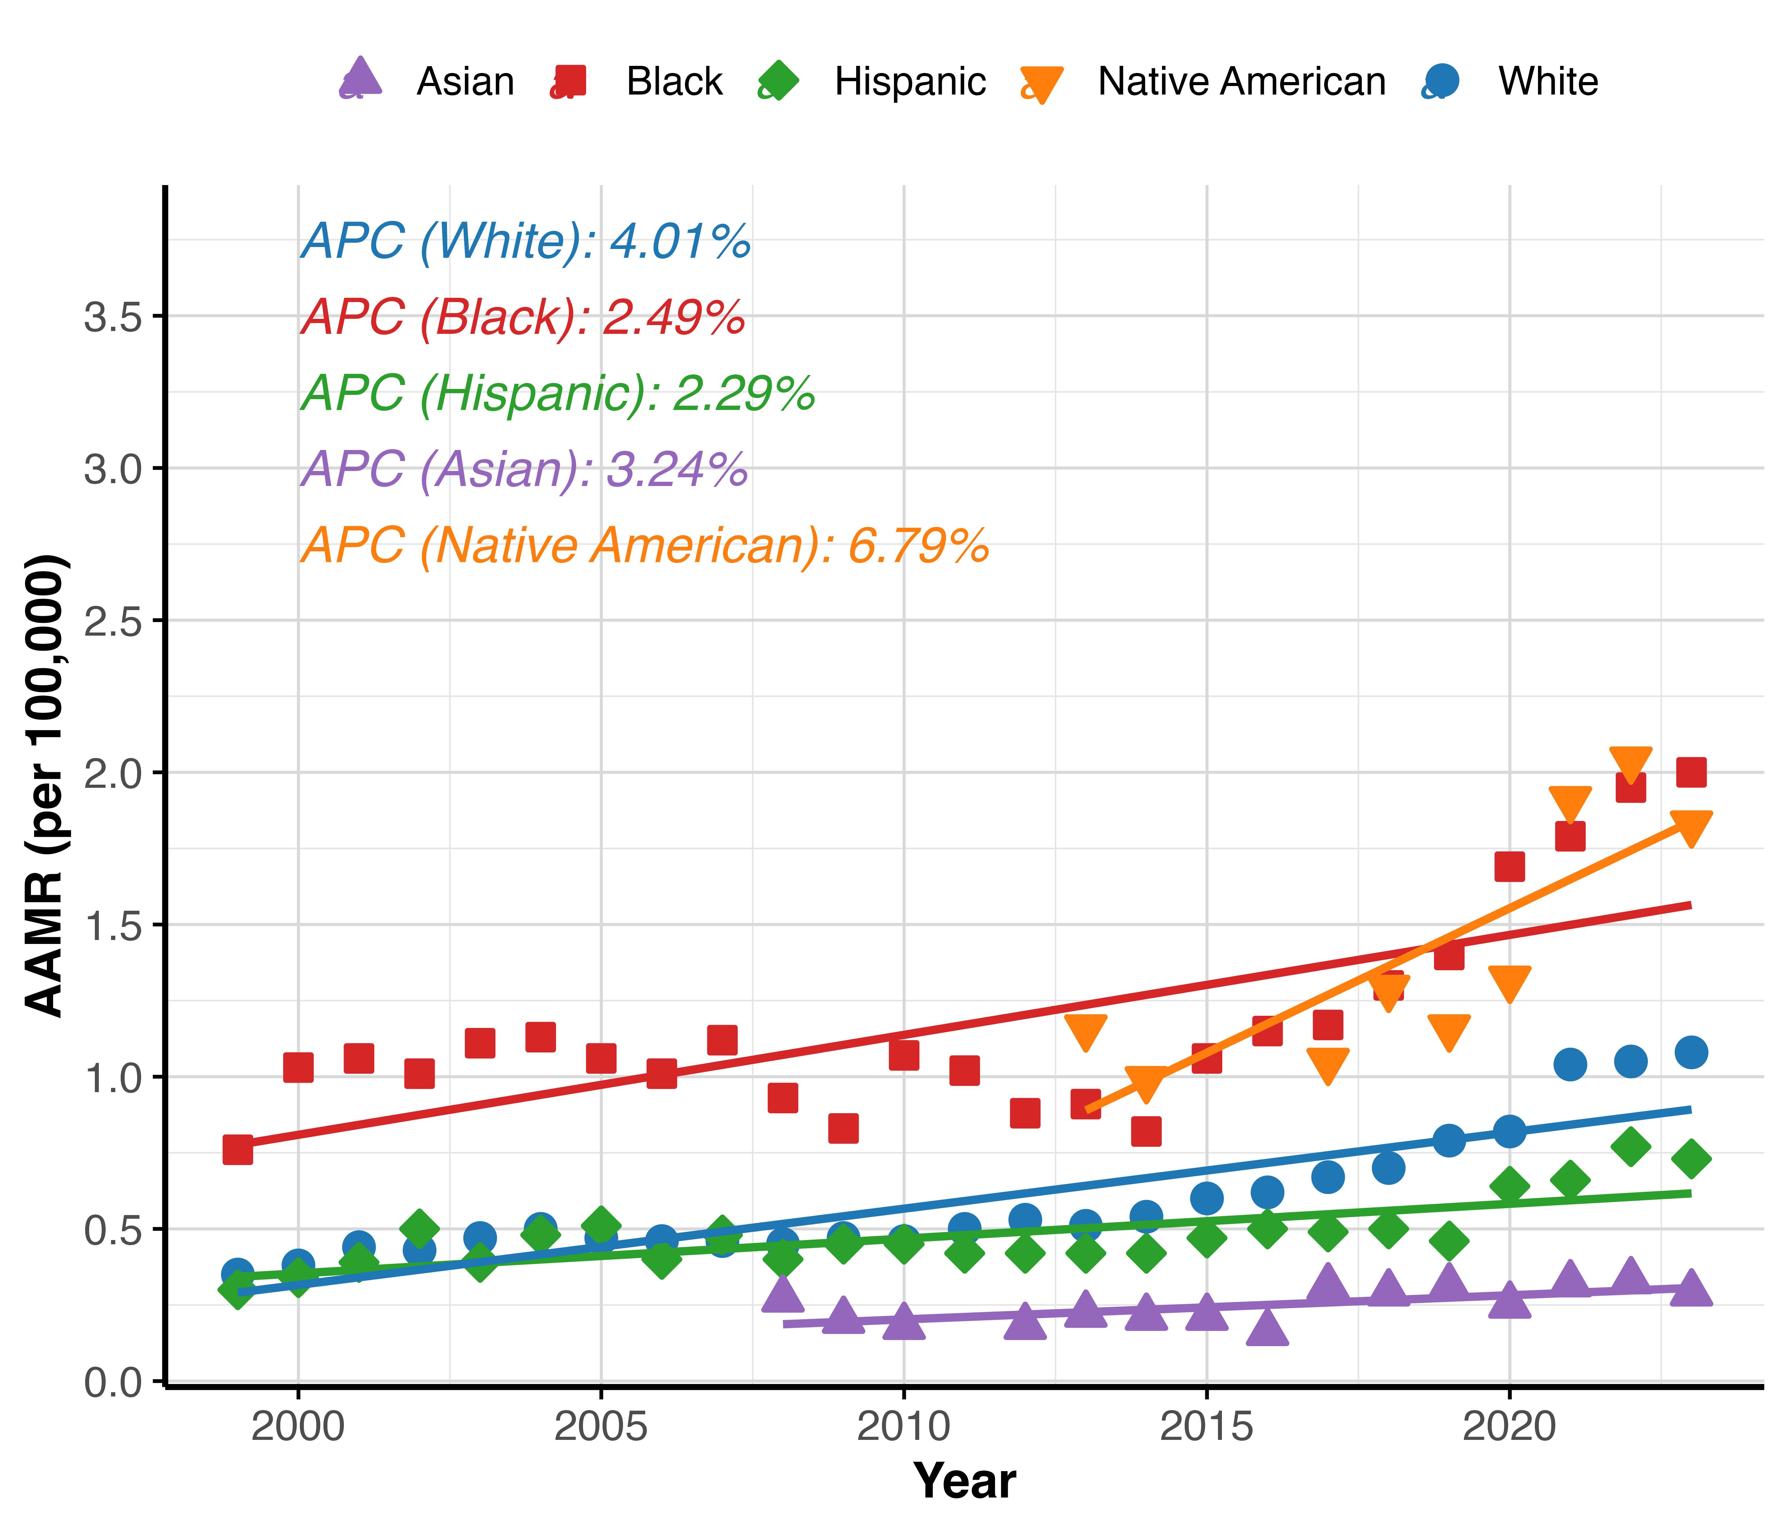
National Trends in Osteomyelitis-Associated Mortality in the United States, 1999-2023
Krishna O. Sanaka BS¹, Andrew L. Wang BS², Rodrigo M. Carrillo-Larco MD, PhD^{3,4}, Marcos C. Schechter MD^{5,6}
1. Perelman School of Medicine, University of Pennsylvania, Philadelphia, PA, USA, 2. Geisel School of Medicine, Dartmouth College, Hanover, NH, USA , 3. Emory Global Diabetes Research Center of Woodruff Health Sciences Center, Emory University, Atlanta, GA, USA , 4. Hubert Department of Global Health, Rollins School of Public Health, Emory University, Atlanta, GA, USA , 5. Grady Health System, Atlanta, GA, USA , 6. Division of Infectious Diseases, Department of Medicine, School of Medicine, Emory University, Atlanta, GA, USA
Introduction
Table 1. Age-adjusted mortality rates and annual percent changes for osteomyelitis by demographic group and comorbidity.
Figure 1. Age-adjusted mortality rates over time for osteomyelitis by sex category.
Group | 1999 AAMR | 1999 Deaths | 2023 AAMR | 2023 Deaths | APC (95% CI) (%) | p-value
Overall | 0.38 | 1,068 | 1.11 | 4,677 | 3.54 (2.8, 4.28) | <0.001
Male | 0.47 | 488 | 1.44 | 2,700 | 3.92 (3.23, 4.61) | <0.001
Female | 0.33 | 580 | 0.83 | 1,977 | 3.05 (2.21, 3.89) | <0.001
NH White | 0.35 | 831 | 1.08 | 3,381 | 4.01 (3.28, 4.75) | <0.001
NH Black | 0.76 | 166 | 2 | 821 | 2.49 (1.37, 3.62) | <0.001
Hispanic | 0.3 | 41 | 0.73 | 326 | 2.29 (1.45, 3.15) | <0.001
Asian or Pacific Islander | N/A | 15 | 0.29 | 71 | 3.24 (0.85, 5.68) | 0.11
American Indian/Alaska Native | N/A | 11 | 1.83 | 47 | 6.79 (2.68, 11.08) | 0.005
0-34 | N/A | 13 | 0.02 | 32 | <0.001 (0, <0.001) | 0.08
35-64 | 0.15 | 155 | 0.67 | 855 | 6.08 (5.47, 6.7) | <0.001
65+ | 2.61 | 907 | 6.4 | 3,789 | 2.9 (2.2, 3.6) | <0.001
Diabetes | 0.28 | 771 | 0.83 | 3,532 | 4.04 (3.03, 5.07) | <0.001
Peripheral Vascular Disease | 0.06 | 176 | 0.21 | 939 | 5.27 (4.19, 6.36) | <0.001
Trauma | 0.02 | 55 | 0.06 | 281 | 6.85 (5.09, 8.64) | <0.001
Decubitus Ulcer | 0.07 | 210 | 0.27 | 1,210 | 6.17 (5.32, 7.04) | <0.001
Methods
Results
Figure 2. Age-adjusted mortality rates over time for osteomyelitis by racial/ethnic category.
Conclusions

