Slide 1


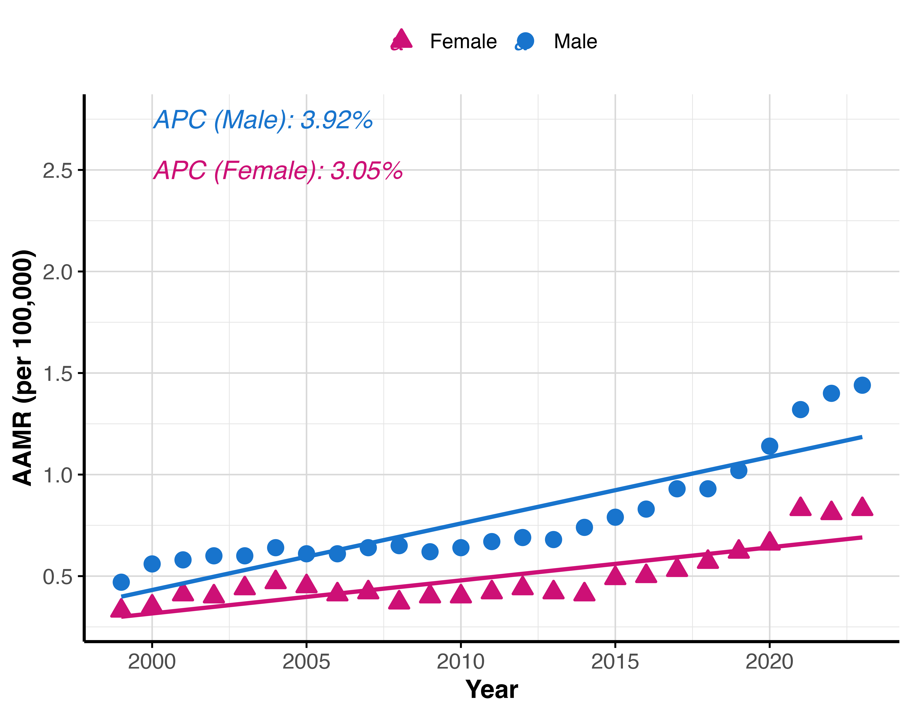
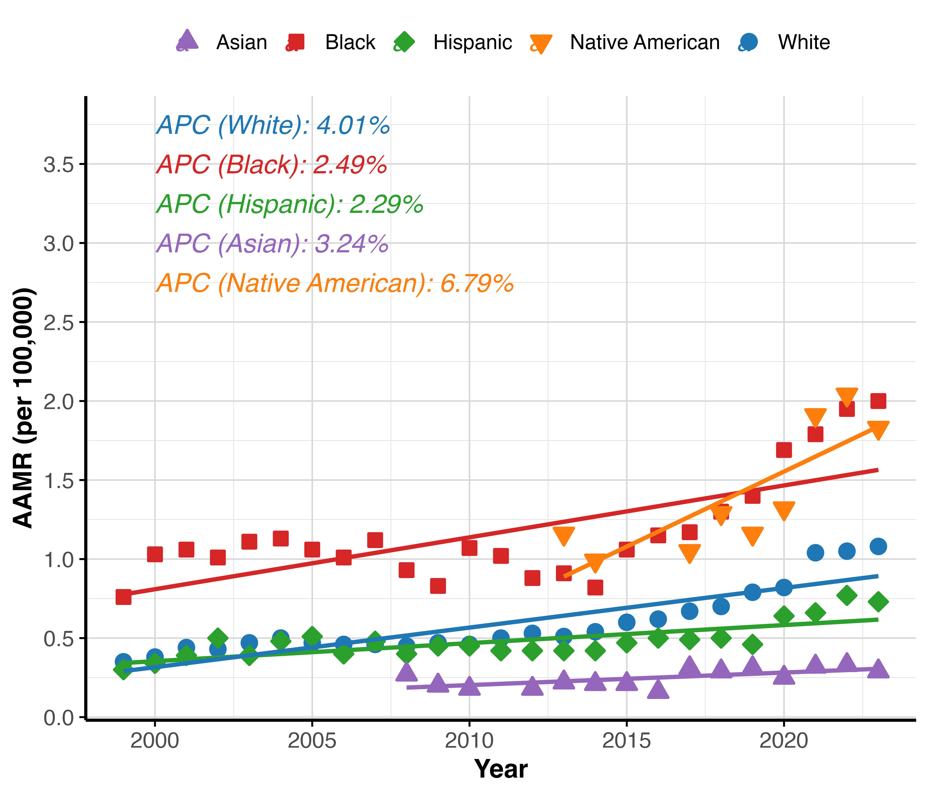
National Trends in Osteomyelitis-Associated Mortality in the United States, 1999-2023
Krishna O. Sanaka BS¹, Andrew L. Wang BS², Rodrigo M. Carrillo-Larco MD, PhD^{3,4}, Marcos C. Schechter MD^{5,6}
1. Perelman School of Medicine, University of Pennsylvania, Philadelphia, PA, USA, 2. Geisel School of Medicine, Dartmouth College, Hanover, NH, USA , 3. Emory Global Diabetes Research Center of Woodruff Health Sciences Center, Emory University, Atlanta, GA, USA , 4. Hubert Department of Global Health, Rollins School of Public Health, Emory University, Atlanta, GA, USA , 5. Grady Health System, Atlanta, GA, USA , 6. Division of Infectious Diseases, Department of Medicine, School of Medicine, Emory University, Atlanta, GA, USA
Introduction
Table 1. Age-adjusted mortality rates and annual percent changes for osteomyelitis by demographic group and comorbidity.
Figure 1. Age-adjusted mortality rates over time for osteomyelitis by sex category.
Osteomyelitis is a serious infection associated with prolonged hospitalizations, amputation risk, and high mortality in vulnerable populations. Despite clinical advances, little is known about national trends in osteomyelitis mortality over time or across demographic groups. We aimed to characterize population-level mortality patterns associated with osteomyelitis in the United States from 1999 to 2023.
Group | 1999 AAMR | 1999 Deaths | 2023 AAMR | 2023 Deaths | APC (95% CI) (%) | p-value
Overall | 0.38 | 1,068 | 1.11 | 4,677 | 3.54 (2.8, 4.28) | <0.001
Male | 0.47 | 488 | 1.44 | 2,700 | 3.92 (3.23, 4.61) | <0.001
Female | 0.33 | 580 | 0.83 | 1,977 | 3.05 (2.21, 3.89) | <0.001
NH White | 0.35 | 831 | 1.08 | 3,381 | 4.01 (3.28, 4.75) | <0.001
NH Black | 0.76 | 166 | 2 | 821 | 2.49 (1.37, 3.62) | <0.001
Hispanic | 0.3 | 41 | 0.73 | 326 | 2.29 (1.45, 3.15) | <0.001
Asian or Pacific Islander | N/A | 15 | 0.29 | 71 | 3.24 (0.85, 5.68) | 0.11
American Indian/Alaska Native | N/A | 11 | 1.83 | 47 | 6.79 (2.68, 11.08) | 0.005
0-34 | N/A | 13 | 0.02 | 32 | <0.001 (0, <0.001) | 0.08
35-64 | 0.15 | 155 | 0.67 | 855 | 6.08 (5.47, 6.7) | <0.001
65+ | 2.61 | 907 | 6.4 | 3,789 | 2.9 (2.2, 3.6) | <0.001
Diabetes | 0.28 | 771 | 0.83 | 3,532 | 4.04 (3.03, 5.07) | <0.001
Peripheral Vascular Disease | 0.06 | 176 | 0.21 | 939 | 5.27 (4.19, 6.36) | <0.001
Trauma | 0.02 | 55 | 0.06 | 281 | 6.85 (5.09, 8.64) | <0.001
Decubitus Ulcer | 0.07 | 210 | 0.27 | 1,210 | 6.17 (5.32, 7.04) | <0.001
Methods
We conducted a retrospective, population-based analysis from the CDC WONDER Multiple Cause of Death database, covering all United States deaths from the years 1999 to 2023. Death certificates with osteomyelitis as an underlying or contributing cause were identified using the M86 code in the ICD-10. We fitted log-linear regression models to estimate the annual percent change (APC) in age-adjusted mortality rates (AAMRs) over time with stratifications for demographic subgroups.
Results
From 1999 to 2023, there were 55,976 deaths in the U.S. where osteomyelitis was listed as the underlying cause and 131,490 deaths where it was listed as contributing among multiple causes. Among deaths where osteomyelitis was an underlying cause, 54.02% were men and 74.28% were non-Hispanic White. Diabetes was the most common comorbid condition listed on the certificates (29.64%), followed by decubitus ulcers (9.48%), peripheral vascular disease (7.93%), and trauma (2.66%). The AAMR from osteomyelitis as an underlying cause of death increased from 0.38 per 100,000 in 1999 to 1.11 per 100,000 in 2023 [APC of 3.54% (95% CI) 2.8, 4.28; p < 0.001] (Table 1). Most demographic subgroups also experienced increases in AAMR over the study period. Both male and female residents saw significant increases in their AAMRs, as did those who were Non-Hispanic White, Non-Hispanic Black, and Hispanic. Asian and Pacific Islander residents did not experience a significant increase in AAMRs from 1999 to 2023.
Figure 2. Age-adjusted mortality rates over time for osteomyelitis by racial/ethnic category.
Conclusions
Osteomyelitis mortality rates have steadily increased over the past two decades, with marked demographic disparities. These findings underscore the need for improved prevention, earlier diagnosis, and targeted intervention strategies, particularly in high-burden populations.

