Slide 1


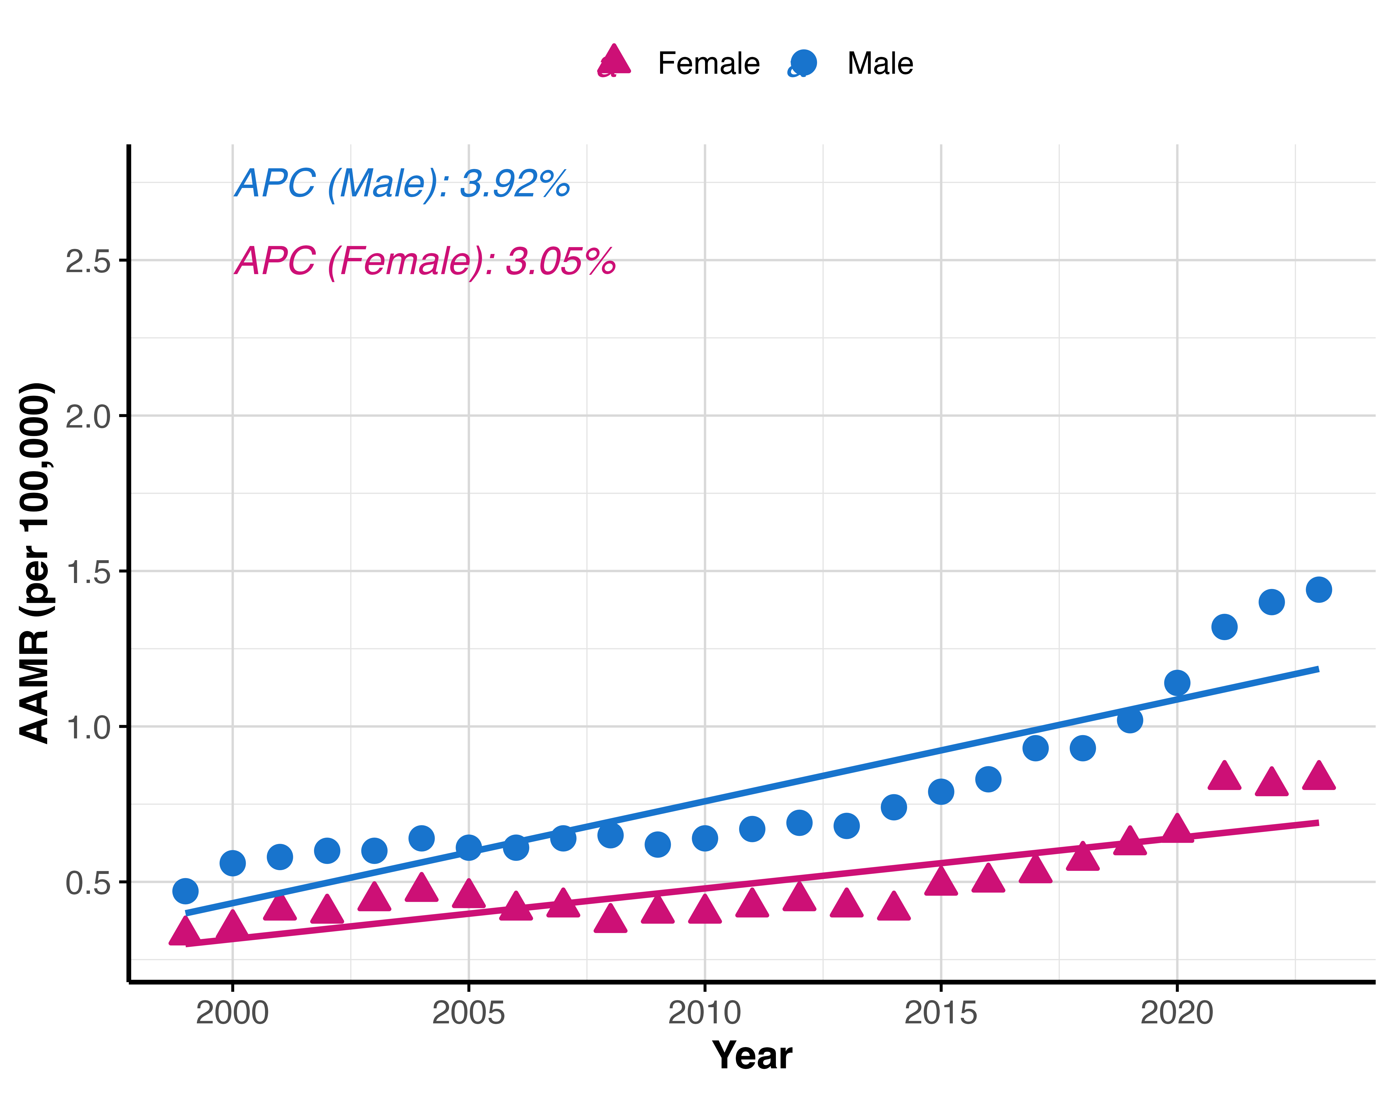
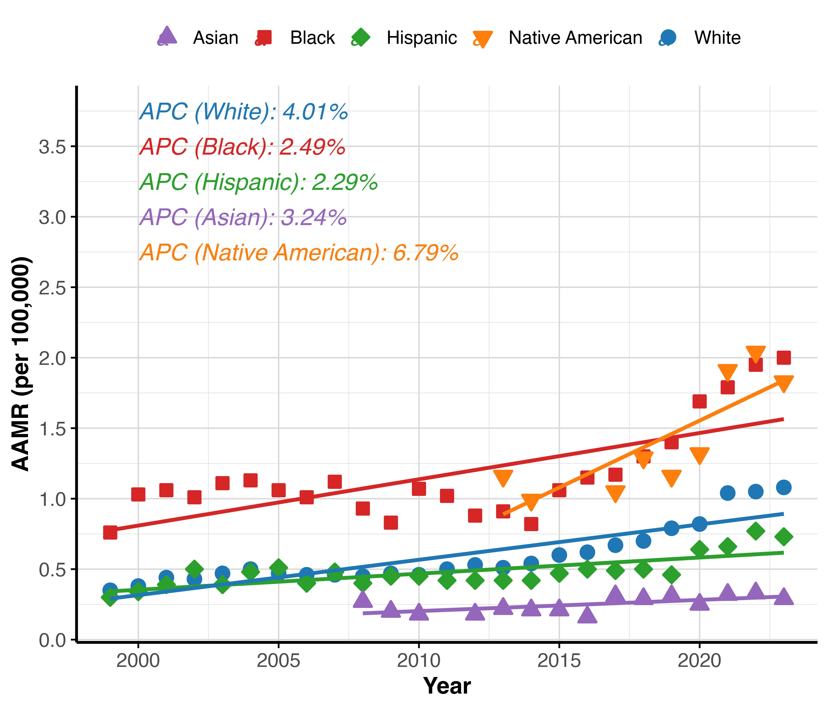
National Trends in Osteomyelitis-Associated Mortality in the United States, 1999-2023
Krishna O. Sanaka BS¹, Andrew L. Wang BS², Rodrigo M. Carrillo-Larco MD, PhD^{3,4}, Marcos C. Schechter MD^{5,6}
1. Perelman School of Medicine, University of Pennsylvania, Philadelphia, PA, USA, 2. Geisel School of Medicine, Dartmouth College, Hanover, NH, USA , 3. Emory Global Diabetes Research Center of Woodruff Health Sciences Center, Emory University, Atlanta, GA, USA , 4. Hubert Department of Global Health, Rollins School of Public Health, Emory University, Atlanta, GA, USA , 5. Grady Health System, Atlanta, GA, USA , 6. Division of Infectious Diseases, Department of Medicine, School of Medicine, Emory University, Atlanta, GA, USA
Introduction
Figure 1. Age-adjusted mortality rates over time for osteomyelitis by sex category.*
Figure 2. Age-adjusted mortality rates over time for osteomyelitis by racial/ethnic category.*
Results (cont.)
Osteomyelitis is a serious infection linked to prolonged hospitalizations, amputations, and high mortality in vulnerable groups.
Despite clinical advances, national trends in osteomyelitis mortality remain poorly characterized.
We aimed to describe population-level mortality patterns associated with osteomyelitis in the United States from 1999–2023.
Among underlying-cause deaths, 54.02% were men and 74.28% were non-Hispanic White.
Most common comorbidities:
  Diabetes (29.64%)
  Decubitus ulcers (9.48%)
  Peripheral vascular disease (7.93%)
  Trauma (2.66%)
AAMR increased from 0.38 per 100,000 (1999) to 1.11 per 100,000 (2023)
  APC: 3.54% (95% CI: 2.8–4.28; p < 0.001)
Most demographic subgroups showed significant increases in AAMR:
  Both sexes
  Non-Hispanic White, Non-Hispanic Black, and Hispanic populations
Asian and Pacific Islander residents did not experience a significant increase.
Methods
Retrospective, population-based analysis of CDC WONDER Multiple Cause of Death database, all United States deaths (1999- 2023).
Death certificates with osteomyelitis (M86) as an underlying or contributing cause were identified.
Log-linear regression models to estimate the annual percent change (APC) in age-adjusted mortality rates (AAMRs) with stratifications for demographic subgroups.
Table 1. Age-adjusted mortality rates and annual percent changes for osteomyelitis by demographic group and comorbidity.*
Group | 1999 AAMR | 1999 Deaths | 2023 AAMR | 2023 Deaths | APC (95% CI) (%) | p-value
Overall | 0.38 | 1,068 | 1.11 | 4,677 | 3.54 (2.8, 4.28) | <0.001
Male | 0.47 | 488 | 1.44 | 2,700 | 3.92 (3.23, 4.61) | <0.001
Female | 0.33 | 580 | 0.83 | 1,977 | 3.05 (2.21, 3.89) | <0.001
NH White | 0.35 | 831 | 1.08 | 3,381 | 4.01 (3.28, 4.75) | <0.001
NH Black | 0.76 | 166 | 2 | 821 | 2.49 (1.37, 3.62) | <0.001
Hispanic | 0.3 | 41 | 0.73 | 326 | 2.29 (1.45, 3.15) | <0.001
Asian or Pacific Islander | N/A | 15 | 0.29 | 71 | 3.24 (0.85, 5.68) | 0.11
American Indian/Alaska Native | N/A | 11 | 1.83 | 47 | 6.79 (2.68, 11.08) | 0.005
0-34 | N/A | 13 | 0.02 | 32 | <0.001 (0, <0.001) | 0.08
35-64 | 0.15 | 155 | 0.67 | 855 | 6.08 (5.47, 6.7) | <0.001
65+ | 2.61 | 907 | 6.4 | 3,789 | 2.9 (2.2, 3.6) | <0.001
Diabetes | 0.28 | 771 | 0.83 | 3,532 | 4.04 (3.03, 5.07) | <0.001
Peripheral Vascular Disease | 0.06 | 176 | 0.21 | 939 | 5.27 (4.19, 6.36) | <0.001
Trauma | 0.02 | 55 | 0.06 | 281 | 6.85 (5.09, 8.64) | <0.001
Decubitus Ulcer | 0.07 | 210 | 0.27 | 1,210 | 6.17 (5.32, 7.04) | <0.001
Conclusions
Osteomyelitis mortality rates have steadily increased over the past two decades.
Demographic disparities persist across subgroups.
Findings highlight the need for improved prevention, earlier diagnosis, and targeted interventions in high-burden populations.
Results
From 1999–2023, 55,976 deaths listed osteomyelitis as the underlying cause and 131,490 deaths listed it as a contributing cause.
* All estimates and statistics are computed based on osteomyelitis as an underlying cause of death.

