Slide 1

Daylight Saving Time (DST) & its Effects on Society
Kimberly Gonzalez
DSC680 Applied Data Science
Spring 2022 – Bellevue University

Slide 2
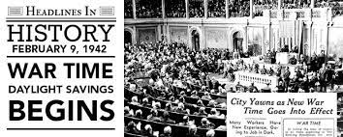
Background
“Twice a year, in the spring and fall, people across the nation adjust their clocks and modify their schedules to adjust to the new time,” Pallone and Schakowsky said. “Historians will provide all sorts of justifications for why we do this, but increasingly our changing of the clocks twice a year is getting harder to explain. Next week, the Subcommittee will hear from a panel of experts on the impacts of springing forward and falling back, and whether it still makes sense in our modern times.” - Chair Jan Schakowsky (D-IL), Consumer Protection and Commerce Subcommittee
In late February 2022, the Energy and Commerce Committee announces a hearing will be held to discuss Daylight Saving Time (DST), to decide whether a bipartisan bill would move forward to eliminate the time-change, beginning in 2023.
DST was first adopted in 1916 during WWI by Germany as a method of conserving fuel. The U.S. however, didn’t permanently adopt DST until the end of the energy crisis in 1976, where the DST schedule was amended several times before the Energy Policy Act of 2005, which houses the current DST schedule that’s been followed since 2007.
If our justifications for changing of the clocks is getting harder to explain; why do we continue to do so?...

Slide 3
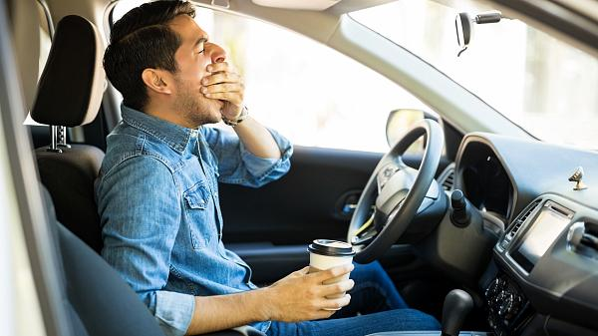
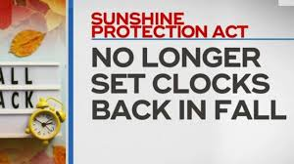
The Argument
DST negatively impacts areas such as:
Health
Crime
Traffic
“Studies have shown an increase in the rate of heart attacks and stroke in the two days immediately following the time change”- Chairman Frank Pallone, 2022 (Consumer Protection and Commerce Subcommittee)
Are these negative impacts directly correlated to Daylight Saving Time?
Does DST indeed have a negative effect on society and individuals which would justify no longer doing the time change?

Slide 4
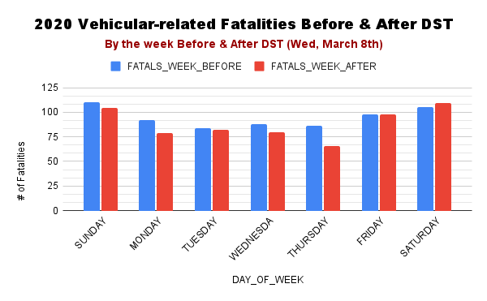
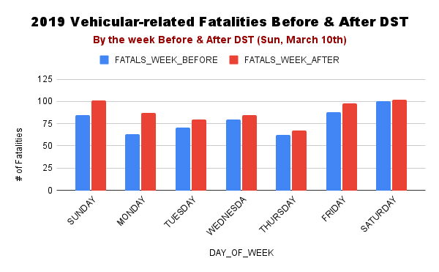
According to data from the Fatality Analysis Reporting System (FARS), DST is linked to a 6% increase in car accidents. Furthermore, the study found that DST is responsible for around 28 deaths each year.
Impact of DST on Vehicular-related Fatalities
Immediately following DST (Wed, March 8, 2020) we observe a decrease in vehicular-related fatalities.
An increase wasn’t observed until the weekend.
Key takeaways:
2020 was the first year of COVID-19 lockdown
Potential other contributing factors to observed increased particularly around the weekend.
Immediately following DST (Sun, March 10, 2019) we observe an increase in vehicular-related fatalities
Key takeaways:
The data for this year supports argument that DST increases vehicular-related fatalities.
Potential other contributing factors to observed increased rates.

Slide 5
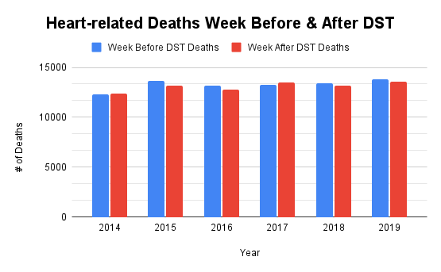
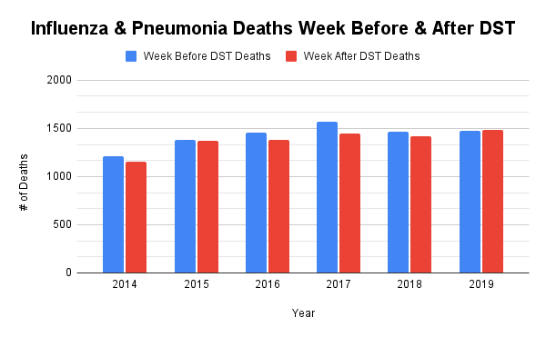
Studies have shown an increase in the rate of heart attacks and stroke in the two days immediately following the time change. – Chairman Frank Pallone, 2022
Impact of DST on Health Rates
Consistent rates
Key takeaways:
Other possible contributing factors
Highest rates observed during the week BEFORE the DST change
Key takeaways:
Data does not support argument

Slide 6
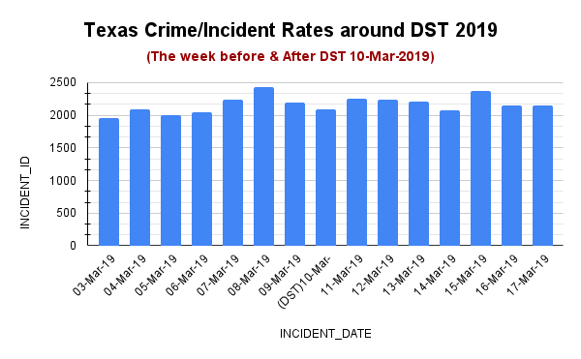
Impact of DST on Crime Rates
Slight increase in rates observed the day immediately following DST change, followed by a slow decline, and another surge on the Friday immediately following DST (15-Mar-19)
Key takeaways:
Other possible contributing factors

Slide 7
Conclusion
Limitations & Ethical Considerations
Recommendations
Although data may show rates which support the various arguments around the negative impacts of the DST change on areas of society such as Traffic, Health, and Crime; from these data sources we are unable to definitively determine that the change between Standard Time and Daylight-Saving Time (vice versa) is the direct cause. It would be more accurate to say it’s possible that it’s a contributing factor, but to say definitively that it’s the reason for rate increases would be inaccurate.
My recommendation is that in order to definitively say that the DST change is the causing factor for increased rates in the above-mentioned topics, surveys or assessments must be constructed to a level of such granular detail to remove any potential risk for outliers or other possible contributing factors.
Differently structured data
Data unavailability
Correlation does not equal Causation
“studies have shown people simply are not as productive at work in the days following the time-change – spending more time on their computer on non-work related activities; a side effect that hurts our economy.” – Chairman Frank Pallone, 2022

Slide 8
Section | Data Sources
Impact of DST on Vehicular-related Fatalities | The data used for this section was obtained by the National Center for Statistics and Analysis (NCSA), an office of the National Highway Traffic Safety Administration, which provides analytical and statistical support for the National Highway Traffic Safety Administration (NHTSA) and the highway safety community at large for over 45 years. https://www.nhtsa.gov/file-downloads?p=nhtsa/downloads/FARS/2020/National/ FARS2020NationalCSV.zip https://www.nhtsa.gov/file-downloads?p=nhtsa/downloads/FARS/2019/National/ FARS2019NationalCSV.zip
Impact of DST on Health Rates | The data used for this section was obtained from the CDC WONDER database, which provides access to a wide array of publicly available health information. https://wonder.cdc.gov/controller/datarequest/D76;jsessionid=F6F0B47B90916521843A879B2D48 Weekly_Counts_of_Deaths_by_State_and_Select_Causes__2014-2019.csv
Impact of DST on Crime Rate | The data used for this section was obtained from the National Incident-Based Reporting System (NIBRS) Series which is a component part of the Uniform Crime Reporting Program (UCR), a nationwide view of crime administered by the Federal Bureau of Investigation (FBI), based on the submission of crime information by participating law enforcement agencies. https://ucr.fbi.gov/crime-in-the-u.s/2019/crime-in-the-u.s.-2019/additional-publications/nibrs NIBRS_incident.csv
Methodology
When getting started with my analysis, one thing I needed to do was remove outliers; this led to me removing Arizona and Hawaii from the datasets I was using as they do not observe DST and didn’t want them to skew my results.
I was looking to analyze rates for each topic by comparing the week before and week after DST to identify if there was indeed an increase in rates around this time, supporting the arguments by stakeholders vested in this topic.
Code and Datasets for this project can be found:
https://github.com/k-sgonzalez/Portfolio/tree/main/Project1_DaylightSavingTime

Slide 9
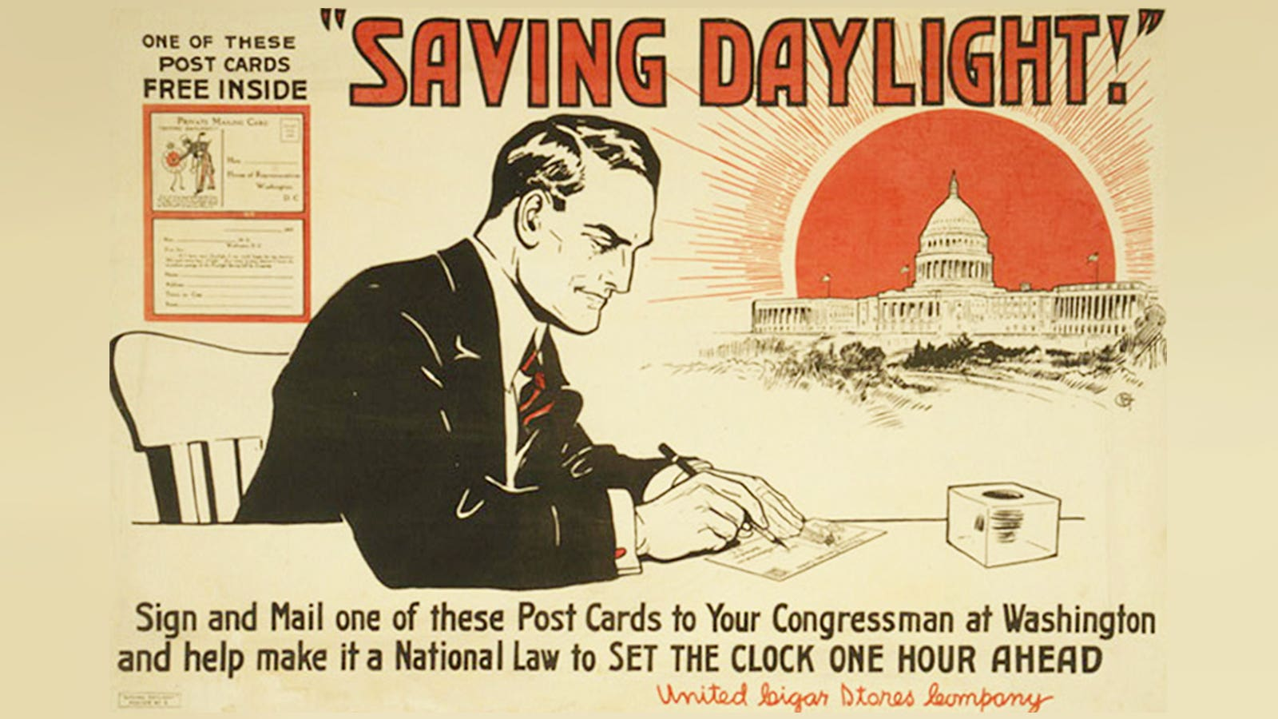
Questions?
What inspired you to research this topic?
What was the most interesting fact you found out while researching this topic?
If it were your choice, would you do away with DST?
What do you believe are the biggest considerations that should be taken into account for this topic?
What was the most challenging part of this project?
What would you have done differently?
Do you think DST will be rid of permanently?
Where is the Sunshine Protection Act Now?
Are there any other topics you would like to have covered?
Any other lessons learned?
Notes:
Passed by the Senate in early March, if passed by the House of Reps and signed into law by Pres, the bill would make DST permanent across the country starting in 2023.

