Slide 1
IBM University Engagement Project Submission
“Power System Fault Detection and Classification”

Slide 2

Project Tile – Power System Fault Detection and Classification
Domain of Project – Machine Learning / Electrical Engineering
Student Name | Recent Passport Photo | Email ID | Mobile number [WhatsApp]
KOTHAPALLI GOWRI SHANKAR |  | kothapalligourishankar@gmail.com | 9059846439

Slide 3
Problem Statement No.41- Power System Fault Detection and Classification
Design a machine learning model to detect and classify different types of faults in a power distribution system. Using electrical measurement data (voltage, current, power load, temperature), the model distinguishes between normal operating conditions and various fault conditions (line breakage, transformer failure, overheating).
This will enable rapid and accurate fault identification, which is crucial for maintaining power grid stability and reliability.
Dataset – Kaggle: Power System Faults Dataset https://www.kaggle.com/datasets/ziya07/power-system-faults-dataset
Technology – IBM Cloud Lite services (mandatory)

Slide 4
Proposed Solution -
We propose an AI-powered Power System Fault Detection and Classification System built using IBM watsonx.ai Studio and AutoAI.
Electrical measurement data, including voltage and current phasor values, was collected and uploaded to the watsonx.ai platform. AutoAI automatically handled data preprocessing, feature engineering, algorithm selection, and hyperparameter tuning — eliminating the need for manual coding or model building.
Multiple classification pipelines were generated and compared using a ranked leaderboard based on accuracy and cross-validation scores. The best-performing pipeline was selected and trained to classify power system status into categories such as Line Breakage, Overheating, and Transformer Failure.
The final model was promoted to a deployment space and published as an online, real-time prediction service on IBM Cloud. It was tested using sample electrical measurement values, and the model returned fault classifications with confidence scores — demonstrating a working end-to-end deployment pipeline for real-world power grid monitoring applications.

Slide 5
Technology Used
IBM Cloud – Provides the infrastructure to build, train, deploy, and scale the fault detection model. IBM Cloud enables a reliable, secure, and scalable environment for deploying machine learning models.
ML Algorithm/Model Used: Snap Logistic Regression
Accuracy Obtained: 0.393 (39.3%)
Enhancements and Hyperparameter Tuning: HPO-1 (Hyperparameter Optimization), Feature Engineering (FE), HPO-2
Note: Accuracy was limited (39.3%) due to weak correlation between the dataset's numeric features and fault type — a common real-world ML challenge tied to data quality.

Slide 6
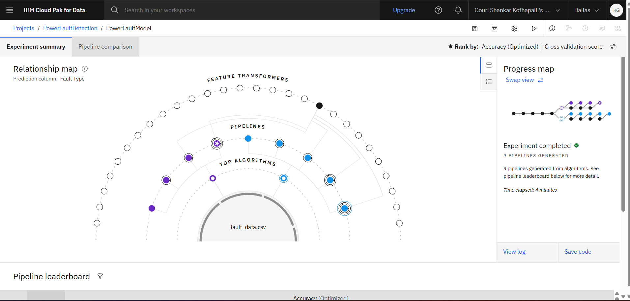
Training Screenshots-
Fig: AutoAI experiment showing 9 pipelines generated from the training dataset.

Slide 7
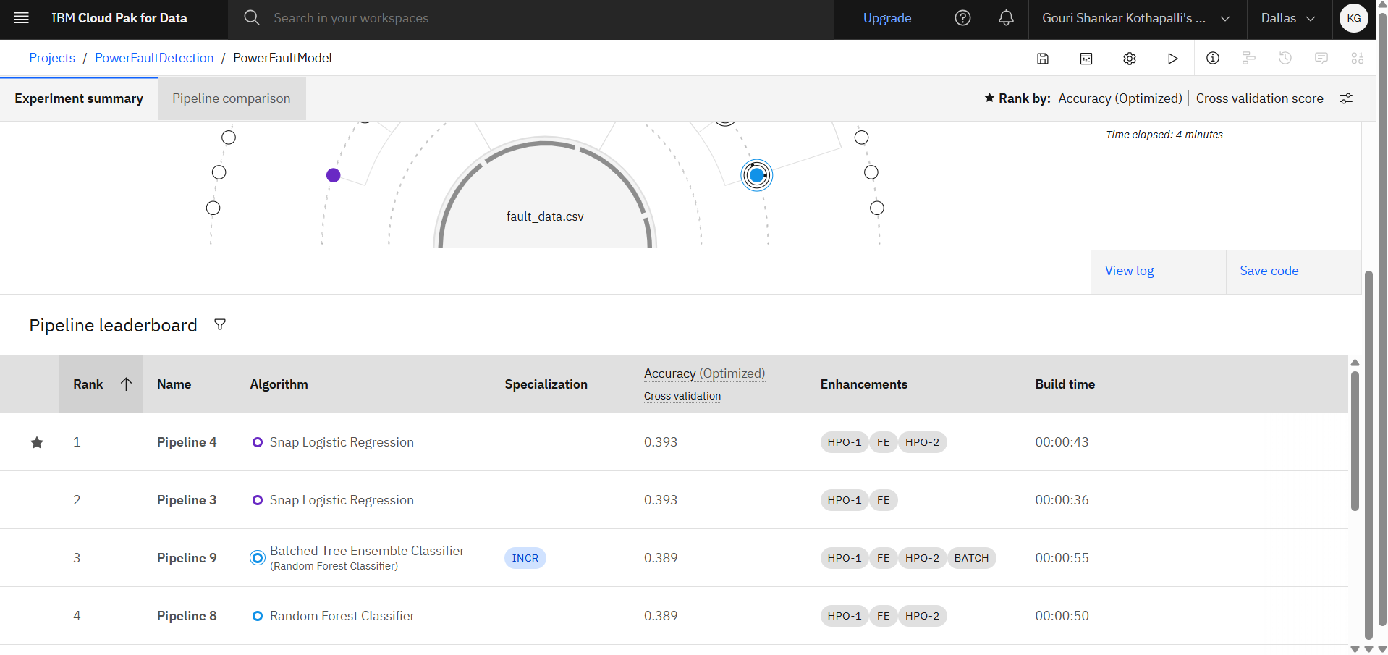
Best Model Screenshot:
Fig: Pipeline leaderboard — Rank 1: Snap Logistic Regression (0.393).

Slide 8
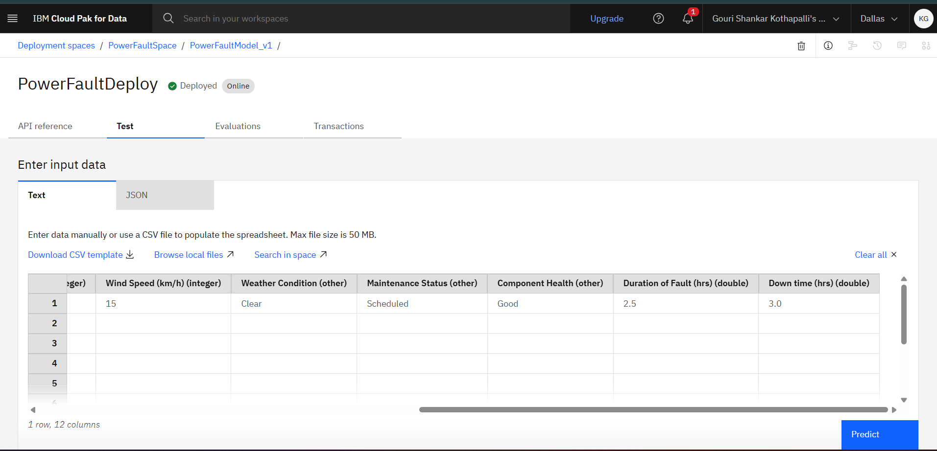
Testing Screenshot:
Fig: Model successfully deployed — status "Deployed", type "Online".

Slide 9
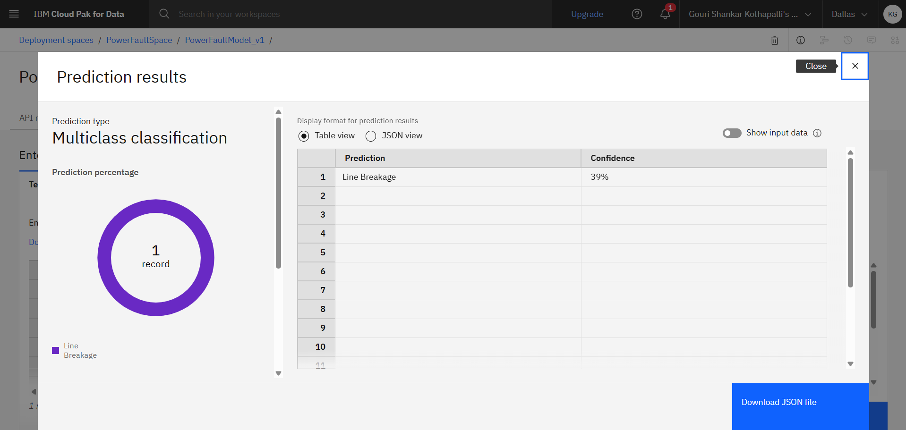
Testing Screenshot:
Fig 4: Model tested with sample input, predicting "Line Breakage" with 39% confidence.

Slide 10
Novelty and Uniqueness
This solution offers several advantages over traditional fault detection approaches:
Faster Response Time – Automated classification enables near-instant fault detection compared to manual inspection methods.
No-Code AI Development – AutoAI builds and optimizes the entire machine learning pipeline without requiring the student to write code, making advanced AI accessible.
Multi-Fault Classification – Unlike simple threshold-based relays, this model can distinguish between multiple fault types (line-to-ground, line-to-line, three-phase) in a single system.
Data-Driven Accuracy – The model learns directly from real electrical measurement patterns, improving detection accuracy over static rule-based systems.
Real-World Deployment Ready – The model isn't just trained — it's deployed as a live, testable web service, showing practical readiness for integration into grid monitoring systems.
Together, these features make the solution both technically sound and practically valuable for improving power grid reliability.

Slide 11
Git Hub Link
https://github.com/k-shankar0905/power-fault-detection-ps41

Slide 12
Future Scope
Integration with Real-Time Grid Sensors – The model can be connected to live SCADA or IoT-based grid sensors for continuous, real-time fault monitoring instead of relying on static datasets.
Automated Protection Systems – Future versions could trigger automatic circuit breaker actions or alerts when a fault is detected, reducing response time during emergencies.
Scalability to Larger Networks – The same approach can be extended to larger, more complex distribution networks with multiple substations and feeders.
Continuous Learning – As new fault data becomes available, the model can be retrained periodically using IBM watsonx.ai to keep improving its accuracy over time.
Nationwide Grid Protection – With further development, this solution has potential to be scaled into a broader smart-grid protection system, improving reliability across regions.

Slide 13
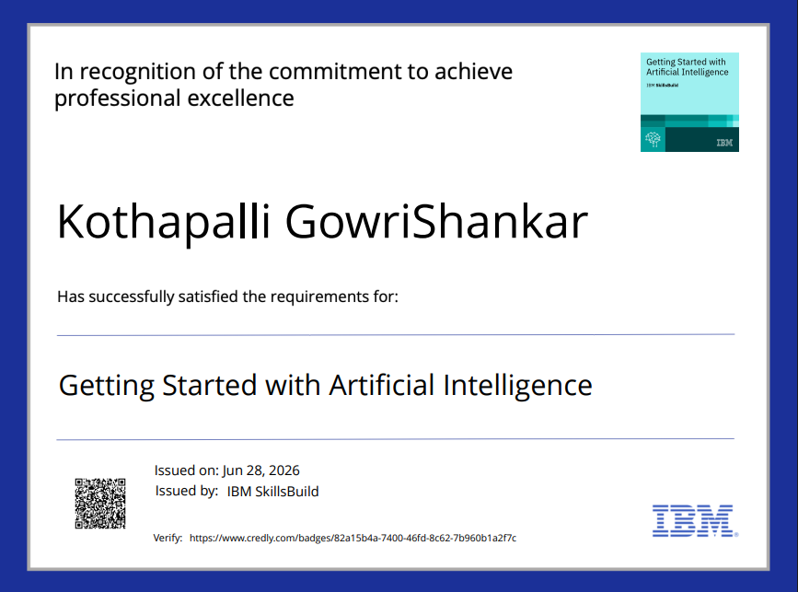
Certificates Earned:

Slide 14
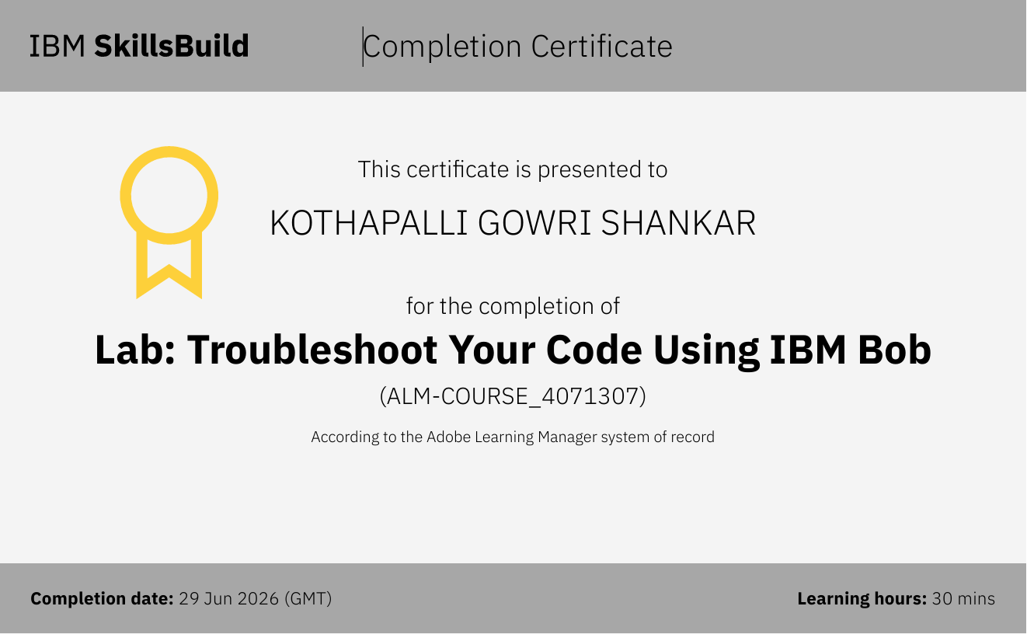
Certificates Earned:​

Slide 15


