Slide 1
Final Project
AMS 573
Su-Ah Kwon

Slide 2
Table of Content
Employee Attrition
Research problem and purpose of analysis
Statistical Analysis
Suggestion and Conclusion
Happiness 1972-2006
Research problem and purpose of analysis
Statistical Analysis
Suggestion and Conclusion

Slide 3
01.
Employee Attrition

Slide 4
Research Problem
What are the conditionally dependent explanatory variables for the probability of employee attrition adjusted for all other variables that gives a good fit to the model?
What affects the probability of employee attrition the most and the least among the dependent variables?
Which dependent variable has a linear trend against employee attrition?
What is the association between years with current manager, performance rating, and years in current role?

Slide 5
Purpose of Analysis
What are the conditionally dependent explanatory variables for the probability of employee attrition adjusted for all other variables that gives a good fit to the model?
To find a model with a good fit that explains the reason for the probability of employee attrition
What affects the probability of employee attrition the most and the least among the dependent variables?
For a manager in a company to effectively focus on eliminating the biggest cause of employee attrition with given resources
Which dependent variable has a linear trend against employee attrition?
To better understand the relationship between the explanatory variables and response
What is the association between years with current manager, performance rating, years in current role?
To see how the three variables affect each other and find the cause for high performance rating

Slide 6
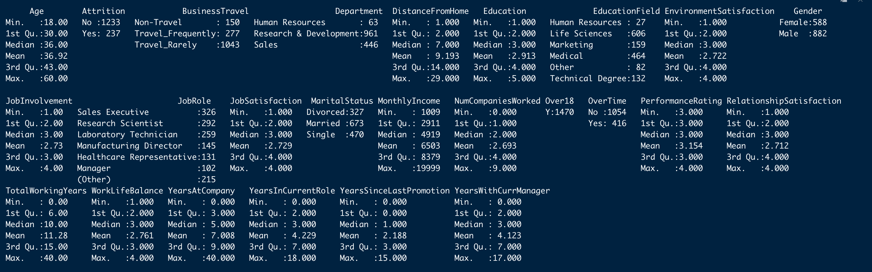
Explanation
The dataset is a fictional data set created by IBM data scientists to find components that impact employee attrition. There are 1470 employees (or observations) and 25 variables.

Slide 7
Explanation
Ordinal categorical variables are already coded with numeric values given below.
Education 1 ‘Below College’ 2 ‘College’ 3 ‘Bachelor’ 4 ‘Master’ 5 ‘Doctor’
EnvironmentSatisfaction 1 ‘Low’ 2 ‘Medium’ 3 ‘High’ 4 ‘Very High’
JobInvolvement 1 ‘Low’ 2 ‘Medium’ 3 ‘High’ 4 ‘Very High’
JobSatisfaction 1 ‘Low’ 2 ‘Medium’ 3 ‘High’ 4 ‘Very High’
PerformanceRating 1 ‘Low’ 2 ‘Good’ 3 ‘Excellent’ 4 ‘Outstanding’
RelationshipSatisfaction 1 ‘Low’ 2 ‘Medium’ 3 ‘High’ 4 ‘Very High’
WorkLifeBalance 1 ‘Bad’ 2 ‘Good’ 3 ‘Better’ 4 ‘Best’

Slide 8
Logistic Regression
Consider that we have 1470 independent binary data, a binomial random component regarding whether there is employee attrition or not.
We will construct a logistic regression model using logit link function.
First, the 5 explanatory variables, Job Satisfaction, Marital Status, Monthly Income, Relationship Satisfaction, and Work Life Balance are assumed to be the dependent variables on the employee attrition.

Slide 9
Condition for Goodness of Fit Test
To perform the goodness of fit test, we will discretize the continuous variable, Monthly Income.
MonthlyIncome=cut(MonthlyIncome, breaks=5, include.lowest = TRUE, labels = c(1,2,3,4,5))
Yes=1 and No=0 is encoded in Attrition.
Each fitted cell in the contingency table should be bigger than 5.

Slide 10
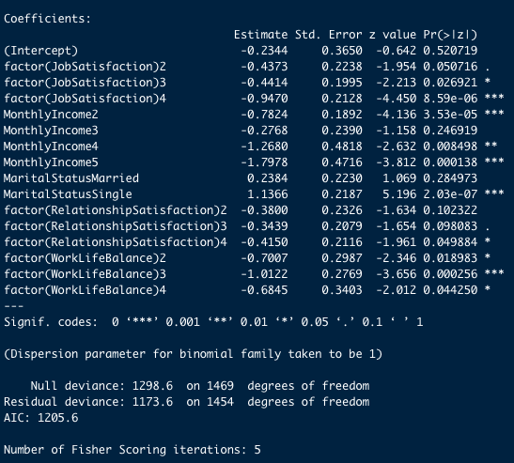

Statistical Analysis
Goodness of Fit Test
1-pchisq(1173.6,1454) -> 1 > 0.05
Likelihood Ratio Test of all coefficients being 0
1-pchisq(1298.6-1173.6,1469-1454)< 0.05
-> TRUE
Likelihood Ratio Test for each coefficient being 0
-> conditionally independent

Slide 11
Statistical Analysis
The estimated odds ratio of having employee attrition for having high income level is exp(-1.7978)= 0.17 times that for not having high income level.
The estimated odds ratio of having employee attrition for married people is exp(0.2384)= 1.27 times that for non-married people.
It is not significant that the coefficient of Marital Status Married is 0 while not true for high monthly income

Slide 12
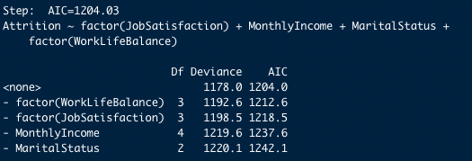
Stepwise Algorithm: AIC
Goodness of Fit Test
1-pchisq(1178,1457) -> 1 > 0.05
No complete or quasi-complete separation in the data
- The coefficient or its standard error is not too large.
- The number of Fisher Scoring Iteration is not too large
Diagnostic Investigation
-> n is the number of observations
-> 0.03; About 3% of the cells show lack of fit based on Pearson standardized residual
-> This result could have happened by chance

Slide 13
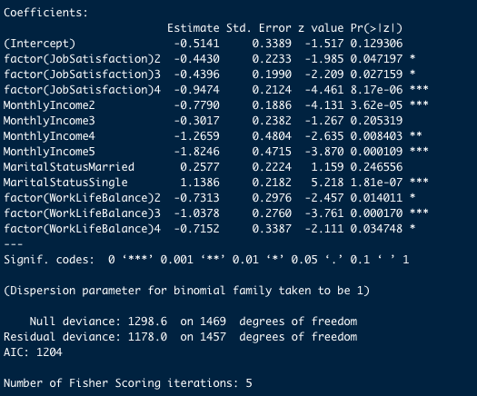
Statistical Analysis
The estimated odds ratio of having employee attrition for having high income level is exp (-1.8246)= 0.17 times that for not having high income level.
The estimated odds ratio of having employee attrition for married people is exp(0.2577)= 1.3 times that for non-married people.
It is not significant that the coefficient of Marital Status Married is 0 while not true for high monthly income.

Slide 14
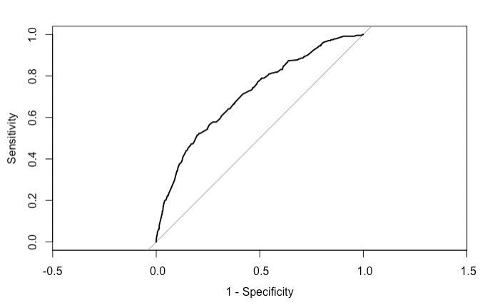
Predictive Power
-> The area under the curve: 0.7117 (better than random guessing)
-> The correlation between the observation and fitted value is 0.300759.
Notes:
It judges a model by how close its fitted values tend to be to the true expected values.

Slide 15
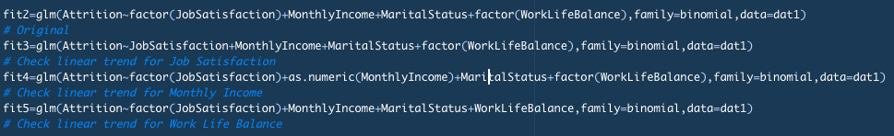

Linear Trend
Conclusion: Job Satisfaction has a linear trend against the probability of having employee attrition.

Slide 16
Loglinear Regression
Consider that we have 1470 observations about years with current manager, performance rating, and years in current role. Each count for different combination of explanatory variables are assumed to follow poisson distribution.
We will construct a loglinear regression model using log link function.
To avoid sparse contingency table, we discretize the continuous variables, which are years with current manager, and years in current role.

Slide 17
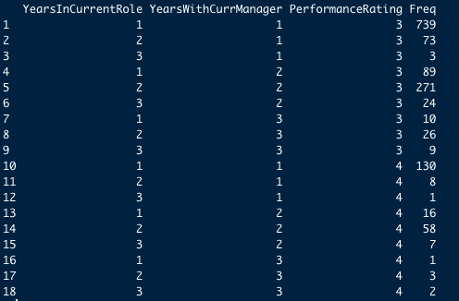
Statistical Analysis
Condition for Goodness of Fit Test
sum(fitted(fit1)*n<5)=0 -> fitted cells> 5 -> satisfied

Slide 18
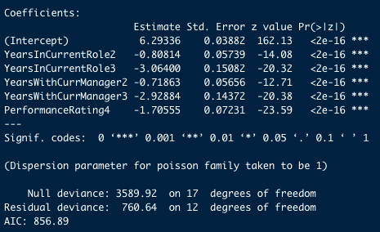
Statistical Analysis
Fit the Loglinear Model for Independence
Goodness of Fit Test
1-pchisq(760.64,12) < 0.05
-> not well fitted
-> The three variables are not mutually independent

Slide 19
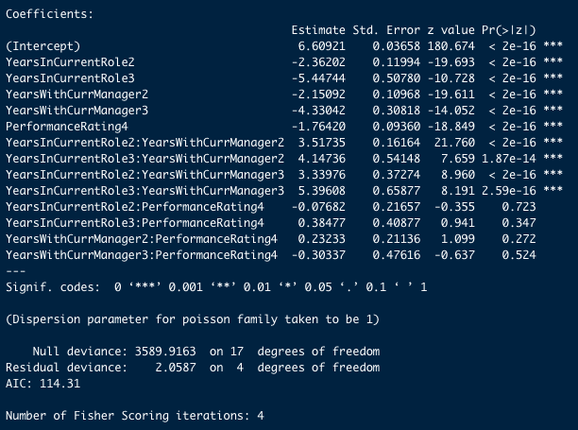
Statistical Analysis
Fit the Loglinear Model for Homogeneous association
Goodness of Fit Test
1-pchisq(2.0587,4)>0.05
-> well fitted
-> The three variables have a homogeneous association

Slide 20
Statistical Analysis
The effect of conditional association between any two variables are the same at each category of the third variable.
The association term related to performance rating is not significant.

Slide 21
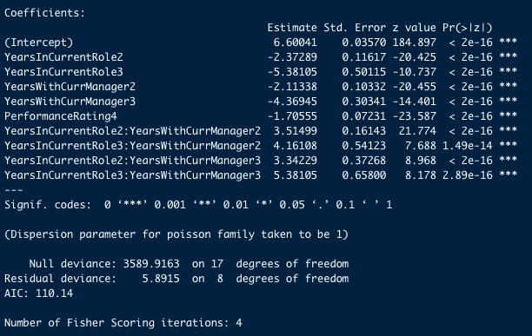
Statistical Analysis
Goodness of Fit Test
1-pchisq(5.8915,8)>0.05
-> well fitted
-> Performance Rating is independent of Years In Current Role and Years with Current Manager
-> Years In Current Role and Years with Current Manager are positively correlated for level 2 and 3.

Slide 22
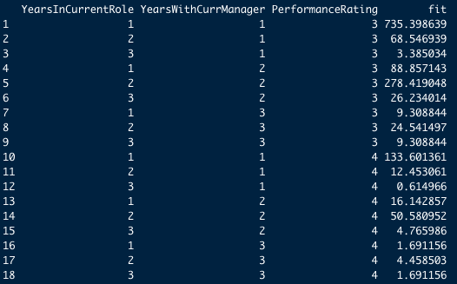
Statistical Analysis

Slide 23
Suggestion & Conclusion
What are the conditionally dependent explanatory variables for the probability of employee attrition adjusted for all other variables that gives a good fit to the model?
Job Satisfaction, Marital Status, Monthly Income, and Work Life Balance
What affects the probability of employee attrition the most and the least among the dependent variables?
Monthly Income (Level 5), and Marital Status(Married)
Which dependent variable has a linear trend against employee attrition?
Job Satisfaction
What is the association between years with current manager, performance rating, years in current role?
Independent Performance Rating
Correlated years with current manager and years in current role

Slide 24
02.
Happiness 1972-2006

Slide 25
Research Problem
Can we fit the given data using only finrela (relative financial status),year,or health?
What is the association between health, and relative financial status?

Slide 26
Purpose of Analysis
Can we fit the given data using only finrela (relative financial status), year, or health?
To find a model that fits the data well with only the info of finrela,year, or health
What is the association between health, and relative financial status?
To see any possible trend between health and relative financial status

Slide 27
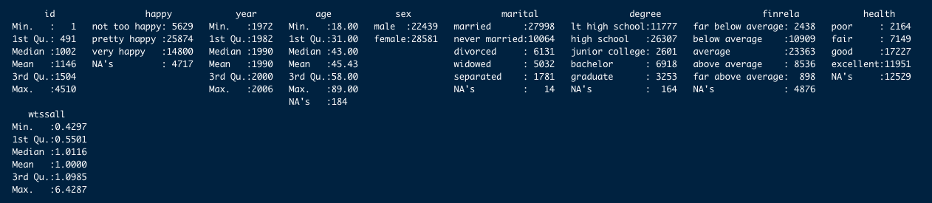
Explanation
The data is a small sample of variables related to happiness from the general social survey (GSS). The GSS is a yearly cross-sectional survey of Americans, run from 1972 to 2006. There are 51,020 observations, and of the over 5,000 variables, nine were selected related to happiness:

Slide 28
Explanation
We will deal with independent 34823 obs after eliminating rows with NA values.
age - age in years: 18–89.
degree - highest education: lt high school, high school, junior college, bachelor, graduate.
finrela - relative financial status: far above, above average, average, below average, far below.
happy - happiness: very happy, pretty happy, not too happy.
health- health: excellent, good, fair, poor.
marital- marital status: married, never married, divorced, widowed, separated.
sex- sex: female, male.
wtsall- probability weight. 0.43–6

Slide 29
Logistic Regression
The response variable is happy with 3 categories:
very happy, pretty happy, not too happy
We assume that the response follows a multinomial distribution.
We will construct a Baseline-Category Logit Model and Cumulative Logit Model using logit link function.
The 3 explanatory variables, finrela, health, and year are considered to be the dependent variables for happiness degree.
To avoid sparse contingency table, we will discretize the continuous variable, year.

Slide 30
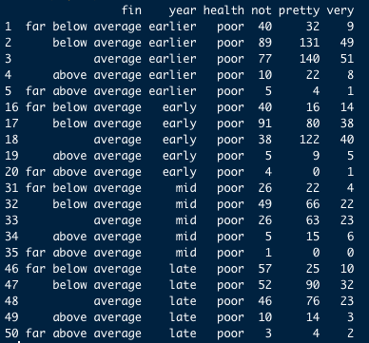
Statistical Analysis
Condition for Goodness of Fit Test
sum(fitted(fit1)*n<5)=0 -> fitted cells> 5 -> satisfied

Slide 31
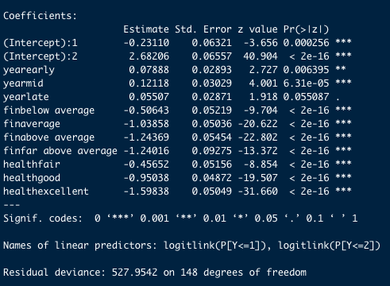
Cumulative Logit Model
Goodness of Fit Test
1-pchisq(527.9542,148)<0.05
-> TRUE
-> not well fitted

Slide 32
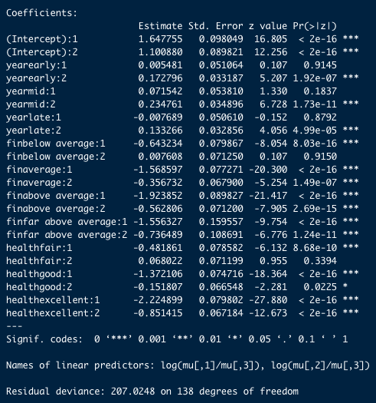
Baseline-Category Logit Model
Goodness of Fit Test
1-pchisq(207.0248,138)= 0.0001302404 <0.05
-> TRUE
-> not well fitted
-> However, p-value is larger than that of cumulative logit model
-> The coefficient related to year has the most non-significant p-values.

Slide 33
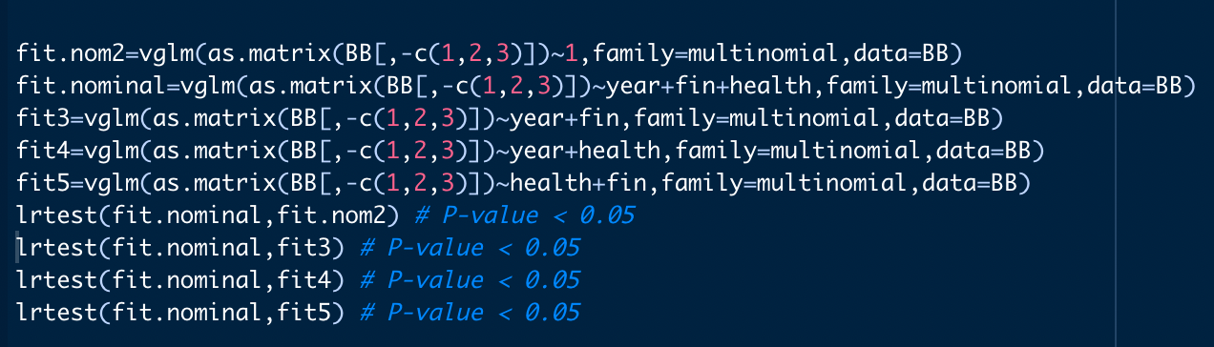
Likelihood Test
Year, finrela,and health are dependent variables to the degree of happiness.
Based on the overall test, at least one of the 3 explanatory has a nonzero coefficient.

Slide 34
Ordinal Variables
Now, we assume that relative financial status and health have a linear trend to the degree of happiness.
Each variable will have scores (1,2,3,4,5), and (1,2,3,4) respectively.
We will now compare baseline and cumulative logit models again.
Result: Both models give strong significant p-value.

Slide 35
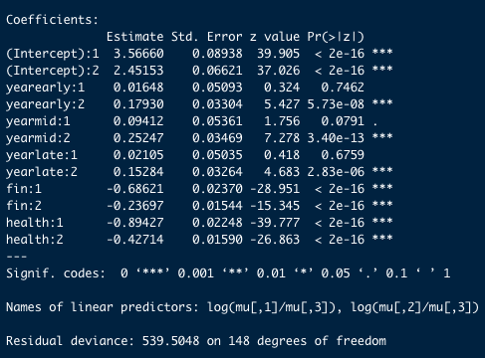
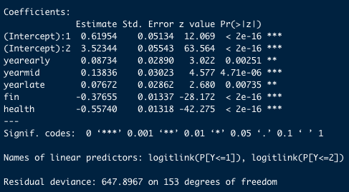
Ordinal Variables
Cumulative Logit Model
Baseline-Category Logit Model

Slide 36
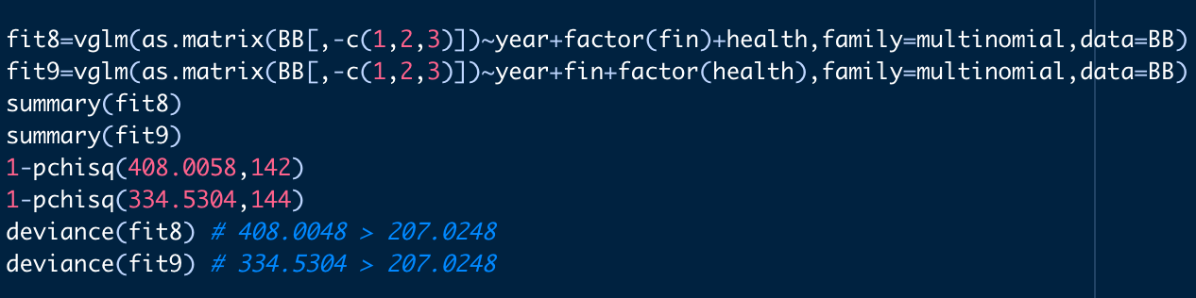
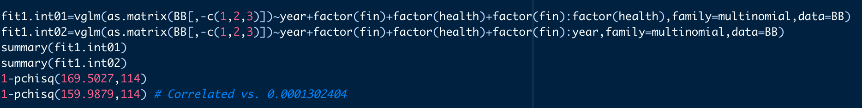
Ordinal Variables
The baseline category logit model with interaction (fit1.int02) only gives bigger p-value than the original one. (0.002938662)

Slide 37
Statistical Analysis
Adding another explanatory variable to finrela, health, and year can create a sparse contingency table.
The coefficient related to year has the most non-significant p-values.
Eliminate years and fit with the finrela and happy.
As a result, the baseline category logit model produces bigger p-value than the original for the goodness of fit test 0.003494556.

Slide 38
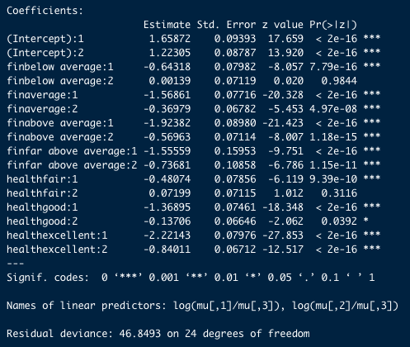
Statistical Analysis
The model that treated finrela or health as ordinal is not a good fit.
The model with interaction term of nominal health and finrela did not fit well, too.
Conclusion: We cannot fit the data with only any combination of year,finrela, and health possibly unless we reduce the # of categories of years, finrela, or health.

Slide 39
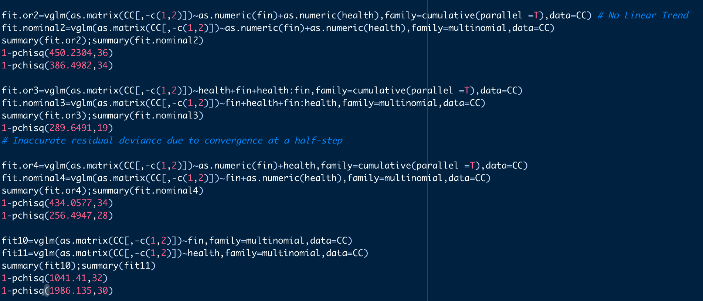
Statistical Analysis

Slide 40
Loglinear Regression
Consider that we have 34823 observations about health and finrela. Each count for different combinations of the explanatory variables are assumed to follow poisson distribution.
We will construct a loglinear regression model using log link function.

Slide 41
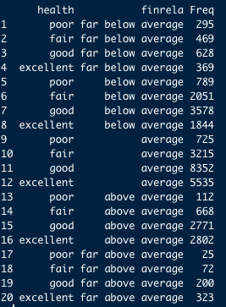
Loglinear Regression
Fit the Loglinear Model for Independence
Goodness of Fit Test
1-pchisq(2007.6,12) < 0.05
-> not well fitted
-> The three variables are not mutually independent

Slide 42
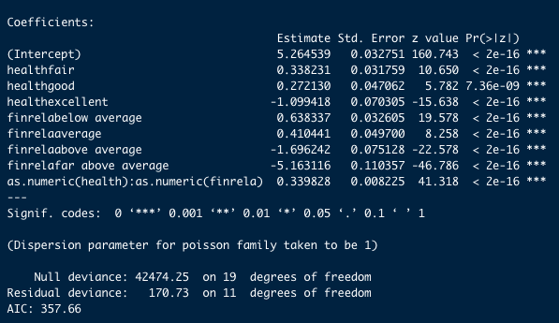
Loglinear Regression
Fit the Linear-by-Linear model
Goodness of Fit Test
1-pchisq(170.73,11) < 0.05
-> not well fitted
-> There is no linear trend between the health and finrela

Slide 43
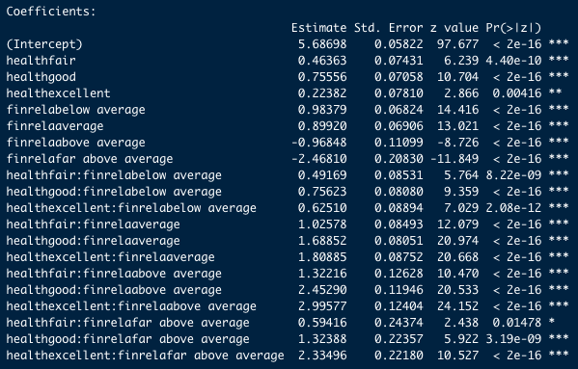
Loglinear Regression
Conclusion:
The saturated model of the two-way contingency table

Slide 44
Suggestion & Conclusion
Can we fit the given data using only finrela (relative financial status),year,or health?
We cannot fit the data with only any combination of year,finrela, or health possibly unless we reduce the # of categories of years,finrela or health.
What is the association between health, and relative financial status?
Health and financial status are correlated and do not show linear trend

Slide 45
Thank you

